Slide 1
APPLIED ML • MODEL RISK
Churn prediction,
with the trade-offs
in the open.
XGBoost / SHAP / Fairlearn
A time-aware evaluation on KKBox competition data
February → March 2017 • 300,000 sampled snapshots
A research prototype, not a deployment recommendation
01
Notes:
Dataset: WSDM - KKBox Churn Prediction Challenge. Competition page: https://www.kaggle.com/competitions/kkbox-churn-prediction-challenge

Slide 2
01 / STUDY DESIGN
A temporal test makes the question harder
Train on an earlier customer snapshot. Evaluate on a later one.
FIT + POLICY VALIDATION
OUT-OF-TIME TEST
February cohort
March cohort
150k sampled labels
150k sampled labels
112.5k fit · 37.5k validation
Latest feature cutoff: 28 Feb 2017
31 Jan
Train snapshot cutoff
28 Feb
Inputs: transaction summaries + member attributes | Listening logs omitted | Raw member IDs excluded
CHURN • EXPLAINABILITY • FAIRNESS
02
Notes:
The February and March cohort construction follows the KKBox challenge labels and point-in-time feature snapshots. Source: https://www.kaggle.com/competitions/kkbox-churn-prediction-challenge . The sample is 150,000 per cohort; this is not the full competition population.

Slide 3
02 / PERFORMANCE
The model ranks risk well; the default threshold misses churners
Out-of-time March holdout • 150,000 customers • churn prevalence 9.0%
0.884
0.570
0.927
ROC AUC • raw XGBoost
Average precision
Accuracy • calibrated
Logistic: 0.820 • prior: 0.500
Logistic: 0.460 • prior: 0.090
Calibrated AUC: 0.883
The probability-quality check
Target the highest-risk 10%
Brier score ↓ better
+$44.6k
Raw XGBoost
0.0563
illustrative expected net value • +$100.1k vs random
Sigmoid calibrated
59.1% of observed churners captured in 15,000 contacts. Assumes 20% intervention success, $100 retained value and $5 outreach cost.
0.0578
Scenario only—not causal savings. Calibration worsened Brier (0.0578 vs 0.0563) and log loss (0.212 vs 0.201).
CHURN • EXPLAINABILITY • FAIRNESS
03
Notes:
Metrics from artifacts/kkbox-temporal/model_metrics.json. Accuracy is dominated by the 91% non-churn class, so ROC AUC and average precision provide useful complementary views. Calibration slightly worsened Brier score (0.05625 to 0.05781) and log loss (0.2010 to 0.2121) against raw XGBoost.

Slide 4
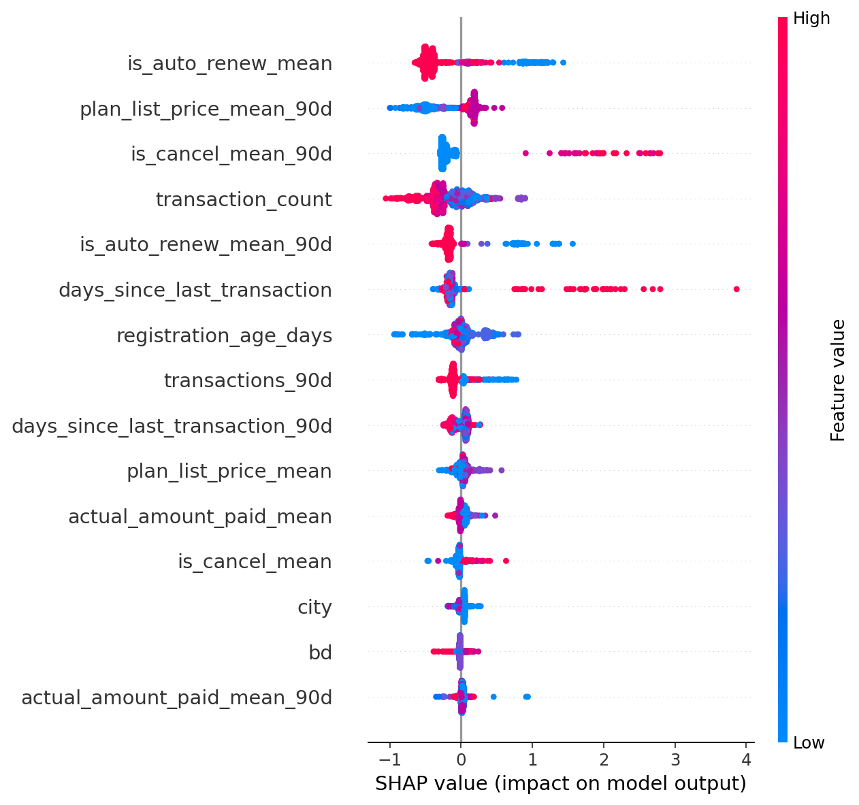
03 / EXPLAINABILITY
Explanations point to payment behavior—not a causal story
Global SHAP importance • mean absolute contribution to model raw margin
Leading signals
01
Auto-renew status
0.485
02
Plan list price • 90d
0.305
03
Cancellation flag • 90d
0.274
04
Transaction count
0.271
05
Days since last txn
0.221
SHAP describes model behavior, not causation.
CHURN • EXPLAINABILITY • FAIRNESS
04
Notes:
Image and numeric importance from artifacts/kkbox-temporal/shap_summary.png and shap_feature_importance.csv. These are mean absolute SHAP values for XGBoost raw margin (log-odds). They show which features move the fitted model output, not what causes churn. Feature effects can be correlated and are not interventions.

Slide 5
04 / FAIRNESS TRADE-OFF
Parity improved—while equal opportunity got worse
Gender groups • held-out March cohort • Fairlearn ThresholdOptimizer
MAX–MIN GROUP GAP
The audit context matters
Selection rate
Global threshold
2.72 pp [2.44–2.99]
True positive rate
“Missing” gender is 89,857 of 150,000 customers.
2.70 pp [1.34–4.55]
Selection rate
Fairlearn’s demographic parity criterion made positive prediction rates nearly equal. It did not equalize recall; the TPR gap grew sharply.
Parity postprocessor
0.03 pp [0.03–0.32]
True positive rate
16.87 pp [15.42–18.38]
The postprocessor uses group-specific randomized thresholds and needs the sensitive feature at inference.
What moved with the intervention
Accuracy 92.7% → 92.3% • Accuracy gap 5.8 → 6.8 pp
CHURN • EXPLAINABILITY • FAIRNESS
05
Notes:
Fairness metrics from artifacts/kkbox-temporal/fairness_metrics.json. Difference is max minus min across gender groups. Mitigation was fitted on a separate policy-validation split and evaluated on the March holdout. Equal selection rates are only one fairness criterion; the substantial TPR and accuracy gaps remain. “Missing” is a large group, not a negligible subgroup. This is not a fairness certification or legal assessment.

Slide 6
05 / WHAT NEXT
A useful prototype is honest about what remains unknown
Good evidence for a demo. More evidence needed before any operational use.
01 • DATA
02 • EVALUATION
03 • GOVERNANCE
Broaden the signal
Stress-test the policy
Make it accountable
Add listening-history features; investigate why gender is missing; validate full-population and later-month cohorts.
Repeat out-of-time tests; examine subgroup uncertainty; compare parity, equal opportunity and cost-based objectives.
Set a real intervention and error-cost definition; review privacy, affected customers and human-override paths.
The strongest result is the trade-off itself.
A fairness constraint can redistribute model decisions. It cannot decide which outcomes matter, make the data representative, or establish that a system is safe to deploy.
Project code, model card, metrics and demo guide are included with the deck.
CHURN • EXPLAINABILITY • FAIRNESS
06
Notes:
Suggested next work: incorporate the large listening logs if legally/operationally feasible; improve missingness analysis and data provenance; run multiple later cohort holdouts and confidence intervals; choose criteria with stakeholders and explicit error costs; evaluate calibration by group and operational utility; document model governance. The current challenge data and sampled snapshots are not evidence of performance on an organization’s customers.

