Slide 1
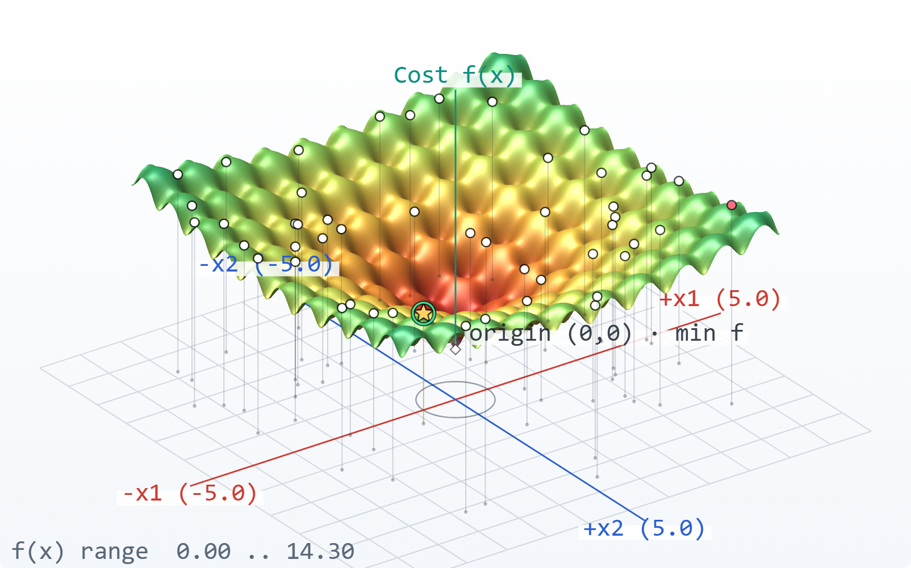
PROJECT PRESENTATION
Searching for the minimum
A genetic algorithm
for the 2D Ackley function
From random points to a solution
near (0, 0).
PYTHON + WEB VISUALIZER
A visual, reproducible walkthrough
Fig. 01 — Ackley landscape. White-mode frontend; the central basin contains the known optimum.
2D ACKLEY / GENETIC ALGORITHM
12 September 2026
01
Notes:
Introduce the project as a population-based search for a known test-function minimum. The screenshot is the actual project frontend in light mode. The deck follows the default seed-42 run. No presenter or institution name was supplied, so none has been invented.

Slide 2
CONTENTS
The route through the project
Problem → design choices → a real run → evidence
01 The problem
02 The settings
03 The methods
GA basics and the Ackley landscape
Parameters and a tuning experiment
How each operator works—and why
04 The walkthrough
05 The evidence
06 The takeaway
Seven steps in the white frontend
Convergence, spikes, and final result
Conclusion and references
2D ACKLEY / GENETIC ALGORITHM
12 September 2026
02
Notes:
Agenda. Icons are from the supplied icons directory; each has its concept name and description beneath it.

Slide 3
THE IDEA
GA: improve a population through generations
A genetic algorithm searches by selecting, combining, and randomly changing candidate solutions.
Population
Selection
Next generation
Several candidate answers at once.
Better candidates get more chances.
Keep useful changes; repeat.
In this project
One chromosome = [x₁, x₂] • One score = Ackley f(x₁, x₂)
Lower objective values are better.
2D ACKLEY / GENETIC ALGORITHM
12 September 2026
03
Notes:
A simple GA definition: evolve a collection of answers using biased reproduction and random variation. Real-valued chromosomes hold the two coordinates directly. The objective is minimized. General background: Holland, Adaptation in Natural and Artificial Systems, MIT Press, 1992 edition. https://doi.org/10.7551/mitpress/1090.001.0001

Slide 4
PROBLEM STATEMENT
The problem: find the bottom of a rippled basin
Minimize Ackley over x₁, x₂ ∈ [−5, 5]. The known global minimum is f(0, 0) = 0.
min f(x₁, x₂)
−20 exp[−0.2 √((x₁²+x₂²)/2)]
− exp[(cos 2πx₁ + cos 2πx₂)/2]
+ 20 + e
Why this is challenging
Local valleys can trap the search before it reaches the central basin.
Fig. 02 — Search landscape. White-mode 3D view; many local basins surround the origin.
2D ACKLEY / GENETIC ALGORITHM
12 September 2026
04
Notes:
The implementation uses a=20, b=0.2, c=2π with a restricted domain [-5,5]^2. The commonly cited benchmark domain is larger; the project deliberately uses this smaller search square. The optimum remains (0,0). Source: ga_ackley.py, CONFIG and ackley; Surjanovic and Bingham, SFU, https://www.sfu.ca/~ssurjano/ackley.html .

Slide 5
GA SETTINGS
The baseline settings balance search and preservation
These are the project defaults used in every walkthrough and result slide.
50
0.80
0.05
individuals
crossover / pair
mutation / gene
Variety with a small evaluation budget.
Recombine most pairs; keep some copies.
About 5 changes among 100 genes.
1.0
1
42
Gaussian σ
elite
random seed
Steps span 10% of the coordinate range.
Protect progress while most slots evolve.
Replay the same random decisions.
2D ACKLEY / GENETIC ALGORITHM
12 September 2026
05
Notes:
Defaults: n_genes=2; bounds=-5,+5; N=50; Pc=.8 per pair; Pm=.05 per gene; elite_count=1; gaussian sigma=1; seed=42. Operators are also part of the assignment specification. These are practical baseline choices, not experimentally established global best settings. Expected mutated genes per generation = 50×2×.05 =5; actual count varies. Expected crossover pairs=25×.8=20. Stopping parameters appear on slide 11.

Slide 6
PARAMETER TUNING
Tuning: smaller steps help, but can miss the basin
20 runs per setting · same seeds 42–61 · change one parameter · default stopping rules
SETTING
MEDIAN FINAL f(x) ↓
WORST RUN ↓
Baseline
0.0673
0.1775
Pc = 0.70
0.0458
0.2970
Pm = 0.10
0.0187
0.0758
σ = 0.10
0.0052
2.5802
σ = 0.50
0.0247
0.1387
N = 100
0.0264
0.0971
σ = 0.10: strong median, weak worst case.
Tune exploration and precision together.
Exploratory comparison; larger N uses more evaluations. No setting reached f < 0.001 in these 20 runs.
2D ACKLEY / GENETIC ALGORITHM
12 September 2026
06
Notes:
New experiment generated by presentation/build_data.py with the existing run_ga function. Each setting uses seeds 42 through 61, max_generations=100 and stagnation_limit=30; all other settings remain baseline. Nine configurations (180 runs) are stored in summary.json; six representative rows shown. Median and worst final best objective are reported because sigma=.1 has a good median but a heavy poor-run tail (mean .64875, max2.58022). This does not establish statistical superiority, and the 100-individual comparison is not an equal-evaluation-budget study. Baseline remains unchanged for the walkthrough. Data: presentation/data/summary.json.

Slide 7
METHODS · ENCODING & INITIALIZATION
Initialization: store real numbers and spread the search
Each coordinate is sampled independently and uniformly from [−5, 5].
One chromosome
Uniform initialization
x₁
x₂
Equal sampling density across the domain.
Each gene ∼ U(−5, 5)
Why: broad starting coverage,
with no preferred region.
−5
0
5
2D ACKLEY / GENETIC ALGORITHM
12 September 2026
07
Notes:
Source: create_individual and create_population in ga_ackley.py. Real-valued encoding is direct: no binary decoding and no discretization step. Uniform independent draws are unbiased over the bounded search square, though finite samples do not guarantee every area is covered. Initialization and real encoding follow the project specification.

Slide 8
METHODS · FITNESS & ROULETTE
Selection: turn low cost into a higher chance
Fitness is recomputed relative to the worst individual in each generation.
Fᵢ = fworst − fᵢ
Toy scores
A: f = 2
60%
pᵢ = Fᵢ / ΣF
B: f = 4
40%
C: f = 8
0%
50 draws with replacement
Roulette sampling
Why: reward better candidates while keeping selection random.
If every fitness is zero, choose uniformly at random.
2D ACKLEY / GENETIC ALGORITHM
12 September 2026
08
Notes:
Toy example is explicitly separate from the real-run walkthrough: f=[2,4,8], worst=8, fitness=[6,4,0], probabilities=[.6,.4,0]. The baseline uses fitness-proportionate roulette with replacement to fill a pool of N=50. The highest objective has zero fitness; if all objectives tie and total fitness is zero, the implementation falls back to uniform random indices. Tournament selection is an available alternative but is not used in the baseline. Source: objective_to_fitness, roulette_wheel_selection in ga_ackley.py.

Slide 9
METHODS · ONE-POINT CROSSOVER
Crossover: swap the second coordinate
With two genes, there is exactly one cut point.
Parent A
A₁
A₂
Pc = 0.80
Child 1
A₁
B₂
Parent B
B₁
B₂
Child 2
B₁
A₂
cut
What it cannot do
Why this method?
Create a new coordinate value.
That job belongs to mutation.
Simple coordinate recombination; preserves useful gene values.
2D ACKLEY / GENETIC ALGORITHM
12 September 2026
09
Notes:
The assignment specifies 1-point crossover. With two coordinates, child1=[A.x1,B.x2] and child2=[B.x1,A.x2]. One random number is drawn per pair; if it exceeds Pc the parents are copied. Crossover therefore recombines existing coordinate values but does not synthesize intermediate real values; arithmetic crossover is an available alternative in the code. Source: one_point_crossover and do_crossover, ga_ackley.py.

Slide 10
METHODS · GAUSSIAN MUTATION & BOUNDS
Mutation: introduce new coordinate values
For each gene: mutate with Pm = 0.05; otherwise keep the original value.
x′ = x + ε
ε ∼ Normal(0, σ²), σ = 1
Why Gaussian?
Explore around the current point;
occasionally take a larger step.
−3σ
0
+3σ
Out of bounds? Resample in [−5, 5].
2D ACKLEY / GENETIC ALGORITHM
12 September 2026
10
Notes:
The Gaussian parameter is standard deviation sigma. The mathematical notation Normal(0,sigma²) uses variance as its second parameter; random.gauss(0,sigma) uses standard deviation. Every gene gets an independent Bernoulli mutation decision. Bounds handling resamples a fresh coordinate uniformly if the proposed value leaves [-5,5]. This avoids invalid chromosomes and boundary pile-up caused by clipping, but an out-of-bounds mutation becomes a global jump. Source: mutate_population, mutate_gene, repair_gene in ga_ackley.py.

Slide 11
METHODS · ELITISM & STOPPING
Protect the best—and know when to stop
Two stopping checks limit wasted work; neither proves the exact optimum has been found.
Keep one elite
100 generations
30 stagnant generations
Replace the worst child only if the saved elite is better.
A fixed upper bound on the run length.
Stop if no improvement > 10⁻¹² persists for 30 generations.
Why: preserve progress.
Why: control computation.
Why: end an unproductive run.
f(x) < 0.001 is a reporting threshold in this project, not an early-stop rule.
2D ACKLEY / GENETIC ALGORITHM
12 September 2026
11
Notes:
Source: get_elites, apply_elitism and run_ga in ga_ackley.py; GAEngine evaluate and commit stages. Elitism protects the best objective from worsening, though an elite need not be inserted if all children are at least as good. Max_generations=100 is the hard run budget. Stagnation resets only when best-ever improvement is greater than 1e-12; smaller improvements are still recorded but count as stagnant. The success verdict f<1e-3 is checked in the reporting function, not used as a stopping condition. The returned history evaluates each generation at loop entry; a final post-commit population is not an extra history point.

Slide 12
ALGORITHM MAP
The complete GA flow
Initialization happens once; the remaining stages repeat.
1
Initialize
2
Evaluate
3
Select
4
Crossover
check criteria
repeat
STOP → report best
7
Commit
6
Elitism
5
Mutate
Budget or stagnation
Evaluate → transform fitness → save elite → select → cross → mutate + repair → elitism → commit
2D ACKLEY / GENETIC ALGORITHM
12 September 2026
12
Notes:
Conceptual flow matches the implementation sequence. At evaluation, compute objectives, histories, fitness and elites, then test stagnation. The web engine checks generation budget at commit. When continuing, commit makes offspring the next population and evaluation begins again. Initialization occurs before generation1. The next seven slides expand these steps with authentic frontend panels; the frontend itself numbers six stages after initialization.

Slide 13
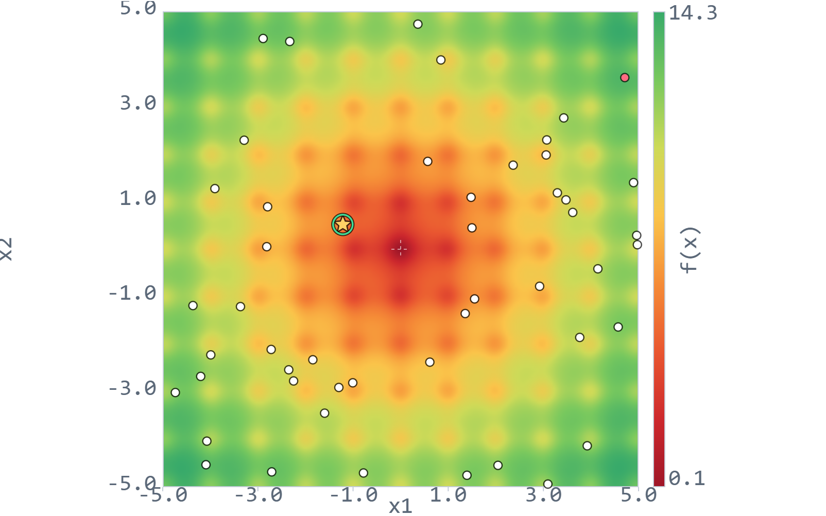
WALKTHROUGH · SEED 42
1 · Initialize 50 candidate points
One run throughout: 50 individuals · Pc 0.80 · Pm 0.05 · σ 1.0
1 Init
2 Evaluate
3 Select
4 Cross
5 Mutate
6 Elite
7 Commit
One point = one chromosome
The coordinates are the two genes.
Uniform random start
No candidate is placed at the origin by design.
Repeatable example
Seed 42 fixes the random stream.
Fig. 03 — Initialize 50 candidate points. Generation 1, seed 42; points cover the search square.
2D ACKLEY / GENETIC ALGORITHM
12 September 2026
13
Notes:
The initial population contains 50 two-gene chromosomes drawn uniformly. The captured map is after the initial evaluation so the frontend can highlight the best and worst; point positions are exactly the initialized population. No breeding has yet occurred.
Source: ga_ackley.py; ga-web/engine.py; presentation/data/run.json. UI row identifiers are zero-based. Captures use the actual light-theme frontend with larger presentation text and selected rows where labelled.

Slide 14
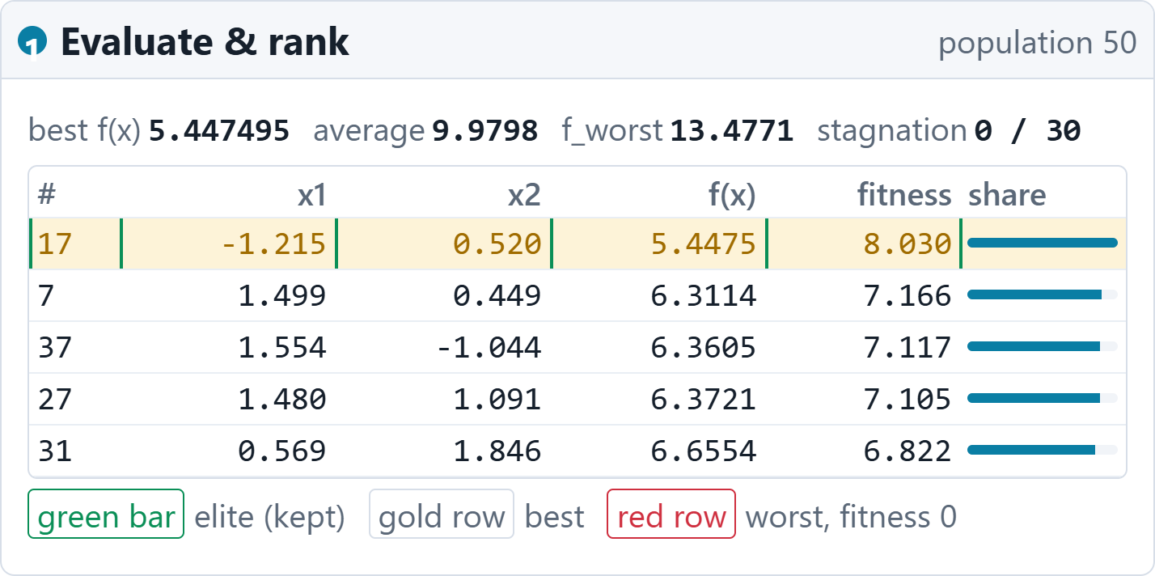
WALKTHROUGH · SEED 42
2 · Evaluate and rank the population
One run throughout: 50 individuals · Pc 0.80 · Pm 0.05 · σ 1.0
1 Init
2 Evaluate
3 Select
4 Cross
5 Mutate
6 Elite
7 Commit
Best is individual #17
f = 5.4475 at (−1.2147, 0.5204).
Convert cost to fitness
13.4771 − 5.4475 = 8.0296.
Save the elite
Keep a protected copy before breeding.
Fig. 04 — Evaluate and rank the population. White-mode inspector; five highest-ranked rows shown.
2D ACKLEY / GENETIC ALGORITHM
12 September 2026
14
Notes:
Generation1 has best objective5.447494814976, mean9.979817006302 and worst13.477089228593. Individual #17 has fitness8.029594413617. Total fitness174.863611114545 gives #17 a draw probability of approximately4.592%. The bars in this inspector are scaled to the largest displayed fitness for visualization; use normalized total fitness for true roulette probability.
Source: ga_ackley.py; ga-web/engine.py; presentation/data/run.json. UI row identifiers are zero-based. Captures use the actual light-theme frontend with larger presentation text and selected rows where labelled.

Slide 15
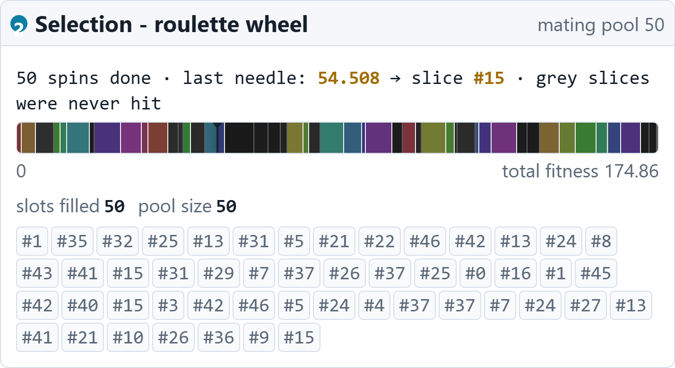
WALKTHROUGH · SEED 42
3 · Select the mating pool
One run throughout: 50 individuals · Pc 0.80 · Pm 0.05 · σ 1.0
1 Init
2 Evaluate
3 Select
4 Cross
5 Mutate
6 Elite
7 Commit
Draw 50 parent slots
The first four IDs: #1, #35, #32, #25.
Duplicates are allowed
#37 is selected four times.
Better is more likely
A strong candidate is favoured, not guaranteed.
Fig. 05 — Select the mating pool. White-mode inspector; roulette tape and complete mating pool.
2D ACKLEY / GENETIC ALGORITHM
12 September 2026
15
Notes:
Actual generation1 roulette draws: spin2.0076129562 picks#1; spin126.0280199424 picks#35; spin119.2063368622 picks#32; spin93.8965710367 picks#25. Sampling uses replacement. Most picked#37 appears4 times. The fitness tape and full pool are genuine frontend content. Some rows of the frequency summary are hidden solely to make a readable excerpt.
Source: ga_ackley.py; ga-web/engine.py; presentation/data/run.json. UI row identifiers are zero-based. Captures use the actual light-theme frontend with larger presentation text and selected rows where labelled.

Slide 16
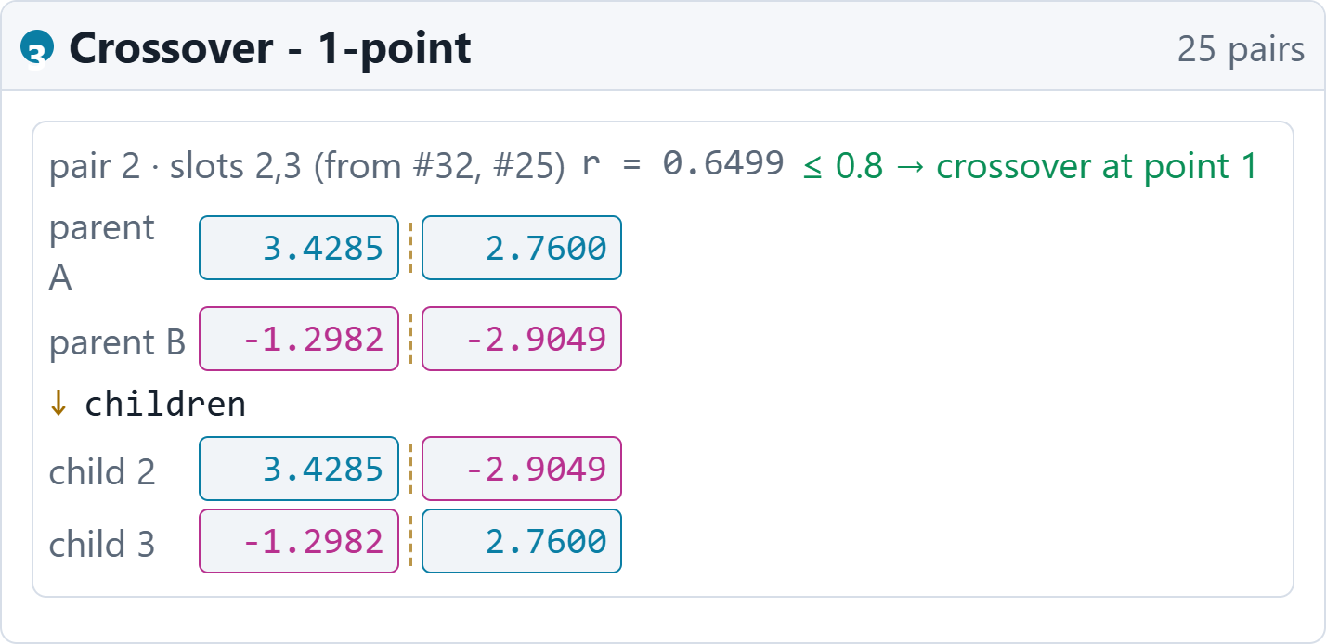
WALKTHROUGH · SEED 42
4 · Crossover creates two children
One run throughout: 50 individuals · Pc 0.80 · Pm 0.05 · σ 1.0
1 Init
2 Evaluate
3 Select
4 Cross
5 Mutate
6 Elite
7 Commit
The random roll is 0.6499
0.6499 ≤ 0.80 → crossover happens.
Cut between x₁ and x₂
Parents #32 and #25 swap their tails.
19 of 25 pairs cross
The expected count is 20; actual counts vary.
Fig. 06 — Crossover creates two children. White-mode inspector; pair 2 shown from 25 pairs.
2D ACKLEY / GENETIC ALGORITHM
12 September 2026
16
Notes:
Pair2 is selected for a simple illustration of one-point crossover. ParentA#32=[3.428519201898096,2.759999115462448]; ParentB#25=[-1.2981903288311738,-2.904929692285123]. Roll=.6498780576394535. Child2=[3.428519201898096,-2.904929692285123], child3=[-1.2981903288311738,2.759999115462448]. These exact values are from generation1, not invented toy numbers.
Source: ga_ackley.py; ga-web/engine.py; presentation/data/run.json. UI row identifiers are zero-based. Captures use the actual light-theme frontend with larger presentation text and selected rows where labelled.

Slide 17
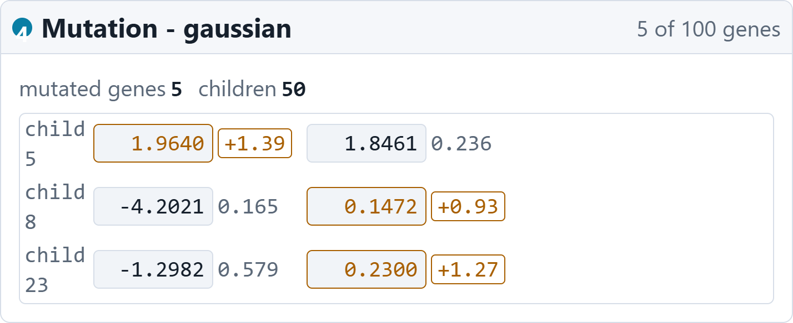
WALKTHROUGH · SEED 42
5 · Mutate selected genes
One run throughout: 50 individuals · Pc 0.80 · Pm 0.05 · σ 1.0
1 Init
2 Evaluate
3 Select
4 Cross
5 Mutate
6 Elite
7 Commit
5 of 100 genes mutate
Each coordinate has its own 5% chance.
Child 5, first coordinate
0.5695 + 1.3945 = 1.9640.
Repair only if needed
All five mutations stay within [−5, 5].
Fig. 07 — Mutate selected genes. White-mode inspector; three changed children shown.
2D ACKLEY / GENETIC ALGORITHM
12 September 2026
17
Notes:
Generation1 mutates child5 gene0, child8 gene1, child23 gene1, child29 gene1 and child48 gene0. Child5 roll=.0147578565, Gaussian delta1.39448230997, old.569497437746 -> new1.963979747715. None of the five proposals requires bounds repair. The UI excerpt shows children5,8,23; the three shown rows are not the complete mutation list.
Source: ga_ackley.py; ga-web/engine.py; presentation/data/run.json. UI row identifiers are zero-based. Captures use the actual light-theme frontend with larger presentation text and selected rows where labelled.

Slide 18
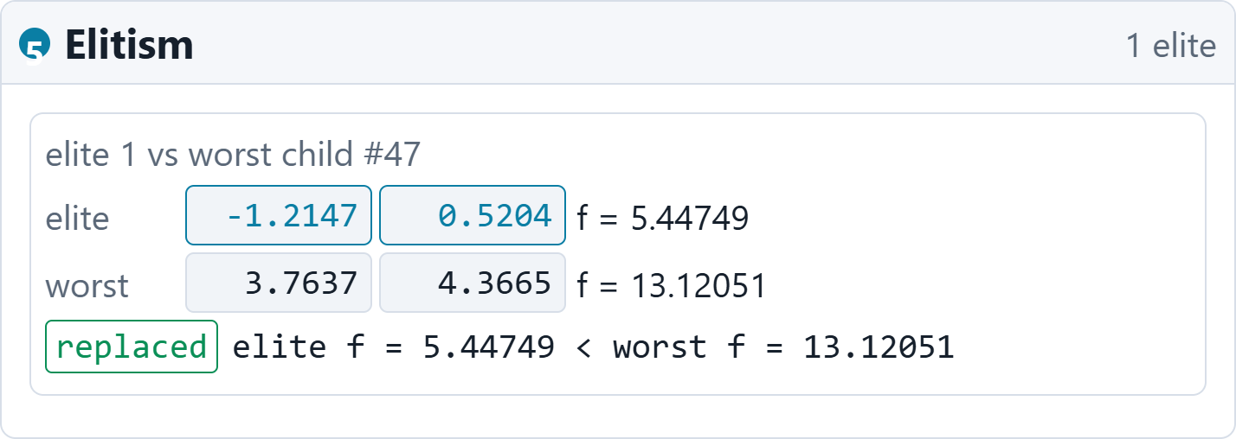
WALKTHROUGH · SEED 42
6 · Insert the protected elite
One run throughout: 50 individuals · Pc 0.80 · Pm 0.05 · σ 1.0
1 Init
2 Evaluate
3 Select
4 Cross
5 Mutate
6 Elite
7 Commit
Saved elite: f = 5.4475
The best parent was protected before breeding.
Worst child: f = 13.1205
Child #47 is replaced by the better elite.
Population stays at 50
One replacement; no extra individual.
Fig. 08 — Insert the protected elite. White-mode inspector; the actual generation-1 replacement.
2D ACKLEY / GENETIC ALGORITHM
12 September 2026
18
Notes:
Actual event: elite[-1.214656227916465,.5204063127322698],f5.447494814976 replaces child47=[3.763676264726689,4.36654587712494],f13.120508066058. Other children may already be better than the elite; elitism is preservation, not a requirement to make the previous elite the next best.
Source: ga_ackley.py; ga-web/engine.py; presentation/data/run.json. UI row identifiers are zero-based. Captures use the actual light-theme frontend with larger presentation text and selected rows where labelled.

Slide 19
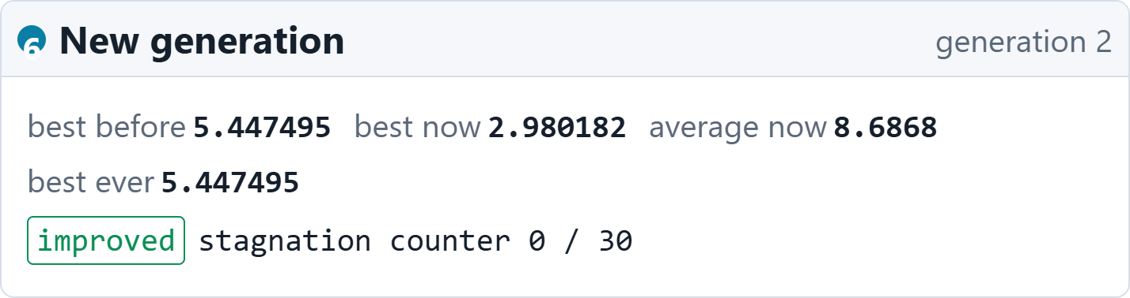
WALKTHROUGH · SEED 42
7 · Commit and repeat
One run throughout: 50 individuals · Pc 0.80 · Pm 0.05 · σ 1.0
1 Init
2 Evaluate
3 Select
4 Cross
5 Mutate
6 Elite
7 Commit
Children become generation 2
The best candidate now has f = 2.9802.
A better combination
New best: (0.8459, 0.0953).
Next: evaluate again
Update history, check stopping, and repeat.
Fig. 09 — Commit and repeat. White-mode generation summary after the first breeding cycle.
2D ACKLEY / GENETIC ALGORITHM
12 September 2026
19
Notes:
Commit after generation1 changes population to the offspring. Best goes from5.447494814976 to2.980182401782 at [.8458599022354054,.09526293676464537]. The frontend reports the new best at commit, but its convergence history appends that value when generation2 is evaluated. This accounts for generation labels across screenshot panels.
Source: ga_ackley.py; ga-web/engine.py; presentation/data/run.json. UI row identifiers are zero-based. Captures use the actual light-theme frontend with larger presentation text and selected rows where labelled.

Slide 20
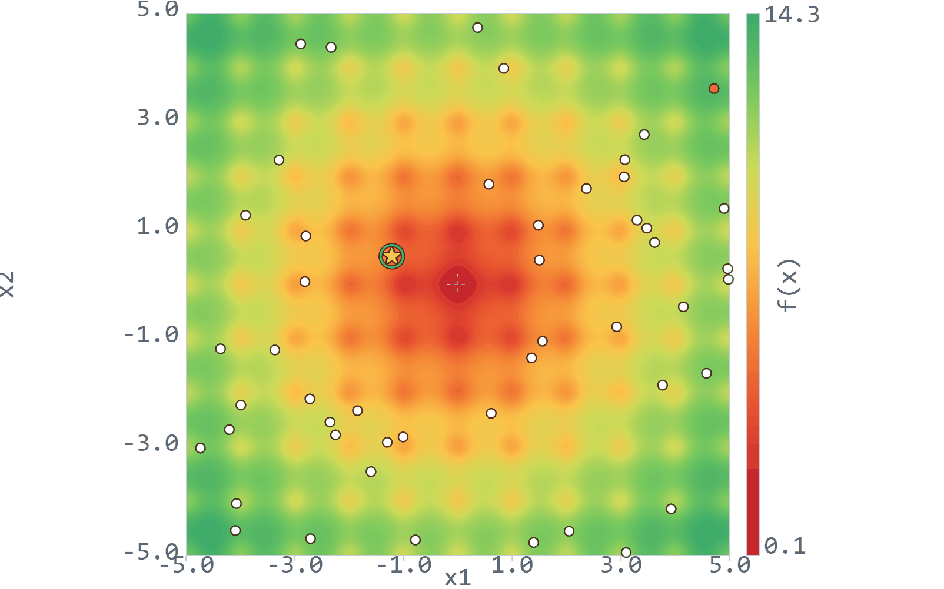
ALGORITHM IN MOTION
Watch the population gather around the origin
Animated white-mode frontend replay · selected evaluated generations from the same run
Early: broad movement
Selection and recombination rapidly reduce the objective.
Later: a compact cluster
New mutations still send some points away from the centre.
A persistent best point
Elitism keeps the strongest candidate safe.
Fig. 10 — Population replay. 10 snapshots, generations 1–100; loops in PowerPoint Slide Show.
2D ACKLEY / GENETIC ALGORITHM
12 September 2026
20
Notes:
The embedded GIF uses actual frontend screenshots at evaluated generations1,2,5,10,17,30,47,67,77,100. It is a time-lapse, not every generation and not real elapsed time. The image animates in desktop PowerPoint Slide Show and loops; PDF exports show a static frame. The original GIF is provided in presentation/assets/evolution.gif.

Slide 21
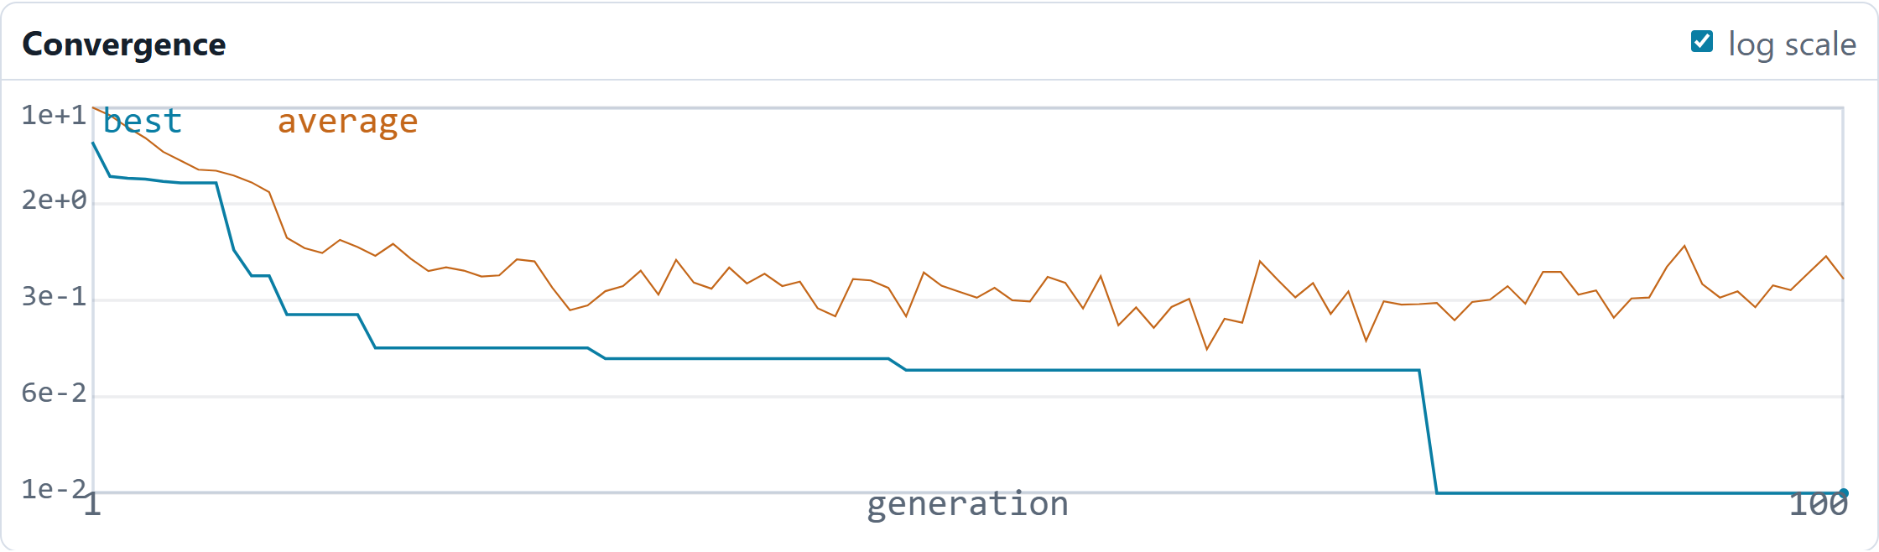
RESULTS · CONVERGENCE
Convergence: fast gains, long plateaus, a late drop
Blue = best objective · orange = population average · logarithmic vertical scale
Fig. 11 — Convergence curve. Actual white-mode frontend; 100 evaluated generations, seed 42.
G1 → G5
G47 → G76
G77 → G100
5.4475 → 2.7318
Best stays at 0.10067
Best reaches 0.011695
2D ACKLEY / GENETIC ALGORITHM
12 September 2026
21
Notes:
History values are from the evaluated population at the start of each generation. Roughly49.96% of the total absolute best-value improvement occurs from generation1 to generation5. Later gains matter: the objective moves below1 at generation9 and reaches.0116950928353 at generation77. From generation47 through76 best remains .100666379838; the improvement at generation77 arrives just before 30 stagnant generations would trigger a stop. With one elite the best curve is nonincreasing. The orange mean oscillates because the population contains new, sometimes poor offspring. Log scale makes later improvements visible; it does not cause the spikes.

Slide 22
RESULTS · EXPLAIN THE CURVE
Why did the average spike at generation 67?
The generation-66 mutation stage produced the population evaluated at generation 67.
Mean f(x)
8 GENES MUTATED
0.2313
0.1740
0.7877
0.6762
G66 population
After crossover
After mutation
After elitism
Best stays at 0.10067. Mutation worsened the mean; elitism removed the worst child.
2D ACKLEY / GENETIC ALGORITHM
12 September 2026
22
Notes:
Exact stage decomposition: mean of generation66=.23126789337595507. After selection and crossover in generation66 the children have mean.17400936886974133. Eight genes mutate, taking the mean to.7876932534951682. Elitism replaces worst child31,f5.67681516268388 by elite f.10066637983769455, reducing mean to.6761702778382442. That is the generation67 history average. Net jump=.44490238446228914, the largest one-generation upward average jump in this run. Best remains .10066637983769455 at all three offspring stages. This is a directly measured explanation, not a generic assumption that all spikes are caused by mutation. Data: run.json, generations[65].

Slide 23
RESULTS · SEED 42
Final result: close to the known optimum
The run ends at the 100-generation limit, with 23 consecutive stagnant generations.
Best point
99.79%
(0.003973, 0.000317)
reduction from the initial best
5.447495 → 0.011695
f(x) = 0.011695
Distance to origin: 0.003985
Near the centre; still above 0.001.
The known answer is (0, 0), with f = 0.
2D ACKLEY / GENETIC ALGORITHM
12 September 2026
23
Notes:
Exact best chromosome[.003972697250467887,.00031705775953021903]; best objective .011695092835325216; Euclidean distance .003985329229405449.100 evaluated generations; stop reason generation limit reached; stagnation23. Percent reduction from initial best =100×(5.447494814975997-.011695092835325216)/5.447494814975997 =99.7853%. The objective is above the project reporting threshold1e-3. Therefore this is a near-origin solution, not exact convergence to zero. Command-line and web histories match.

Slide 24
RESULTS · INTERPRETATION
Why did the run stop short of zero?
The final point is good, but the operators make very fine improvement increasingly unlikely.
Limited recombination
A fixed step size
A finite search budget
One-point crossover can only reuse existing coordinates.
σ = 1 is large compared with the final ≈0.004 distance.
No better candidate appears after generation 77.
A useful next experiment
Reduce σ later in the run, then test across many seeds.
2D ACKLEY / GENETIC ALGORITHM
12 September 2026
24
Notes:
Interpretation grounded in code and trace, not proof of a unique cause: one-point crossover creates no new coordinate values; mutation sigma remains1, about251 times the final Euclidean distance .003985; a narrow improvement near zero therefore requires a fortunate small perturbation. The best improves at generation77, and the remaining23 evaluated generations show no further progress before the100 cap. An adaptive mutation sigma is proposed future work; it is not implemented in this project. Tuning showed that a small constant sigma can have poor outliers, motivating a schedule rather than claiming that a universally small sigma is best.

Slide 25
CONCLUSION
The GA found the right basin—and exposed its limits
A visual run makes both the progress and the remaining gap explainable.
Selection directs the search
01
Fitter candidates receive more opportunities.
Variation explores; elitism protects
02
Average quality can fall while the best is preserved.
Tuning needs repeated evidence
03
Check typical quality, poor runs, and evaluation cost.
FINAL BEST 0.011695
Near the optimum; further precision needs better search control.
2D ACKLEY / GENETIC ALGORITHM
12 September 2026
25
Notes:
Close the talk with the measured result and three ideas: biased selection, stochastic exploration with elite preservation, and evidence-based tuning. The frontend makes each stochastic operator visible and matches the original Python run. No claim of exact optimum or universally best settings is made.

Slide 26
REFERENCE
References and reproducibility
Primary sources, local implementation, and the evidence used in this presentation
01 Project implementation
ga_ackley.py; ga-web/engine.py; ga-web/static/
Exact operators, parameters, stage traces, and white-mode captures.
02 Ackley benchmark
Surjanovic & Bingham · SFU Virtual Library
Definition, landscape, recommended constants, and known optimum.
03 Genetic algorithms
John H. Holland · Adaptation in Natural and Artificial Systems
MIT Press, 1992 edition; foundations of adaptation and genetic search.
04 Icons
ByteDance IconPark + the supplied custom icons
SVG assets from icons/; IconPark under Apache 2.0.
05 Run evidence
presentation/data/run.json and summary.json
Seed-42 trace; 180 tuning runs; all 14 existing parity checks passed.
Web sources accessed 12 September 2026 · full links and run details are also in speaker notes.
2D ACKLEY / GENETIC ALGORITHM
12 September 2026
26
Notes:
Full references:
1. Local project README.md and ga_ackley.py. Web visualizer: ga-web/engine.py, server.py, static/index.html, static/js/stages.js, landscape.js, chart.js.
2. Surjanovic, S. and Bingham, D. Virtual Library of Simulation Experiments: Test Functions and Datasets, Ackley Function. https://www.sfu.ca/~ssurjano/ackley.html
3. Holland, John H. Adaptation in Natural and Artificial Systems: An Introductory Analysis with Applications to Biology, Control, and Artificial Intelligence. MIT Press,1992 edition. https://doi.org/10.7551/mitpress/1090.001.0001
4. ByteDance IconPark. https://github.com/bytedance/IconPark . Apache2.0. The supplied icons/README.md identifies the custom DNA and random-initialization drawings.
5. presentation/build_data.py generated180 runs using20 seeds42–61 for9 configurations. All measured results in presentation/data/summary.json; full walkthrough trace in run.json. verify_parity.py:14/14 exact matches. Sources accessed12 September2026.

