Slide 1
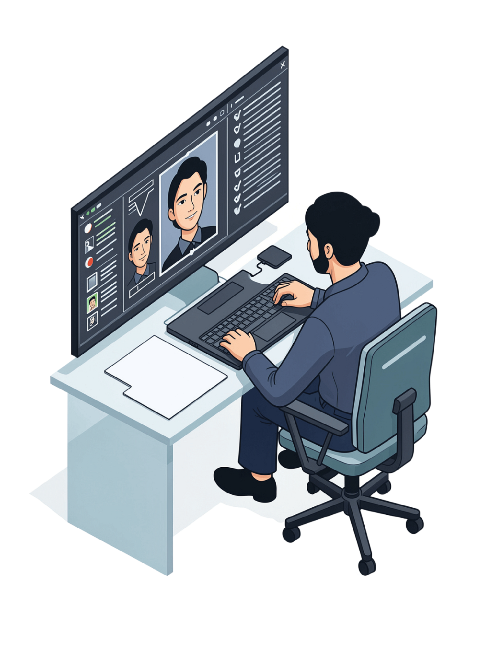
Occlusion-Robust Face Identification Using a Pretrained ArcFace Model
Machine Learning Laboratory — CSE 4112
Department of Computer Science & Engineering
Khulna University of Engineering & Technology (KUET)
08 September 2026

Slide 2
The Problem: Identity Under Occlusion
Recognising a known person when the face is deliberately or partly covered.
Eight conditions × two lighting levels
Why compound is hardest
None
Cap
Mask
Scarf
Mask hides nose, mouth, jaw
Sunglasses hide the eyes
Together → no identity cues left
Clear glasses
Sunglasses
Mask + clear
Mask + sun
Use case — spotting a wanted person in a confined system
A closed campus, office floor or checkpoint where everyone is already enrolled. A cap and a mask defeat an ordinary camera system — this one should still name them.
Research question Under heavy occlusion, does a pretrained face model need more diverse training data, or a retrained backbone?
Closed-set: every test image is one of 30 enrolled people.
08 Sep 2026
01
Notes:
Open with the use case: a closed site where everyone is enrolled, and you need to flag a specific person who is deliberately covering their face. Then the three bullets: mask takes the lower face, sunglasses take the eyes, together there is nothing left. Close on the research question.

Slide 3
Dataset & Occlusion Conditions
Captured in person, with signed consent from every participant.
30
Identities
p01 – p30
6,000
Raw images
200 each
5,988
Processed
99.8% detected
8 × 2
Conditions
occlusion × light
Capture protocol
Final split
Six team members, five participants each
Eight occlusions × regular and low light
Balanced to exactly 200 images per person
Split
Images
%
Train
3,546
59
Validation
1,444
24
Test
998
17
Test set by condition: none 138 · cap 129 · mask 161 · scarf 84 · clear 108 · sun 125 · mask+clear 120 · mask+sun 133
08 Sep 2026
02
Notes:
Four numbers and the split. Everything was captured in person with signed consent -- no stock photos, no scraped images.

Slide 4

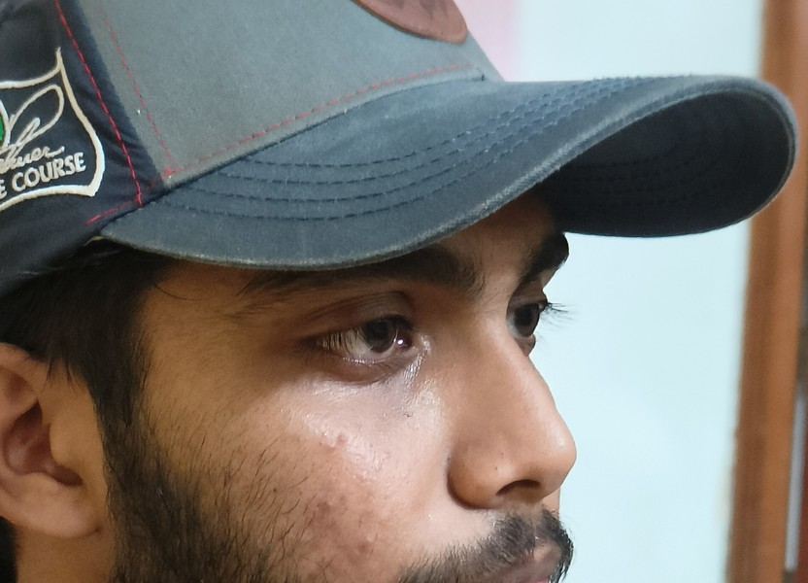
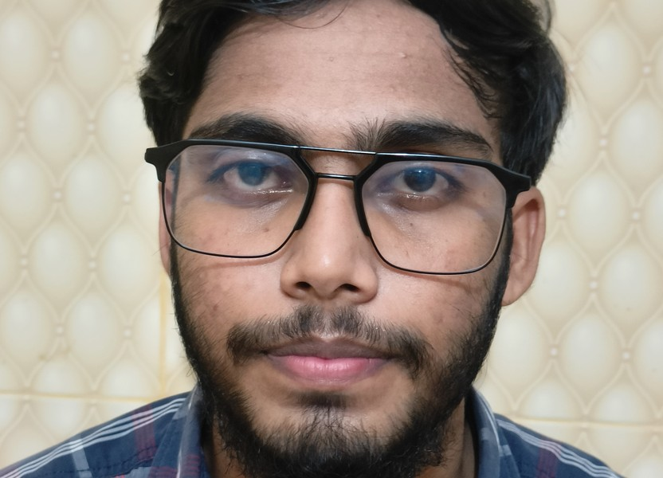
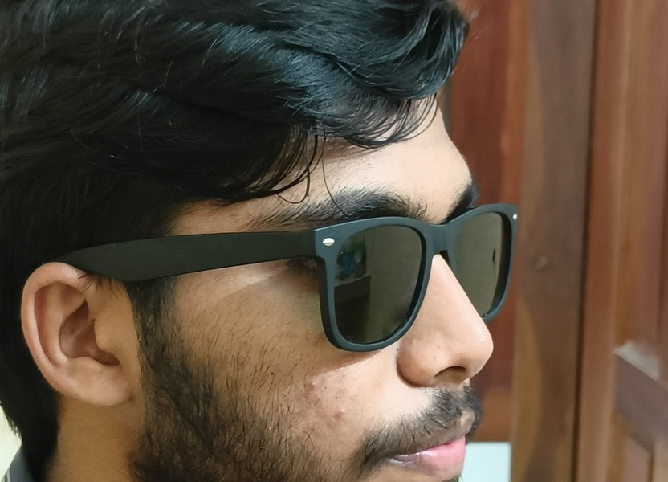
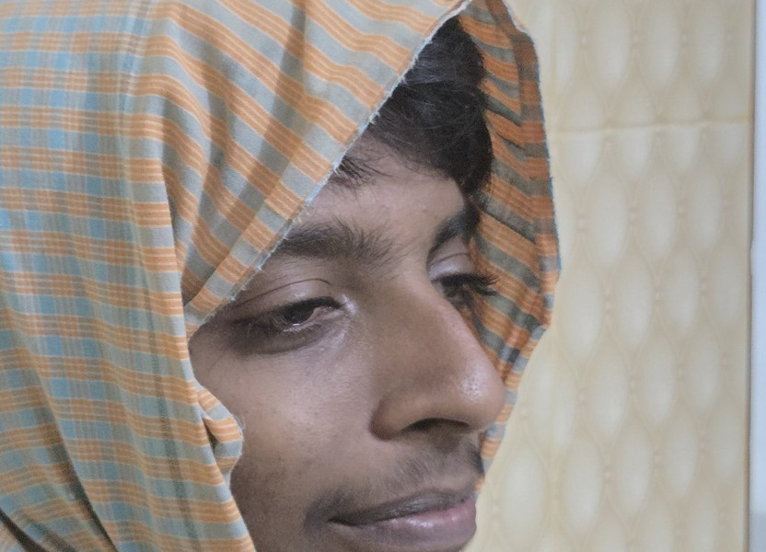
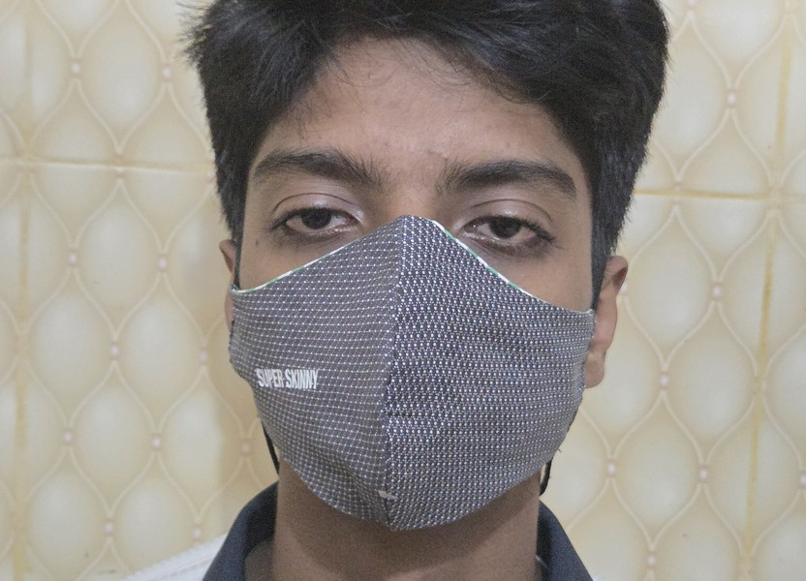
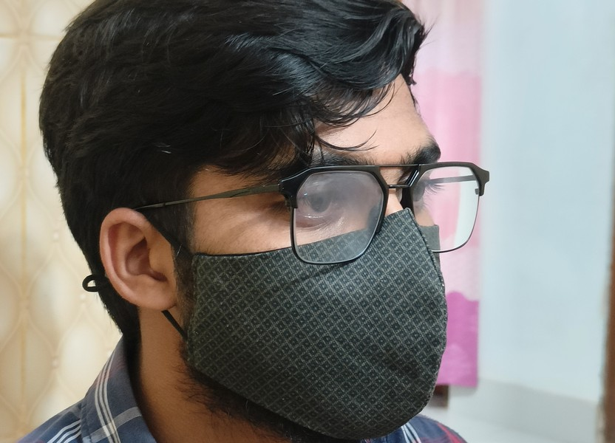
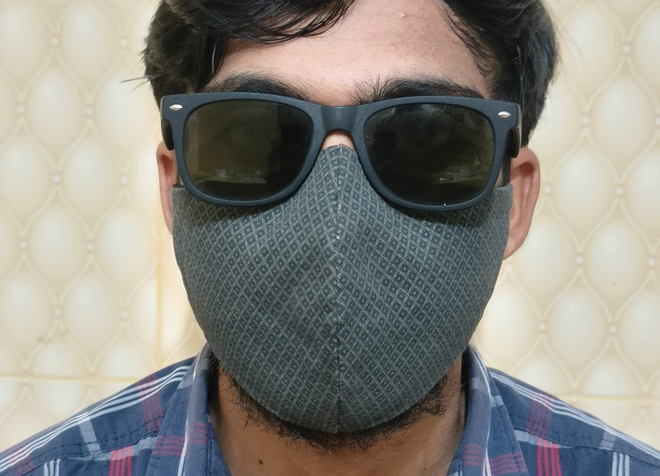
Training Data — The Eight Conditions
One capture per condition. The two in red are the compound occlusions E1 could not handle.
None
Cap
Clear glasses
Sunglasses
Scarf
Mask
Mask + clear glasses
Mask + sunglasses
08 Sep 2026
03
Notes:
Show the eight conditions the model actually receives. Point at the two red captions: those compound conditions are the only ones E1 could not handle.

Slide 5
Data Curation
Three steps before any face was detected. Nothing was deleted — only moved.
A · Completing the set
B · Balancing to 200
Some participants declined some conditions
114 images brightness-derived from their own photos
Raw collection was uneven — 7,081 images
1,117 moved to put_asides/ with a reason
C · HEIC → JPEG conversion
HEIC / HEIF
Orientation
RGB
JPEG q95
Verified
1,863 iPhone captures converted — OpenCV cannot decode HEIC, so one uniform format keeps the pipeline reproducible.
08 Sep 2026
04
Notes:
Three curation steps. The honest point is the green bar: about 2% of images are brightness-derived from the same person's own photos, because some participants declined some conditions. Nothing was ever deleted.

Slide 6
Manual Preprocessing & Automated Pipeline
From raw phone captures to aligned face crops, with transparent curation and a reproducible pipeline.
1
Phone Capture
2
Manual Review
3
Standardize &
Organize
4
Freeze Dataset
Automated Face Prep
5
6 team members,
5 participants each
8 occlusions × 2 lighting
conditions
Reject blur, too dark, fully
covered, mis-cropped
Canonical naming:
30 identities × 200 images =
RetinaFace detection +
5-point landmarks
6,000 images
p##_occlusion_lighting_seq.jpg
Rejected files kept
separately
Organized into participant
folders
No further adding, removing,
or relabeling
Align → 112×112 crop →
preprocess log
Key Transparency Practices
Detection Success
Output of This Stage
Rejected files moved to put_asides/ — never silently deleted
5,988 / 6,000 images (99.8%)
Aligned face crops for all experiments
Successfully detected and aligned
Structured preprocess log / manifest metadata
429 exact duplicate files were disclosed
Only 12 failures, mostly in mask+sunglasses
and mask
Ready for train / validation / test split
08 Sep 2026
05
05
Notes:
This is the step that makes the system background-independent: a 112x112 crop aligned on landmarks contains almost no background, so the classifier cannot key on the room. Emphasise that the same align_crop() function is imported by the live demo.

Slide 7
Data Split Pipeline
No near-duplicate may cross a split boundary, and every identity must appear in all three splits.
preprocess_log.csv
Group near-duplicates
union-find
Deficit-based
greedy allocator
Hard assertions
manifest.csv
Grouping rules
same source stem (darkened copy)
same person + occlusion in an 8 s burst
Allocation
per (person × occlusion) cell
largest group first, into the biggest shortfall vs 60/20/20
Both assertions pass
no group spans two splits
all 30 identities in all three splits
3,546 Train · 59%
1,444 Validation · 24%
998 Test · 17%
Disclosed: 429 byte-identical duplicates were kept as independent images, not merged.
08 Sep 2026
06
Notes:
This is arch.md diagram 2. One capture session means near-duplicate frames could straddle the split, so images are grouped first and whole groups are placed together. Two hard assertions must pass or the script aborts.

Slide 8
Model Architecture
Two pretrained components, plus one small head trained locally.
RetinaFace det_10g.onnx
ArcFace iResNet50 w600k_r50.onnx
Finds the face and five landmarks
Outputs a box + 5 points — not an identity
112×112 crop → 512-D identity vector
Output is not unit length — L2 normalize
112 × 112 face
iResNet50
512-D embedding
L2 normalize
30-way head
Identity
Detection
Is there a face, and where?
Embedding
What does it look like as numbers?
Identification
Which enrolled person is it?
08 Sep 2026
07
Notes:
Two pretrained models with strictly separate jobs. RetinaFace never sees identity; ArcFace never sees a name. Only the 30-way head knows who p07 is.

Slide 9
Training Pipeline — E1, E2, E3
E1 and E2 reuse cached embeddings. E3 needs raw pixels, so it branches earlier.
processed_data/
+ manifest.csv
01_preprocess.py
detect + align
crops/
112 × 112
03_embed.py
frozen ArcFace
embeddings.npz
512-D cached
E1 from embeddings.npz
E2 from embeddings.npz
E3 from crops/ — branches earlier
05_train_head.py --mode normal
05_train_head.py --mode mixed
06_e3_finetune.py
TRAIN = 'none' only
TRAIN = all 8 occlusions
unfreeze last 15%, BN frozen
runs/e1_head.pt
runs/e2_head.pt
runs/e3_model.pt
10_full_eval.py → confusion matrix · per-class and per-occlusion P / R / F1 → runs/eval/
08 Sep 2026
08
Notes:
arch.md diagram 3. The key structural point: E1 and E2 train on cached 512-D embeddings and never touch pixels again, so they are cheap. E3 needs raw pixels to backpropagate, so it branches off one step earlier.

Slide 10
Inference Pipeline — E1 / E2 / E3
Detection and alignment are shared. Only the embedding source and classifier differ.
Phone camera frame
POST /predict
RetinaFace
largest detected face
align_crop()
112 × 112, from common.py
active_mode — dropdown, switched without restarting the server
E1
E2
E3
Frozen ArcFace + L2
Same frozen embedding
Fine-tuned backbone
rolling buffer avg
rolling buffer avg
loaded lazily, own space
argmax vs e1_head.pt
argmax vs e2_head.pt
argmax vs e3_model.pt
JSON → phone browser: label, score, mode, bbox — always one of 30, no UNKNOWN in any active mode.
08 Sep 2026
09
09
Notes:
arch.md diagram 4. Detection and alignment are shared by all three modes; only the embedding source and the classifier differ. Stress the last line: every mode is closed-set, so there is no UNKNOWN.

Slide 11
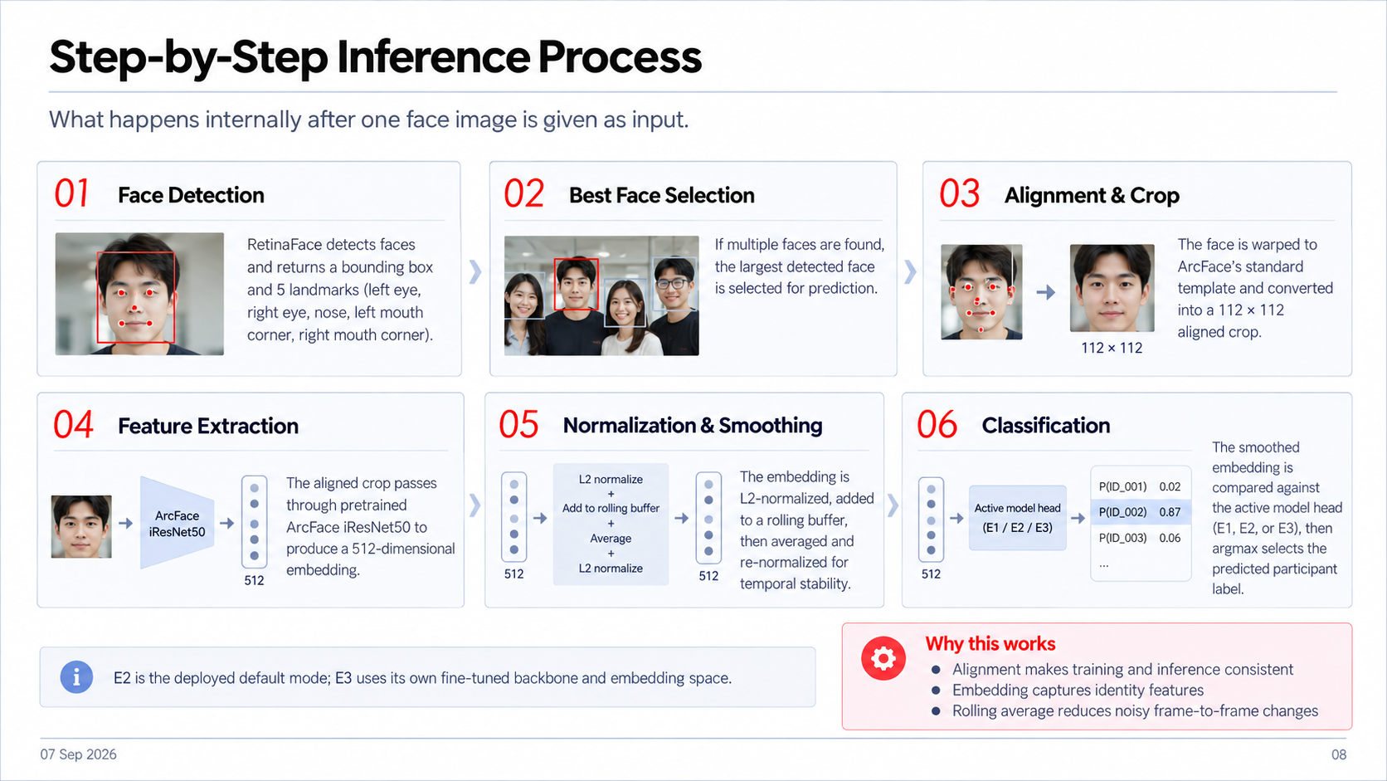
08 Sep,2026
10

Slide 12
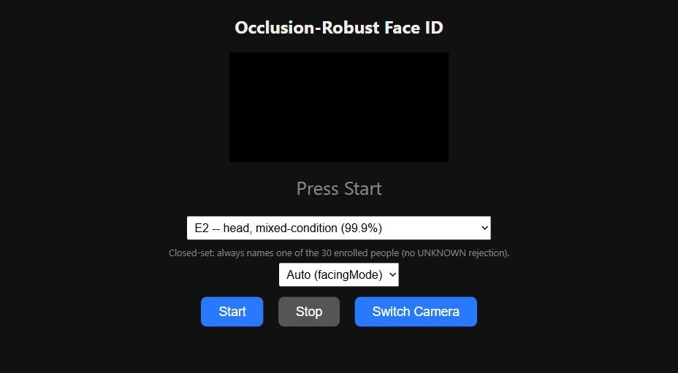
Live Demo Inference Output
How the deployed system returns the final identity in real time.
▣
Input frame
POST /predict
▥
Inference Pipeline
</>
JSON Output (from /predict)
Real demo app UI
1
⧉
Detect
RetinaFace
{
"mode": "e2",
"label": "p07",
"display_name": "participant",
"score": 0.81,
"bbox": [271, 184, 383, 296]
}
2
Align
112×112 face crop
3
Embed
Face embedding (512-D)
4
Average
Rolling average of recent frames
What the live app does
✓
Predicted Identity
•
Phone/browser opens deployed UI
5
Classify
argmax vs learned model head (E1 / E2 / E3)
•
User selects E1 / E2 / E3 mode
Select Inference Mode
p07
•
Start streams frames to /predict
Confidence
E1
E2
E3
participant
0.81
Start
Stop
Switch
Clean-only
Mixed-condition
Partial fine-tune
⚡
Speed
☷
Closed-set behavior
▭
Deployment
~400 ms per update in E1/E2
Phone browser + laptop server over local Wi‑Fi
Always returns one of 30 enrolled identities
08 Sep 2026
11

Slide 13
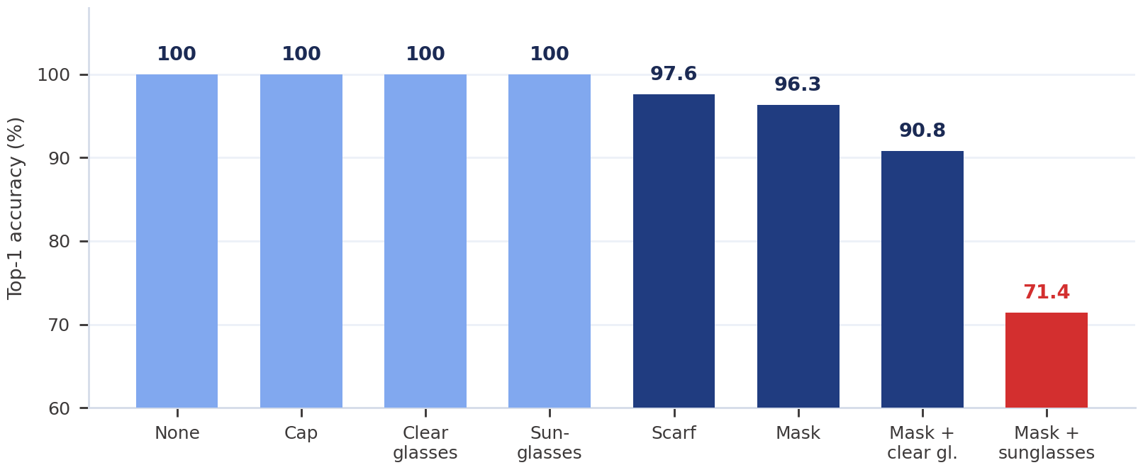
E1 — Clean-Only Training
Train the head on unoccluded faces only, then test on everything.
Clean 'none' images
ArcFace iResNet50
FROZEN
512-D embedding
30-way head
TRAINED
94.29%
Top-1 94.29%
Macro-F1 93.89% · 57 errors
Mask + sunglasses
71.4%
38 of E1's 57 errors
Single occlusions are already solved. Only the compound one breaks.
08 Sep 2026
12
Notes:
The headline is the shape of the chart, not the 94.29%. Every single occlusion is solved perfectly. The whole loss sits in one bar: 38 of E1's 57 errors are mask + sunglasses.

Slide 14
E2 — Occlusion-Diverse Training
Identical model, hyperparameters and seed. Only the training data changed.
All 8 conditions
ArcFace iResNet50
FROZEN
512-D embedding
30-way head
TRAINED
99.90%
What changed
Where the gain landed
E1
E2
Hardest
E1
E2
Backbone
frozen
frozen
Scarf
97.6%
100%
Head
512→30
512→30
Mask
96.3%
99.4%
Seed
42
42
Mask + clear
90.8%
100%
Training data
'none'
all 8
Mask + sun
71.4%
100%
Errors: 57 → 1. Every other variable held fixed, so the +5.61 points is attributable to the data alone.
08 Sep 2026
13
Notes:
The cleanest experiment in the project. Same architecture, same hyperparameters, same seed. Only the training data changed, so the gain is attributable to occlusion diversity and nothing else.

Slide 15
E3 — Partial Backbone Fine-Tuning
Does adapting the backbone weights themselves help further?
All 8 conditions
iResNet50
first 85% frozen
last 15%
TRAINABLE
30-way head
TRAINED
100.00%
Backbone 1×10⁻⁵ nudge, never overwrite
New head 1×10⁻³ starts from random
Engineering required
ONNX → PyTorch via onnx2torch
Verified identical: cos 1.000000
BatchNorm pinned to eval() throughout
Top-1 100.00%
Zero errors · 95% CI 99.6 – 100.0
The honest reading: E3 beats E2 by one image out of 998. That sits inside E2's own confidence interval — on this dataset the two are statistically indistinguishable.
08 Sep 2026
14
Notes:
E3 needed real engineering: insightface ships ArcFace as inference-only ONNX, so we converted the same graph and verified it numerically first. Be honest that the gain is one image out of 998.

Slide 16
E1 vs E2 vs E3
Each experiment isolates one variable. Blue marks the row that changed.
E1 Clean-only
E2 All conditions
E3 Fine-tuned
TRAINING DATA
'none' only
TRAINING DATA
all 8 conditions
TRAINING DATA
all 8 conditions
BACKBONE
frozen
BACKBONE
frozen
BACKBONE
last 15% trainable
94.29%
99.90%
100.00%
E1 → E2 data only. +5.61 pts
E2 → E3 backbone only. +0.10 pts
08 Sep 2026
15
Notes:
Read column by column. Between E1 and E2 exactly one row changes. Between E2 and E3 a different single row changes.

Slide 17
Validation & Test Metrics
Two splits, two jobs. Never reported in the same table.
VALIDATION 1,444 images
Chooses the checkpoint and stops training. Never reported as accuracy.
TEST 998 images
Scored once, after every hyperparameter was frozen.
Experiment
Top-1
Macro-P
Macro-R
Macro-F1
95% CI
E1 clean-only
94.29%
95.06%
93.55%
93.89%
92.7 – 95.6
E2 all conditions
99.90%
99.92%
99.92%
99.92%
99.4 – 100
E3 fine-tuned
100.00%
100.00%
100.00%
100.00%
99.6 – 100
A normalization bug, found and fixed: the head assumed unit-length embeddings that insightface never returned. After adding L2 normalization and retraining, E1 rose 70.34% → 94.29% and E2 96.29% → 99.90%. All figures are post-fix.
08 Sep 2026
16
Notes:
Validation chose the checkpoint; test was scored once at the end. Be ready for the normalization question -- it is the most interesting debugging story here.

Slide 18
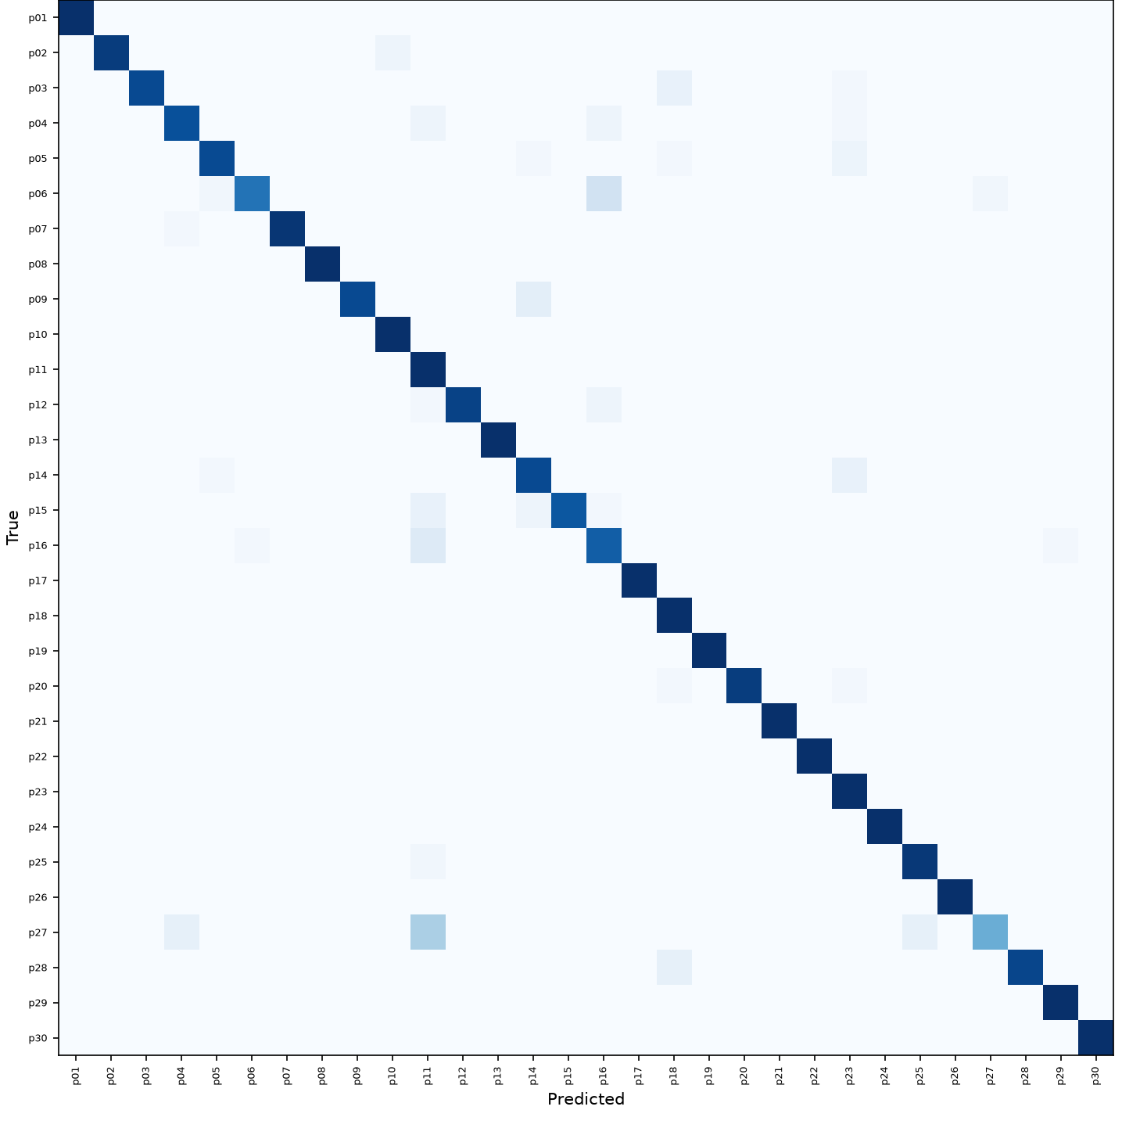
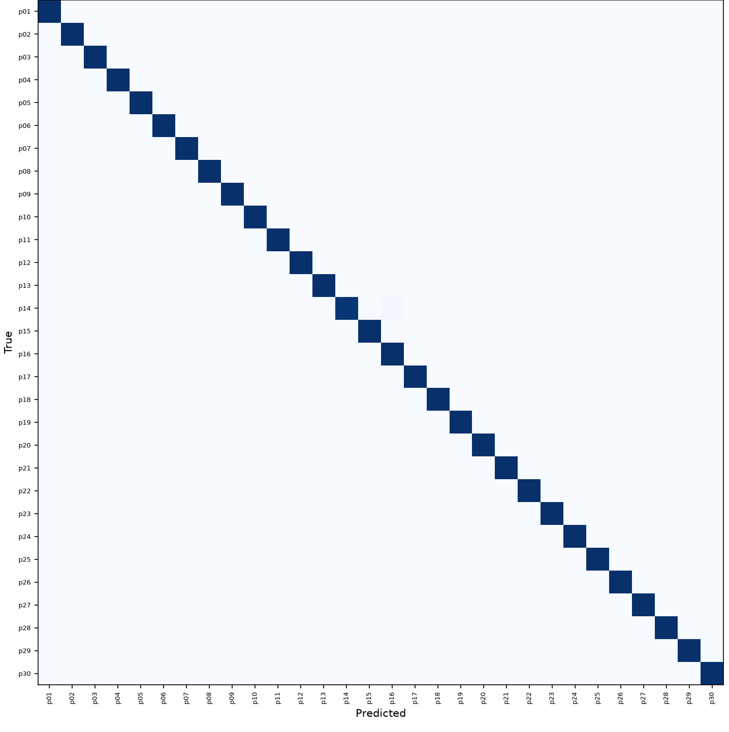

Confusion Matrices — Test Split
Row-normalized 30 × 30 over all 998 test images.
E1 — clean-only
E2 — all conditions
E3 — fine-tuned
57 errors → 1 error → 0 errors E1's worst: p06→p16, p16→p11, p27→p11
08 Sep 2026
17
Notes:
Point at the pattern, not the cells. E1 scatters; E2 has one faint cell; E3 is a clean diagonal.

Slide 19
Occlusion-wise Performance
Per-condition test accuracy — where every remaining error lives.
Condition
n
E1
E2
E3
Robustness gap
None
138
100%
100%
100%
E1
6.6
E2
0.1
E3
0.0
Cap
129
100%
100%
100%
Clear glasses
108
100%
100%
100%
Sunglasses
125
100%
100%
100%
Scarf
84
97.6%
100%
100%
Where E1 fails
Mask
161
96.3%
99.4%
100%
57 errors on 998 images
38 are mask + sunglasses
Mask + clear glasses
120
90.8%
100%
100%
Mask + sunglasses
133
71.4%
100%
100%
The one message: compound occlusion — not occlusion in general — breaks a clean-trained model.
08 Sep 2026
18
Notes:
The primary scientific table. The message is the bottom row.

Slide 20
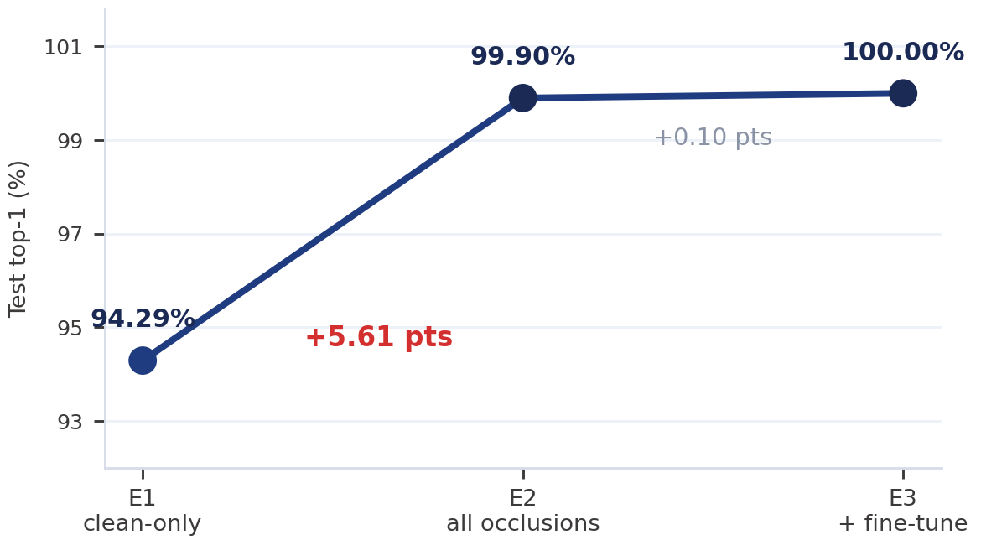
What Made the Biggest Difference?
Both steps helped. Not by comparable amounts.
E1 → E2 +5.61 points
Training data only. 57 errors → 1.
E2 → E3 +0.10 points
Backbone weights. 1 error → 0.
Key finding
Occlusion-diverse training data mattered more than fifty times as much as adapting the backbone. The pretrained representation was never the bottleneck — what it had never been shown was.
08 Sep 2026
19
Notes:
If the examiners remember one thing, make it this: on this dataset, data diversity beat backbone adaptation by roughly fifty-six to one.

Slide 21
Related Work — Base Papers
One supplies the dataset precedent, the other the method precedent.
Aspect
Pgu-Face (2016)
Chong et al. (2022)
This project
Role
Dataset base
Method base
Applied system
Identities
224
50-category subsets
30 enrolled
Images
896
RMFD 90k / LFW 13k
5,988 used
Occlusions
Sunglasses, beard
Masks
8 incl. combinations
Model
None proposed
CNN + SVM
Pretrained ArcFace + head
Best result
Not applicable
98.39% TAR
99.90% E2 / 100% E3
Not a like-for-like comparison
Chong et al. report TAR on a public benchmark subset; we report closed-set top-1 on 30 locally captured identities. Our 100% does not beat their 98.39% — a closed set of 30 is a fundamentally easier problem.
08 Sep 2026
20
Notes:
Two base papers, two roles. Pgu-Face proposes no recognition model, so no accuracy is attributed to it. Do not let anyone leave thinking our 100% beat Chong's 98.39% -- different datasets, protocols and metrics.

Slide 22
Deployment — Live Phone-to-Laptop
A person wearing an occlusion is named in real time.
PHONE CAMERA
Why HTTPS is not optional
getUserMedia() only exists in a secure context — a plain http:// page never even prompts for the camera. A self-signed cert is reused from runs/certs/.
Browser · getUserMedia()
JPEG frame → POST
HTTPS Flask + gevent
Why gevent replaced the dev server
ssl_context='adhoc' accepted the connection then hung on the TLS handshake with real mobile browsers, with no server-side error.
Detect · align · embed
Temporal smoothing
Switching modes live
A dropdown swaps E1/E2/E3 without restarting. E3 loads lazily and the embedding buffer is cleared, because its space is incompatible.
E1 / E2 / E3 head
PHONE DISPLAY
08 Sep 2026
21
Notes:
The acceptance test was a live phone camera naming a masked person. HTTPS and gevent were both real debugging findings, not design flourishes.

Slide 23
Limitations & Future Work
These bound what the reported numbers mean.
Limitations
Future work
Single capture session per person
Closed-set only — cannot reject a stranger
~8% test/train duplicate overlap
One phone per group of five identities
Only 30 identities, no anti-spoofing
Multi-session capture across days
Cross-device evaluation
Report duplicate-free test accuracy
Open-set rejection with unenrolled visitors
Liveness detection and more identities
How to read 100%: on this 30-person, single-session, closed-set split, E3 classified all 998 test images correctly. Duplicate overlap and one capture session push that figure optimistic — it is a result about this dataset, not a claim about real-world accuracy.
08 Sep 2026
22
Notes:
Present these without defensiveness. Single-session design and duplicate overlap are the two an examiner will press on, and both were measured, not discovered later.

Slide 24
Key Findings & Conclusion
01
The pretrained embedding was already strong
Every single occlusion was solved at 100% by the clean-only baseline.
02
Compound occlusion is the real failure
Mask + sunglasses caused 38 of E1's 57 errors.
03
Diverse data repaired exactly that
E2 reached 100% on it with an identical model and seed.
04
Fine-tuning added almost nothing
E3's +0.10 points is one image out of 998.
Conclusion
A correctly normalized pretrained ArcFace embedding with a small locally trained head reaches 99.90% closed-set top-1 across eight occlusion conditions — without touching the backbone.
The transferable finding: training-condition diversity matters far more than how much of the backbone you unfreeze.
08 Sep 2026
23
Notes:
Close on the ranking, not the number. The transferable result is that training-data diversity beat backbone adaptation.

