Slide 1
KHULNA UNIVERSITY OF ENGINEERING & TECHNOLOGY
Department of Computer Science and Engineering — CSE 4112 Machine Learning Laboratory
Occlusion-Robust Face Identification
Using a Pretrained ArcFace Model
Project Report Presentation
Roll: 2107031, 2107044, 2107046, 2107047, 2107057, 2107059 | Section A | 4th Year, 1st Semester
Submitted to: Dr. Muhammad Aminul Haque Akhand & Nabil Faiyaz Sadi
Khulna, Bangladesh

Slide 2
Agenda
▪ Problem Statement & Objectives
▪ Dataset: Collection, Consent & Manual Curation
▪ Preprocessing: Detection & Alignment
▪ Data Splitting Strategy (Constrained)
▪ Why a Pretrained ArcFace Backbone
▪ Experiment Design: E1, E2, E3
▪ Training Pipelines & Design Choices
▪ A Real Bug, Found and Fixed
▪ Results: Accuracy, Per-Occlusion, Confusion Matrices
▪ Comparison with Related Published Work
▪ Inference Pipeline: Image → Label
▪ Live Web Demo
▪ Limitations, Future Work & Conclusion
Occlusion-Robust Face ID | Agenda
2

Slide 3
Problem Statement & Objectives
The Problem
Objectives (all completed)
▪ Closed-set face identification: every test photo belongs to one of 30 enrolled people.
▪ System must return the correct participant ID (e.g. p07) — not just detect “is a mask present.”
▪ Occlusions hide different regions:
– Mask → nose, mouth, jawline
– Sunglasses → eye region
– Cap → forehead, hairline
– Low light → visible texture generally
▪ Central question: can a pretrained face embedding stay discriminative under these conditions with only a small amount of per-identity data?
▪ Collect a structured dataset across occlusion & lighting conditions
▪ Detect, align, crop & quality-check every image (one pipeline)
▪ Split into train/val/test with every identity in all three
▪ Evaluate a pretrained ArcFace pipeline with two forms of task-specific training
▪ Report accuracy, confusion matrices, and per-class/per-occlusion P/R/F1
▪ Produce a working live phone-camera demonstration
Occlusion-Robust Face ID | Problem & Objectives
3

Slide 4
Dataset Overview
30
Enrolled identities
6
Team members, 5 people each
8 × 2
Occlusion types × lighting levels
6,000
Raw images captured
5,988
Successfully preprocessed
99.8%
Detection success rate
Occlusion conditions captured:
none · cap · mask · scarf · clear glasses · sunglasses · mask+sunglasses · mask+clear glasses
Filenames encode ground truth directly (p07_mask_sunglass_low_014.jpg) — parsed by regex, with a CSV manifest as the single authoritative metadata source downstream.
Occlusion-Robust Face ID | Dataset Overview
4

Slide 5
The Eight Occlusion Conditions
Real photos are withheld for participant privacy (consent-gated); shown here as labeled diagrams
None
Cap
Mask
Scarf
Clear, unoccluded baseline face
Forehead & hairline hidden
Nose, mouth, jawline hidden
Lower face wrapped/hidden
Clear Glasses
Sunglasses
Mask + Clear Glasses
Mask + Sunglasses
Mild eye-region distortion
Eye region fully hidden
Lower face + mild eye distortion
Both eyes AND lower face hidden — hardest condition
Occlusion-Robust Face ID | Occlusion Conditions
5

Slide 6
Consent & Manual Data Curation
Phone capture
(6 members x 5 people)
Consent form
signed
Manual quality
review
metadata/person_id_mapping.txt
p## -> member -> real person
Reject: blurry, too dark,
fully covered, mis-cropped, duplicate
Accept: rename to
p##_occ_light_seq.jpg
put_asides/<member>/<person>/
(kept, with reason)
processed_data/p01..p30/
FROZEN dataset (6,000 images)
Privacy note
▪ Every participant signed a consent form before any photo was taken; anonymous p## IDs only — no names in any dataset file.
▪ A separate optional box grants permission to show a recognisable photo in the report/demo — respected throughout this project.
▪ 429 images turned out to be byte-identical duplicates (repeat shutter presses) — kept as independent samples, not silently merged; effect measured and disclosed in Results.
Occlusion-Robust Face ID | Consent & Data Curation
6

Slide 7
Preprocessing: Detect, Align, Crop
Raw photo
(full resolution)
RetinaFace detect
bbox + 5 landmarks
Similarity transform
align to template
112x112 crop
(training-ready)
Why RetinaFace?
Why alignment matters
▪ Purpose-built face detector — not a generic object detector repurposed for faces.
▪ Outputs 5 landmarks (eyes, nose, mouth corners) in the same pass as detection — exactly what alignment needs.
▪ Single-shot, multi-level: robust across scales without a separate landmark model.
▪ Precedent in published work adapting the same family to occluded/masked faces.
▪ Maps eyes/nose/mouth to the SAME pixel positions every time — regardless of phone tilt, distance, or head turn.
▪ Without it, a classifier could key on background or camera artifacts instead of the actual face.
▪ The exact same align_crop() function builds training crops AND live-demo frames — no train/inference mismatch.
99.8%
Detection success rate (5,988 / 6,000)
12
Failures — mostly mask+sunglasses (10/12)
Occlusion-Robust Face ID | Preprocessing
7

Slide 8
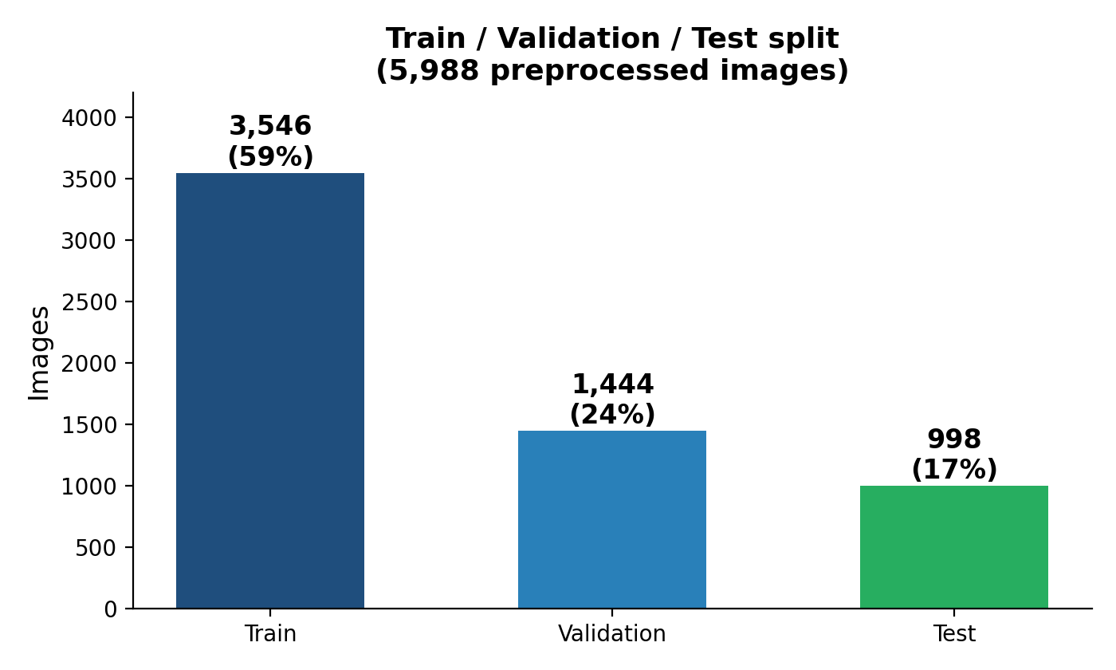
Data Splitting Strategy (Constrained)
preprocess_log.csv
(md5, detection log)
Group near-
duplicates
Deficit-based
greedy allocator
Hard assertions
(coverage check)
manifest.csv
(final split)
Why not just random-split?
▪ Near-duplicate leakage risk: burst-mode shots taken seconds apart, or a low-light image derived by darkening a regular one, could land on opposite sides.
▪ Fix: union-find groups images sharing a source OR captured within an 8s burst for the same (person, occlusion) — then splits by whole GROUP, never individual image.
▪ 429 byte-identical duplicates are deliberately kept as independent samples — not merged — with the ~8% resulting test/train overlap measured and disclosed, not hidden.
▪ Hard guarantee: every one of the 30 identities appears in ALL three splits (asserted, not hoped for). Per-occlusion coverage per split is best-effort only.
Occlusion-Robust Face ID | Data Splitting
8

Slide 9
Why a Pretrained ArcFace Backbone?
The reasoning
The angular-margin loss, intuitively
▪ Purpose-built for faces — RetinaFace + ArcFace are designed specifically for finding and telling apart human faces, unlike a general-purpose image classifier.
▪ Needs far less local data — ArcFace already understands faces broadly from large-scale pretraining, so it needs far less new data to learn our 30 specific people than training from scratch.
▪ Practical to run — iResNet50 is light enough for a 2xRTX3090 box AND a modest laptop CPU, while far stronger than a small CNN trained from random initialisation.
▪ Proven on occluded faces — prior published work has already adapted this exact model family to masked/occluded faces, supporting its use here.
▪ No from-scratch CNN baseline was trained: with only 30 classes and a few hundred images per identity, it was judged inherently weaker and less informative than the E1-vs-E2 comparison.
L = -log[ e^(s·cos(θy+m)) / (e^(s·cos(θy+m)) + Σ e^(s·cosθj)) ]
▪ Adds an angular margin m directly to the target class's angle before the softmax.
▪ Effect: pulls same-person embeddings tighter together, and pushes different-person embeddings further apart, on the surface of a hypersphere.
▪ This is WHY nearest-centroid matching already works well on this pretrained space — it was explicitly optimised for exactly that kind of separation.
512-d
Embedding size (w600k_r50.onnx)
iResNet50
Backbone architecture
Occlusion-Robust Face ID | Why ArcFace
9

Slide 10
Experiment Design Overview
ID | Name | Backbone State | Train Data | Question
E1 | Trained head, clean-only | Frozen | none-occlusion only | The proposal's original baseline
E2 | Trained head, mixed-condition | Frozen | all 8 occlusions | Does occlusion-diverse data help over E1?
E3 | Partial backbone fine-tune | Last 15% unfrozen | all 8 occlusions | Does adapting backbone weights help further?
Architecture at a glance
E1 / E2: FROZEN
+ new 30-way head
▪ E1/E2 = linear probing — zero backbone weights ever touched, only the head is learned.
▪ E3 = genuine partial fine-tune — backbone AND head both get gradient updates, at very different learning rates.
▪ All three share the identical frozen-embedding starting point and evaluation protocol.
Pretrained ArcFace backbone
(w600k_r50.onnx)
E3: last 15% UNFROZEN
+ new 30-way head
Occlusion-Robust Face ID | Experiment Overview
10

Slide 11
E1 & E2: Linear Probing Pipeline
crops/
112x112 aligned
03_embed.py
frozen ArcFace
embeddings.npz
512-d cached
05_train_head.py
30-way ArcFace head
e1_head.pt / e2_head.pt
What differs between E1 and E2?
Why call this “linear probing”, not fine-tuning?
▪ Only the TRAINING DATA — architecture and optimiser settings are identical.
▪ E1 trains on none-occlusion images only. E2 trains on all 8 occlusion conditions.
▪ The backbone (w600k_r50.onnx) receives ZERO gradient updates in E1/E2 — it is packaged as inference-only ONNX and never touched.
▪ Only a brand-new 512→30 linear layer is trained on top of the frozen embedding — the pretrained representation is used exactly as-is.
▪ This isolates one specific question: given a fixed representation, does the TRAINING DATA'S occlusion-diversity matter?
Training details
▪ cos(θy + m)·s angular-margin head, s=32, margin warm-up 0→0.20 over 5 epochs, label smoothing 0.1
▪ AdamW, cosine LR schedule, early stopping on validation macro-F1 (patience 7)
Occlusion-Robust Face ID | E1 & E2 Pipeline
11

Slide 12
E3: Partial Backbone Fine-Tuning
crops/
112x112 aligned
onnx2torch convert
+ numerical verify
Unfreeze last 15%
+ new head, BN frozen
Train (grad on
backbone + head)
e3_model.pt (~166MB)
Why only the last 15%?
Two safeguards that made this trustworthy
▪ Only ~3,500 training images. Unfreezing the WHOLE ~25M-parameter backbone risks catastrophic forgetting on so little data.
▪ Last layers encode identity/task-specific features; early layers encode generic edges/textures that should transfer regardless of which 30 people.
▪ Faster training, less GPU memory, lower risk of optimiser instability.
▪ Honest caveat: 15% was one chosen value, not the result of a sweep across 5%/30%/50%.
▪ Numerical verification: converted backbone checked against original ONNX output BEFORE training — cosine similarity 1.000000, max abs diff 1.86e-4.
▪ BatchNorm frozen throughout (even during training): letting BN running stats update on so few images would silently destroy pretrained features.
10^-5
Backbone LR (vs 10^-3 for head)
15%
of backbone parameters unfrozen
Occlusion-Robust Face ID | E3 Pipeline
12

Slide 13
A Real Bug, Found and Fixed
A methodological red flag caught before it became a false finding
insightface's get_feat() does NOT return unit-length embeddings — but the E1/E2 head code assumed it did, computing cos(θ)=x·w as an unbounded dot product instead of a true cosine. This silently corrupted the arccos margin term on every training and evaluation batch.
Experiment | Before fix | After fix
E1 | 70.34% | 94.29%
E2 | 96.29% | 99.90%
How it was caught
▪ Red flag: a strictly more expressive model (frozen backbone + trainable head) scored WORSE than a training-free baseline — that ordering should never happen without an explanation.
▪ Root cause traced to a documented-but-easy-to-miss insightface API detail.
Why this matters beyond the numbers
▪ Fixed the story, not just the score: pre-fix, E1 looked broadly worse everywhere; post-fix, E1 fails specifically on mask+sunglasses — a controlled, explainable effect.
▪ A useful debugging heuristic: sanity-check EXPECTED ORDERING between experiments, not just absolute numbers.
▪ Reported transparently in the final report as a case study — not hidden as an embarrassment.
Occlusion-Robust Face ID | The Bug
13

Slide 14
Results: Accuracy Across E1, E2, E3
Experiment | Top-1 | Macro-P | Macro-R | Macro-F1 | 95% CI
E1 — Head, clean-only | 94.29% | 95.06% | 93.55% | 93.89% | [92.7%, 95.6%]
E2 — Head, mixed-condition | 99.90% | 99.92% | 99.92% | 99.92% | [99.4%, 100.0%]
E3 — Partial fine-tune | 100.00% | 100.00% | 100.00% | 100.00% | [99.6%, 100.0%]
Key takeaways
▪ 998 test images, 30 classes, 95% Wilson confidence intervals throughout.
▪ E2 and E3's intervals overlap — not statistically distinguishable at this sample size.
▪ The real finding isn't E2-vs-E3 (small gap); it's E1-vs-E2 (large, explainable gap) — see next slide.
Occlusion-Robust Face ID | Results: Accuracy
14

Slide 15
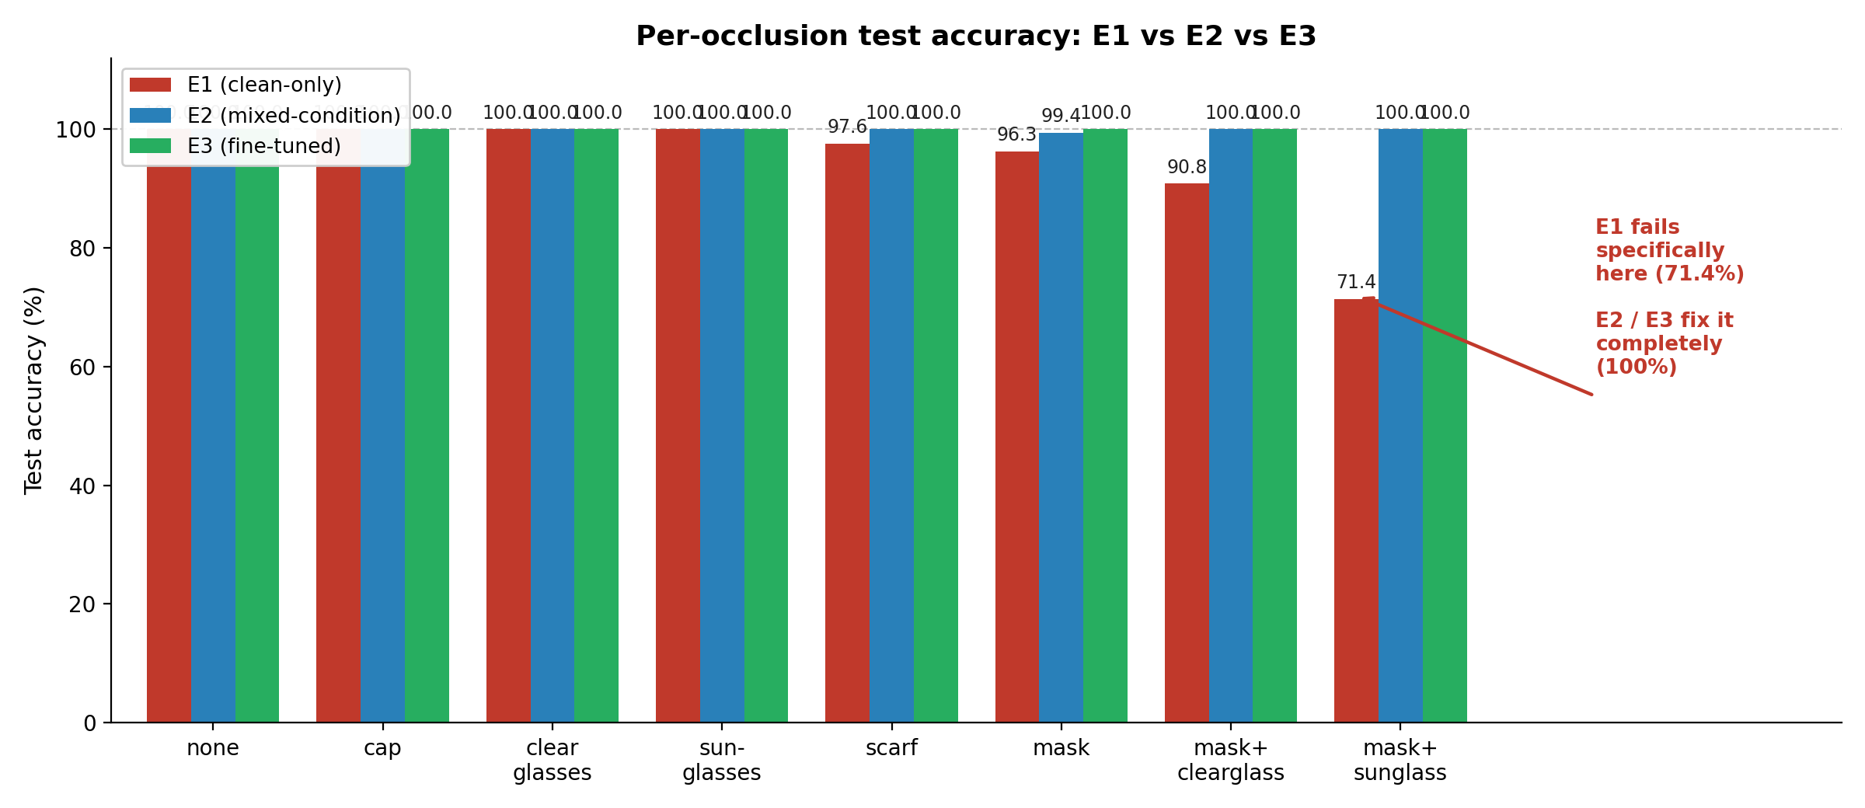
Results: Per-Occlusion Breakdown
The clearest, most informative comparison in this project
Occlusion-diverse training data matters specifically for COMPOUND occlusions — single occlusions were already handled well by all three approaches.
Occlusion-Robust Face ID | Per-Occlusion Results
15

Slide 16
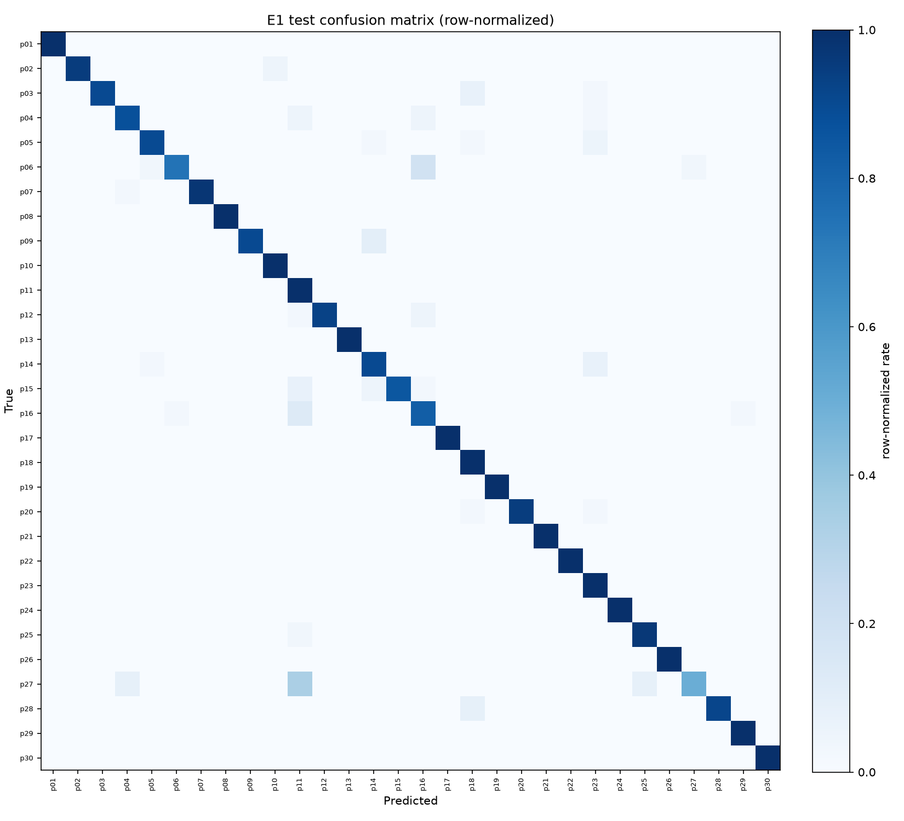
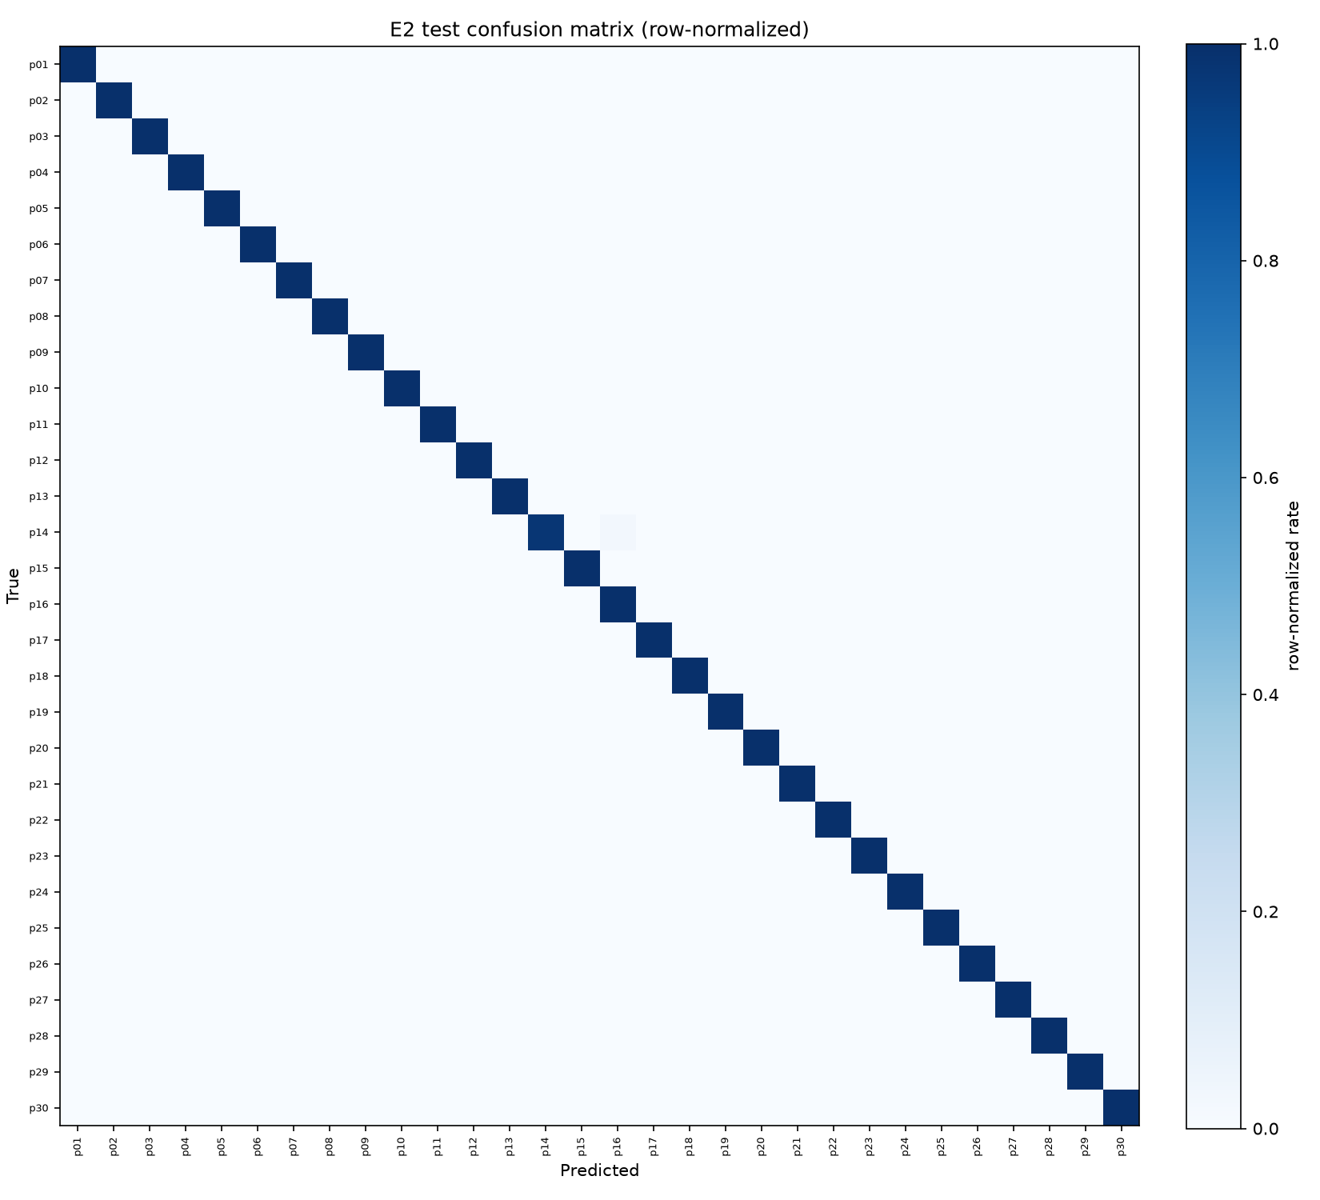

Confusion Matrices: E1 vs E2 vs E3
(a) E1 — clean-only
(b) E2 — mixed-condition
(c) E3 — fine-tuned
▪ E1 is the only one with visible off-diagonal structure — top confusion: p06→p16 (6 images), concentrated in mask+sunglasses.
Occlusion-Robust Face ID | Confusion Matrices
16

Slide 17
Comparison with Related Published Work
Work | Task | Scale | Reported accuracy
This project (E3) | Closed-set ID, 30 identities | 5,988 images, 8 occlusion types | 100.00% top-1 (998/998, CI [99.6,100.0]%)
Boutros et al. 2022 (SRT loss) | Open-set verification | Large masked verification benchmarks | High-90s% verification acc. (mask-aware triplet loss)
InsightFace MFR Challenge 2021 | Open-set verif. / identification | Millions of identities, web-scale | 90s% masked TAR at very low FAR
NIST FRVT Part 6B 2020 | Verification, commercial algos | Large government- operational dataset | 5-50 pt accuracy drop masked vs unmasked
The honest framing
▪ This project does NOT “beat” these papers — the comparison doesn't survive the scale / open-set-vs-closed-set difference.
▪ A closed-set task with 30 known identities is dramatically easier than open-set, web-scale recognition — which is exactly why a plain pretrained embedding, with no mask-specific loss engineering, was already sufficient here.
▪ The real contribution: an empirical demonstration of HOW FAR an off-the-shelf pretrained model goes, and WHERE the remaining gap actually lives (E1-vs-E2, not further architecture engineering).
Occlusion-Robust Face ID | Related Work
17

Slide 18
Inference Pipeline: Image → Label
Worked example: a photo of p07, wearing a mask
Phone photo
(full frame)
RetinaFace
detect + landmarks
align_crop()
112x112 crop
ArcFace embed
+ L2 normalize
Rolling buffer
avg of 6 frames
Classify
(argmax vs head)
Example scores (mask photo, E2 mode)
What's actually in the 512-d vector?
Person | Similarity score
p07 | 0.81 <- highest
p14 | 0.22
p03 | 0.19
▪ Not human-interpretable per-dimension — geometrically, same-person faces land close together, different people land far apart.
▪ Raw embedding is NOT unit-length — must be explicitly L2-normalized before any similarity comparison (the bug from Slide 13).
▪ Rolling buffer of 6 frames (~2 seconds) smooths out per-frame blur/blink noise before classifying.
argmax -> label = p07
Occlusion-Robust Face ID | Inference Pipeline
18

Slide 19
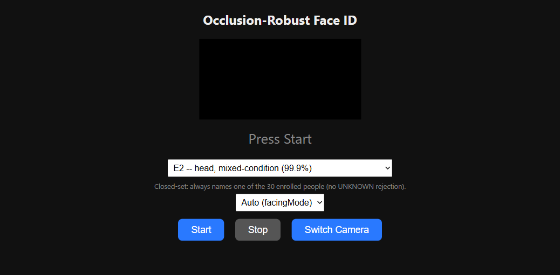
Live Web Demo
How it works
▪ Flask server on a laptop; phone connects over the same Wi-Fi as a browser page and streams its camera.
▪ HTTPS required — getUserMedia only works in a secure context; served via gevent's WSGIServer + a persistent self-signed cert (Flask's dev server hung on real TLS handshakes).
▪ A dropdown switches between E1 / E2 / E3 LIVE, no server restart — default is E2.
▪ E3 loads lazily on first selection since it's heaviest; frames throttle to 900ms there vs 400ms for E1/E2.
Idle state: model dropdown, camera picker, Start/Stop
Practical touches
3
modes live
~400ms
E1/E2 cadence
~1-3s
E3 lazy load
▪ Camera-lens picker + front/back switch — many phones default to a blurry ultra-wide rear lens.
▪ Rolling embedding buffer clears on every mode switch (different embedding spaces must never mix).
▪ Currently closed-set only: a calibrated UNKNOWN-rejection gallery classifier exists in code but is suppressed for now.
Occlusion-Robust Face ID | Live Demo
19

Slide 20
Limitations, Future Work & Conclusion
Limitations (stated plainly)
Future work
▪ Single capture session — train/val/test all same day, clothing, background; inflates accuracy vs. a true multi-session protocol.
▪ Closed-set only in the current demo — no unenrolled-visitor rejection active.
▪ ~8% test images are MD5-identical to a training image (disclosed, not hidden).
▪ Camera confound: each member's 5 people share one phone's sensor signature.
▪ Only 30 identities — not comparable in absolute terms to open-set, web-scale results.
▪ No anti-spoofing / liveness detection — a lab prototype, not access-control.
▪ A mask-aware triplet loss or a restoration/de-occlusion front end, evaluated on a second, genuinely multi-session capture round.
▪ Re-enable the gallery/UNKNOWN-rejection mode for open-set-aware deployment.
Conclusion
A pretrained ArcFace pipeline, given occlusion-diverse training data, reaches 99.9-100% closed-set accuracy on 30 people under 8 real occlusion types — with the one controlled, mechanistic finding that occlusion diversity in training data (not architecture or loss engineering) is what fixes compound-occlusion failures.
Occlusion-Robust Face ID | Conclusion
20

