Slide 1

Occlusion-Robust Face Identification with Partially Fine-Tuned ArcFace
Machine Learning Laboratory — CSE 4112
Department of Computer Science & Engineering
Khulna University of Engineering & Technology (KUET)
20 September 2026
Team members (rolls)
2107031
2107044
2107046
2107047
2107057
2107059
Notes:
Current project sources: final_technical_report.md and final.pdf. E0 frozen; E1 last residual block; E2 last block plus embedding head. Saved pooled results are authoritative. See References & Reproduction for citations. Dataset comparison is task-specific; it is not a claim of universal superiority.

Slide 2
Research Question
Does occlusion robustness transfer to identities never seen during fine-tuning?
The task
The experiment
Identify an enrolled person from an occluded face.
Compare three adaptation scopes using the same gallery and decision threshold.
A correct label below the threshold is still a rejection.
E0 · Frozen pretrained ArcFace
E1 · Fine-tune the final residual block
E2 · Fine-tune the block + embedding head
20 train / 5 validation / 5 test identities per fold.
Person-disjoint fine-tuning evaluation; all 30 identities remain enrolled in the gallery.
20 Sep 2026
01
Notes:
Current project sources: final_technical_report.md and final.pdf. E0 frozen; E1 last residual block; E2 last block plus embedding head. Saved pooled results are authoritative. See References & Reproduction for citations. Dataset comparison is task-specific; it is not a claim of universal superiority.

Slide 3
Dataset & Occlusion Conditions
In-person capture, signed consent, pseudonymous identities p01–p30.
30
6,000
5,988
8 × 2
Identities
Raw images
Aligned crops
Conditions
6 collectors × 5 people
200 per person
99.8% detection
occlusion × lighting
Capture protocol
Evaluation pool
Phone-camera collection in regular and low light. Single-sitting capture; indoor conditions.
5,818 queries after 170 gallery / near-burst exclusions. Fixed gallery: 30 identities.
Dataset folder · consent and access restrictions still apply
20 Sep 2026
02
Notes:
Current project sources: final_technical_report.md and final.pdf. E0 frozen; E1 last residual block; E2 last block plus embedding head. Saved pooled results are authoritative. See References & Reproduction for citations. Dataset comparison is task-specific; it is not a claim of universal superiority.

Slide 4




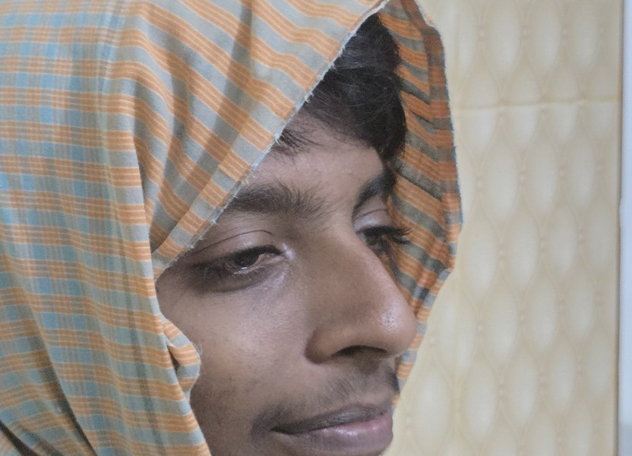
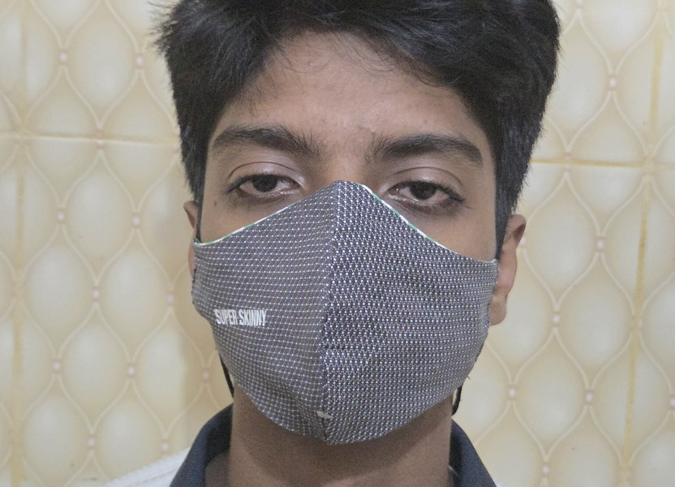
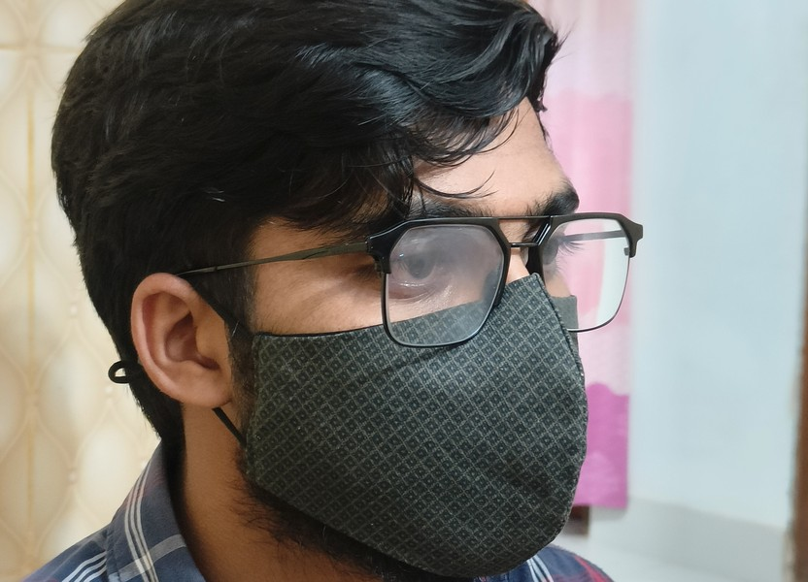

Eight Occlusion Conditions
Representative participant images reused from the previous presentation.
None
Cap
Clear glasses
Sunglasses
Scarf
Mask
Mask + clear glasses
Mask + sunglasses
20 Sep 2026
03
Notes:
Current project sources: final_technical_report.md and final.pdf. E0 frozen; E1 last residual block; E2 last block plus embedding head. Saved pooled results are authoritative. See References & Reproduction for citations. Dataset comparison is task-specific; it is not a claim of universal superiority.

Slide 5
Why This Dataset?
Pgu-Face is the base dataset paper—not a directly comparable recognition benchmark.
Property
Pgu-Face (2016)
Our dataset
Participants
224
30
Images / person
4 (896 total)
200 raw (6,000 total)
Covering variation
Facial hair + sunglasses
8 types, including compound masks
Capture conditions
Up to 2 sessions, ≥6 days apart
Regular + low light; one sitting
Evaluation artifacts
Partially covered-face collection
112 × 112 crops, labels, six-fold split
More within-person variation and coverings; fewer identities and no across-session evaluation.
20 Sep 2026
04
Notes:
Current project sources: final_technical_report.md and final.pdf. E0 frozen; E1 last residual block; E2 last block plus embedding head. Saved pooled results are authoritative. See References & Reproduction for citations. Dataset comparison is task-specific; it is not a claim of universal superiority.

Slide 6
Different—and Better for This Question
Broader occlusion stress testing, rather than a claim of universally better data.
What the new data enables
What Pgu-Face still offers
~6.7× as many raw images overall.
50× as many captures per identity.
Mask + glasses combinations probe severe, compound occlusion.
Two light levels and condition labels support targeted error analysis.
224 identities versus our 30: greater identity diversity.
Separated capture sessions probe time-related change.
Different data and protocols mean published accuracies cannot be ranked directly.
The advantage is alignment with our occlusion-transfer study—not broader population coverage.
20 Sep 2026
05
Notes:
Current project sources: final_technical_report.md and final.pdf. E0 frozen; E1 last residual block; E2 last block plus embedding head. Saved pooled results are authoritative. See References & Reproduction for citations. Dataset comparison is task-specific; it is not a claim of universal superiority.

Slide 7
Curation, Quality & Provenance
Retain the documented dataset; disclose limitations rather than inventing cleanup counts.
Processing checks
Coverage & consent
12 raw images failed detection.
5,988 crops: 3,050 regular / 2,938 low light.
429 duplicate MD5 occurrences retained, all within the same identity.
Person-disjoint folds keep a person’s copies together.
Scarf coverage: 24 of 30 people; some other condition gaps.
A small, unflagged digitally added covering subset was reported previously.
Academic, non-commercial, withdrawable consent; faces are still identifiable.
No claim of perfectly balanced coverage, fully natural coverings, or an unrestricted public license.
20 Sep 2026
06
Notes:
Current project sources: final_technical_report.md and final.pdf. E0 frozen; E1 last residual block; E2 last block plus embedding head. Saved pooled results are authoritative. See References & Reproduction for citations. Dataset comparison is task-specific; it is not a claim of universal superiority.

Slide 8
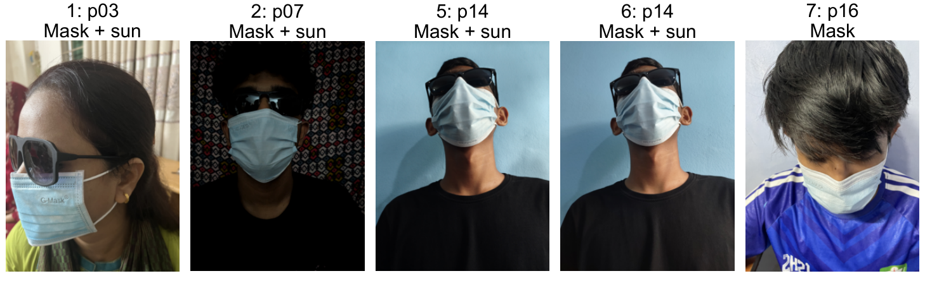
Detection Failures: Actual Examples
Five documented rejected raw images: examples 1, 2, 5, 6 and 7 from the report.
RetinaFace detects 5,988 of 6,000 raw images. These failures never enter the recognition evaluation.
20 Sep 2026
07
Notes:
Current project sources: final_technical_report.md and final.pdf. E0 frozen; E1 last residual block; E2 last block plus embedding head. Saved pooled results are authoritative. See References & Reproduction for citations. Dataset comparison is task-specific; it is not a claim of universal superiority.

Slide 9
Preprocessing Pipeline
Frozen RetinaFace detection and landmark alignment produce the recognizer’s inputs.
Raw photo
RetinaFace
Alignment
Manifest
Read orientation
RGB image
Face box + score
5 landmarks
Similarity transform
112 × 112 RGB
Identity, covering, light
Crop + quality fields
Recognition normalization
(pixel − 127.5) / 127.5; channel-first tensor N × 3 × 112 × 112.
20 Sep 2026
08
Notes:
Current project sources: final_technical_report.md and final.pdf. E0 frozen; E1 last residual block; E2 last block plus embedding head. Saved pooled results are authoritative. See References & Reproduction for citations. Dataset comparison is task-specific; it is not a claim of universal superiority.

Slide 10
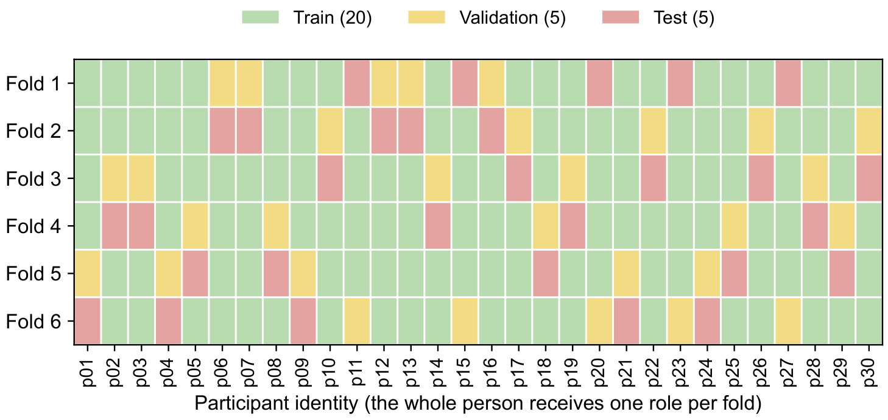
Person-Disjoint Six-Fold Evaluation
Seed 42 · 20 train identities, 5 validation identities, 5 held-out test identities per fold.
Every identity is tested once. Validation uses the next five-person block cyclically.
20 Sep 2026
09
Notes:
Current project sources: final_technical_report.md and final.pdf. E0 frozen; E1 last residual block; E2 last block plus embedding head. Saved pooled results are authoritative. See References & Reproduction for citations. Dataset comparison is task-specific; it is not a claim of universal superiority.

Slide 11
One Fixed Gallery, Fair Comparisons
Enrollment is not fine-tuning: held-out test identities have a gallery reference only.
Build once with E0
Prevent shortcut evaluation
Choose the highest-detection-score “none” crop per identity.
Compute and L2-normalize its pretrained 512-D embedding.
Lock these 30 reference vectors across E0, E1, and E2.
Exclude gallery photos and near-burst queries (170 images total).
Fine-tuning uses only the 20 training identities’ fixed vectors.
Validation and testing match against all 30 gallery identities.
5,818 pooled test queries. No held-out person contributes fine-tuning gradients.
20 Sep 2026
10
Notes:
Current project sources: final_technical_report.md and final.pdf. E0 frozen; E1 last residual block; E2 last block plus embedding head. Saved pooled results are authoritative. See References & Reproduction for citations. Dataset comparison is task-specific; it is not a claim of universal superiority.

Slide 12
Two Models, Two Distinct Roles
Detector stays frozen. Only selected ArcFace recognition layers are adapted.
1 · RetinaFace
2 · ArcFace / iResNet-50
Raw RGB → box, score, 5 landmarks
4,225,835 parameters
Detection and alignment only
Aligned RGB → 512-D embedding
43,590,976 parameters
Fixed-gallery cosine identification
The following diagrams reflect the exported model graphs used in the report.
20 Sep 2026
11
Notes:
Current project sources: final_technical_report.md and final.pdf. E0 frozen; E1 last residual block; E2 last block plus embedding head. Saved pooled results are authoritative. See References & Reproduction for citations. Dataset comparison is task-specific; it is not a claim of universal superiority.

Slide 13
RetinaFace: Actual Architecture
Frozen det_10g.onnx · typical detector input 1 × 3 × 640 × 640 RGB.
OUTPUTS
P3 · stride 8
Face scores
Bounding boxes
Five facial landmarks
80 × 80
Input RGB
Backbone
3-level FPN
P4 · stride 16
Face scores
Bounding boxes
Five facial landmarks
640 × 640
Dynamic H, W
Convolutional
features
Multi-scale
fusion
40 × 40
P5 · stride 32
Face scores
Bounding boxes
Five facial landmarks
Nine output tensors per image:
scores, boxes and landmarks at each level.
20 × 20
Outputs → box decoding / filtering → 5-landmark alignment → 112 × 112 RGB crop.
20 Sep 2026
12
Notes:
Current project sources: final_technical_report.md and final.pdf. E0 frozen; E1 last residual block; E2 last block plus embedding head. Saved pooled results are authoritative. See References & Reproduction for citations. Dataset comparison is task-specific; it is not a claim of universal superiority.

Slide 14
ArcFace: Actual iResNet-50 Architecture
w600k_r50.onnx · 24 residual blocks; block internals intentionally omitted.
Input RGB
Stem
Stage 1
Stage 2
N × 3 × 112 × 112
Convolution + PReLU
3 residual blocks
4 residual blocks
Stage 3
Stage 4
Embedding head
Output embedding
14 residual blocks
3 residual blocks
Last block: layer4.2
BN → flatten
FC → final BN
N × 512
External L2 normalization
E1: final block of stage 4 (layer4.2). E2: that block + embedding head. Earlier layers stay frozen.
20 Sep 2026
13
Notes:
Current project sources: final_technical_report.md and final.pdf. E0 frozen; E1 last residual block; E2 last block plus embedding head. Saved pooled results are authoritative. See References & Reproduction for citations. Dataset comparison is task-specific; it is not a claim of universal superiority.

Slide 15
E0 / E1 / E2: What Changes?
The reference vectors and evaluation rule are identical; the trainable scope changes.
Experiment
Trainable layers
Trainable parameters
E0 · pretrained
None
0
E1 · block only
Final stage-4 residual block (layer4.2)
4,720,640
E2 · block + head
Same block + BN / FC / final BN
17,568,256
Important distinction
The 20-vector training classifier is a fixed buffer—not a learned classification head.
20 Sep 2026
14
Notes:
Current project sources: final_technical_report.md and final.pdf. E0 frozen; E1 last residual block; E2 last block plus embedding head. Saved pooled results are authoritative. See References & Reproduction for citations. Dataset comparison is task-specific; it is not a claim of universal superiority.

Slide 16
Training Pipeline
20 training identities per fold; gradients affect only the selected E1 or E2 layers.
Aligned crops
ArcFace
Cosine logits
Loss + update
Training identities
Augment + normalize
Selected layers trainable
512-D L2 embeddings
20 locked E0 references
Angular margin + scale
Smoothed cross-entropy
AdamW on selected layers
Validation
Baseline is eligible
All 30 gallery vectors; select by validation accuracy, then confidence gap.
Epoch 0 is a candidate. E2 keeps E0 on folds 3, 4 and 5.
20 Sep 2026
15
Notes:
Current project sources: final_technical_report.md and final.pdf. E0 frozen; E1 last residual block; E2 last block plus embedding head. Saved pooled results are authoritative. See References & Reproduction for citations. Dataset comparison is task-specific; it is not a claim of universal superiority.

Slide 17
Training Recipe
Same optimization schedule and data protocol for both fine-tuned configurations.
Setting
Configuration
Optimizer
AdamW · learning rate 3 × 10⁻⁵ · weight decay 10⁻⁴
Schedule
Cosine decay (Tmax = 20); maximum 20 epochs; patience 5
Batch / seed
Train 32 · evaluation 64 · random seed 42
Classification loss
Scale 32; label smoothing 0.1; fixed benchmark classifier
Angular margin
0 for epochs 1–2; ramp to 0.20 over epochs 3–6
Batch normalization
Running statistics stay frozen; selected affine terms may train
Augmentations: flip, down-up blur, Gaussian blur, noise, JPEG compression, brightness / contrast.
20 Sep 2026
16
Notes:
Current project sources: final_technical_report.md and final.pdf. E0 frozen; E1 last residual block; E2 last block plus embedding head. Saved pooled results are authoritative. See References & Reproduction for citations. Dataset comparison is task-specific; it is not a claim of universal superiority.

Slide 18
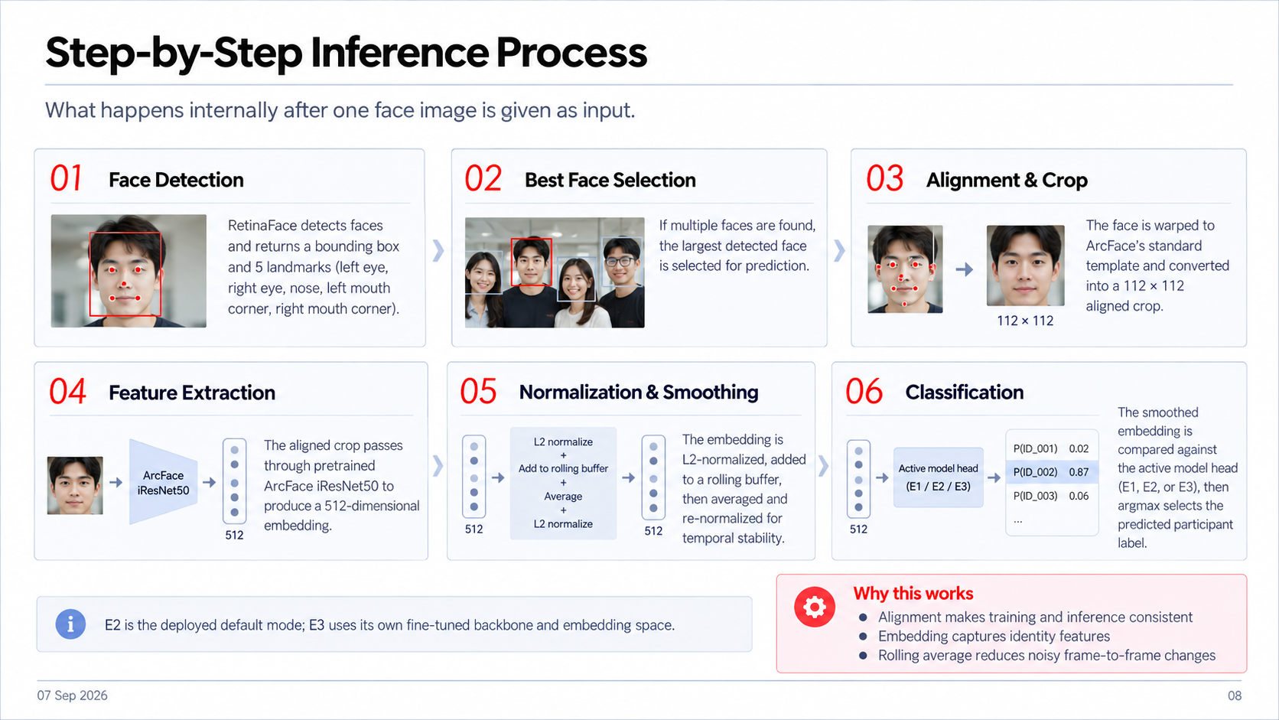
Inference & Decision Rule
Identical identification pipeline and acceptance threshold for all three configurations.
01
Face Detection
02
Alignment & Crop
03
Feature Extraction
RetinaFace returns a face box and five landmarks.
Five landmarks align the face to a 112 × 112 RGB crop.
E0 or fold-specific E1 / E2 ArcFace produces 512 features.
›
›
ArcFace
→ 512-D
112 × 112
04
L2 Normalization
05
Gallery Matching
06
Decision Rule
Normalize the embedding to unit length. No rolling buffer.
Compare with all 30 locked pretrained gallery vectors.
IDENTITY
Choose the top identity if cosine ≥ 0.30; else UNKNOWN.
z / ‖z‖₂
›
512-D
×
30 vectors
›
UNKNOWN
Correct = right identity AND cosine ≥ 0.30. All queries are enrolled people; UNKNOWN means rejection.
20 Sep 2026
17
Notes:
Current project sources: final_technical_report.md and final.pdf. E0 frozen; E1 last residual block; E2 last block plus embedding head. Saved pooled results are authoritative. See References & Reproduction for citations. Dataset comparison is task-specific; it is not a claim of universal superiority.

Slide 19
Main Results: Pooled Held-Out Queries
5,818 queries across all six test folds; the report’s saved aggregate results.
Model
Accuracy
Macro precision
Macro recall
Macro F1
E0
84.98%
100.00%
85.12%
91.67%
E1
86.18%
99.72%
86.33%
92.15%
E2
84.72%
96.43%
84.87%
89.85%
Best configuration: E1
+1.20 percentage points over E0, with 4.72M trainable parameters. E2 is 0.26 points below E0.
20 Sep 2026
18
Notes:
Current project sources: final_technical_report.md and final.pdf. E0 frozen; E1 last residual block; E2 last block plus embedding head. Saved pooled results are authoritative. See References & Reproduction for citations. Dataset comparison is task-specific; it is not a claim of universal superiority.

Slide 20
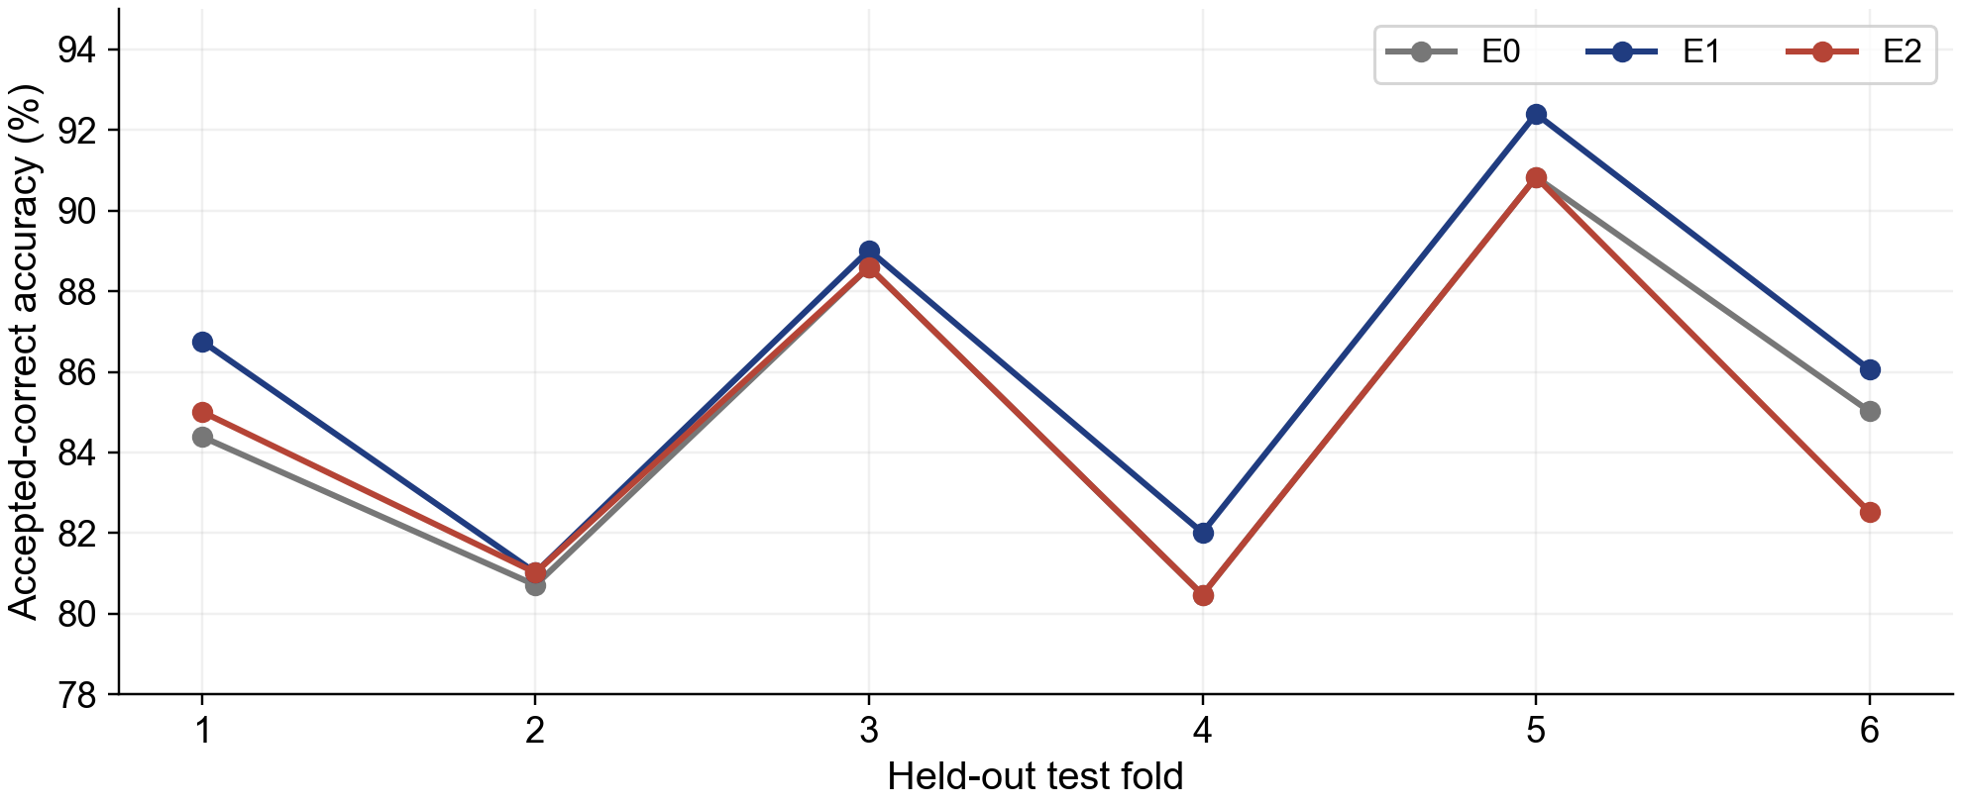
Consistency Across Six Test Folds
E1 improves over E0 on every fold; E2 improves on only two test folds.
20 Sep 2026
19
Notes:
Current project sources: final_technical_report.md and final.pdf. E0 frozen; E1 last residual block; E2 last block plus embedding head. Saved pooled results are authoritative. See References & Reproduction for citations. Dataset comparison is task-specific; it is not a claim of universal superiority.

Slide 21
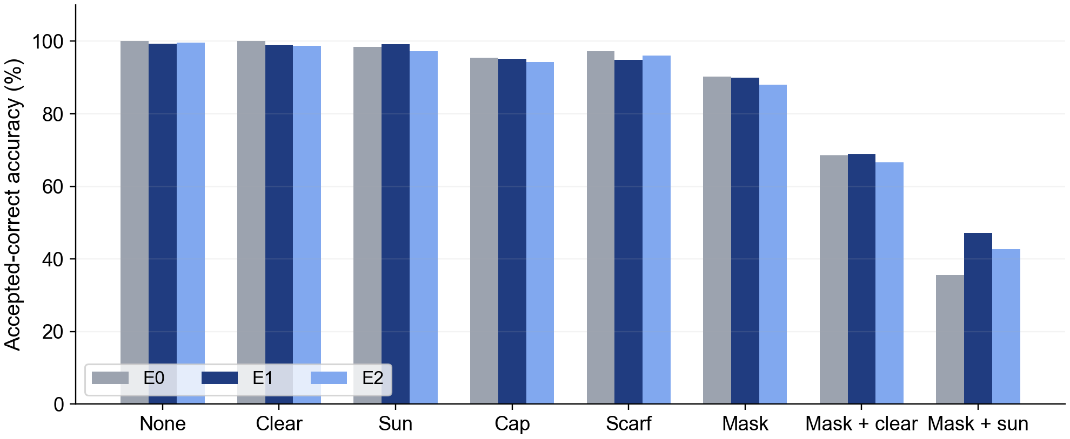
Where E1 Helps Most
The largest benefit is severe compound occlusion—not uniform improvement in every condition.
Mask + sunglasses: 35.6% → 47.2% (+11.6 points). Scarf, mask, and clean-face results do not all improve.
20 Sep 2026
20
Notes:
Current project sources: final_technical_report.md and final.pdf. E0 frozen; E1 last residual block; E2 last block plus embedding head. Saved pooled results are authoritative. See References & Reproduction for citations. Dataset comparison is task-specific; it is not a claim of universal superiority.

Slide 22
Accuracy Alone Hides the Trade-Off
Lower rejection can come with more accepted wrong identities.
Outcome (count)
E0
E1
E2
Accepted, correct
4,944
5,014
4,929
Rejected, correct argmax
727
493
421
Rejected, wrong argmax
147
298
275
Accepted, wrong
0
13
193
Interpretation
E2 accepts 193 wrong identities (3.32%), versus 13 (0.22%) for E1.
20 Sep 2026
21
Notes:
Current project sources: final_technical_report.md and final.pdf. E0 frozen; E1 last residual block; E2 last block plus embedding head. Saved pooled results are authoritative. See References & Reproduction for citations. Dataset comparison is task-specific; it is not a claim of universal superiority.

Slide 23
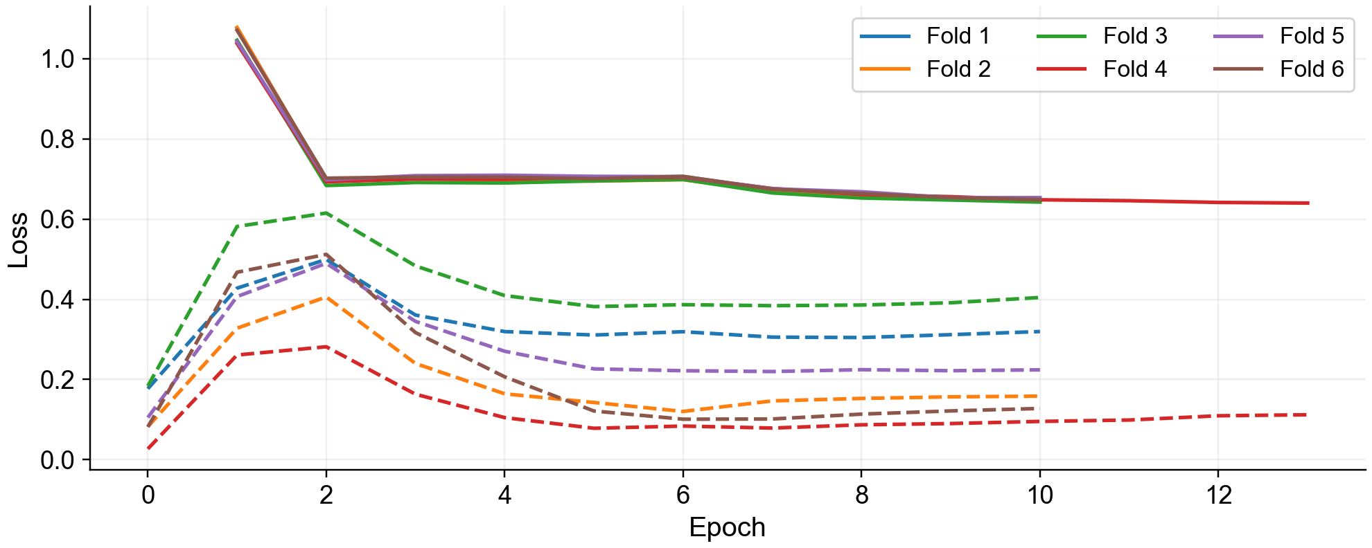
E1: Training & Validation Loss
Same axes: solid = training loss; dashed = validation loss; one colour per fold.
Loss scales differ: training uses 20-class margin + smoothing; validation uses 30-class plain logits.
20 Sep 2026
22
Notes:
Current project sources: final_technical_report.md and final.pdf. E0 frozen; E1 last residual block; E2 last block plus embedding head. Saved pooled results are authoritative. See References & Reproduction for citations. Dataset comparison is task-specific; it is not a claim of universal superiority.

Slide 24
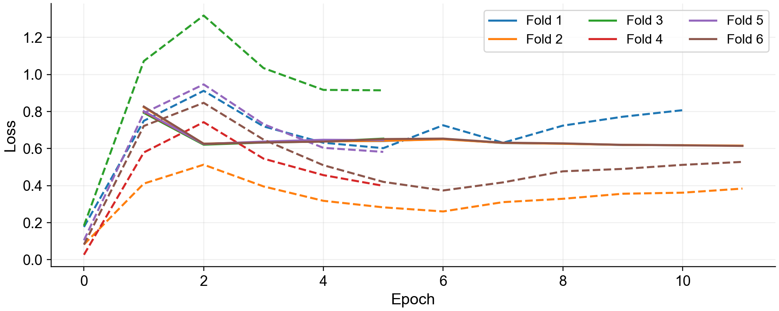
E2: Training & Validation Loss
Same axes: solid = training loss; dashed = validation loss; one colour per fold.
Loss scales differ: training uses 20-class margin + smoothing; validation uses 30-class plain logits.
20 Sep 2026
23
Notes:
Current project sources: final_technical_report.md and final.pdf. E0 frozen; E1 last residual block; E2 last block plus embedding head. Saved pooled results are authoritative. See References & Reproduction for citations. Dataset comparison is task-specific; it is not a claim of universal superiority.

Slide 25
Why More Trainable Layers Did Not Win
The block-only update is the strongest transfer configuration in this experiment.
Evidence
Interpretation—not proof
E1: 86.18%, improvements in all six folds.
E2: 84.72%, 193 accepted wrong labels.
Validation retained epoch 0 in three E2 folds.
The embedding FC matrix alone has ~12.85M weights.
With only 20 training people, the larger update may adapt too strongly to them.
A fixed pretrained gallery may amplify embedding-space drift.
These explanations need dedicated ablations; the measured conclusion is narrower.
Fine-tuning scope matters: increasing capacity does not guarantee better held-out identity transfer.
20 Sep 2026
24
Notes:
Current project sources: final_technical_report.md and final.pdf. E0 frozen; E1 last residual block; E2 last block plus embedding head. Saved pooled results are authoritative. See References & Reproduction for citations. Dataset comparison is task-specific; it is not a claim of universal superiority.

Slide 26
Related Work & Positioning
Complementary precedents; their reported accuracies use different datasets and protocols.
Work
Contribution
Relation to our project
Salari & Rostami, 2016
Pgu-Face partially covered-face dataset
Collection precedent; broaden covering types
Chong et al., 2022
CNN features + SVM for masked faces
Different recognition pipeline and benchmark
Montero et al., 2022
Multi-task ArcFace for masked faces
Our study varies layer scope, not task losses
Deng et al., 2019 / 2020
ArcFace / RetinaFace
Embedding and detection foundations
Our contribution: a documented local collection and a fixed-gallery, person-disjoint adaptation study.
20 Sep 2026
25
Notes:
Current project sources: final_technical_report.md and final.pdf. E0 frozen; E1 last residual block; E2 last block plus embedding head. Saved pooled results are authoritative. See References & Reproduction for citations. Dataset comparison is task-specific; it is not a claim of universal superiority.

Slide 27
Limitations & Responsible Use
The results describe this collection and protocol, not unrestricted real-world recognition.
Data limitations
Evaluation limitations
Only 30 people; indoor, single-sitting capture.
Scarf coverage and some conditions are incomplete.
Same-identity duplicates remain.
Previously added digital coverings are not flagged individually.
Faces remain personal data despite pseudonyms.
All test queries are enrolled identities; no unseen-stranger rejection benchmark.
Threshold 0.30 is fixed, not a deployment guarantee.
Gallery is locked to pretrained embeddings.
Consent is academic / non-commercial and withdrawable; access is not a public license.
20 Sep 2026
26
Notes:
Current project sources: final_technical_report.md and final.pdf. E0 frozen; E1 last residual block; E2 last block plus embedding head. Saved pooled results are authoritative. See References & Reproduction for citations. Dataset comparison is task-specific; it is not a claim of universal superiority.

Slide 28
Key Findings
A modest, targeted update gives the best measured transfer to held-out people.
86.18%
+1.20 pp
+11.6 pp
E1 pooled accuracy
E1 improvement over E0
Mask + sunglasses gain
The new dataset targets richer occlusion variation, not greater identity diversity.
Train the final ArcFace block; keep the gallery and early representation stable.
Next: independent sessions, more participants, and unseen-identity rejection tests.
20 Sep 2026
27
Notes:
Current project sources: final_technical_report.md and final.pdf. E0 frozen; E1 last residual block; E2 last block plus embedding head. Saved pooled results are authoritative. See References & Reproduction for citations. Dataset comparison is task-specific; it is not a claim of universal superiority.

Slide 29
References & Reproduction
Report-aligned sources and artifacts; original deck retained as the visual template.
Salari & Rostami · Pgu-Face · Data in Brief 9 (2016), 288–291
Chong et al. · Masked Face Recognition Using SVM and CNN · ICoICT 2022
Montero et al. · Boosting Masked Face Recognition with Multi-Task ArcFace · 2022
Deng et al. · ArcFace · CVPR 2019
Deng et al. · RetinaFace · CVPR 2020
Project artifacts: final_technical_report.md, final.pdf, metadata/e1e2_person_folds.json, runs/e1e2/. Results reproduced from saved aggregates and histories.
Open our dataset folder (Google Drive)
20 Sep 2026
28
Notes:
Current project sources: final_technical_report.md and final.pdf. E0 frozen; E1 last residual block; E2 last block plus embedding head. Saved pooled results are authoritative. See References & Reproduction for citations. Dataset comparison is task-specific; it is not a claim of universal superiority.

Slide 30
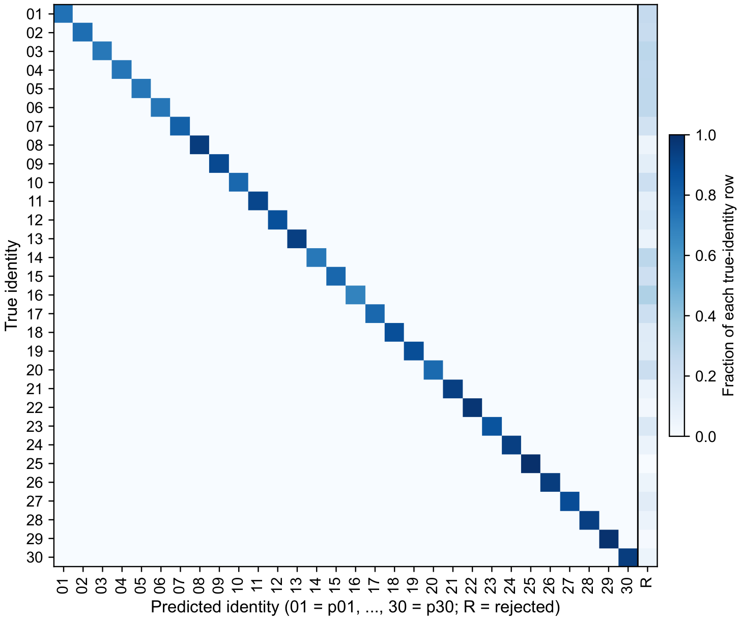
Appendix · E0 Confusion Matrix
30 identity columns + R for rejection; held-out queries pooled across six folds.
20 Sep 2026
29
Notes:
Current project sources: final_technical_report.md and final.pdf. E0 frozen; E1 last residual block; E2 last block plus embedding head. Saved pooled results are authoritative. See References & Reproduction for citations. Dataset comparison is task-specific; it is not a claim of universal superiority.

Slide 31

Appendix · E1 Confusion Matrix
30 identity columns + R for rejection; held-out queries pooled across six folds.
20 Sep 2026
30
Notes:
Current project sources: final_technical_report.md and final.pdf. E0 frozen; E1 last residual block; E2 last block plus embedding head. Saved pooled results are authoritative. See References & Reproduction for citations. Dataset comparison is task-specific; it is not a claim of universal superiority.

Slide 32

Appendix · E2 Confusion Matrix
30 identity columns + R for rejection; held-out queries pooled across six folds.
20 Sep 2026
31
Notes:
Current project sources: final_technical_report.md and final.pdf. E0 frozen; E1 last residual block; E2 last block plus embedding head. Saved pooled results are authoritative. See References & Reproduction for citations. Dataset comparison is task-specific; it is not a claim of universal superiority.

