Slide 1
Fruit Ninja using modern opengl (3.3)
Presented By:
Md. Shoriful Islam
Roll : 1807082

Slide 2
Outlines
Introduction
Keyboard Controls
Features
Conclusion
References

Slide 3
Introduction
OpenGL 3.3 is used to simulate the Fruit Ninja game.
Basic objects that are created in this project are as below –
1. Untextured Cube (Wall, Knife)
2. Textured Cube (Floor, Score, Game Over Screen)
Untextured Sphere (Life)
Textured Sphere (Fruit)
Textured Curved Object (Flower Vase)

Slide 4
Key Controls(View)
Press W: Camera Forward
Press S: Camera Backward
Press A: Camera Left
Press D: Camera Right
Press UP: Knife up
Press LEFT: Knife left
Press DOWN: Knife down
Press RIGHT: Knife right
Press C: Pitch up
Press X: Pitch down
Press Y: Yaw left
Press U: Yaw right
Press Q: Roll left
Press E: Roll right
Press K: Game Restart
Press G: Move the Knife

Slide 5
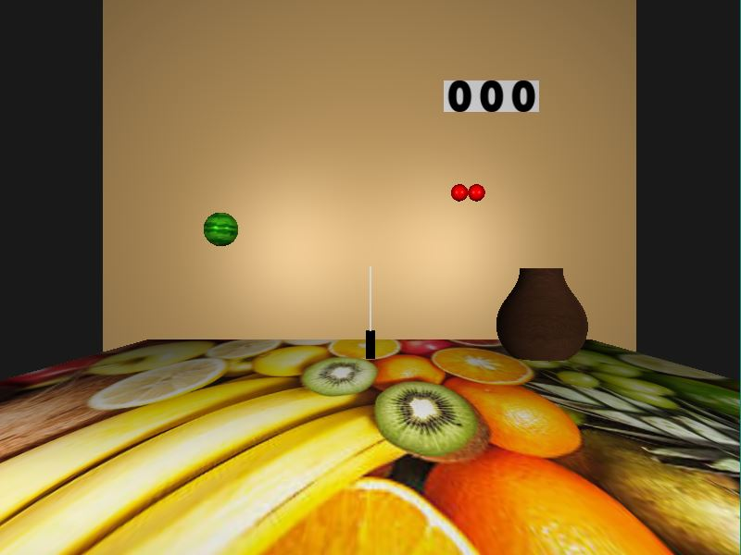
Features
Figure 1: Game Overview

Slide 6
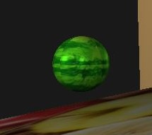
Features
Figure 2: Fruit

Slide 7
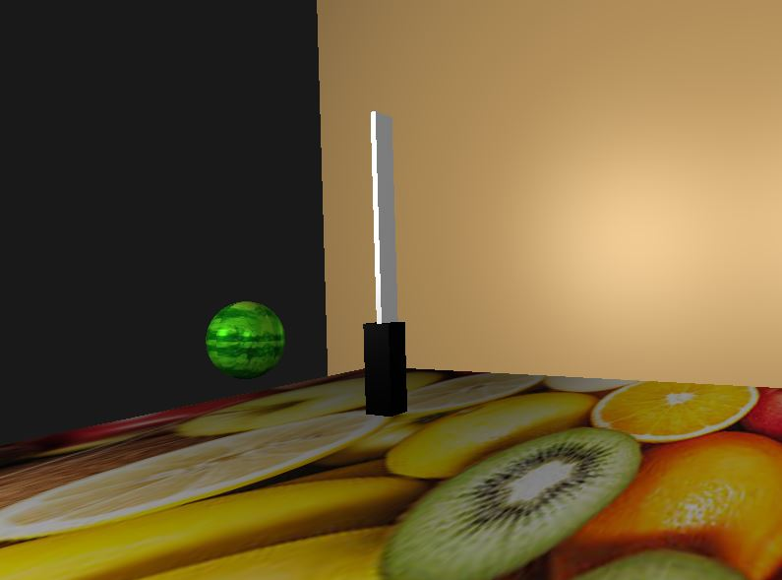
Features (Contd.)
Figure 3: Knife

Slide 8
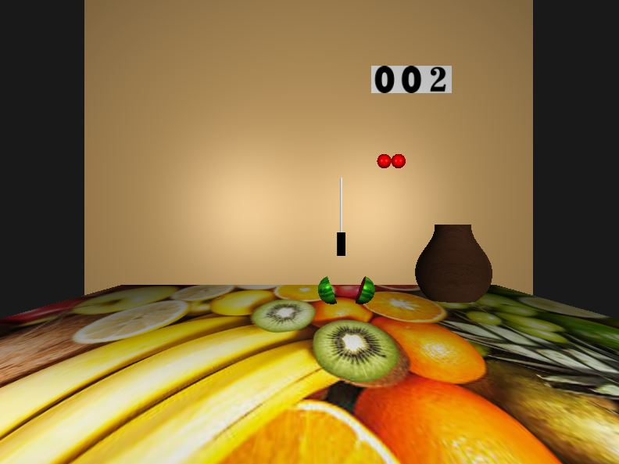
Features (Contd.)
Figure 4: Cutting Fruit

Slide 9
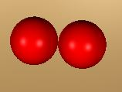
Features (Contd.)
Figure 5: Life remaining

Slide 10
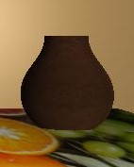
Features (Contd.)
Figure 6: Curved Vase

Slide 11
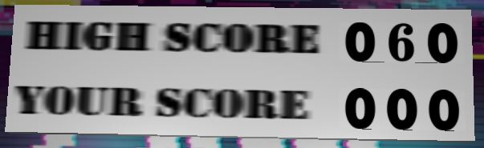
Features (Contd.)
Figure 7: Score

Slide 12
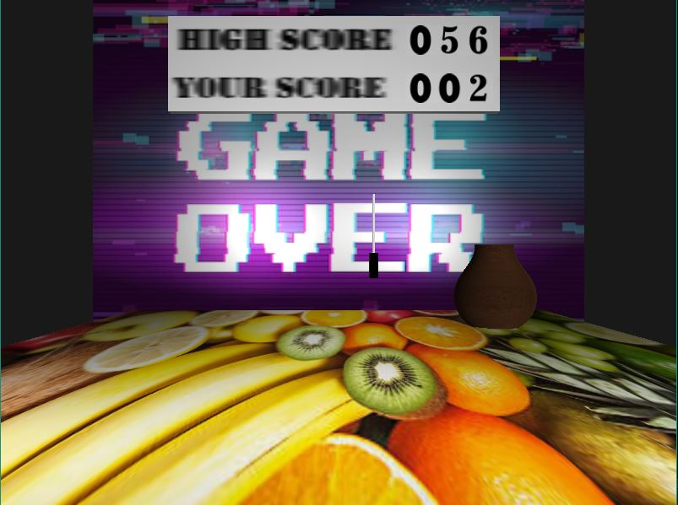
Features (Contd.)
Figure 8: Game Over

Slide 13
Conclusion
After handling all the logical features and dynamicity the project is successfully executed.
The gameplay is smooth and the user experience is satisfying.

Slide 14
References
https://learnopengl.com/
https://www.songho.ca/opengl/gl_sphere.html

Slide 15
Thank You

