Slide 1
Angular
One framework

Slide 2


About name

Slide 3
What is new Angular?
More new concepts
Yet more new words to study
Scattered granularity
Double modularity
Classes and decorators
TypeScript
Compilations
Router distribution
Shadow DOM
Observables
Lazy loading

Slide 4
Angular infrastructure
Angular
ZoneJS
RxJS

Slide 5
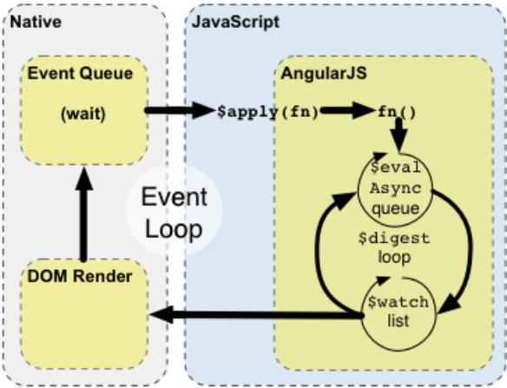
Change detection mechanisms comparison
AppComponent
CD
Child CD
Child CD*
Child CD
Child CD
Child CD

Slide 6
Building blocks
Component
Route
Guard
Directive
Service
Pipe
Form

Slide 7
Component
export class DemoCmpComponent implements ng.IComponentOptions {
template = '...';
controller = DemoCmpController;
controllerAs = '$demoCmpCtrl';
bindings = { greeting: '@' };
}
class DemoCmpController implements ng.IComponentController {
static $inject = ['$window'];
title = 'World';
constructor(public window: ng.IWindowService) {}
$onInit() { }
$onDestroy() { }
}

Slide 8
Further reading
Official documentation: https://angular.io/docs
Official Angular2+ tutorial: https://angular.io/tutorial
Angular cheat sheet: https://angular.io/guide/cheatsheet
Visual RxJS streams: http://rxmarbles.com
RxJS manual: http://reactivex.io/rxjs/manual/index.html
Getting acquainted with Angular CLI: https://github.com/angular/angular-cli
Angular in plain JavaScript: https://daveceddia.com/angular-2-in-plain-js
About change detection: https://blog.thoughtram.io/angular/2016/02/22/angular-2-change-detection-explained.html
About ZoneJS: https://github.com/angular/zone.js

