Slide 1

TypeScript
First Steps

Slide 2
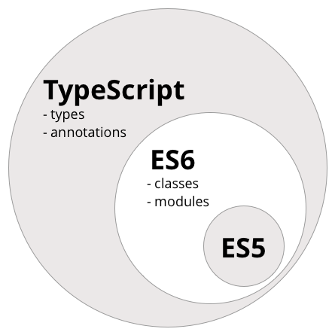
TypeScript is a superset of JavaScript
TypeScript is a free and open-source programming language. It is a strict syntactical superset of JavaScript, and adds optional static typing to the language.

Slide 3
Why TypeScript?
Increases productivity with static checking, autocompletion and refactoring
Includes the most recent JavaScript features out of the box
Includes experimental/future features of JavaScript
Ease out work with a large code base

Slide 4

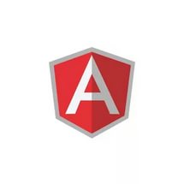




Where TypeScript is used?

Slide 5
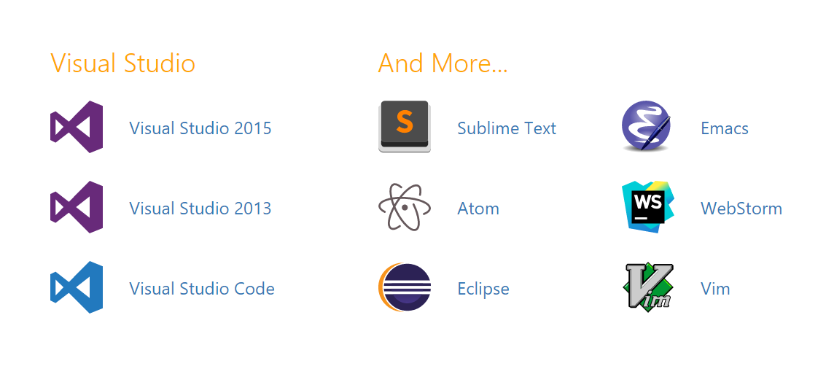
IDE support

Slide 6

TypeScript and NPM
No need at for an additional package manager
NPM includes more then 3000 packages with types
You can set your main.d.ts file in your package.json
Search your library: http://microsoft.github.io/TypeSearch
Install with npm:
npm install --save @types/lodash

Slide 7
Basic Types
boolean
number
string
array
tuple
enum
any
void
null
undefined
never
generic
function
class
interface
type

Slide 8




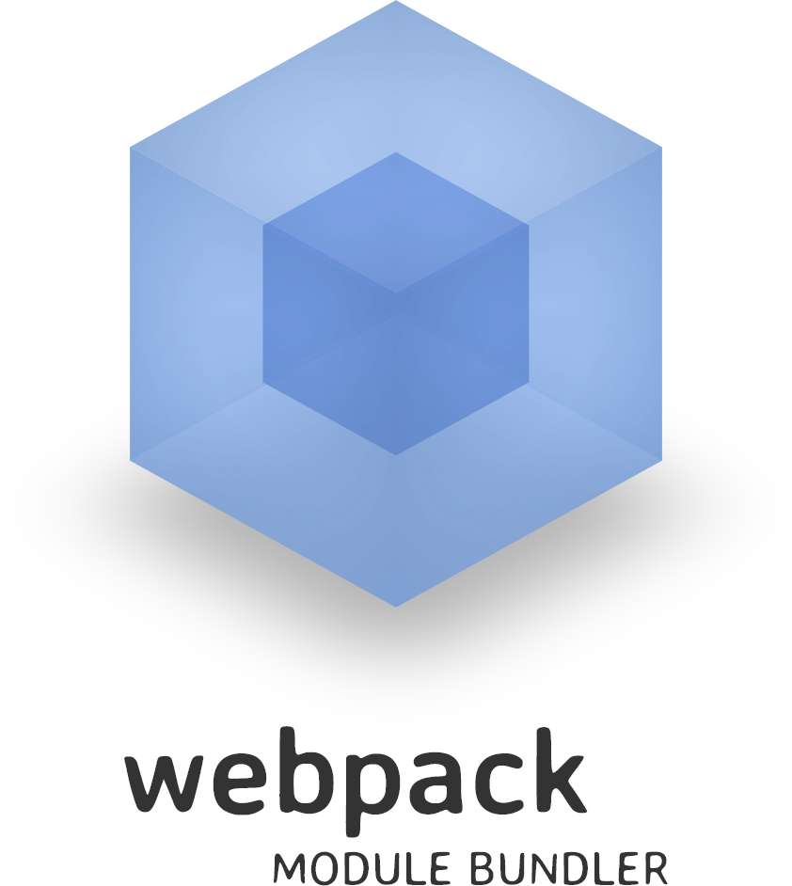

Integration with build tools

Slide 9
What next?
Read official documentation: https://www.typescriptlang.org/docs/home.html
Examples for this presentation are here: https://github.com/Mishurin/frontend-examples
About decorators: http://blog.wolksoftware.com/decorators-reflection-javascript-typescript

Slide 10

Questions?

