Slide 1
Webpack
BASIC OVERVIEW

Slide 2
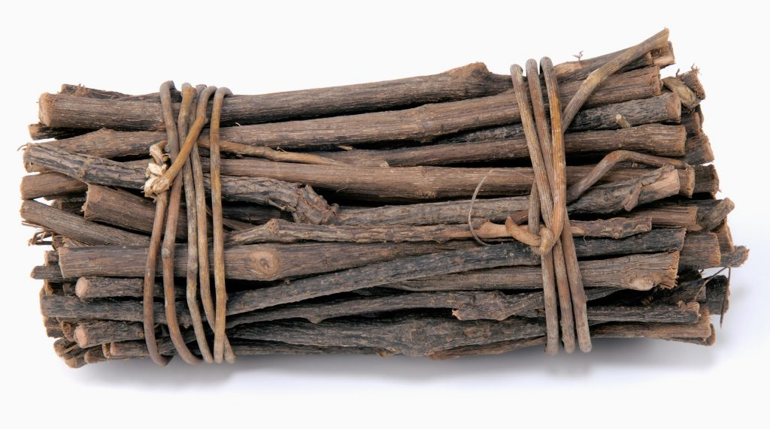
Anyways What is a bundler?

Slide 3
Dependencies
html
javascript
css
bundle

