Slide 1
Angular
One framework

Slide 2


About name

Slide 3
What is new Angular?
More new concepts
Yet more new words to study
Scattered granularity
Double modularity
Classes and decorators
TypeScript
Compilations
Router distribution
Shadow DOM
Observables
Lazy loading

Slide 4
Angular infrastructure
Angular
ZoneJS
RxJS

Slide 5
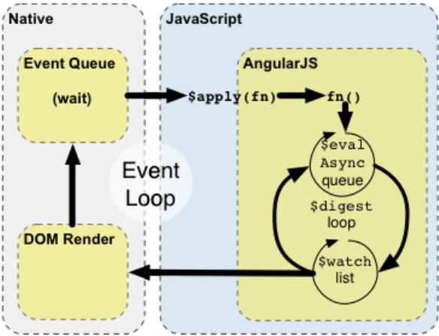
Change detection mechanisms comparison
AppComponent
CD
Child CD
Child CD*
Child CD
Child CD
Child CD

Slide 6
Building blocks
Component
Route
Guard
Directive
Service
Pipe
Form

Slide 7
Module
import * as ng from 'angular';
import { DemoCmpComponent as OldDemoCmpComponent } from './demo-cmp/old/demo-cmp.component';
ng.module('MyApp', ['demo']);
ng.module('demo', []).component('demoCmpOld', new OldDemoCmpComponent());

Slide 8
New module
import { BrowserModule } from '@angular/platform-browser';
import { NgModule } from '@angular/core';
import { HttpModule } from '@angular/http';
import { AppComponent } from './app.component';
import { DemoCmpComponent } from './demo-cmp/demo-cmp.component';
@NgModule({
declarations: [ AppComponent, DemoCmpComponent ],
imports: [ BrowserModule, HttpModule ],
// exports: [],
providers: [],
bootstrap: [AppComponent]
})
export class AppModule { }

Slide 9
Component
export class DemoCmpComponent implements ng.IComponentOptions {
template = '...';
controller = DemoCmpController;
controllerAs = '$demoCmpCtrl';
bindings = { greeting: '@' };
}
class DemoCmpController implements ng.IComponentController {
static $inject = ['$window'];
title = 'World';
constructor(public window: ng.IWindowService) {}
$onInit() { }
$onDestroy() { }
}
ng.module('demo', [])
.component('demoCmpOld', new OldDemoCmpComponent());
// HTML
<demo-cmp-old greeting="Hello"></demo-cmp-old>

Slide 10
New component
import { Component, OnInit, Input } from '@angular/core';
import { Http } from '@angular/http';
@Component({
selector: 'app-demo-cmp',
templateUrl: './demo-cmp.component.html',
styleUrls: ['./demo-cmp.component.css']
})
export class DemoCmpComponent implements OnInit {
title = 'World';
@Input() greeting;
constructor(http: Http) { }
ngOnInit() { }
ngOnDestroy() {}
}
// HTML <app-demo-cmp greeting="Hello"></app-demo-cmp>
import { DemoCmpComponent } from './.../file-name';
@NgModule({
declarations: [
AppComponent,
DemoCmpComponent
],
imports: [
BrowserModule,
HttpModule
],
providers: [],
bootstrap: [AppComponent]
})
export class AppModule { }

Slide 11
Directive
ng.module('demo', [])
.directive('demoDirOld', () => new DemoDirDirective());
// HTML
<demo-dir-old
every-second="$ctrl.everySecond"
five-5-secs="$ctrl.everyFiveSeconds"
></demo-dir-old>
export class DemoDirDirective implements ng.IDirective {
restrict = 'E';
scope = {
everySecond: '=',
five5Secs: '='
}
link = () => {};
template = `...`;
controllerAs = '$demoDirCtrl'
controller = DemoDirDirectiveCtrl;
}
class DemoDirDirectiveCtrl implements ng.IController {
static $inject = ['$window', '$scope'];
prop = 'World';
constructor(public $window: ng.IWindowService, public $scope: ng.IScope) {
}
$onInit() { }
}

Slide 12
New directive
import { Directive, EventEmitter } from '@angular/core';
@Directive({
selector: 'app-demo-dir',
outputs: ['everySecond', 'five5Secs: everyFiveSeconds']
})
export class DemoDirDirective {
everySecond = new EventEmitter();
five5Secs = new EventEmitter();
constructor() {
setInterval(() => this.everySecond.emit("second:event"), 1000);
setInterval(() => this.five5Secs.emit("fivesecond:event"), 5000);
}
}

Slide 13
New directive
import { Directive, EventEmitter } from '@angular/core';
@Directive({
selector: 'app-demo-dir',
outputs: ['everySecond', 'five5Secs: everyFiveSeconds']
})
export class DemoDirDirective {
everySecond = new EventEmitter();
five5Secs = new EventEmitter();
constructor() {
setInterval(() => this.everySecond.emit("second:event"), 1000);
setInterval(() => this.five5Secs.emit("fivesecond:event"), 5000);
}
}

Slide 14
Structural directives
<div *ngIf="hero" >{{hero.name}}</div>
<ul>
<li *ngFor="let hero of heroes">{{hero.name}}</li>
</ul>
<div [ngSwitch]="hero?.emotion">
<happy-hero *ngSwitchCase="'happy'" [hero]="hero"></happy-hero>
<sad-hero *ngSwitchCase="'sad'" [hero]="hero"></sad-hero>
<confused-hero *ngSwitchCase="'confused'" [hero]="hero"></confused-hero>
<unknown-hero *ngSwitchDefault [hero]="hero"></unknown-hero>
</div>

Slide 15
Further reading
Official documentation: https://angular.io/docs
Official Angular2+ tutorial: https://angular.io/tutorial
Angular cheat sheet: https://angular.io/guide/cheatsheet
Visual RxJS streams: http://rxmarbles.com
RxJS manual: http://reactivex.io/rxjs/manual/index.html
Getting acquainted with Angular CLI: https://github.com/angular/angular-cli
Angular in plain JavaScript: https://daveceddia.com/angular-2-in-plain-js
About change detection: https://blog.thoughtram.io/angular/2016/02/22/angular-2-change-detection-explained.html
About ZoneJS: https://github.com/angular/zone.js

Slide 16
Q&A

Slide 17

Thanks!

