Slide 1
Webpack
General OVERVIEW

Slide 2

Anyways What is a bundler?

Slide 3
HOW DOES IT WORK?
html
javascript
css
bundle

Slide 4
Module FORMATS
Asynchronous Module Definition (AMD)
CommonJS
Universal Module Definition (UMD)
System.register (ES6 modules for ES5)
ES6 module format
WebAssembly (Wasm) Module Format

Slide 5




Module LoaderS
Load required (imported) modules at run time
SystemJS

Slide 6



MODULE BUNDLERS

Slide 7
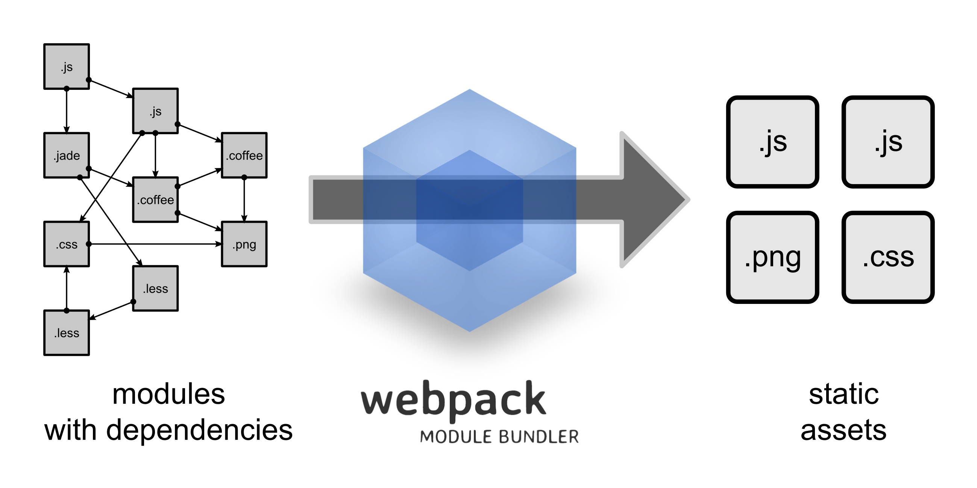
Webpack is a Module Bundler

Slide 8
KEY CONCEPTS
WebPack
Loader
Output
Plugin
Entry

Slide 9
Further Reading
Official documentation: https://webpack.js.org
For curious: https://github.com/sindresorhus/awesome
For curious in WebPack: https://github.com/webpack-contrib/awesome-webpack
Build your Angular2+ app with AngularCLI: https://cli.angular.io

Slide 10

Q&A

Slide 11

Thank YOU

