Slide 1
Redux
State management pattern

Slide 2
Why redux?
State management: centralized and unidirectional
Predictable state mutations
Light weight
Simplicity
Compatibility with many mainstream solutions

Slide 3

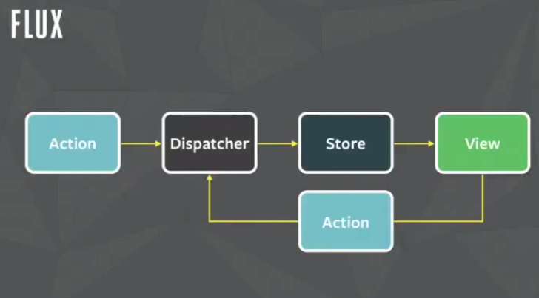
INfluENCED BY
Flux
Elm programming language

Slide 4
GlossaRy
Store
State
Action
Reducer
Dispatch
Subscribe

Slide 5
Store
import { createStore } from 'redux'
import todoApp from './reducers'
let store = createStore(todoApp)
Methods:
getState()
dispatch(action)
subscribe(listener)
replaceReducer(nextReducer)

Slide 6
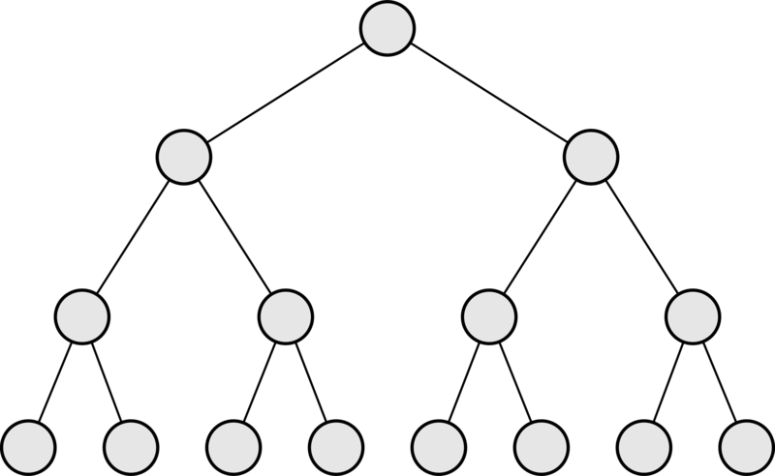
State

Slide 7
IN ACTION
const ADD_TODO = 'ADD_TODO'
function addTodo(text) {
return {
type: ADD_TODO,
text
}
}
store.dispatch(addTodo('Text'))
store.subscribe(function() {})

Slide 8
ReduCERS
export default function todoApp(state = {}, action) {
return {
visibilityFilter: visibilityFilter(state.visibilityFilter, action),
todos: todos(state.todos, action)
}
}
function visibilityFilter(state = SHOW_ALL, action) {
switch (action.type) {
case SET_VISIBILITY_FILTER:
return action.filter
default:
return state
}
}

Slide 9
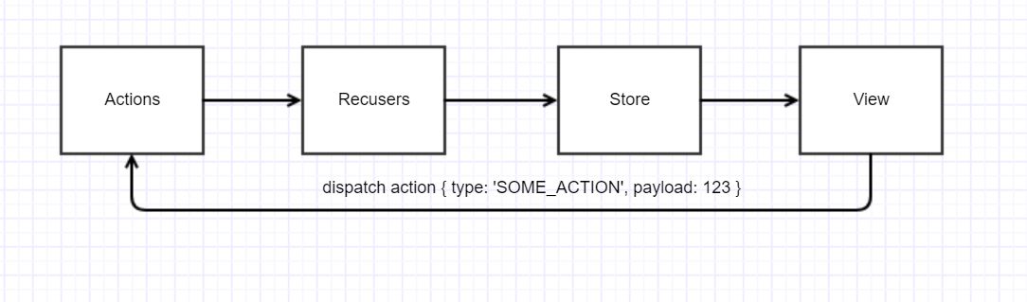
UNIDIRECTIONAL DATA FLOW

Slide 10
Key Principles
- State of a store is a single source of truth
- State is read only
- Changes should be made with pure function

Slide 11
Further Reading
Official redux website: http://redux.js.org
Redux adopter for Angular1: https://github.com/angular-redux/ng-redux
Todo app with Redux: https://medium.com/google-developer-experts/angular-2-introduction-to-redux-1cf18af27e6e
RxJS based state management: https://github.com/ngrx/store

Slide 12

THANK YOU

