Slide 1
Angular
One framework

Slide 2

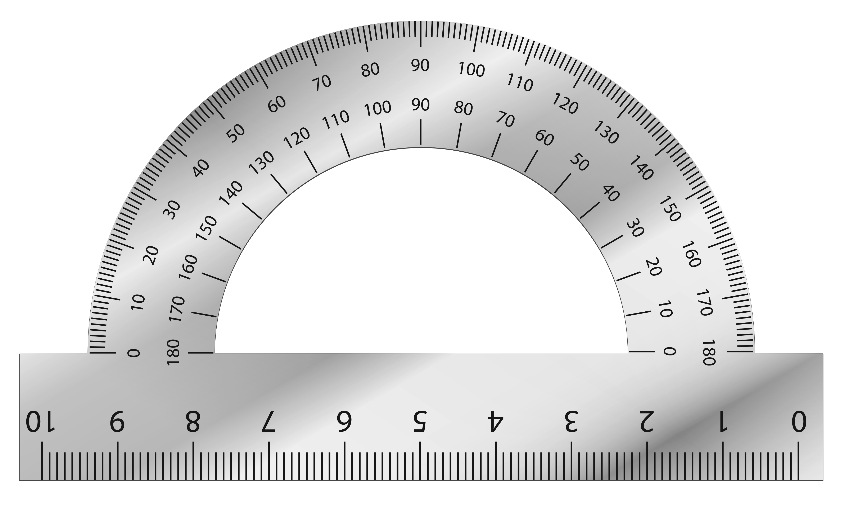
About the name

