Slide 1

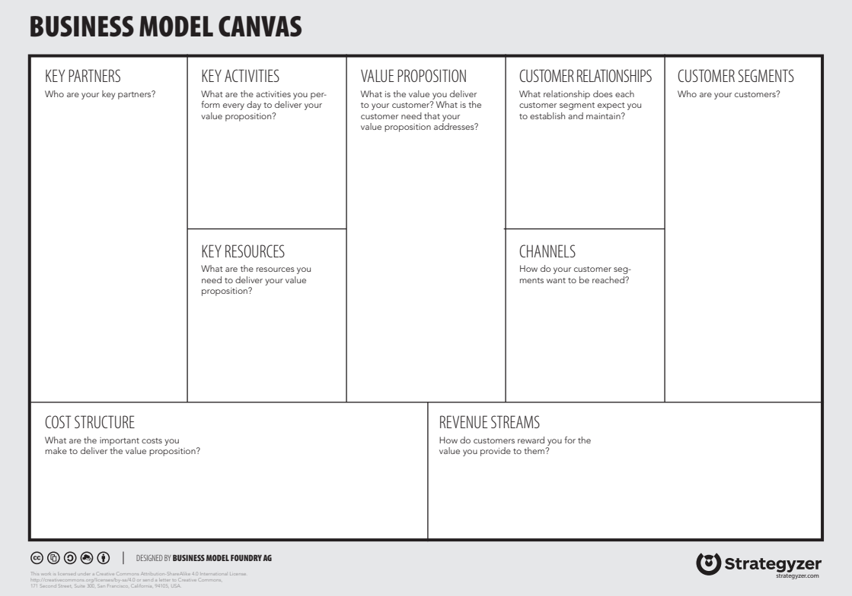
Business models
Business model: A business model describes the rationale of how an organization creates, delivers, and captures value.

Slide 2
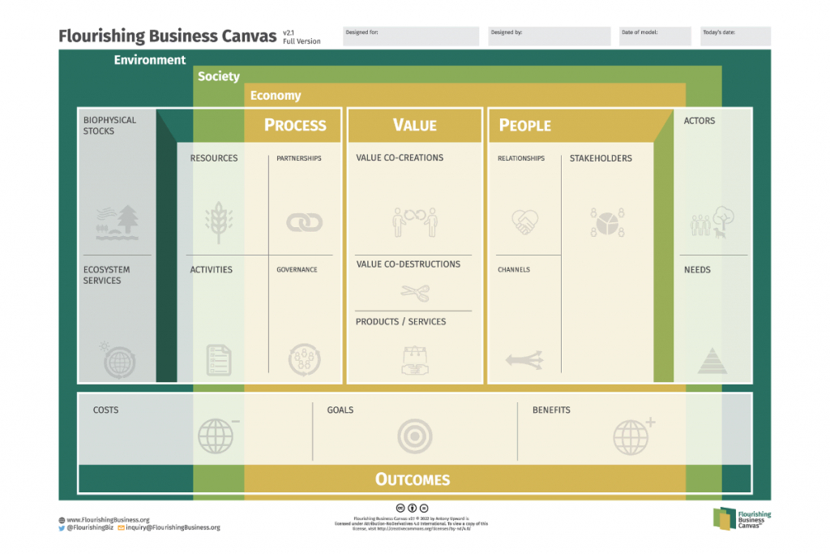
Flourishing business models canvas
Sustainable business models: A sustainable business model is a business model that creates, delivers, and captures value in a way that is sustainable for the environment, society, and the economy.

Slide 3
Interviews and surveys following BS
See here

Slide 4
Data Used in Business Model Preparation
Environmental Data - Data portal - water quality, biodiversity indicators, carbon sequestration data.
Socio-economic Data - macro data, local employment, business subject dynamics.
Community and Stakeholder Feedback - community surveys, interviews.

Slide 5
Data science principles:
Dynamic - automatic updates when new data is ingested or parameters are changed.
Interactive - allow users to explore data and insights.
Reproducible - reproducible by other teams using the same datasets and methods.
Versioning and Traceability - track all changes to data, code, and reports.
Open source - use open-source tools and libraries to ensure transparency and collaboration.

Slide 6
All oin one document
Methodology part is in the document on teams: ~/WP6/Business models literature materials/business_models_methodology.docx
fast look at link

