Slide 1
Midterm project presentation
Quantized Neural-Network Acceleration on RV64IMC
115061629 潘弘恩

Slide 2
Basic guideline
Evaluate the model and use custom ISA to speedup the model
Use tiny change to get large performance improve

Slide 3
Efficientnet-Lite0
Quantize uint→int8
Stem
1xMBConv1
2xMBConv6
2xMBConv6
Image classification model from Google MediaPipe
Fully integer with 64 ops
A MBConv block:
3xMBConv6
3xMBConv6
4xMBConv6
Input
Expand
Depthwise
Project
Add
1xMBConv6
Head 1x1 conv
Avg pool,Reshape
Fully connected
Softmax
Quantize
Source:https://huggingface.co/ketiswp/mediapipe-EfficientNet-Lite0-ImageNet-224-int8-uint8-onnx
Notes:
Lite = exclude squeeze-and-excitation swish to ReLU6
Expand:Mix channels at each pixel to create a richer feature space
ReLU6 min max 0 6
Depthwise conv: each channel filtered separately captures spatial patterns
Project: compress the feature back and add

Slide 4
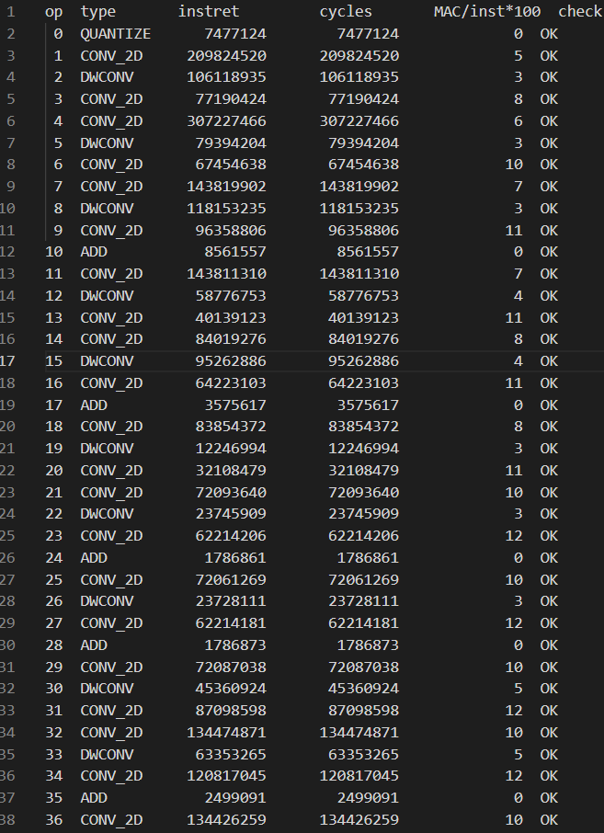
Spike evaluation
Model code (c file) → riscv64-unknown-elf-gcc→spike -g
Total instruction count:4,301,230,253
store
1.2%
csr
<0.001%
Mul/div
10.7%
branch
13.3%
ALU
50.9%
load
24%
The report using spike -g

Slide 5
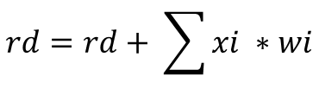

Custom ISA
X1
X2
qmac8 rd, rs1, rs2
qrequant rd, rs1, rs2
rs1:activation int8
rs2:weight int8
rd :accumulator int32 →int64
rs1:accumulator result int32
rs2:requant parameters int8
rd :requant result int8
64 bit
rs2: | act_max | act_min | out_zp | shift | mult (32 bits) |
rs1: | x7 | x6 | x5 | x4 | x3 | x2 | x1 | x0 |
rs2: | w7| w6| w5| w4 w3| w2| w1| w0 |
$$rd=clamp(round\left(rs1,M\right)+out_{zp},act_{min},act_max)$$
$$rd=rd+ \sum{xi ∗wi}$$
$$where M=\frac{mult}{2^{31}}∗2^{Shift}$$

Slide 6
Custom ISA
X1
X2
qmac8 rd, rs1, rs2
qrequant rd, rs1, rs2
Focusing on 1x1 conv
rs1:activation int8
rs2:weight int8
rd :accumulator int32 →int64
rs1:accumulator result int32
rs2:requant parameters int8
rd :requant result int8
64 bit
rs2: | act_max | act_min | out_zp | shift | mult (32 bits) |
rs1: | x7 | x6 | x5 | x4 | x3 | x2 | x1 | x0 |
rs2: | w7| w6| w5| w4 w3| w2| w1| w0 |
$$rd=clamp(round\left(rs1,M\right)+out_{zp},act_{min},act_max)$$
$$rd=rd+ \sum{xi ∗wi}$$
$$where M=\frac{mult}{2^{31}}∗2^{Shift}$$

Slide 7
Why 1x1 conv
1.Dominates the model computation
-87.9% of MACs, 75.5% of B0 instructions
2.It’s a simple general matrix multiply
-fit xqmac8 describtion in project.md
3.Data layout fits naturally
-Cin of all 32 layers is a multiples of 8
-8 activation/weight are contiguous→ no need data rearrangement
-stride = 1, no padding → straightforward

Slide 8
After introducing custom ISA
Total instruction count:B0=4,301,230,253 X1=1,622,690,253 X2=1,460,470,253

Slide 9
Performance improvement(by Instruction count)
 | B0 | X1 | X2
1x1 convolution (32 layers) | 3218M | 539M | 377M
Speedup vs B0 | 1.00x | 5.97x | 8.53x
Whole model (w/o softmax) | 4264M | 1585M | 1423M
Whole model speedup vs B0 | 1.00x | 2.69x | 3.00x
Depthwise % | 18.6% | 50.0% | 55.7%
Top-1 (golden = 208) | 208 | 208 | 208
*This table is based on kernel itself, and the data from previous pages include spike from start to end

