Slide 2
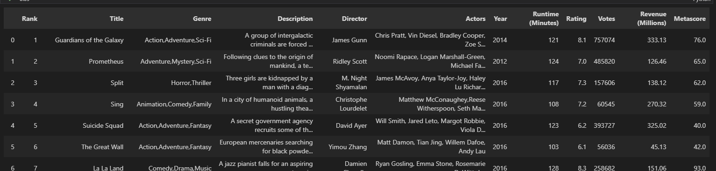
Questions explored
What factors predict the revenue of a film and how well (if at all) can we predict the revenue of a film?
Can we predict which films will be highly rated by users, regardless of if they are a commercial success?
Visualise the distribution of ranked position and number of votes, and comment on the relationship between them.

Slide 3
Cleaning The Data
No duplicates
128 missing values in “Revenue(Millions)” column
64 missing values in “Metascore” column
Rows with missing values were removed, since values in the “Revenue(Millions)” and “Metascore” columns are vital for the exploration of the given dataset
Setting a new index to be the rank column

Slide 4
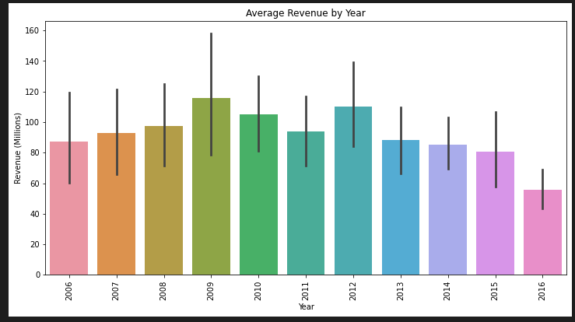
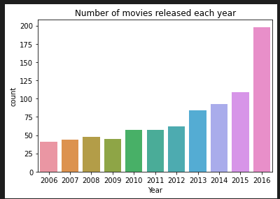
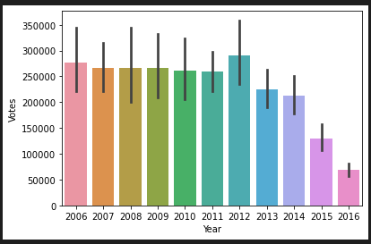
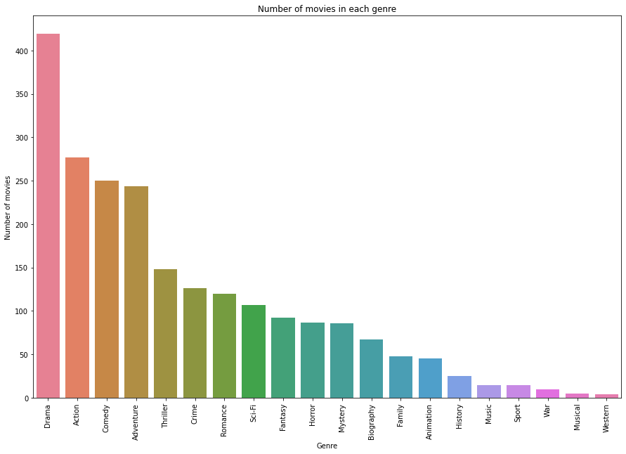
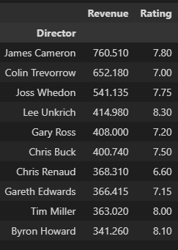

Slide 5
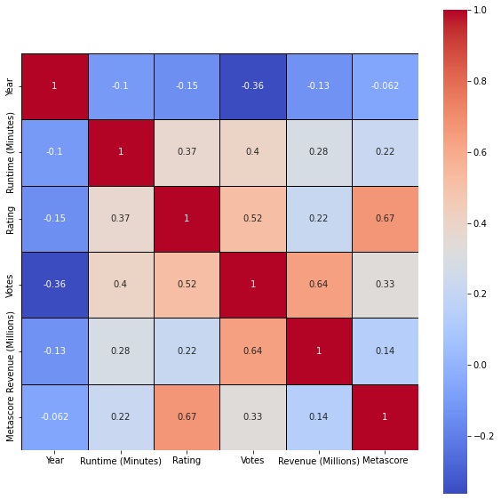

Data Exploration

Slide 6
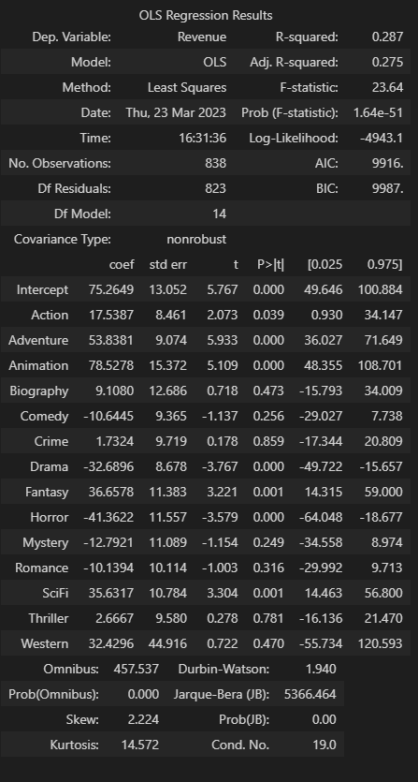
Regression

Slide 7
Flop or not to flop… that is the question.
Can we predict which films will be highly rated by users, regardless of if they are a commercial success?

Slide 8
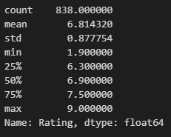

Rating_class

Slide 9
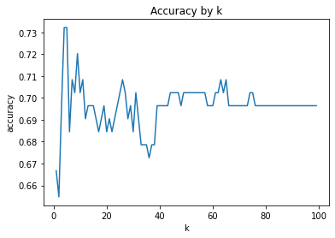
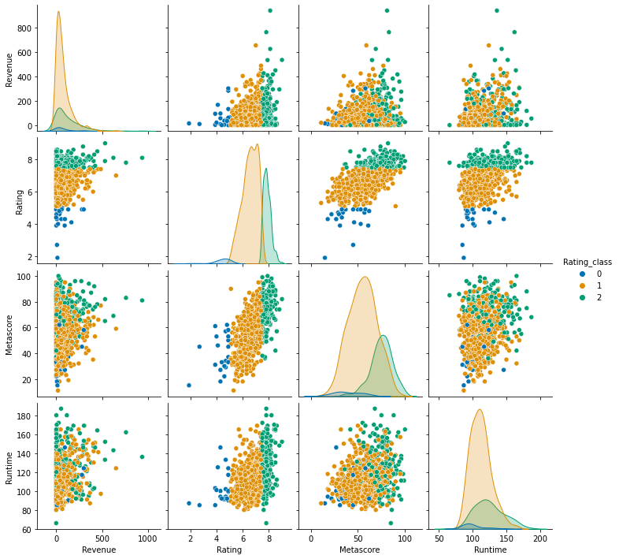
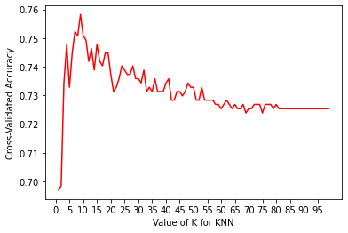
k-Nearest Neighbours The accuracy of the model is : 0.7321

Slide 10
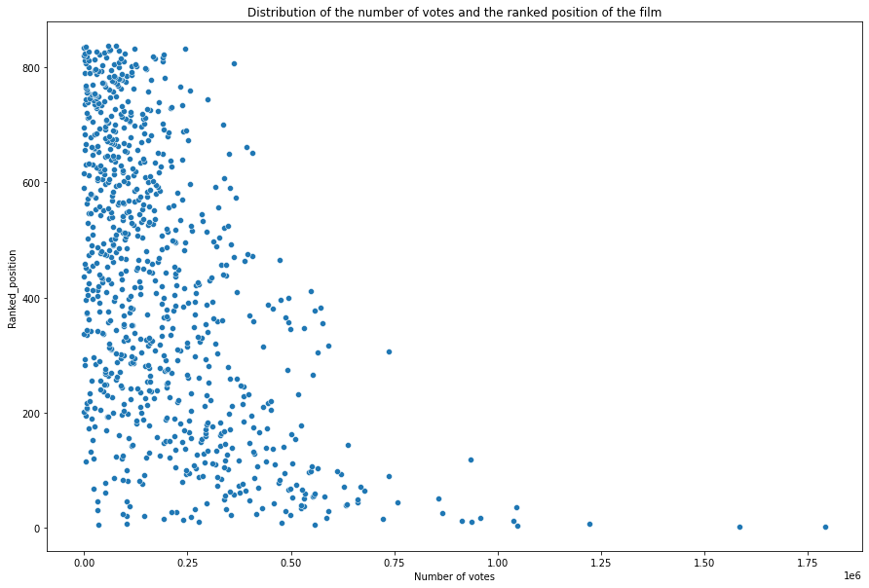
Exploring the Relationship Between Ranked Position and Number of Votes: A Visualization
The more votes a film has the higher the ranked position of the film is.
It is important to note that this relationship does not necessarily imply that a film with a high number of votes is inherently better than one with a lower number of votes

