Slide 1

BOOKING FUNNEL DROP-OFF MONITOR
FlySafair Booking Funnel
A self-healing Playwright framework that walks the live funnel end-to-end, with CI/CD to GitHub Actions & AWS
Playwright
TypeScript
GitHub Actions
AWS S3 + CloudFront
github.com/Miss-Kay/flysafair-booking-framework
Notes:
FlySafair booking-funnel monitor. Unlike the flag carriers, FlySafair permits automation, so the whole funnel runs live — search through to the customer-details page.

Slide 2



Booking funnels leak customers silently
The search widget is the front door
Search JNB → CPT, one-way, 30 days out
A broken autocomplete or calendar loses customers before a booking exists — revenue just dips, no bug report.
Results render flight-selection page loads
Evidence at every step
Select flight + fare first bookable, cheapest fare
Origin, destination, date, submit, fare, details — each checkpoint attaches a screenshot, so a failure shows what the customer saw.
Customer details passenger page displayed
Runs before customers notice
Every push and PR plus a scheduled run every 3rd day; a failure pinpoints the leaking step instead of a vague “bookings are down”.
Payment gate hard stop — never automated
coloured = automated & asserted today · grey = the deliberate stop before payment
Notes:
Four live checkpoints, each asserted, each screenshotted. The fifth — payment — is a deliberate hard stop: we prove the funnel is passable without ever entering personal data or paying.

Slide 3






Architecture — deliberately simple
Journey spec
Page objects
Self-healing locators
flysafair.co.za
booking-journey.spec.ts
one test per search in the matrix
Home / Results / Passenger
locators + actions only
selfHealing.ts
ordered fallback chains
the real site, driven live
from search to details
Site profile
Typed test data
Self-heal + skip
every airline-specific value in one object — URLs, locale, results & bot-block patterns
search matrix + evergreen dates (daysFromNow)
heals logged loudly; a bot-blocked run skips, never false-fails
Design rules: selectors live only in page objects · heals are logged, never silent · tests read like the customer journey
Notes:
Four layers, one dependency direction. Adopting another airline is a new site profile plus page objects — nothing else references the airline.

Slide 4
Self-healing locators — ordered fallbacks, no magic
data-testid / stable attr
2–3
ordered strategies per element — a UI change degrades the suite gracefully instead of breaking it
1
most stable — survives redesigns
2
role + accessible name
survives CSS refactors
Heals demand a fix
Every fallback use is logged with the failed candidates, so the primary selector gets repaired instead of rotting quietly.
3
placeholder / visible text
last resort
[SELF-HEAL] "One-way trip type": healed using fallback "role=radio oneWay" (candidate #2)
Notes:
No AI, no external service — an ordered chain per element. The heal log is the maintenance signal.

Slide 5
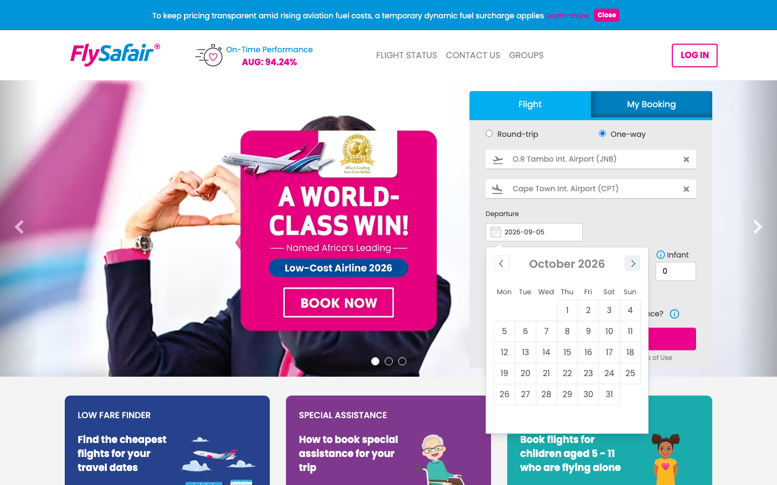
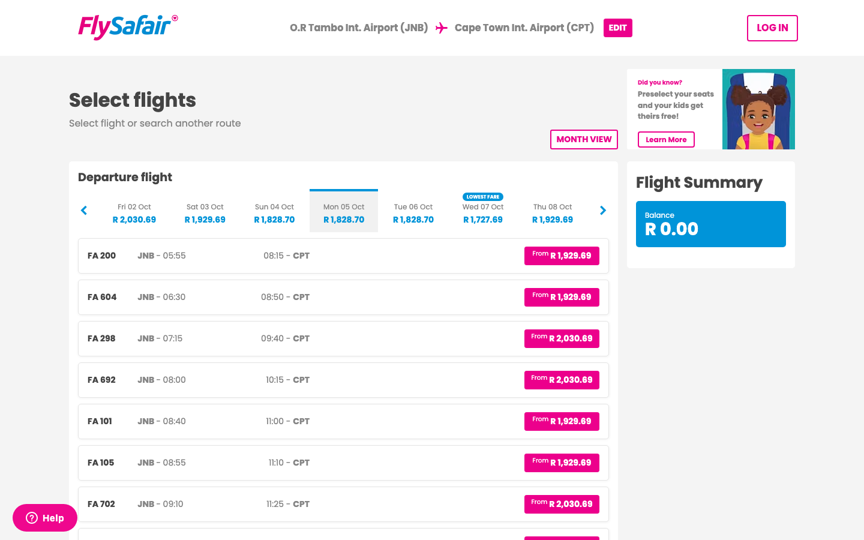
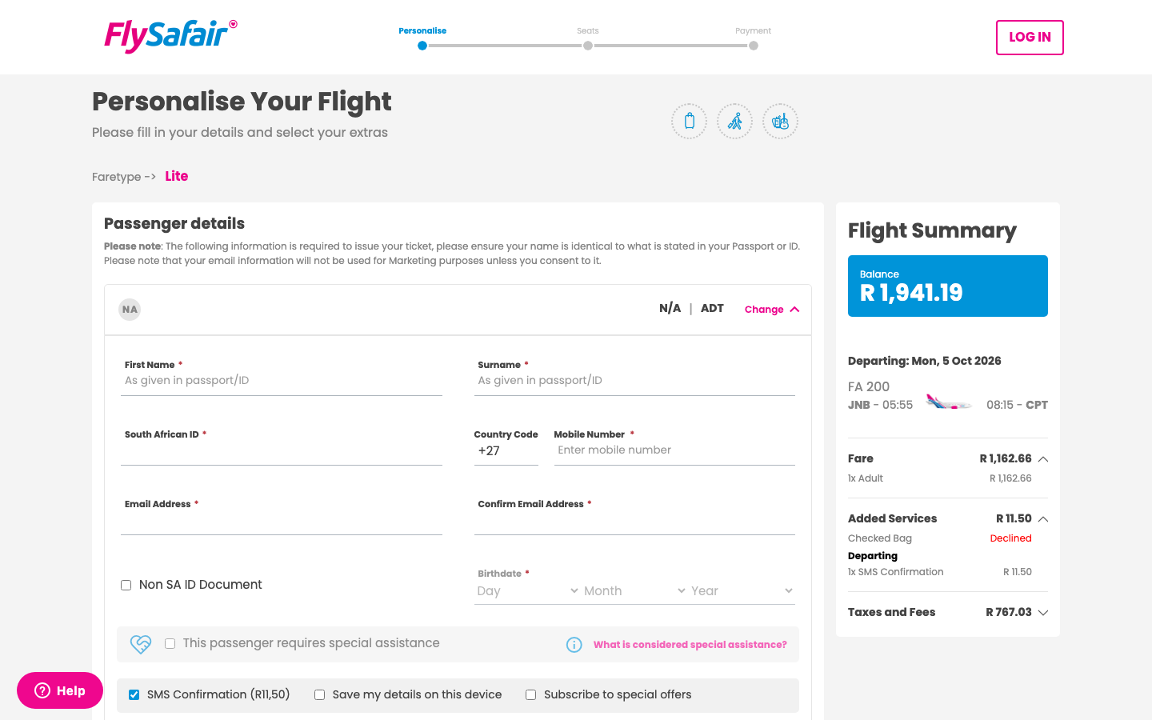
The whole funnel, driven live
FlySafair permits automation, so every step runs against the real site — no mocks, no fixtures.
1 · Search
2 · Results & fare
3 · Customer details
JNB → CPT, one-way, 30 days out
flight selected, cheapest fare
passenger page — then STOP
Sites that block automation are handled honestly: if a bot-protection page appears, the test SKIPS with a reason — it never fakes a human session or evades detection.
Notes:
Left to right: the real search widget, the live results with a fare selected, and the passenger-details page reached with no data entered. The bottom bar states the ethical boundary.

Slide 6






CI/CD — from push to published report
GitHub
Actions job
AWS S3
CloudFront
Stakeholders
push · PR · every
3rd day 06:00 SAST
typecheck
test (chromium)
HTML report
reports/<run>/ + latest/
90-day lifecycle
HTTPS, no-cache
stable latest link
click a link —
screenshots inside
No long-lived AWS keys
Failure pings
Dependabot
GitHub authenticates via OIDC; the IAM role is assumable only by this repo’s runs and can only write reports.
Optional Slack webhook fires when a run fails — a monitor nobody hears is not a monitor.
Weekly PRs keep Playwright, TypeScript and the workflow actions current — each PR gets the full test run.
Live report: https://d1536s1ld6tg9l.cloudfront.net/reports/latest/index.html
Notes:
Every run publishes an immutable per-run report and a stable latest link. Security: OIDC, repo-scoped role, least-privilege S3 writes.

Slide 7

Any airline can adopt it — two artifacts
1
2
✓
Write a site profile
Map the widgets
Everything else carries over
URLs, locale, calendar label format, results & optional bot-block patterns — one typed object in siteProfile.ts
Page objects with self-healing chains for that airline’s search, results and passenger pages
Self-healing engine, skip-on-block, CI/CD, S3 reporting and screenshots — all reused unchanged
NEXT ON THE ROADMAP
— Data-driven matrix: more routes, return trips, passenger mixes (adult / child / infant)
— API-level funnel checks (Playwright request) for a faster drop-off signal
— Lighthouse performance budget on the results page
— Fare-family assertions (Lite vs bundled) as the fare mix changes
Notes:
The FlySafair-specific surface is two small artifacts; the framework is the reusable rest. Roadmap ordered by signal value.

