Slide 1
BCB546X – Group Project Presentation
Department of Bioinformatics and Computational Biology
Amy Pollpeter
Elena Jiang
Kelby Kies
Zack Lozier

Slide 2
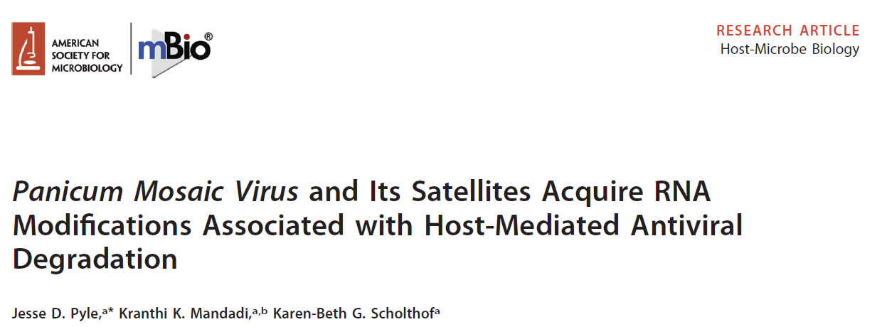
Paper Chosen
July/August 2019 Volume 10 Issue 4 e01900-19
Bioinformatics and Computational Biology

Slide 3
Why we chose this paper:
Bioinformatics and Computational Biology

Slide 4
Their Bioinformatics Pipeline
Bioinformatics and Computational Biology

Slide 5
How we attempted to replicate their pipeline:
Bioinformatics and Computational Biology

Slide 6
Our Results Compared to Their Results:
Bioinformatics and Computational Biology

Slide 7
Our Suggestion for a Different Pipeline:
Bioinformatics and Computational Biology

Slide 8
Our Results using our Suggested Pipeline:
Bioinformatics and Computational Biology

Slide 9
How our new results compare to theirs:
Bioinformatics and Computational Biology

Slide 10
Struggles we encountered:
Bioinformatics and Computational Biology

