Slide 1
BCB546X – Group Project Presentation
Department of Bioinformatics and Computational Biology
Amy Pollpeter
Elena Jiang
Kelby Kies
Zack Lozier

Slide 2
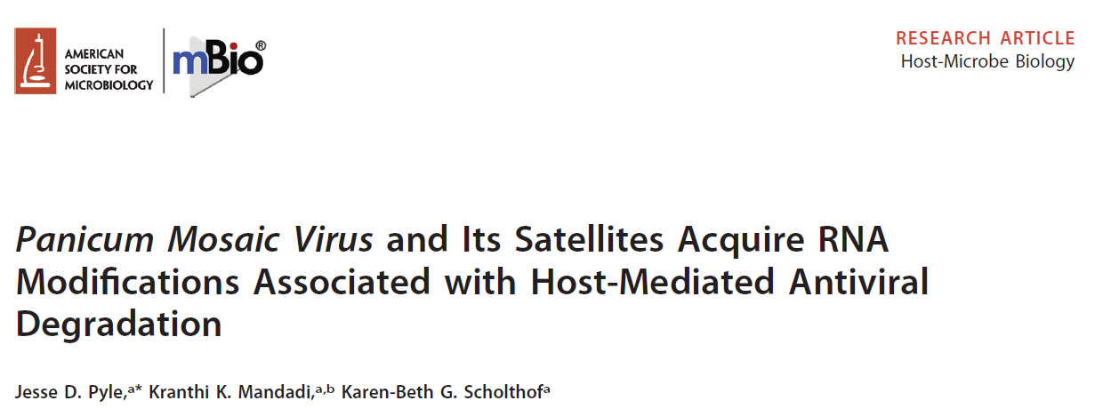
Paper Chosen
July/August 2019 Volume 10 Issue 4 e01900-19
Bioinformatics and Computational Biology

Slide 3
Why we chose this paper:
Their pipeline did not appear to follow a typical NGS pipeline.
In addition, the documentation on their pipeline appeared scant.
Didn’t use a typical read mapping software – which leads to questions in the quality of the mapping.
What they are claiming is somewhat biologically ridiculous.
Bioinformatics and Computational Biology

Slide 4
Their Bioinformatics Pipeline
Sequenced Samples
Counted Reads
BLAST
Seq Data = Database
Ref Genome = Query
Assembled into contigs with CodonCode Aligner
Use Contigs as Query for megablast
Bioinformatics and Computational Biology

Slide 5
How we attempted to replicate their pipeline:
Download Data using their Accession numbers.
Count Reads
Download Reference Genomes
Blast Reads
Tabulate Results and Compare to Table S1
Assembled into contigs with CodonCode Aligner
Use Contigs as Query in Megablast
Bioinformatics and Computational Biology

Slide 6
Our Results Compared to Their Results:
Bioinformatics and Computational Biology

Slide 7
Our Suggestion for a Different Pipeline:
Bioinformatics and Computational Biology

Slide 8
Our Results using our Suggested Pipeline:
Bioinformatics and Computational Biology

Slide 9
How our new results compare to theirs:
Bioinformatics and Computational Biology

Slide 10
Struggles we encountered: Lack of Documentation
BLAST
BLAST does not run on FASTQ files but they make no mention of converting to FASTA or how they converted.
BLAST has a maximum # of reads it reports – they did not specify if they changed this parameter.
How Reads Were Counted – We don’t know if they are counting unique reads only or all reads.
They do not state how they extracted the reads that matched back to the reference sequence.
Bioinformatics and Computational Biology

Slide 11
Struggles we encountered: Lack of Documentation (continued)
Alignment Step
CodonCode Aligner can handle FASTA or FASTQ files: we don’t know which they used.
Bioinformatics and Computational Biology

Slide 12
Struggles we encountered: Inconsistencies
Inconsistencies between Table and their report.
In discussion they state “More than 20,000”, we obtained ~21,000; yet their table states exactly 20000.
Bioinformatics and Computational Biology

