Slide 1
Stochastic Calculus

Slide 2
Geometric Brownian Motion
What is GBM?
A geometric Brownian motion (GBM) is a continuous-time stochastic process in which the logarithm of the randomly varying quantity follows a Brownian motion (also called a Wiener process) with drift.
Parameters Used -
drift coefficient → mu = 0.1
number of steps → n = 100
time in years → T = 1
number of sims → M = 100
initial stock price → S0 = 100
Volatility → sigma = 0.3

Slide 3
Simulation of Stochastic Differential Equation using Numpy Array –
St = np.exp((mu - sigma ** 2 / 2) * dt + sigma * np.random.normal(0,np.sqrt(dt), size=(M,n)).T)
Calculating the predicted value as per initial stock price –
St = S0 * St.cumprod(axis=0)

Slide 4
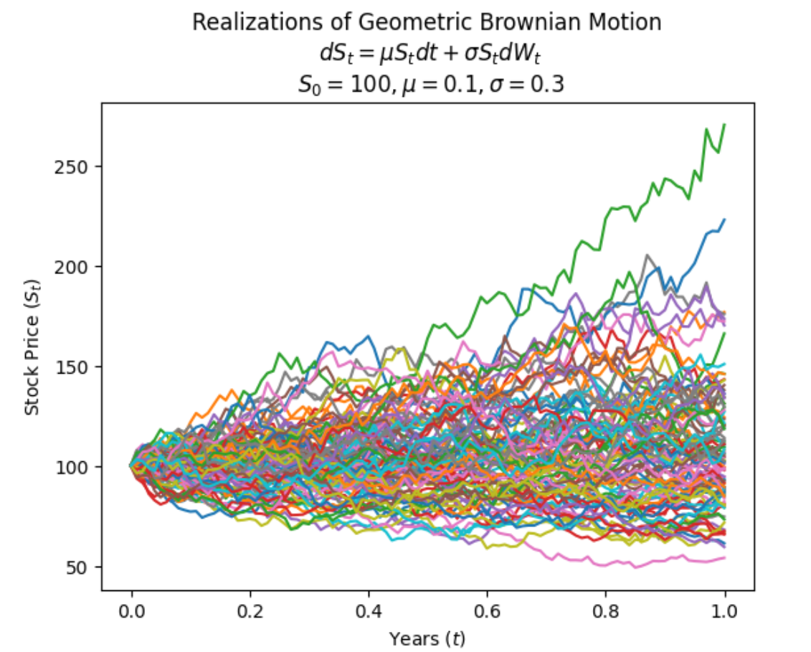

Slide 5
Breeden Litzenberger
Here calculation of option pricing is done using Heston Model.
The parameters defined are –
initial stock price → S0 = 100.0
strike price → K = 150.0
time to maturity in years → tau = 1.0
annual risk-free rate → r = 0.06

Slide 6
Heston Dependent Parameters-
rate of mean reversion of variance under risk-neutral dynamics → kappa = 3
long-term mean of variance under risk-neutral dynamics → theta = 0.20**2
initial variance under risk-neutral dynamics → v0 = 0.20**2
correlation between returns and variances under risk-neutral dynamics → rho = 0.98
volatility of volatility → sigma = 0.2
risk premium of variance → lambd = 0

Slide 7
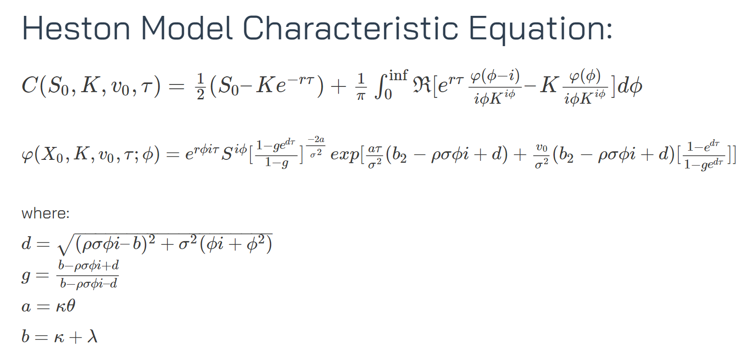
This equation is implemented in Python for calculating option prices for different strikes (strike array created using numpy)

Slide 8
The curvature of option prices is calculated using strike prices. This can provides us insights into how the option prices change in response to different strike price movement.
The curvature values helps in providing the shape of the option price curve.
Hence, a Dataframe is created using option price, strike price and curvature values.
A graph is plotted which is shown in the next slide →

Slide 9
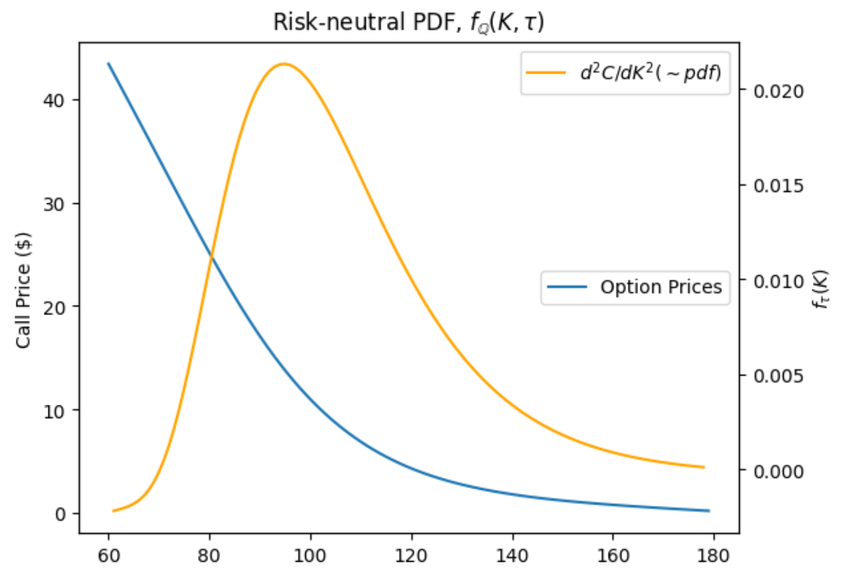

Slide 10
Brownian Motion for Mathematics and Finance
In this section, stochastic calculus is investigated using a symmetric random walk, scaled random walk and Brownian motion. Quadratic variation and variance is calculated for each.
Symmetric Random Walk –A sequence of steps taken in a random manner, where the steps have equal probabilities of being positive (upward) or negative (downward).
Scaled Random Walk – Here, the steps are not of a fixed size but are scaled or multiplied by a factor at each time step.
Brownian Motion – It is used to model random and unpredictable fluctuations.

Slide 11
At first, simple random walk is plotted directly using steps created by –
number of simulations → M = 10
Time→ t = 10
random_walk = [-1, 1]
steps = np.random.choice(random_walk, size=(M,t)).T
The plot is shown in the next slide →

Slide 12
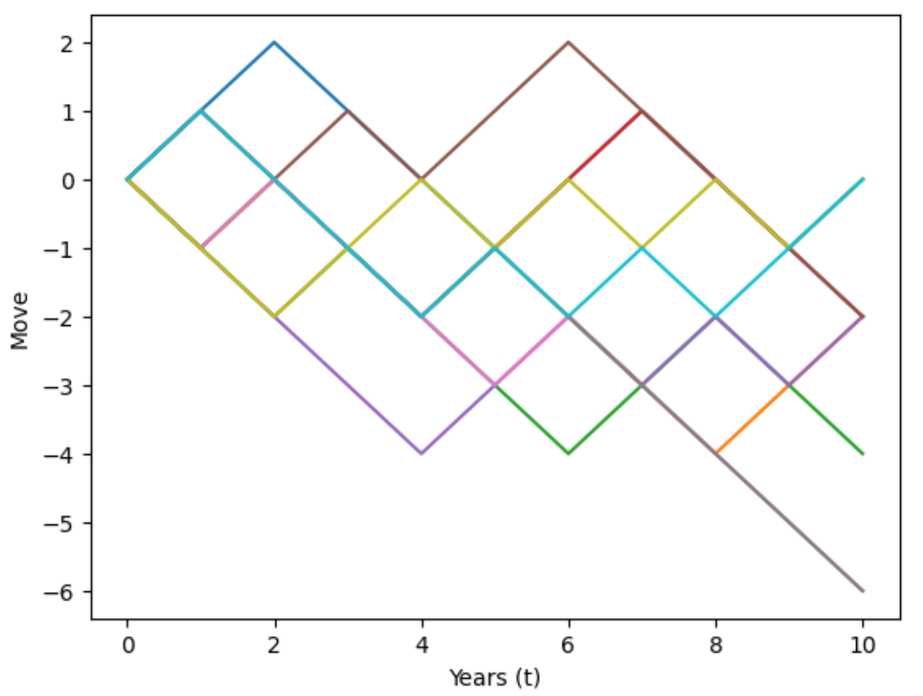

Slide 13
Secondly, scaled symmetric random walk is plotted using steps created by-
number of simulations → M = 10
Time → t = 10
n = 10
random_walk = [-1, 1]
steps = (1/np.sqrt(n)) * np.random.choice(random_walk, size=(M,t*n)).T
The plot is shown in the next slide →

Slide 14
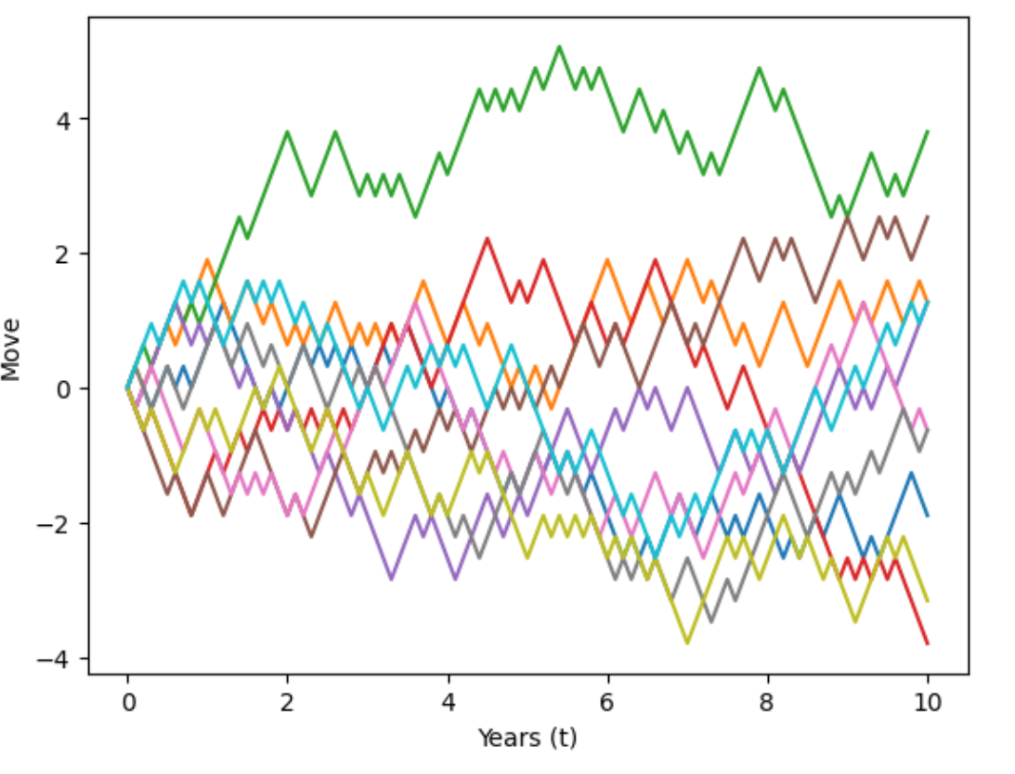

Slide 15
Lastly, Brownian Motion is plotted using steps created by –
number of simulations → M = 10
Time → t = 10
steps we want to see → n = 100
time step → dt = t/n
steps = np.random.normal(0, np.sqrt(dt), size=(M, n)).T
The plot is shown in the next slide →

Slide 16
