Slide 1
Week 03

Slide 2
Warm-up (5 minutes)
What is the difference between a list and an array in python? What are some similarities?
Whats the difference between a class, an object, and an instance?

Slide 3
Today's Activities
Warmup (15 mins)
Install VS code (15 mins)
Homework Answers/Q&A (30 mins)
Classes and Objects (25 mins)
pip install numpy (10 mins)
Break (15 mins)
NumPy Overview(25 mins)
Survival Guide (15 mins)
Group Exercise (30 minutes)

Slide 4
Submitting In-Class Assignments
Going forward you will need to submit the link to your answer for the group activity (in your github repo).
We are just checking for completion and that your code runs

Slide 5
Install VS Code
https://code.visualstudio.com/download
I love VS Code. It is amazing. I use it for small projects and huge orchestration pipelines that are managing terabytes of data.
You can use other tools (PyCharm boo), but I strongly suggest you use VS code.

Slide 6
Homework Answers (30 mins)
To save some time I will discuss a subset of answers.
Voluntarily slack answers to the #datascience channel
Don't be shy!

Slide 7
It’s okay if you don’t understand everything 100% the first time you learn it!

Slide 8
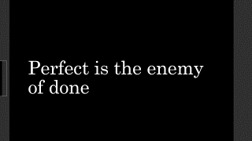

Perfect is the enemy of done

Slide 9
Objects
All objects have 2 things:
State
Behavior
Using objects allows for us to:
Make our code modular
Hide information (IDs, sensitive information, etc)
Re-use code
Easier debugging
What is an object around you (on your desk, in your house)? What is its state and behavior?

Slide 10
Classes
Three types: class methods, static methods, and instance methods
Need to create an object to call Non-Static Methods
Factory functions separate the process of creating an object from the code that depends on the interface of the object.
Utility functions handle logic and checks (see if person on the website is over 18, see if inputs meet particular requirements, etc)
Class Method | Static Method | Instance Method
CAN modify class state | CANT access class state | CANT modify class state
CANT modify object state | CANT access object state | CAN modify object state
Used for factory functions | Used for utility functions

Slide 11
Static Method Practice
Why does this not work? Fix it to make it work.
class Music: @staticmethod def play(): print("*playing music*") def stop(self): print("stop playing") Music.play() Music.stop()

Slide 12
Install numpy
Run command in a terminal:
Pip install numpy
Pip stands for 'pip installs packages'.
Python's most popular package manager
Other choice is Anaconda
Searches PyPI (Python Package Index) for packages
Run:
Pip show numpy
Get's more info about a package
Optional: DataCamp PIP Tutorial

Slide 13
Break (10 Minutes)
Attendance word: SoftwareStar

Slide 14
NumPy Overview
Arrays
Array Shaping and transposition
Array Math
Array Indexing and slicing
Array Broadcasting
NumPy is all about arrays!

Slide 15

Arrays
Structured lists of numbers.
Vectors
Matrices
Images
Tensors
ConvNets
$$\left[\begin{matrix}p_{x} \\ p_{y} \\ p_{z}\end{matrix}\right]$$
$$\left[\begin{matrix}a_{11} & ⋯ & a_{1n} \\ ⋮ & ⋱ & ⋮ \\ a_{m1} & ⋯ & a_{mn}\end{matrix}\right]$$

Slide 16

Arrays
Structured lists of numbers.
Vectors
Matrices
Images
Tensors
ConvNets

Slide 17
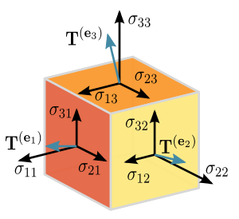
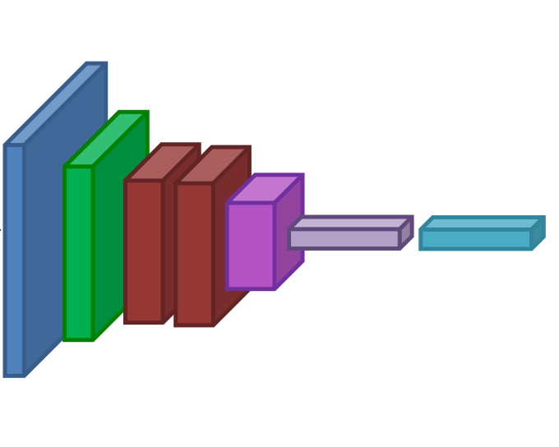
Arrays
Structured lists of numbers.
Vectors
Matrices
Images
Tensors
ConvNets

Slide 18
Arrays, Basic Properties
import numpy as np
a = np.array([[1,2,3],[4,5,6]],dtype=np.float32)
Print(a.ndim, a.shape, a.dtype)
Arrays can have any number of dimensions, including zero (a scalar).
Arrays are typed: np.uint8, np.int64, np.float32, np.float64
Arrays are dense. Each element of the array exists and has the same type.
Arrays are faster than python lists (consume less memory)
Can only combine arrays of the same shape!

Slide 19
Array Exercise (10 mins)
Create an array with three dimensions. Confirm it has three dimensions.
Create an array with 6 dimensions (don’t do this manually, use the appropriate kwarg)
What does this do: np.ones((3,2)) ?
HINT: Use the np.array documentation https://numpy.org/doc/stable/reference/generated/numpy.array.html

Slide 20
Survival Guide
Intro
Did anyone find value in this?
Comments, questions?
Learning How to Learn and Deep Work

Slide 21
Week 3 Group Exercise
If you are logged in to Zoom with your email you use to login to Canvas, you should be automatically put in the right room.

