Slide 1
FACILITATOR SETUP · HIDE THIS SLIDE BEFORE YOU PRESENT
Before you go live
Zoom setup checklist
Create Poll 1 in advance: Zoom web portal → your meeting → Polls. Question: “You still love nursing. You also dread the next shift. Does that describe you?” Answers: Yes, most days / Some days / Not yet, but I'm curious.
(Optional) Poll 2: “Which load do you feel most right now?” Answers: Body / Interruption / Change. (Slide 9 also works as a simple chat vote.)
Enable breakout rooms: Settings → In Meeting (Advanced) → Breakout rooms ON, with “Assign automatically.”
Assign a co-host: they run polls, watch chat, paste the prepared chat prompts, and manage the waiting room.
Turn ON: waiting room, participant rename, “Allow participants to unmute themselves,” and cloud recording if you promised one.
Have ready to paste in chat: the app link, and each slide's chat prompt (written in that slide's notes).
© 2026 Sue Adair · Thrive 55+ Nursing Advantage™
Notes:
HIDE THIS SLIDE BEFORE PRESENTING: right-click the slide thumbnail → Hide Slide (PowerPoint) or Skip slide (Google Slides).
Run-through checklist 30 minutes before: polls created, breakout rooms enabled, co-host confirmed, recording decision made, app link copied, this deck open in Slide Show and shared via Zoom Share Screen (share the window, not the whole desktop).
Co-host job list: admit from waiting room, launch/close polls when cued, paste each chat prompt (they are written verbatim in the notes of each slide), watch for raised hands, and broadcast the breakout warnings.

Slide 2

KICKOFF WEBINAR · WEEK 0
0:00–0:03 · Arrivals
Welcome to Thrive 55+ Nursing Advantage™
Built on the Thrive 55+ Career Direction Method™, the intellectual property behind the transformation: guiding experienced nurses through a six-week cohort with Sue Adair, BSN, RN, and Alyson.
Name the strain. Capture your value. Investigate your options.
WHILE WE GATHER · IN THE CHAT
Where are you joining from tonight, and how many years have you been a nurse?
© 2026 Sue Adair · Thrive 55+ Nursing Advantage™
Notes:
TIMING 0:00–0:03 (open the Zoom room 5 minutes early).
ZOOM — WAITING ROOM: admit people as they arrive and greet each by name; the cohort starts forming before the webinar starts. If you promised a recording, start it now (Record → Record to the Cloud) and say so out loud.
ZOOM — CHAT: co-host pastes this prompt as soon as the first person lands: “👋 While we gather: where are you joining from, and how many years have you been a nurse?” Read answers aloud as they appear. Ask everyone to set chat to “Everyone” (not Host only).
Optional: ask participants to rename themselves — Participants → hover your name → Rename → “First name · specialty” (e.g., “Karen · ICU”). It makes the breakouts warmer.
Start on time even if people are still arriving.

Slide 3
WHY WE'RE HERE
0:03–0:07 · Welcome
You still love nursing.
You also dread the next shift.
Both can be true, and there's a name for what you're feeling. That's what these six weeks are for.
ZOOM POLL
Does that sentence describe you? Yes, most days · Some days · Not yet, but I'm curious
© 2026 Sue Adair · Thrive 55+ Nursing Advantage™
Notes:
TIMING 0:03–0:07.
Sue: your 90-second story — why you built this. Normalize the feeling: this is not burnout-shaming, and nobody here is broken.
ZOOM — POLL: click Polls → launch Poll 1 (“You still love nursing. You also dread the next shift. Does that describe you?”). Give it 30–45 seconds — hold the silence while answers come in. Click End Poll, then Share Results, and read the split aloud (“Look at that — most of this room says ‘yes, most days’”).
The point to land: they are in the right room, and they are not the only one. Close the poll results window before advancing so your slides come back to front.

Slide 4
YOUR GUIDES
0:07–0:10 · Introductions
Who's walking this with you
Sue Adair, BSN, RN
Career direction
Founder of Thrive 55+ Nursing Advantage. Decades at the bedside, and the creator of the three-part method you'll learn here.
Alyson
Financial readiness
A career decision is also a financial decision. Alyson leads Week 5, so your direction is informed on both sides.
Hope, your coach
In the app, anytime
An AI coach grounded in this course. She'll ask more questions than she answers, and she joins you right after tonight.
© 2026 Sue Adair · Thrive 55+ Nursing Advantage™
Notes:
TIMING 0:07–0:10. Keep bios short — credibility plus warmth, under a minute each.
ZOOM — VIDEO: have Sue and Alyson both on camera here. If your Zoom plan allows, use Spotlight (hover a video → ⋯ → Spotlight for everyone) on whoever is speaking, and remove the spotlight when you move on.
Introduce Hope in one line: she's the coach inside the app, she asks more questions than she answers, and she unlocks after tonight.

Slide 5

HOW THIS WORKS
0:10–0:12 · Our agreements
This is a cohort, not a class
Stories stay, lessons leave. What's shared here is confidential.
Every path is welcome. Bedside, clinic, leadership, already searching, just curious. Nobody is behind.
Cameras on when you can, and audio-only is always okay.
Discussion over lecture. The chat is always open; your experience is course material.
No one will tell you to quit, or to stay. You'll decide, informed.
© 2026 Sue Adair · Thrive 55+ Nursing Advantage™
Notes:
TIMING 0:10–0:12. Set the culture explicitly — this slide is the container for every discussion that follows. Emphasize confidentiality: stories stay, lessons leave. Nobody is graded and nobody is behind.
ZOOM — REACTIONS: teach the room the two buttons you'll use all series: Reactions → 👍 / ❤️ (“if that agreement lands for you, tap a heart right now — try it”), and Reactions → Raise Hand for speaking up. Watching everyone try it is a 20-second warm-up that pays off every week.
Invite cameras on when possible, but make audio-only explicitly welcome.

Slide 6

BUILDING YOUR COHORT
0:12–0:20 · Breakout · 8 min
Meet your cohort
Your name, your specialty, and your years in nursing
One word for how work feels right now
If there's time: what made you say yes to this program
BREAKOUT ROOMS · 8 MINUTES
Hold on to your one word; you'll need it when we come back.
© 2026 Sue Adair · Thrive 55+ Nursing Advantage™
Notes:
TIMING 0:12–0:20 (8 minutes in rooms).
ZOOM — CHAT first: co-host pastes the three prompts so people carry them into the rooms: “In your room: 1) name, specialty, years in nursing · 2) ONE WORD for how work feels right now · 3) if time — what made you say yes?”
ZOOM — BREAKOUT ROOMS, exact steps: click Breakout Rooms → Assign automatically → set rooms so groups are 3–4 people → Options: ✔ Automatically move participants into rooms · ✔ Breakout rooms close after 8 minutes · ✔ 60-second countdown → Open All Rooms.
While rooms run: you and the co-host use “Join” to drop into a room or two and just listen. At ~4 minutes, Broadcast Message to All: “Halfway — make sure everyone has shared their one word!”
If breakout rooms aren't available on your account: run popcorn intros on the main mic instead — call on three people at a time, 30 seconds each.

Slide 7
WELCOME BACK
0:20–0:23 · Chat storm
One word, everyone, all at once
Type your one word for how work feels right now, and then just watch the screen for a moment.
CHAT STORM
Look at those words. Whatever yours was, you are not the only one.
© 2026 Sue Adair · Thrive 55+ Nursing Advantage™
Notes:
TIMING 0:20–0:23.
ZOOM — CHAT STORM technique (this makes it feel like a word cloud): say “Type your one word in the chat — but DON'T press Enter until I say GO.” Wait five seconds. Say “GO.” The burst of simultaneous words is the moment.
Read a dozen words aloud, slowly. Name the themes you see — tired, torn, invisible, hopeful, curious. Land the point: look at this screen; you are not the only one. This shared naming IS the cohort forming.
Co-host: screenshot or save the chat (Chat → ⋯ → Save Chat) — these words are gold for Week 2.

Slide 8
THE CAREER DIRECTION METHOD
0:23–0:27 · The big idea
Three parts. Three questions.
1 Name the Strain
What is wearing you down?
Score your body load, interruption load, and change load from 1–10. Strain isn't weakness; it's information.
2 Capture Your Value
What do you bring with you?
Name the strengths you keep dismissing because they feel ordinary. AI cannot duplicate them.
3 Investigate Your Options
What's worth investigating next?
Reconnaissance turns fear into information: study the work, ask people who know it, compare what you learn.
Not one decision made in a panic, but a method you can learn, repeat, and walk with a cohort beside you.
© 2026 Sue Adair · Thrive 55+ Nursing Advantage™
Notes:
TIMING 0:23–0:27. This is the whole program on one slide — take your time here. Each part answers one question, and Weeks 1–6 simply walk the three parts in order.
ZOOM: no interaction on this slide on purpose — after two discussion moments, the room is ready to listen. Keep your video on and large (ask the co-host to Spotlight you) and slow your pace down.

Slide 9
THE REFRAME
0:27–0:32 · Discussion
“Your highest score doesn't tell you to panic. It tells you where to look first.”
Body load: lifting, standing, transferring, needing longer to recover
Interruption load: alarms, call lights, open mental loops, constant task-switching
Change load: new systems and expectations, learned at full speed
IN THE CHAT · OR POLL 2
Which one do you feel most right now? Type B (body), I (interruption), or C (change).
© 2026 Sue Adair · Thrive 55+ Nursing Advantage™
Notes:
TIMING 0:27–0:32. The signature reframe of the whole program — let it breathe. Give one quick example of each load from real shifts.
ZOOM — CHAT VOTE: co-host pastes: “Which load do you feel most right now? Type B (body), I (interruption), or C (change).” Tally out loud as letters scroll by (“lots of I's tonight…”). ALTERNATIVE: launch Poll 2 if you created it — polls give you exact percentages to read back.
Tease Week 1: “Next week we score all three of these together, live.”

Slide 10
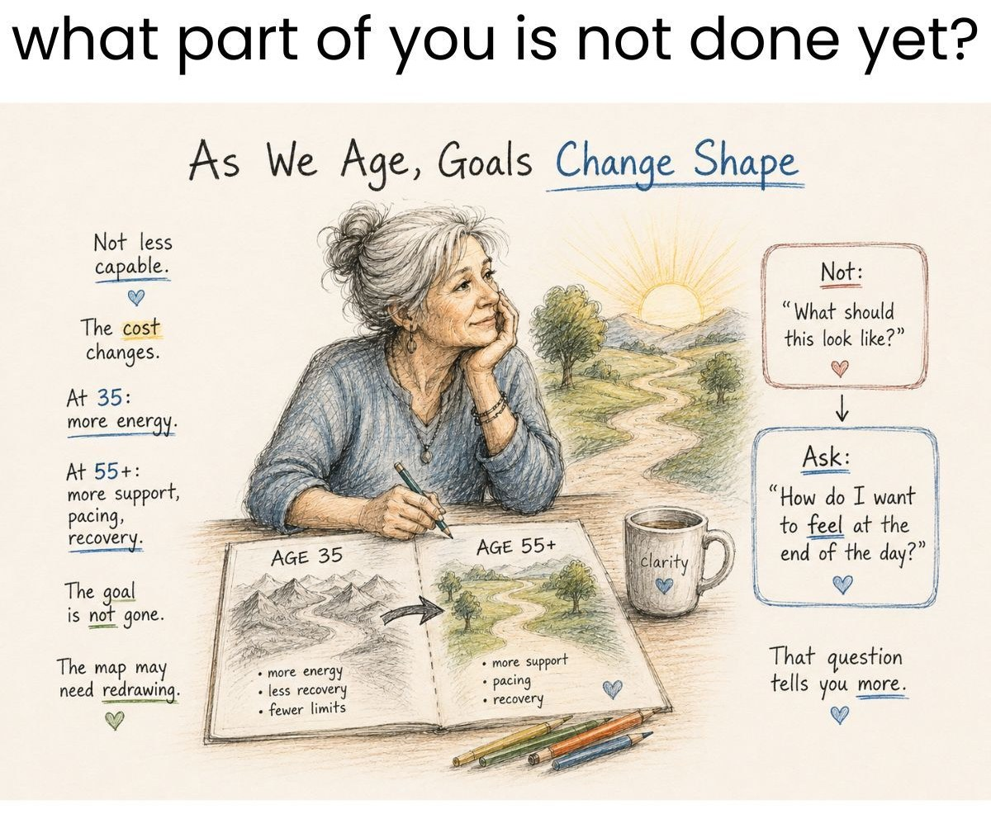
LEARNING GOALS
0:32–0:35 · What you'll leave with
By Week 6, you will be able to…
Name what's wearing you down: your three loads, scored, in writing
Describe five strengths you'd bring to a next role, without shame
Investigate a role before applying: five postings, three conversations, one comparison
Know your money questions: the income, benefit, and timing facts to gather
Commit to one informed step: specific, chosen by you, with a date
And we measure it together: a short survey this week, the same one at the end. You'll see your own change.
© 2026 Sue Adair · Thrive 55+ Nursing Advantage™
Notes:
TIMING 0:32–0:35. These five goals map one-to-one to the pre/post survey items, so you can honestly say: we measure this. Frame the survey as part of the method, not homework — the same short survey this week and in Week 6 shows each nurse her own change.
ZOOM — REACTIONS: quick pulse — “tap a 👍 if at least one of these five is exactly why you signed up.” Acknowledge the flurry and move on.

Slide 11
THE PROGRAM
0:35–0:38 · Six weeks
Your six-week journey
WEEK 0 Orientation Tonight: meet the cohort, see the whole map, set an intention
WEEK 1 Name the Strain Live teaching, and scoring your three loads together
WEEK 2 Capture Your Value A live strengths workshop: naming what you bring
WEEKS 3–4 Investigate Your Options Career reconnaissance: study the work, ask three people, compare
WEEK 5 Financial Readiness A live session with Alyson: career and money belong together
WEEK 6 Your Direction Share your informed step and celebrate with your cohort
© 2026 Sue Adair · Thrive 55+ Nursing Advantage™
Notes:
TIMING 0:35–0:38. Walk the map top to bottom in under three minutes — details come in each week's webinar. Point out that tonight IS Week 0 (the highlighted row). Every week starts live, together; your cohort's meeting day, time, and Zoom link arrive by email.
ZOOM: nothing interactive — but this is a good moment for the co-host to paste the app link in chat so people can see the same map in The Program page.

Slide 12
THE RHYTHM
0:38–0:41 · Every week
Every week, the same four beats
LIVE
Webinar
The week starts here, together: teaching, discussion, and each other.
LEARN
Short lessons
Unlock after the webinar. None over eight minutes.
DO
One mission
One workbook move per week. Small on purpose.
SHARE
Back to the cohort
Bring what you found. Your findings teach the room.
Lessons unlock after each webinar, so the cohort moves together, and nobody is behind.
© 2026 Sue Adair · Thrive 55+ Nursing Advantage™
Notes:
TIMING 0:38–0:41. The rhythm is the promise: no week ever asks for more than short lessons (none over eight minutes), one workbook mission, and showing up to share. Explain unlocking plainly: lessons open after each live webinar, so the cohort moves together — nobody races ahead, nobody falls behind.

Slide 13

YOUR TOOLKIT
0:41–0:44 · The app
Everything lives in one place
Lessons: the week's short videos, with pause-and-do workbook moments
My Workbook: saves automatically in your browser, plus a printable PDF edition to download and keep
Roles Explorer: role categories, search titles, red flags & tradeoffs
Resources: job research, interview prep, and tech-confidence links
Hope, your coach: talk anything through, any hour, judgment-free
UNLOCKS TONIGHT
Take the two-minute starting-point survey, then click “I attended this webinar”: Week 0, your toolkit, and the workbook PDF open with it.
© 2026 Sue Adair · Thrive 55+ Nursing Advantage™
Notes:
TIMING 0:41–0:44.
ZOOM — SCREEN SHARE the app for two minutes: click Share Screen → pick your BROWSER WINDOW (not the whole desktop) → Share. Show: the starting-point survey → mark tonight's webinar attended → Week 0 opens → the “Download the workbook (PDF)” button on My Workbook → the Roles Explorer → say hello to Hope. Then Stop Share and RE-SHARE the slides window (you'll need to restart the slide show).
ZOOM — CHAT: while you share, co-host pastes the app link and: “Follow along or do this right after: survey → ‘I attended this webinar’ → download your workbook PDF.” Encourage everyone to grab the PDF while you're all together.

Slide 14

A TASTE OF WEEK 2
0:44–0:50 · Discussion
What do you dismiss as “just the job”?
Reading the room before a problem has a name. Translating jargon into kindness. Holding a shift together that should have fallen apart.
CHAT STORM → THEN 2–3 VOICES ON THE MIC
Name one thing you do at work that you brush off as ordinary. We'll show you it isn't.
© 2026 Sue Adair · Thrive 55+ Nursing Advantage™
Notes:
TIMING 0:44–0:50. This is a deliberate taste of Week 2 — don't rush it; this moment sells the whole Value week.
ZOOM — CHAT first: co-host pastes: “One thing you do at work that you brush off as ordinary — go.” Read several aloud.
ZOOM — RAISE HAND for voices: “If you'd say yours out loud, use Reactions → Raise Hand.” Participants panel shows raised hands in order — call on 2–3 by name and click “Ask to Unmute” next to each. Lower their hand for them afterward (hover name → Lower Hand).
Your job is to reflect specifics back: “You just described de-escalating a family in crisis — that's not ordinary.” Close with: your ordinary isn't ordinary.

Slide 15
YOUR FIRST MISSION
0:50–0:53 · This week
Before Week 1: about 15 minutes
1 · Take the starting-point survey
Seven questions, two minutes. The same ones return in Week 6, so you can see your change.
2 · Unlock Week 0
Mark tonight's webinar attended; everything opens, and you can download your workbook PDF.
3 · Watch the first lesson
“You're Not Done: Start Here,” five minutes.
4 · Write one intention
In your workbook: “I want to leave this program with ______.”
IF YOURS IS ALREADY FORMING
Share your intention in the chat: “I want to leave with…”
© 2026 Sue Adair · Thrive 55+ Nursing Advantage™
Notes:
TIMING 0:50–0:53. Four small steps, fifteen minutes total this week. The intention sentence is the anchor for the whole program — Hope and the Week 6 close both come back to it.
ZOOM — CHAT: co-host pastes the app link again, plus: “Your mission this week: 1) starting-point survey 2) mark tonight attended 3) watch ‘You're Not Done: Start Here’ 4) write one intention.” Then: “If yours is already forming, share it now: ‘I want to leave with…’” — a few real examples in chat make it concrete for everyone else.

Slide 16
OPEN FLOOR
0:53–0:58 · Q&A
Questions and logistics
What are you hoping for from these six weeks?
What are you worried about?
Money questions? We'll write them down; they're exactly what Week 5 with Alyson is for.
Same day and time each week: the Zoom link comes by email
Can't make one live? The recording and lessons will be there
Stuck between webinars? Ask Hope in the app, anytime
© 2026 Sue Adair · Thrive 55+ Nursing Advantage™
Notes:
TIMING 0:53–0:58. Open floor — mic or chat, both welcome.
ZOOM — RAISE HAND + CHAT together: “Raise your hand (Reactions → Raise Hand) or drop your question in chat.” Co-host reads chat questions aloud so the recording captures them; you call on raised hands with Ask to Unmute.
If quiet, seed it: “What are you hoping for? What are you worried about?”
Park anything financial for Alyson's Week 5 session — say so warmly and visibly write it down (“that's going on the Week 5 list”).
Watch the clock — protect the last two minutes for the close.

Slide 17
UNTIL WEEK 1
0:58–1:00 · Close
You're not done.
You're just evolving.
Next week, Name the Strain: live teaching, and scoring your three loads together.
The Thrive 55+ Career Direction Method™
Name the Strain · Capture Your Value · Investigate Your Options
© 2026 Sue Adair · Thrive 55+ Nursing Advantage™
Notes:
TIMING 0:58–1:00. End on time — that's a promise you're modeling for the next six weeks. Thank a few people by name for what they shared tonight. Last line, slowly: you are not done, you are just evolving. See you at Week 1: Name the Strain.
ZOOM — WRAP: stop the recording (⏹), co-host pastes the app link one last time with “See you next week — same link.” After you formally end, you can stay in the room a minute for stragglers, then End Meeting for All.
AFTER THE MEETING: download the saved chat and the poll results (Zoom web portal → Reports → Meeting → Poll Report) — the one-words and intentions feed directly into your Week 1 and Week 2 teaching.

