Slide 1
HIPAApotamus
The HIPAA-native contract platform.
Built for the Mississippi Department of Health.

Slide 2
How most clinics track Business Associate Agreements today.
No attribution.
Who signed? From which IP? On what document version?
Spreadsheets
45 CFR §164.312(b) — audit controls
No integrity.
A row can be edited. A PDF on a shared drive can be replaced.
45 CFR §164.312(c)(1) — protection from improper alteration
No retention.
How most clinics track Business Associate Agreements today.
Six-year federal retention. Ten years under Mississippi law.
45 CFR §164.530(j)(2) · Miss. Code §41-9-69
No audit packet.
When OCR asks, the clinic gathers evidence by hand.
— a weekend of panic, not a product —
HIPAApotamus · Feature walkthrough
02 / 15

Slide 3
Delivering a BAA to a vendor looks like a solved problem — until you read the bill and the BAA.
DocuSign.
The industry default.
Emailing
Expensive.
≈ $45 / user / month, per seat, plus per-envelope fees.
Generic.
Doesn't know what a BAA is, or what §164.504(e) requires.
Delivering a BAA to a vendor looks like a solved problem — until you read the bill and the BAA.
Third-party.
Your PHI leaves the AWS BAA perimeter to reach their servers.
— adds a Business Associate you must paper separately —
Our answer.
Amazon SES inside the AWS BAA. Signed-URL invitations, no third party on the path.
NIST SP 800-177 · AWS Healthcare Lens HCL_SEC7
HIPAApotamus · Feature walkthrough
03 / 15

Slide 4
Before a vendor sees the document, we prove they are the intended signer.
Magic link.
Email OTP.
Verify
HMAC-SHA256 signed token, 72-hour TTL.
Six digits, ten-minute window, three-attempt lockout.
src/lib/signing/token.ts
src/lib/signing/otp.ts
Authority to bind.
No vendor accounts.
Before a vendor sees the document, we prove they are the intended signer.
OTP goes to the registered contact — not whoever forwarded the link.
Completion matters more than account creation friction.
ESIGN §7001(c) · UETA Miss. Code §75-12-1
HIPAApotamus · Feature walkthrough
04 / 15

Slide 5
The signing ceremony is four distinct, logged acts — not one button press.
Review.
Consent.
Signing
Full contract text on screen; draft PDF downloadable before signing.
Explicit e-sign consent, timestamped before the canvas opens.
ESIGN §7001(c)(1)(C)
ESIGN §7001(a)(1) · UETA §75-12-5
Capture.
Seal.
The signing ceremony is four distinct, logged acts — not one button press.
Drawn signature @ 2× DPR, IP, user-agent, consent time, method.
SHA-256 of the final PDF, signed with AWS KMS.
src/components/signing/SigningInterface.tsx
45 CFR §164.312(c)(1)-(2)
HIPAApotamus · Feature walkthrough
05 / 15

Slide 6
A BAA is bilateral. The clinic signs too — or there is no contract.
Vendor first.
Countersign
Business Associate signs via the OTP-gated link.
status: pending_vendor_signature
Clinic second.
HIPAA officer counter-signs from the dashboard.
status: pending_countersignature
A BAA is bilateral. The clinic signs too — or there is no contract.
Fully executed.
Both signatures embedded. Both hashes recorded. Contract is active.
45 CFR §164.504(e) — required provisions satisfied
HIPAApotamus · Feature walkthrough
06 / 15

Slide 7
Signed documents belong in a place the clinic cannot accidentally delete.
Private S3.
Block-all-public-access. Server-side encryption. Versioning enabled.
Storage
AWS Healthcare Lens HCL_SEC7
Pre-signed access.
No public URLs — access is a short-lived signed URL, scoped to one object.
Object Lock ready.
Signed documents belong in a place the clinic cannot accidentally delete.
Bucket prepared for WORM retention in production (Compliance mode).
10-year retention · Miss. Code §41-9-69
TLS 1.2+ enforced.
Bucket policy refuses non-SSL; SDK refuses plaintext.
45 CFR §164.312(e)(1)
HIPAApotamus · Feature walkthrough
07 / 15

Slide 8
How we answer the auditor's question: "Has this document been altered since signing?"
SHA-256.
KMS ECDSA_SHA_256.
Integrity
256-bit fingerprint of the final PDF.
Hash signed with an ECC NIST P-256 key on a FIPS 140-2 L3 HSM.
src/app/api/baas/[id]/sign/route.ts
src/lib/signing/kms.ts
Verify every read.
Non-repudiation.
How we answer the auditor's question: "Has this document been altered since signing?"
Re-hash on download. Mismatch triggers a security alert.
The signer cannot later claim "that wasn't my document."
45 CFR §164.312(c)(1)
— what makes it legally defensible —
HIPAApotamus · Feature walkthrough
08 / 15

Slide 9
Every action in the signing ceremony is a first-class audit event.
Magic link accessed.
Who opened the invitation, from where, when.
Tracking
OTP sent · verified · failed.
Identity challenge recorded with attempts and lockouts.
Consent · signature · hash · KMS seal.
Every action in the signing ceremony is a first-class audit event.
The four-act ceremony is reconstructable, frame by frame.
Counter-signature · confirmation sent.
Contract lifecycle is a log, not a guess.
45 CFR §164.312(b) — audit controls
HIPAApotamus · Feature walkthrough
09 / 15

Slide 10
One ledger, surfaced three ways — for the operator, the auditor, and the regulator.
Agency view.
Every audit event across every vendor in one filterable table — action, vendor, timestamp, performer. Filter by date range, action type, or free-text search.
Audit
src/app/dashboard/history/page.tsx · getRecentAuditLogs()
Vendor drill-down.
Click any vendor and the full chronological history opens — invitation, OTP, consent, signature, counter-sign, every reminder that ever went out.
src/components/dashboard/BAADetailsModal.tsx · getAuditLogsByVendor()
One ledger, surfaced three ways — for the operator, the auditor, and the regulator.
Audit packet.
One-click ZIP export: Executive Summary + signed BAA + Audit Trail PDF + Compliance Matrix. Hand it to OCR, the state health department, or a prospect's security review.
src/lib/pdf/generator.ts · AuditTrailPDF.tsx · §164.312(b) evidence
HIPAApotamus · Feature walkthrough
10 / 15

Slide 11
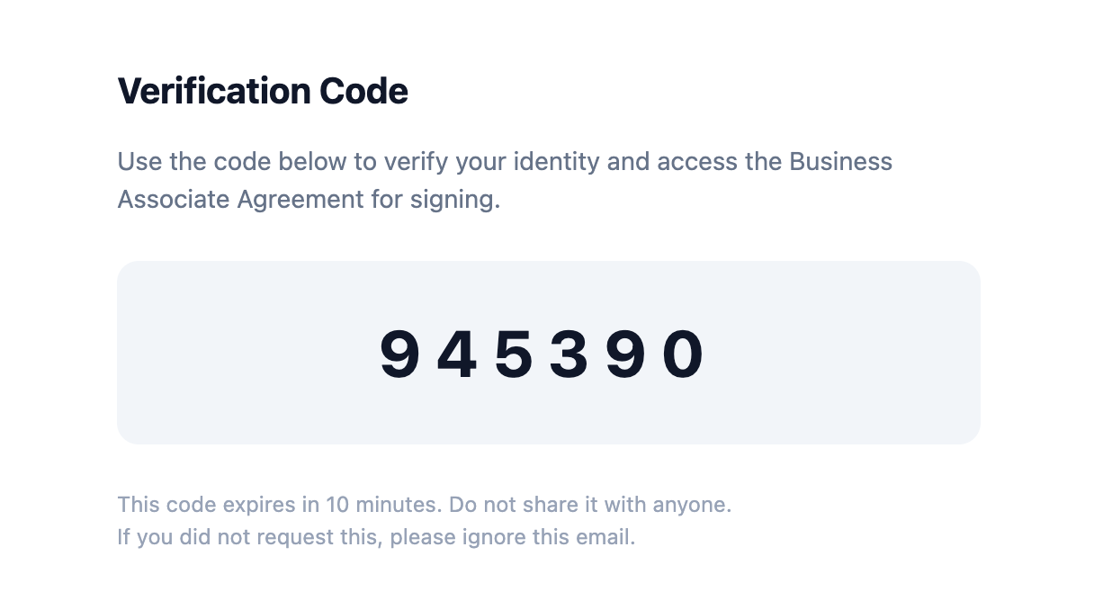
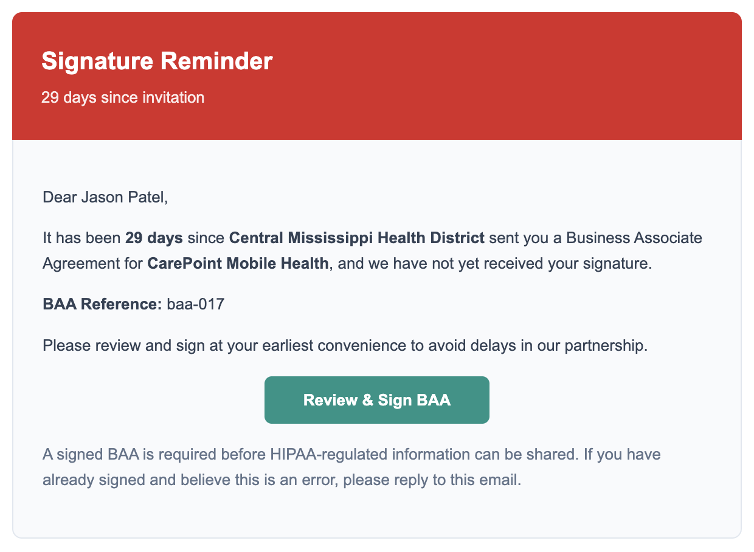
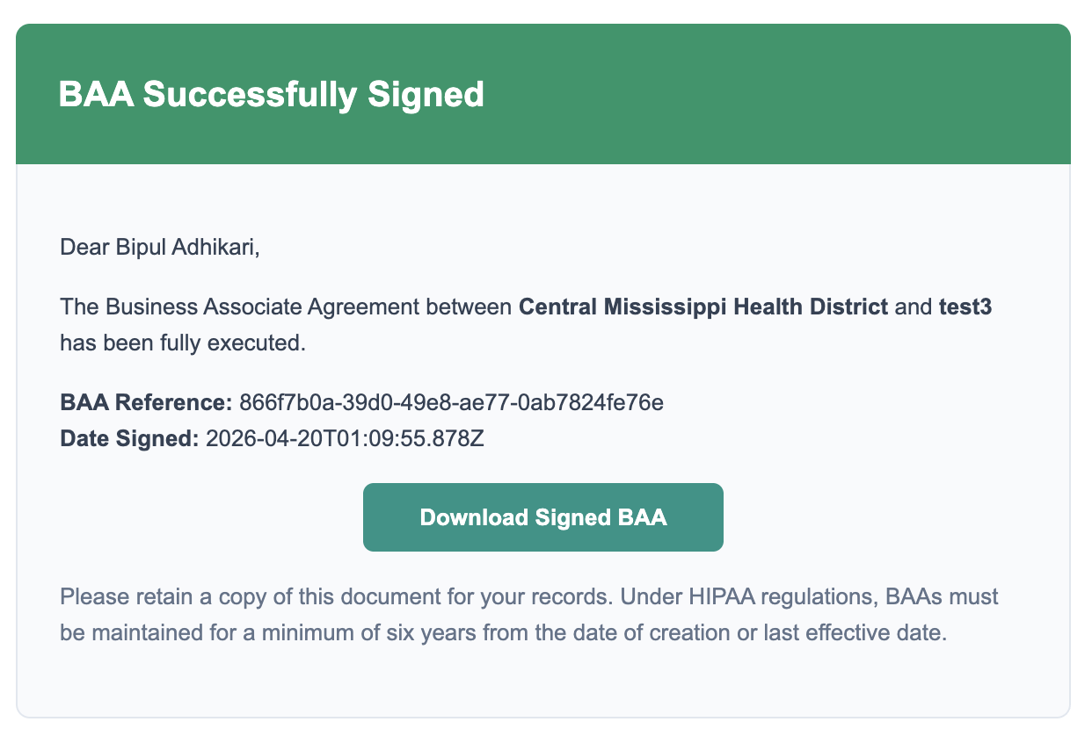
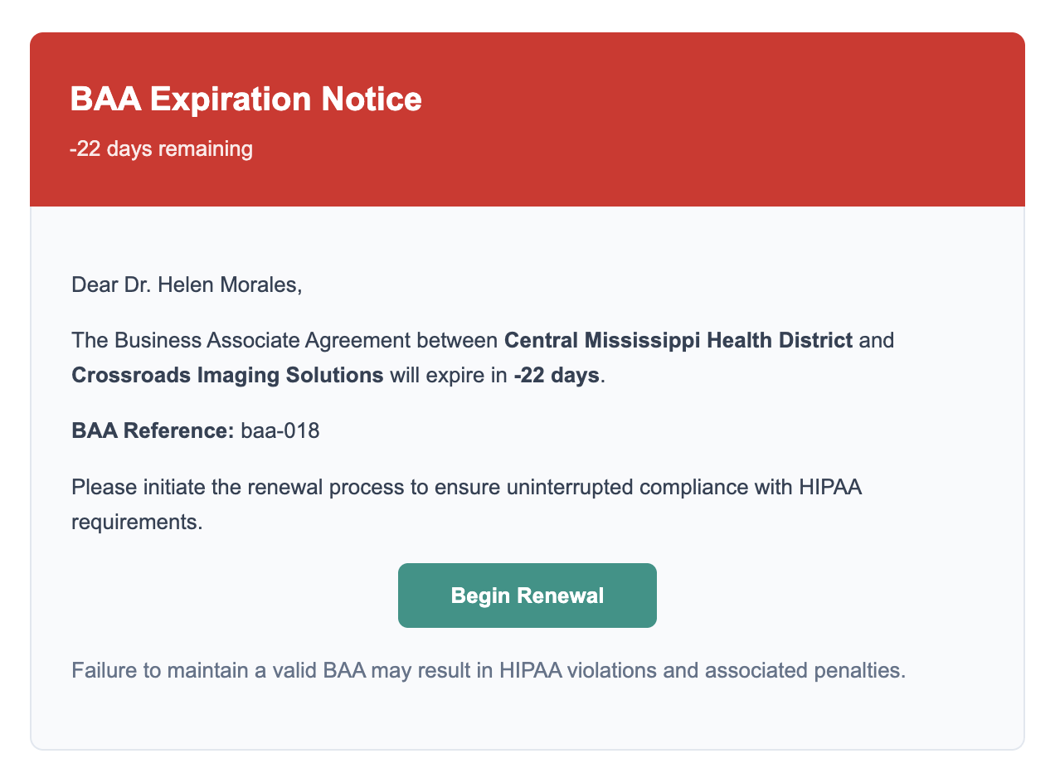
Every status change sends a purpose-built email — and every email stays inside the AWS BAA perimeter.
Reminders
Verification code.
Signature reminder.
Executed confirmation.
Expiration notice.
10-minute OTP sent to the signer's registered email.
Automatic nudges at 7 / 14 / 29 days since invitation.
Delivered to both parties when the clinic counter-signs.
30 / 7 / 0-day warnings with a one-click renewal link.
Every status change sends a purpose-built email — and every email stays inside the AWS BAA perimeter.
ESIGN §7001(c) — attribution
src/lib/reminders/policy.ts
45 CFR §164.504(e) — fully executed
45 CFR §164.502(e)(1)(i)
HIPAApotamus · Feature walkthrough
11 / 15

Slide 12
Every BAA clause is mapped to the regulation it satisfies — on the record, on the page.
45 CFR §164.504(e)(2).
MSDH sections.
Matrix
The required-elements checklist, mapped section by section.
Mississippi-specific provisions cross-walked against state requirements.
src/lib/baa/cfrMappings.ts
Compliance Matrix PDF — generated per BAA
Evidence on demand.
One export — ready for OCR, the state health department, or a prospect's security review.
src/lib/pdf/ComplianceMatrixPDF.tsx
Every BAA clause is mapped to the regulation it satisfies — on the record, on the page.
HIPAApotamus · Feature walkthrough
12 / 15

Slide 13
The audit history is searchable in plain English — grounded in the real ledger.
Ask a question.
Copilot
"Which BAAs expire in 30 days?" "Show me ScriptGuard's signing history."
Gemini 2.0 Flash.
Streaming responses, grounded in audit logs — not model hallucination.
src/lib/ai/gemini.ts
The audit history is searchable in plain English — grounded in the real ledger.
RBAC enforced.
The model sees only what the signed-in user is permitted to see.
45 CFR §164.308(a)(4)
HIPAApotamus · Feature walkthrough
13 / 15

Slide 14
A narrow, explainable AWS stack — every layer inside the BAA perimeter.
Identity.
Amazon Cognito — MFA-ready, custom-attribute RBAC.
Architecture
cdk/lib/hipaa-baa-stack.ts
Data.
DynamoDB (PITR + streams) · S3 (versioned, encrypted).
AWS Healthcare Lens HCL_SEC1 / SEC7
Cryptography.
AWS KMS — FIPS 140-2 Level 3 HSM, ECC NIST P-256.
A narrow, explainable AWS stack — every layer inside the BAA perimeter.
Delivery.
Amazon SES — email stays inside the AWS BAA perimeter.
Intelligence.
Google Gemini — grounded, streamed, scoped.
HIPAApotamus · Feature walkthrough
14 / 15

Slide 15
One HIPAA-native platform — not four SaaS tools duct-taped together.
DocuSign + Dropbox + Spreadsheets + Outlook.
HIPAApotamus
One perimeter. One audit log. One matrix. One renewal loop.
One HIPAA-native platform — not four SaaS tools duct-taped together.
Built for Mississippi DOH. Extensible to every covered entity.
HIPAApotamus · Feature walkthrough
15 / 15

