Slide 1
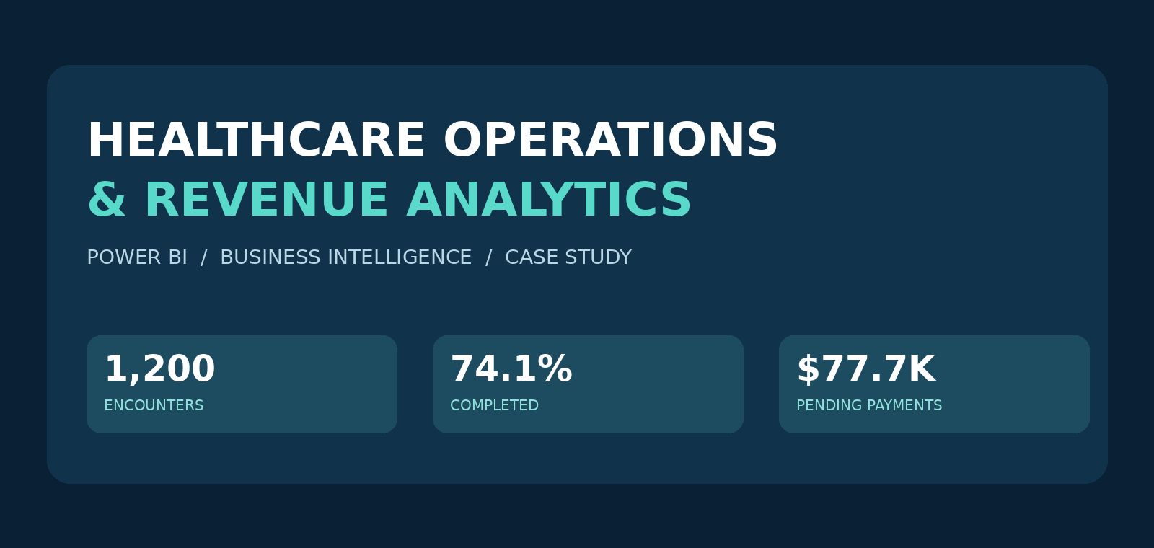
Healthcare Operations & Revenue
An evidence-led Power BI case study | Executive presentation
01

Slide 2
Executive snapshot
Source: supplied five-table healthcare workbook | unfiltered records
ENCOUNTERS
COMPLETION
NO-SHOW RATE
1,200
74.1%
10.0%
500 patients · 40 providers
889 completed encounters
120 no-show appointments
BILLED
COLLECTED
PENDING
$465,896
$284,664
$77,737
Claims table
Payments table
Payments table
02

Slide 3
Analysis framework
Five source entities · six report pages · decision-oriented KPIs
PATIENTS
PROVIDERS
ENCOUNTERS
500 records
Demographics & risk
40 records
Staffing & location
1,200 records
Visits & experience
CLAIMS
PAYMENTS
1,200 records
Payers & denials
1,200 records
Collections & pending
03

Slide 4
Patient access | Throughput is the first signal
Operational outcomes should be tracked as distinct counts and rates
Completed
No-show
Cancelled
Rescheduled
889
120
108
83
74.1% of encounters
10.0% of encounters
9.0% of encounters
6.9% of encounters
Recommendation: pilot reminders and rapid rescheduling, then measure completion and no-show changes by department and encounter type.
04

Slide 5
Demand | Where volume concentrates
High patient volume is not automatically poor performance
Primary Care
Emergency
Cardiology
187
151
142
encounters
encounters
encounters
Action: compare completed visits, provider workload and average wait time before revising scheduling capacity.
05

Slide 6
Revenue | Distinguish billed, collected and at-risk amounts
Payment totals sourced from Claims and Payments tables
Billed
Approved
Collected
$465,896
$362,401
$284,664
Pending
Denied
$77,737
$30,651
06

Slide 7
Collection priorities | Follow the pending balance
Prioritization hypothesis—confirm payer, aging and recoverability first
Cardiology
Primary Care
Neurology
$12,663
$11,820
$8,950
pending amount
pending amount
pending amount
Action: segment these balances by claim age, payer and status. Track recovered cash and days-to-resolution.
07

Slide 8
Denials | Build a root-cause workflow
A separate action stream from pending claim follow-up
Timely Filing
Coding Error
19
16
denied claims with this reason
denied claims with this reason
Eligibility Issue
Missing Documentation
16
12
denied claims with this reason
denied claims with this reason
08

Slide 9
Recommendations | Operationalize the dashboard
Observation → Risk → Action → Measure
01 Protect access
Test reminders, confirmation and quicker rescheduling.
02 Match capacity
Review provider coverage and wait times for high-volume departments.
03 Accelerate cash
Triage Cardiology and Primary Care pending claims by payer / aging.
04 Reduce denial friction
Investigate frequent denial reasons; track resubmission outcomes.
05 Govern weekly
Use an executive scorecard for completion, no-shows and payment status.
09

Slide 10
Methodology & guardrails
Source-backed descriptive analysis—not proven causal business impact
• Counts and financial amounts were recalculated from the supplied Excel workbook.
• Power BI has six report pages; slicer context may produce different page-level figures.
• Operational issues and revenue exposure may be related, but causal effects are not established.
• The original workbook and PBIX contain or may embed identifiable patient data and are withheld from the public package.
• See GitHub case study, KPI definitions and technical notes for supporting details.
10

