Slide 1

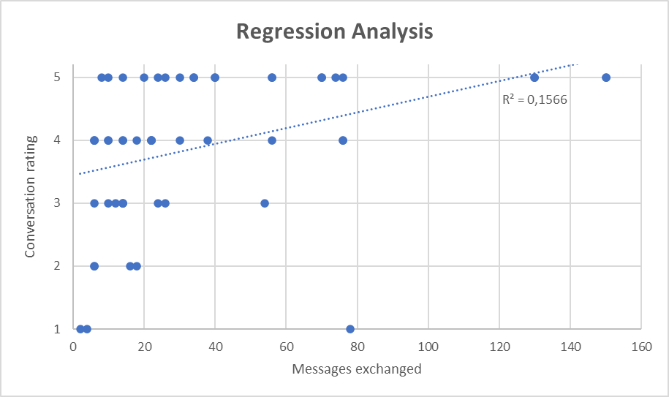
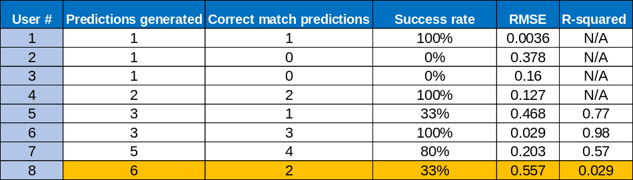
The evaluation of matchmaking algorithm for mobile dating application
Dorota Marczak
BSc (Hons) Computing
Introduction
Method
Results
Discussion
Mobile dating applications (DA) constitute one of the most dynamically growing branches of the mobile market, generating a revenue reaching 555 million dollars a year (Statista, 2019).
With the ever-growing number of mobile dating users and ubiquity of mobile devices, there is an increasing demand for applications that would provide their users with the ability to meet like-minded individuals without the need to sift through the vast amount of available profiles.
Some initial research on matchmaking systems applied to dating domain have shown that reciprocal recommender systems – utilising content-based (Pizzato et al., 2010) and collaborative filtering (Neve and Palomares, 2020) techniques – can be efficient in determining which singles should be presented to each other as matches.
To address those issues, the prototype dating application has been developed and enhanced with a Deep Neural Network.
Proposed solution consisted of four crucial components:
• In-app questionnaire, that collected information on user’s personality, lifestyle and worldview to produce user vector (base for model training)
• User Interface facilitated with chat functionality, designed based on popular dating applications and Android Material Design guidelines
• Firebase database, providing methods of updating the view in real-time on changes to database content
• Matchmaking algorihm, which utilised data from the in-app questionnaire and conversation ratings to predict which singles should be presented to each other as matches
Implemented matchmaking algorithm was based on Deep Neural Network (DNN); computing system inspired on biological neural networks that constitute human brain. Having recorded a minimum of 3 conversation ratings, DNN, the application triggered the matchmaking algorithm, which utilised provided training data – user vectors and ratings as a training label – to infer match score for other users meeting given criterias.
The proposed solution has been evaluated through the experiment with a group of 19 students in the age over 18. During a week-long study, the participants engaged in a number of conversations, ratings of which were utilised to generate potential matches. The study was followed by a survey, which collected users’ feedback on the application, including the review of UI/UX, functionality, as well as accuracy of generated matches.
Matching system
The analysis of explicit data obtained as a result of the study and conducted survey enabled to determine the efficiency of proposed matchmaking system.
Table 1 presents the individual matching results for users with a minimum of 3 conversation ratings. The results of the study exhibited a high correlation of determination (R-squared) between scores and generated predictions. Through average 7% increase of prediction accuracy related to gradual adaptation to user preferences (compared to initial predictions contrasted with final ratings), the applied algorithm shown high consistency in analysing new data. The success rate registered based on predictions generated for 7 participants of the research which met the criteria was estimated to 69%.
Table 1 – Accuracy of predictions for each user for whom the predictions were generated
The following factors utilised commonly in the studies on ANN efficiency were considered:
Recall – measure defining the fraction of matches detected
Precision – measure evaluating the relevance of identified matches.
Based on the individual interpretation of generated predictions, the sensitivity (recall) of the system was estimated to 90%, therefore indicating high accuracy of the applied algorithm in detecting actual positive matches. The analysis of recorded True and False positives resulting in 69% precision rate suggested a positive correlation between the engagement in the conversation and assigned rating.
The analysis of Ahavoo matchmaking system indicated that implemented algorithm outperformed previous recommender systems in detection of actual matches (recall), as well as achieved accuracy and precision - corresponding to the relevance of produced matches - significantly higher than content-based RECON (Pizatto et al., 2010). The linear regression analysis (presented in Fig.2) enabled to identify weak, yet positive correlation between assigned ratings and a number of exchanges messages.
Figure 2- Correlation between assigned ratings and
the number of messages exchanged
Aim and Objectives
Conclusion
Conducted evaluation of the project proved that Ahavoo constitutes an efficient tool for meeting other available users and identification of like-minded individuals. By adopting a recommender system to social science, the project contributed to the landscape of already existing studies on matchmaking systems. The results suggested the accuracy of the system might have been higher if the participants did not rate conversations too early, before meeting their correspondents closer.
This project aimed to answer the question
Can the personalized dating application utilising a matching algorithm enhance a social capital amongst ‘social loners’ ?
The individual objectives were identified as follows:
• Review current dating applications
• Prototype a robust, functional and visually attractive mobile dating application using relevant techniques and modern technology
• Review literature into recommender systems and Deep Neural Networks to explore the ways of adapting recommender systems to online dating
• Examine fields for improvement & suggest future work
References
Neve, J. and Palomares, I., 2020. Latent Factor Models and Aggregation Operators for Collaborative Filtering in Reciprocal Recommender Systems. RecSys ’19, September 16–20, 2019, Copenhagen, Denmark,.
Pizzato, L., Rej, T., Chung, T., Koprinska, I. and Kay, J., 2010. RECON: A Reciprocal Recommender for Online Dating.
Statista.com. (2019). The Statistics Portal for Market Data, Market Research and Market Studies. Available at: www.statista.com

