Slide 1

PopMedNetTM Distributed Research Network Technologies for Population Medicine Initial Setup Instructions for the PopMedNet DataMart Client
July 2011
PopMedNet™ was developed under contract from the Agency for Healthcare Research and Quality, US Department of Health and Human Services as part of the Developing Evidence to Inform Decisions about Effectiveness (DEcIDE) program, awarded to the DEcIDE centers at the HMO Research Network Center for Education and Research on Therapeutics (HMORN CERT) and the University of Pennsylvania. The Food and Drug Administration’s Mini-Sentinel project provided additional support.
PopMedNetTM
Notes:
1

Slide 2
DataMart Client Setup Instructions
These instructions describe the first-time set-up of the PopMedNet DataMart Client and steps for connecting a local DataMart to the network.
The instructions will show how to:
Install the DataMart Client Locally
Create an ODBC Data Source Name (DSN) for your DataMart
Configure the DataMart Client to Point to your ODBC DSN (DataMart)

Slide 3
1. INSTALLING THE DATAMART CLIENT

Slide 4
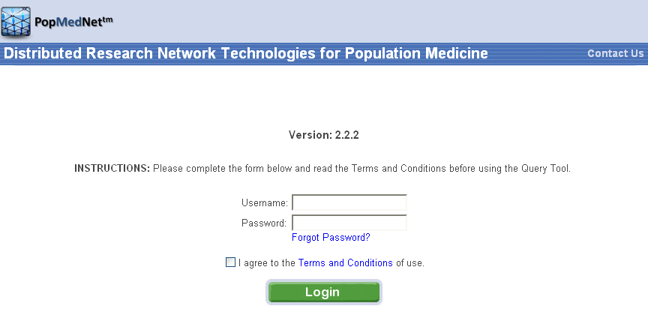
PopMedNet™ Login
* Login to your network portal with your assigned DataMart Administrator credentials
Notes:
Login as a DataMart Administrator

Slide 5
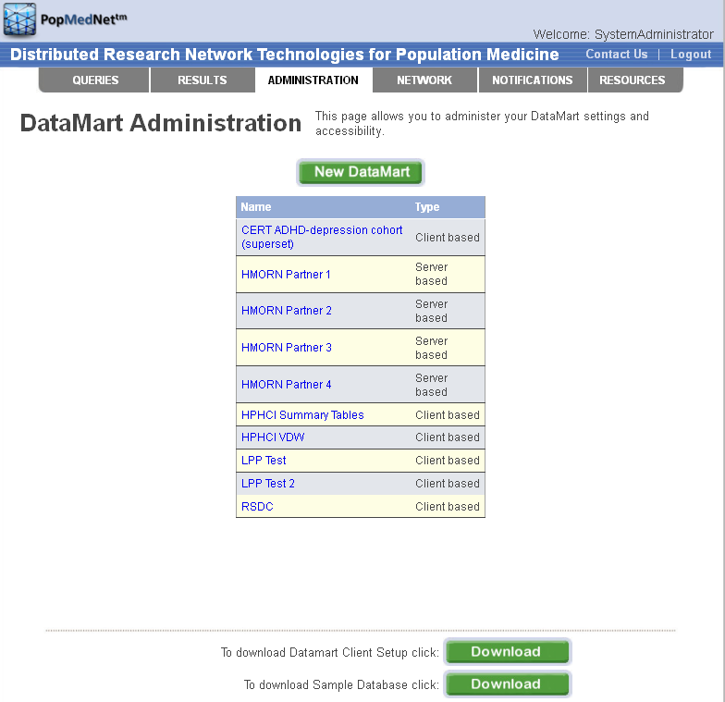
Download the Software from Portal

Slide 6
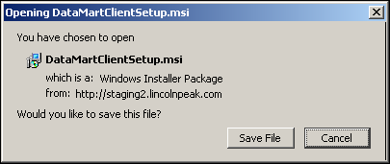
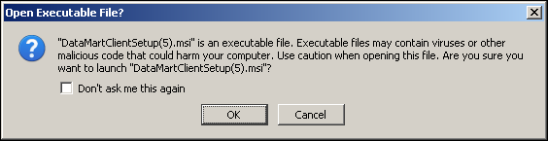
Save and Run the Setup File
Click Save File to start downloading the Client.
Open the DataMartClientSetup file. Click OK to launch.

Slide 7
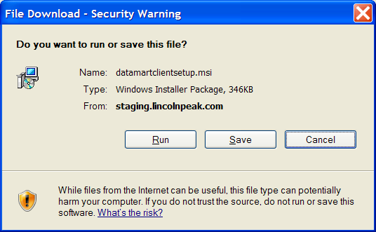
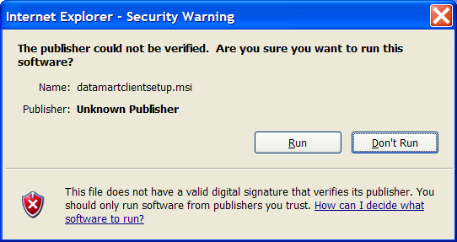
Save and Run the Setup File
Click Run through both File Download Security Warning screens

Slide 8
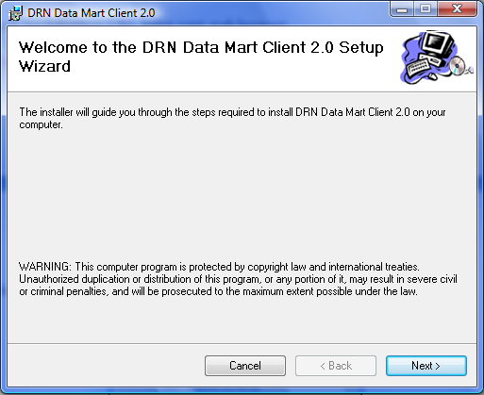
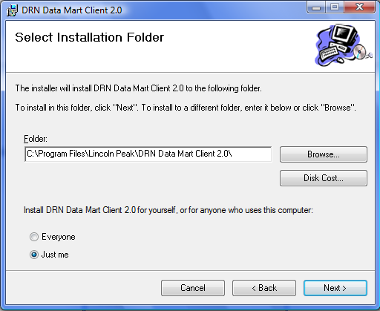
Follow Installation Instructions
Click Next to begin the Setup
Select the installation folder (if desired) then click Next

Slide 9
2. CREATING A DATAMART ODBC CONNECTION

Slide 10
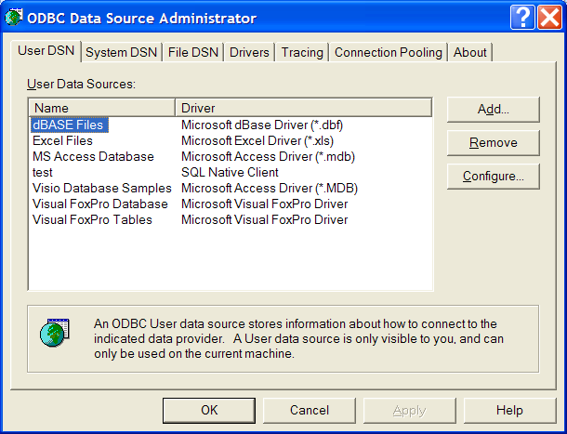
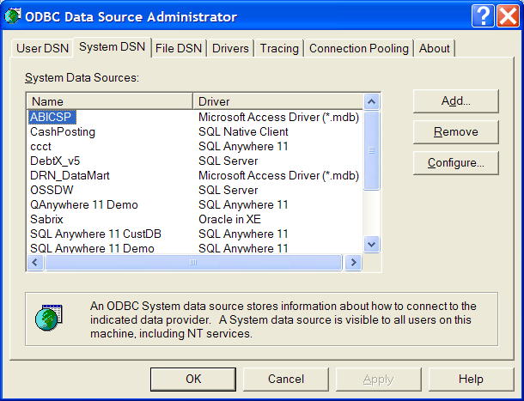
Add an ODBC Connection
Go to Start > Settings > Control Panel > Administrative Tools > Data Sources (ODBC)
Click on the System DSN Tab and then “Add” button

Slide 11
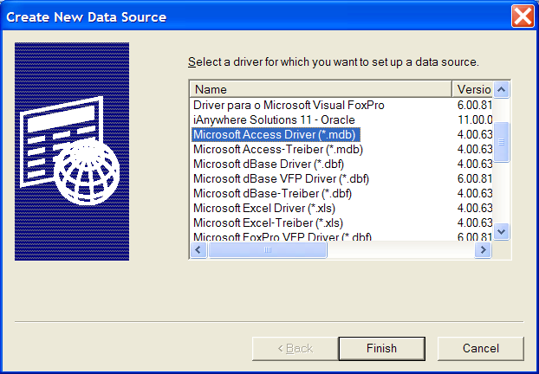
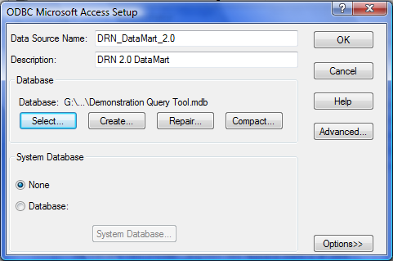
Add an ODBC Connection
Select Microsoft Access Driver (*.mdb) or (*.accdb) and click Finish
Other database formats also can be used
Type in a Data Source Name (Description is optional)
Click the “Select” button to locate your database

Slide 12
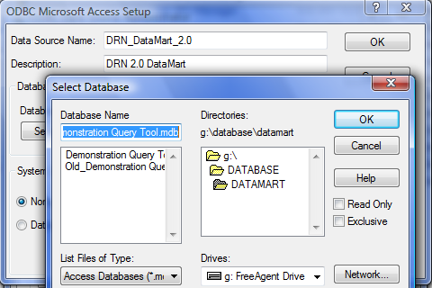
Select DataMart Database
Navigate to your local DataMart database and select
Click OK, and click OK again to save

Slide 13
Sample Database - Testing
A sample DataMart (i.e., database) may be available for testing purposes
The sample DataMart can be downloaded from Network portal under Administration tab

Slide 14
3. CONNECT THE DATAMART CLIENT TO YOUR LOCAL DATAMART

Slide 15
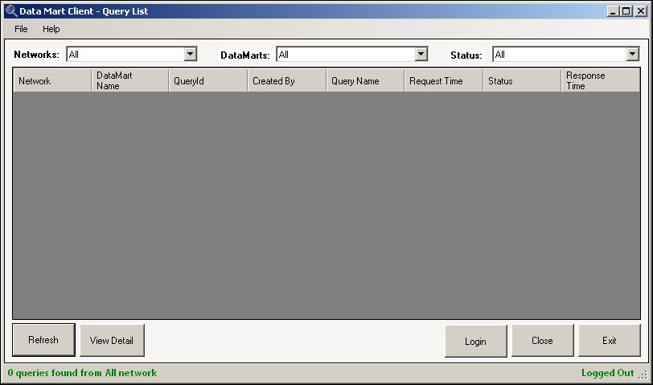
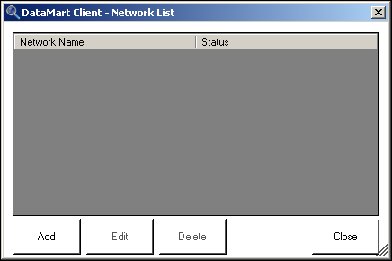
Open the DataMart Client Application
Notes:
Launch the DRN DataMart Client from the icon created on your desktop. Go to File > Settings to view your networks page.
Click Add to create your network:

Slide 16
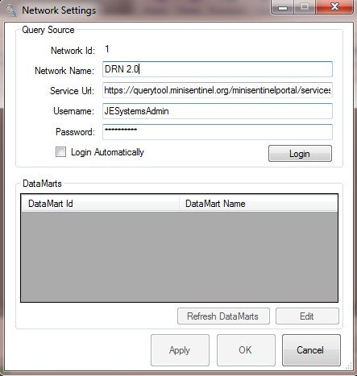
Enter DataMart Administrator Credentials
Fill in your log-in information (use your DataMart Administrator login credentials)
Click Apply to save your settings, this will log you into your DataMart
Click Edit to configure your database to your Network and choose your settings.

Slide 17
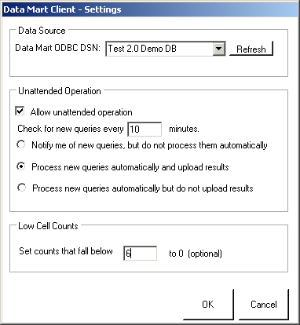
Establish DataMart Connection and Settings
Select your Data Source from your ODBC DSN connection completed in Step 2
Establish the DataMart settings
Check “Allow unattended operation” if you wish to automate your query response (optional)
Select a low cell count cut off (optional)

Slide 18
You’re Done!
For additional resources:
Website: www.popmednet.org
Contact: popmednet@hphc.org

Slide 19
Importing Summary Tables Into MSAccess
One of the data models supported by PopMedNet is the PopMedNet Summary Tables. If necessary, the tables can be imported from other file formats into MSAcess as follows:
All Tab Delimited files can be imported into a single Access database for use by PopMedNet.
Going through the MSAccess Importing Wizard: Go to the External Data tab and in the Import section, select ‘Text File.’ Select a Tab Delimited file.
Check ‘First row contains field names’.
No primary key.
All columns should be listed as ‘TEXT’ fields except those that are explicitly numeric counts (for example, dispensings, members).
Some versions of Office will try to force fields to be numeric because it looks like a number, but the query tool software is expecting a character.
Repeat until all summary tables are imported to MSAccess.

