Slide 1
Data preprocessing for feature extraction
Version: Jan. 21, 2025
Note: Although the example used here is MIMIC-IV dataset, this process is applicable for all 3 datasets used in the study

Slide 2
(I) Extract Chart_Events and Lab_Events features
Item ID | Item name | Item unit
(1) Drop rows that have null values
(I-1) For Lab_Events features
row#: 1621
(A) Lab_Item_ID table
(2) Extract Lab_Events table’s rows which Item IDs match to Lab_Item_ID table’s Item ID
Item ID | Item name | Item unit (e.g. cm, ml)
(C) Lab_Events table-2
feature#: 1625
Subject ID | HADM ID | Item ID | Chart time | Value | Item name | Item unit
(B) Original Lab_Events table
Subject ID | HADM ID | Item ID | Chart time | Value
row#: 122,289,828
(3) Drop rows that have null values
(4) Combine “Item name” and “Item unit” into same column
(D) Lab_Events table-3
Subject ID | HADM ID | Chart time | Value | Item name (Item unit)
(I-2) For Chart_Events features
row#: 59,187,024
feature#: 508
(6.1) Combine Lab_Events-(D) table and Chart_Events-(G) table;
(6.2) Sort HADM_ID in new table
(E) Chart_Item_ID table
Item ID | Item name | Item unit (e.g. cm, ml)
(5) Follow above (1), (2), (3), (4) steps
(G) Chart_Events table-3
Subject ID | HADM ID | Chart time | Value | Item name (Item unit)
feature#: 3835
row#: 139,896,979
feature#: 903
(F) Original Chart_Events table
(H) Chart_Lab_Events table-1
Subject ID | HADM ID | Item ID | Chart time | Value
Subject ID | HADM ID | Chart time | Value | Item name (Item unit)
row#: 199,084,003
feature#: 1410
HADM_ID#: 429,796
(there are one feature duplicate in both tables)

Slide 3

(II) Chart_Lab_Events table
(7-2) Split table-(H) into 1075 data-frames (HADM_ID-based sampling) to process smaller datasets for computing resource limitation reason
(H) Chart_Lab_Events table-1
Subject ID | HADM ID | Chart time | Value | Item name (Item unit)
Data-frame 1-1
Subject ID | HADM ID | Chart time | Value | Item name (Item unit)
HADM_ID#: 400
column#: 5
row#: 199,084,003
feature#: 1410
HADM_ID#: 429,796
(7-1) Create a feature name list & give each feature an index
Data-frame 1-2
Subject ID | HADM ID | Chart time | Value | Item name (Item unit)
HADM_ID#: 400
column#: 5
…
Data-frame 1-1075
Subject ID | HADM ID | Chart time | Value | Item name (Item unit)
HADM_ID#: 400
column#: 5
(I) Feature name & index list
Feature name
Feature index
[ feature a (feature a’s unit), 1 ],
[ feature b (feature b’s unit), 2 ],
(8) Using information from list-(I) to add several columns to data-frames:
(8.1) add a column about feature index information
(8.2) add 1410 columns for feature names
……
1410 sub-lists
[ feature n (feature unit xn), 1410 ]
(J) Chart_Lab_Events table-2
For example, the Data-frame 2-1 (through step 8: Data-frame 1-1 -> Data-frame 2-1)
Subject ID | HADM ID | Chart time | Value | Item name (Item unit) | Item index | Feature a (feature a’s unit) | Feature b (feature b’s unit) | …… | Feature xn (feature xn’s unit)
column#: 1416
1410 columns/features

Slide 4
An example of one row in Data-frame 2-1
Subject ID | HADM ID | Chart time | Value | Item name (Item unit) | Item index | Feature a (feature a’s unit) | Feature b (feature b’s unit) | …… | Feature xn (feature xn’s unit)
1999906 | 100001 | 2161-08-30 20:00:00 | 0.3 | feature a (feature unit a) | 1 | NAN | NAN | NAN | NAN
column#: 1416
Here is the result:
1410 columns
(J) Chart_Lab_Events table-2
Data-frame 2-1
Subject ID | HADM ID | Chart time | Value | Item name (Item unit) | Item index | Feature a (feature a’s unit) | Feature b (feature b’s unit) | …… | Feature xn (feature xn’s unit)
HADM_ID#: 400
column#: 1416
(9) For each data-frame in (J):
(9-1) Extract same HADM_ID rows as a group;
(9-2) In each HADM_ID group, combine rows with same Chart_time and fill the corresponding feature value.
Data-frame 2-2
Subject ID | HADM ID | Chart time | Value | Item name (Item unit) | Item index | Feature a (feature a’s unit) | Feature b (feature b’s unit) | …… | Feature xn (feature xn’s unit)
HADM_ID#: 400
column#: 1416
Data-frame 2-1075
…
Subject ID | HADM ID | Chart time | Value | Item name (Item unit) | Item index | Feature a (feature a’s unit) | Feature b (feature b’s unit) | …… | Feature xn (feature xn’s unit)
HADM_ID#: 400
column#: 1416

Slide 5
Using one data-frame as an example:
Subject ID | HADM ID | Chart time | Value | Item name (Item unit) | Item index | Feature a (feature a’s unit) | Feature b (feature b’s unit) | …… | Feature f (feature f’s unit) | …… | Feature xn (feature xn’s unit)
1999906 | 100001 | 2161-08-30 20:00:00 | 0.3 | feature a (feature unit a) | 1 | NAN | NAN | NAN | NAN | NAN | NAN
1999906 | 100001 | 2161-08-30 20:00:00 | 0.79 | feature f (feature unit f) | 6 | NAN | NAN | NAN | NAN | NAN | NAN
… | … | … | … | … | … | … | … | … | … | … | …
2992106 | 275001 | 2172-03-06 22:00:00 | 2.3 | feature b (feature unit a) | 2 | NAN | NAN | NAN | NAN | NAN | NAN
2992106 | 275001 | 2172-03-07 5:00:00 | 5.79 | feature g (feature unit f) | 7 | NAN | NAN | NAN | NAN | NAN | NAN
2992106 | 275001 | 2172-03-07 5:00:00 | 0.7 | feature k (feature unit a) | 6 | NAN | NAN | NAN | NAN | NAN | NAN
4957106 | 683051 | 2135-07-14 12:51:00 | 8.3 | feature n (feature unit a) | 14 | NAN | NAN | NAN | NAN | NAN | NAN
4957106 | 683051 | 2135-07-14 12:51:00 | 0.53 | feature a (feature unit a) | 1 | NAN | NAN | NAN | NAN | NAN | NAN
Step (9-1)
Extract same HADM_ID rows as a group

Slide 6
Subject ID | HADM ID | Chart time | Value | Item name (Item unit) | Item index | Feature a (feature a’s unit) | Feature b (feature b’s unit) | …… | Feature f (feature f’s unit) | …… | Feature xn (feature xn’s unit)
1999906 | 100001 | 2161-08-30 20:00:00 | 0.3 | feature a (feature unit a) | 1 | NAN | NAN | NAN | NAN | NAN | NAN
1999906 | 100001 | 2161-08-30 20:00:00 | 0.79 | feature f (feature unit f) | 6 | NAN | NAN | NAN | NAN | NAN | NAN
1999906 | 100001 | 2172-09-01 6:07:00 | 2.3 | feature b (feature unit b) | 2 | NAN | NAN | NAN | NAN | NAN | NAN
1999906 | 100001 | 2172-09-01 6:07:00 | 5.79 | feature g (feature unit g) | 7 | NAN | NAN | NAN | NAN | NAN | NAN
1999906 | 100001 | 2172-09-01 6:07:00 | 0.7 | feature f (feature unit f) | 6 | NAN | NAN | NAN | NAN | NAN | NAN
Step (9-2)

Slide 7
Chart time:
2161-08-30 20:00:00
Subject ID | HADM ID | Chart time | Value | Item name (Item unit) | Item index | Feature a (feature a’s unit) | Feature b (feature b’s unit) | …… | Feature f (feature f’s unit) | …… | Feature xn (feature xn’s unit)
1999906 | 100001 | 2161-08-30 20:00:00 | 0.3 | feature a (feature unit a) | 1 | NAN | NAN | NAN | NAN | NAN | NAN
1999906 | 100001 | 2161-08-30 20:00:00 | 0.79 | feature f (feature unit f) | 6 | NAN | NAN | NAN | NAN | NAN | NAN
Step (9-2.1) Using the “Item index” information to fill corresponding feature value;
(9-2.2) Combine rows with same chart time into one row
Subject ID | HADM ID | Chart time | Feature a (feature a’s unit) | Feature b (feature b’s unit) | …… | Feature f (feature f’s unit) | …… | Feature xn (feature xn’s unit)
1999906 | 100001 | 2161-08-30 20:00:00 | 0.3 | NAN | NAN | 0.79 | NAN | NAN
Chart time:
2172-09-01 6:07:00
Subject ID | HADM ID | Chart time | Value | Item name (Item unit) | Item index | Feature a (feature a’s unit) | Feature b (feature b’s unit) | …… | Feature f (feature f’s unit) | Feature g (feature g’s unit) | …… | Feature xn (feature xn’s unit)
1999906 | 100001 | 2172-09-01 6:07:00 | 2.3 | feature b (feature unit b) | 2 | NAN | NAN | NAN | NAN | NAN | NAN | NAN
1999906 | 100001 | 2172-09-01 6:07:00 | 5.79 | feature g (feature unit g) | 7 | NAN | NAN | NAN | NAN | NAN | NAN | NAN
1999906 | 100001 | 2172-09-01 6:07:00 | 0.7 | feature f (feature unit f) | 6 | NAN | NAN | NAN | NAN | NAN | NAN | NAN
Step (9-2.1) & (9-2.2)
Subject ID | HADM ID | Chart time | Feature a (feature a’s unit) | Feature b (feature b’s unit) | …… | Feature f (feature f’s unit) | Feature g (feature g’s unit) | …… | Feature xn (feature xn’s unit)
1999906 | 100001 | 2172-09-01 6:07:00 | NAN | 2.3 | NAN | 0.7 | 5.79 | NAN | NAN
Step (9-2.3) Doing these for all HADM_IDs and combine the resulting rows

Slide 8
The Data-frame 3-1 (through step 9: Data-frame 2-1 -> Data-frame 3-1)
Subject ID | HADM ID | Chart time | Feature a (feature a’s unit) | Feature b (feature b’s unit) | …… | Feature f (feature f’s unit) | …… | Feature xn (feature xn’s unit)
1999906 | 100001 | 2161-08-30 20:00:00 | 0.3 | NAN | NAN | 0.79 | NAN | NAN
… | … | … | … | … | … | … | … | …
2992106 | 275001 | 2172-03-06 22:00:00 | NAN | 2.3 | NAN | 0.7 | NAN | NAN
4957106 | 683051 | 2135-07-14 12:51:00 | 0.53 | NAN | NAN | NAN | NAN | NAN
(10) Repeat above steps for all 1075 data-frames
(K) Chart_Lab_Events table-3
Subject ID | HADM ID | Chart time | Feature a (feature a’s unit) | Feature b (feature b’s unit) | …… | Feature f (feature f’s unit) | …… | Feature xn (feature xn’s unit)
column#: 1413
Data-frame 3-1
Subject ID | HADM ID | Chart time | Feature a (feature a’s unit) | Feature b (feature b’s unit) | …… | Feature f (feature f’s unit) | …… | Feature xn (feature xn’s unit)
Data-frame 3-1
column#: 1413
…
Subject ID | HADM ID | Chart time | Feature a (feature a’s unit) | Feature b (feature b’s unit) | …… | Feature f (feature f’s unit) | …… | Feature xn (feature xn’s unit)
Data-frame 3-1075
column#: 1413

Slide 9
(11) Split each data-frame into 282 sub-tables:
Each sub-table has 5 features (except the last sub-table which has 8 features), the reason is because the computation resource limitation
<Data-frame 3-1>
5 columns/features
<Data-frame 3-2>
<Data-frame 3-1075 >
Data-frame 3-1 s-1
Data-frame 3-2 s-1
Subject ID | HADM ID | Chart time | Feature a (feature a’s unit) | … | Feature e (feature e’s unit)
Subject ID | HADM ID | Chart time | Feature a (feature a’s unit) | … | Feature e (feature e’s unit)
Data-frame 3-1075 s-1
…
column#: 8
column#: 8
Data-frame 3-1 s-2
Data-frame 3-2 s-2
Subject ID | HADM ID | Chart time | Feature f (feature f’s unit) | … | Feature j (feature j’s unit)
Subject ID | HADM ID | Chart time | Feature f (feature f’s unit) | … | Feature j (feature j’s unit)
Data-frame 3-1075 s-2
…
column#: 8
column#: 8
Data-frame 3-1 s-3
Data-frame 3-2 s-3
Subject ID | HADM ID | Chart time | Feature k (feature k’s unit) | … | Feature o (feature o’s unit)
Subject ID | HADM ID | Chart time | Feature k (feature k’s unit) | … | Feature o (feature o’s unit)
Data-frame 3-1075 s-3
…
…
column#: 8
…
column#: 8
Data-frame 3-1 s-282 (the last sub-table)
Data-frame 3-2 s-282
Subject ID | HADM ID | Chart time | Feature xj (feature xj’s unit) | … | Feature xn (feature xn’s unit)
Subject ID | HADM ID | Chart time | Feature xj (feature xj’s unit) | … | Feature xn (feature xn’s unit)
Data-frame 3-1075 s-282
…
column#: 11
8 columns/features
column#: 11

Slide 10
For example:
Data-frame 3-1 s-1
(12) Combine same number sub-tables for all data-frames
Subject ID | HADM ID | Chart time | Feature a (feature a’s unit) | … | Feature e (feature e’s unit)
Data-frame 3 s-1
Data-frame 3-2 s-1
+
Subject ID | HADM ID | Chart time | Feature a (feature a’s unit) | … | Feature e (feature e’s unit)
Subject ID | HADM ID | Chart time | Feature a (feature a’s unit) | … | Feature e (feature e’s unit)
…
row#: 75,664,280
column#: 8
HADM_ID#: 429,796
Data-frame 3-1075 s-1
Subject ID | HADM ID | Chart time | Feature a (feature a’s unit) | … | Feature e (feature e’s unit)
Data-frame 3-1 s-2
Subject ID | HADM ID | Chart time | Feature f (feature f’s unit) | … | Feature j (feature j’s unit)
Data-frame 3 s-2
Data-frame 3-2 s-2
+
Subject ID | HADM ID | Chart time | Feature f (feature f’s unit) | … | Feature j (feature j’s unit)
Subject ID | HADM ID | Chart time | Feature f (feature f’s unit) | … | Feature j (feature j’s unit)
…
row#: 75,664,280
column#: 8
HADM_ID#: 429,796
Data-frame 3-1075 s-2
…
Subject ID | HADM ID | Chart time | Feature f (feature f’s unit) | … | Feature j (feature j’s unit)

Slide 11
Here is the result:
(M) Chart_Lab_Events table-5
(L) Chart_Lab_Events table-4
Data-frame 4 s-1
Data-frame 5 s-1
Subject ID | HADM ID | Chart time | Feature a (feature a’s unit) | … | Feature e (feature e’s unit)
Subject ID | HADM ID | Chart time | Feature a (feature a’s unit) | … | Feature c (feature c’s unit)
column#: 8
HADM_ID#: 429,796
row#: 18,425,341
column#: 6
HADM_ID#: 429,796
Data-frame 4 s-2
Data-frame 5 s-2
Subject ID | HADM ID | Chart time | Feature f (feature f’s unit) | … | Feature j (feature j’s unit)
Subject ID | HADM ID | Chart time
(13.1) Remove features that missing percentage >= 70%
row#: 18,425,341
column#: 3
HADM_ID#: 429,796
column#: 8
HADM_ID#: 429,796
sub-table#: 282
Data-frame 4 s-3
Data-frame 5 s-3
Subject ID | HADM ID | Chart time | Feature k (feature k’s unit) | … | Feature o (feature o’s unit)
Subject ID | HADM ID | Chart time | Feature k (feature k’s unit)
row#: 18,425,341
column#: 4
HADM_ID#: 429,796
column#: 8
HADM_ID#: 429,796
…
…
Data-frame 4 s-282
Data-frame 5 s-282
Subject ID | HADM ID | Chart time | Feature xj (feature xj’s unit) | … | Feature xn (feature xn’s unit)
Subject ID | HADM ID | Chart time | Feature xk (feature xk’s unit) | Feature xm (feature xm’s unit)
column#: 11
HADM_ID#: 429,796
(13.2) label AKI, see slide p.14
row#: 18,425,341
column#: 5
HADM_ID#: 429,796

Slide 12
In experiment, after removing features that missing percentage >= 70%, there are only 3 features remain
(14) Remove sub-tables that column number < 4
(N) Chart_Lab_Events table-5
Data-frame 5 s-1
Sub-table index | column#
Data-frame 4 s-5 | 5 (remain 2 features)
Data-frame 4 s-6 | 4 (remain 1 feature)
Subject ID | HADM ID | Chart time | Feature a (feature a’s unit) | … | Feature c (feature c’s unit)
row#: 18,425,341
column#: 6
HADM_ID#: 429,796
Data-frame 5 s-3
Subject ID | HADM ID | Chart time | Feature k (feature k’s unit)
sub-table#: 281-x
row#: 18,425,341
column#: 4
HADM_ID#: 429,796
…
Data-frame 5 s-282
(15) Final step, combine all remain sub-tables
Subject ID | HADM ID | Chart time | Feature xk (feature xk’s unit) | Feature xm (feature xm’s unit)
row#: 18,425,341
column#: 5
HADM_ID#: 429,796

Slide 13
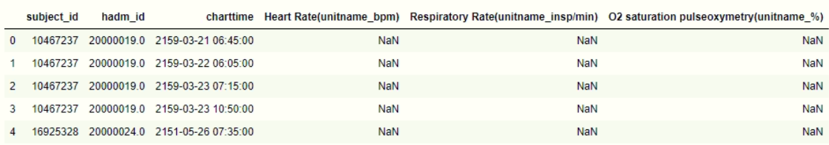
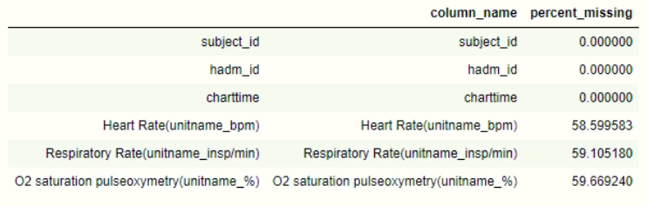
Experiment result:
row#: 18,425,341
column#: 6
feature#: 3
HADM_ID#: 429,796

Slide 14
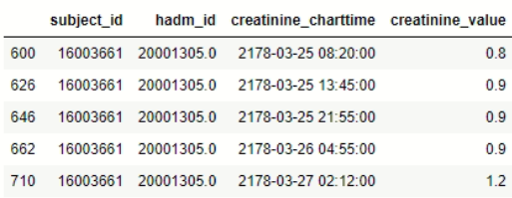
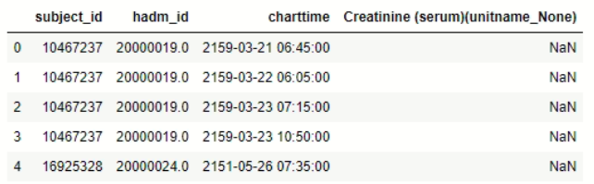
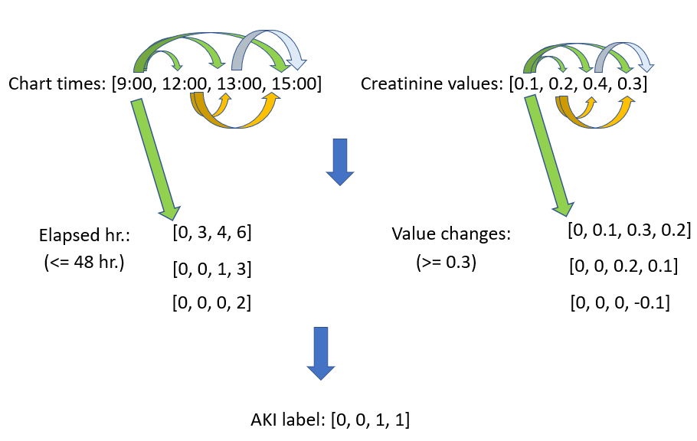
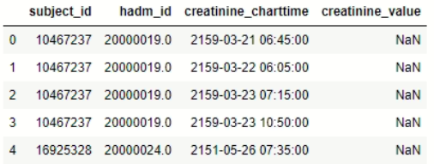
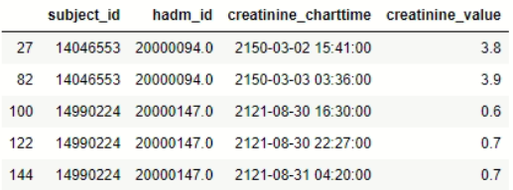
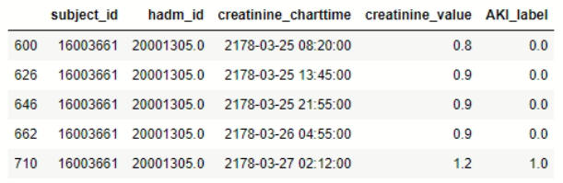
(13.2) AKI labeling
(13.2-4) Extract same HADM_ID rows as a group and compute AKI label
(13.2-1) Extract creatinine feature column as a single table
Using one HADM_ID as example:
AKI calculation process:
row#: 18,425,341
column#: 4
HADM_ID#: 429,796
(13.2-2) Rename rows
(13.2-3) Drop rows with null values
Result:
row#: 417,394
HADM_ID#: 63,122

Slide 15
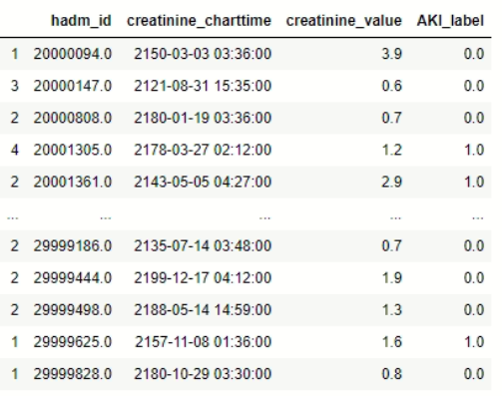
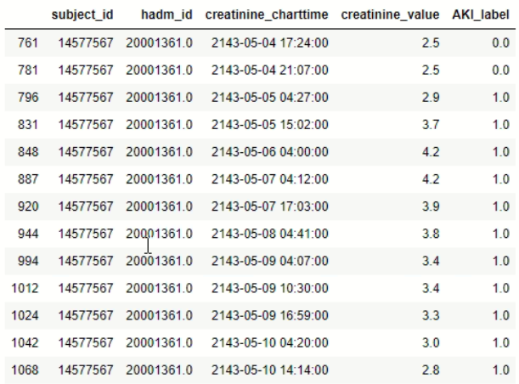

(13.2-5)
Final result:
(i) for every HADM_ID group:
(a) if there is 1 in aki labels: cut data after first label 1
(b) if all aki lables are 0: keep all data
(ii) get last creatinine chart time for each HADM_ID
Example of a HADM_ID group:
row#: 52,550
column#: 4
HADM_ID#: 52,550
(i)
(ii)

