Slide 1
Network Recommendation Engine
Jacky Zhao, April 2018

Slide 2
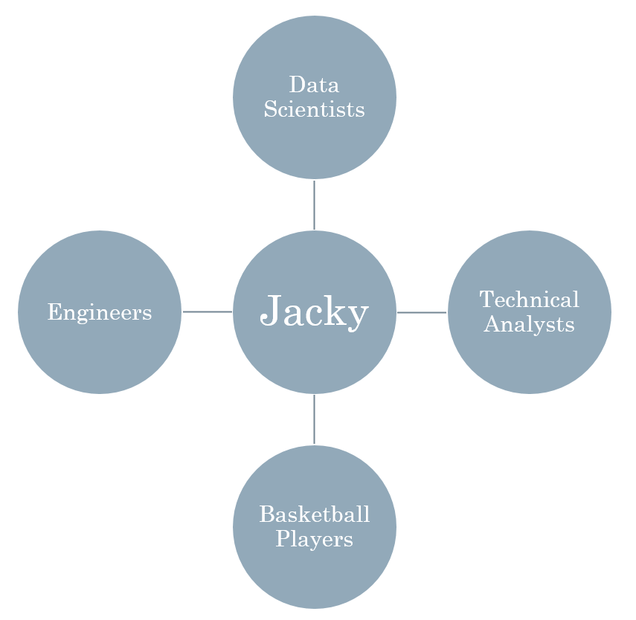
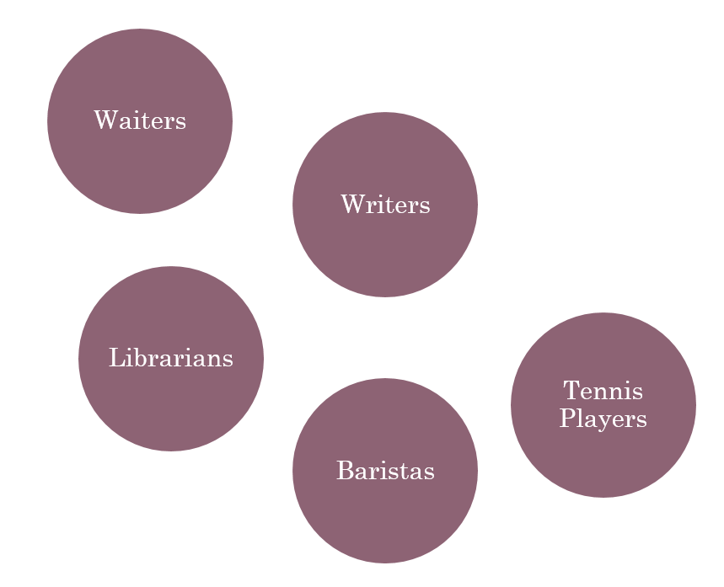
Problem
People tend to self-identify and stay within their own social circle of friends and colleagues.
They are unwittingly excluding others with different labels from their network.
Outside my network
My network

Slide 3
Proposed solution
Recommendation engine API that refers you to 5 likeminded people based on your reddit comments and subreddit of choice. (https://github.com/iamjz/matcher)
Username (BobbyData129)
Subreddit (r/Mizzou)
5 likeminded users
Inputs
Output

Slide 4


What makes this unique?
Matches individuals based on talking points instead of personality questionnaires.
Traditional: OkCupid, eHarmony, Elite Singles, Match.com
Under traditional networking methods, these 2 would have a low chance of meeting.
Likes college basketball
Low-carb diet
Likes modern art
Watches football
Tries out different restaurants
Does graffiti
Bob
Sally

Slide 5
Likes college basketball
Low-carb diet
Likes modern paintings
Watches football
Tries out different restaurants
Does graffiti
Sports
Coaches
Food
Smoothie
Art
Colors
Recruits
Wins
Preseason
Drafts
Kale
Bacon
Delicious
Vibrant
Masterpiece
Paint
Bob
Sally

Slide 6
Implementation
Gather
Reddit API
Recommend
TF-IDF
Validate
Common subreddits
Python library (PRAW)
Data cleansing
Storage
Stop-word removal
Cosine similarity
Outputs top 5 based on similarity score
Similar flairs
Hierarchical document clustering
Porter Stemmer

Slide 7
Implementation: Gather
Reddit RESTful API (https://www.reddit.com/wiki/api):
Requires a Reddit developer account for an API Client ID and Client Secret Key
Free usage – up to 60 requests per minute
PRAW Python Reddit API wrapper (https://praw.readthedocs.io/en/latest):
Only requires basic understanding of Reddit.com and Python
Great documentation
Data cleansing/manipulation (helpers.py):
Organized API requests in functions and loops
Try/Catch blocks to account for suspended/banned/deleted accounts
Removed newlines, page-breaks, non-alphanumeric characters, and extra spaces
Storage:
Only scraped a small fraction of each subreddit.
Stored the cleaned comments in csv files (user – comments)

Slide 8
Implementation: Recommend
TF-IDF (Term frequency – Inverse document frequency):
TF (Term frequency): Measures how frequently a term occurs in a document.
Increasing by the number of times a word appears in a document.
IDF (Inverse document frequency): Measures how import a term is.
Decreasing by the number of times a word appears in the entire corpus.
Porter stemming algorithm:
Reduces a word back to its word stem or root form.
Improves performance in text analytics by categorizing various similar words.
Remove stop-words:
Filter out common words without any significant meaning (the, is, a, that, at, which…)
Combined 2 stop-words dictionaries for extra filters.
Cosine similarity:
Measures the “distance” by finding the cosine angle between 2 vectors (documents)
Catches the direction of the vectors better = semantic meaning
Euclidean distance not as powerful for high dimensional data

Slide 9
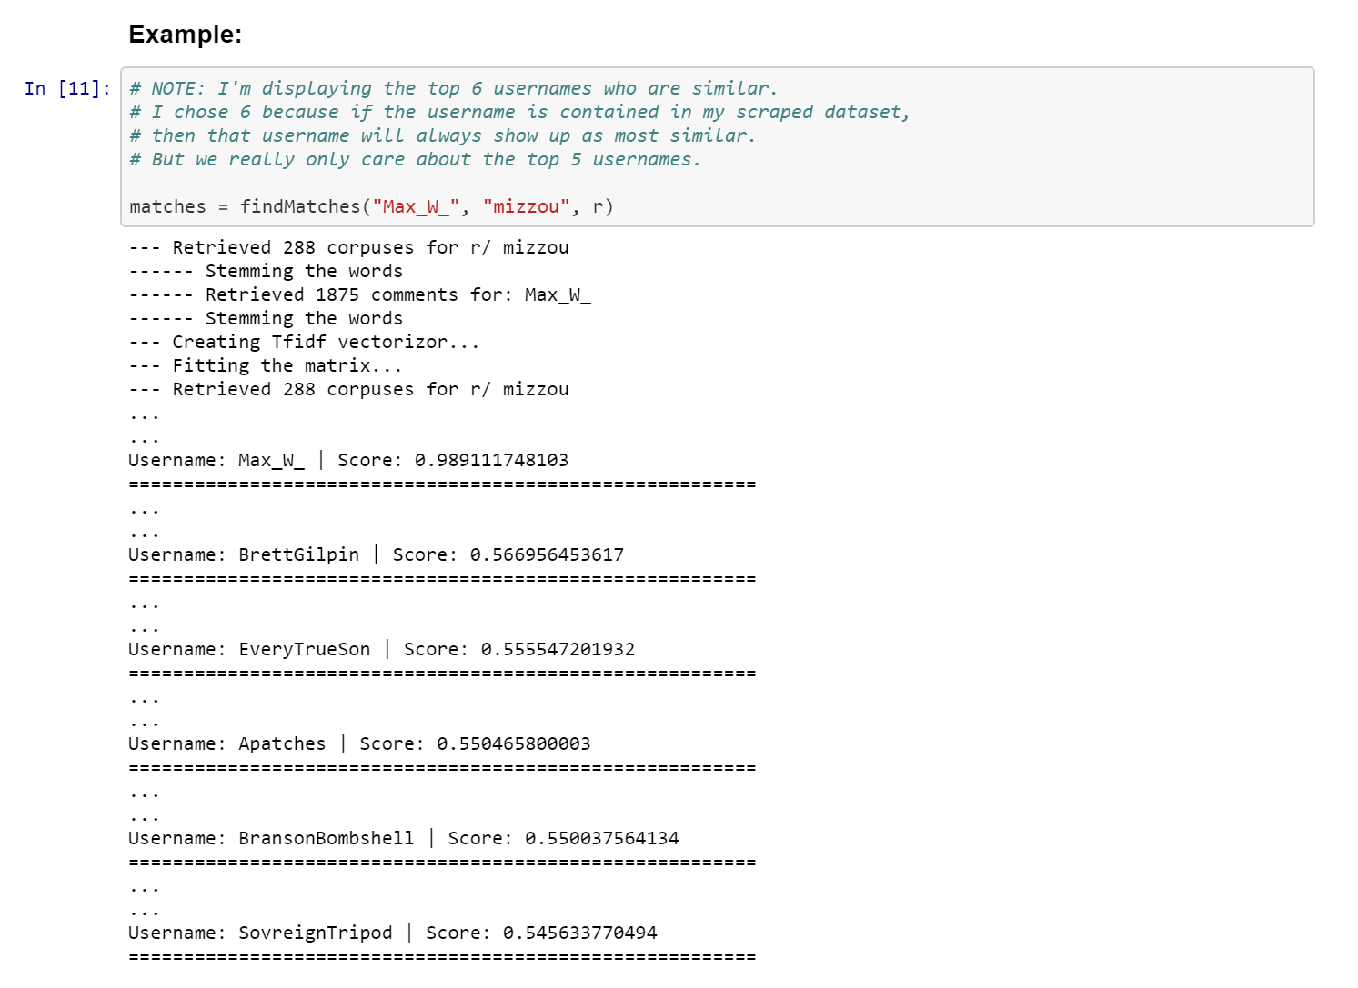
View code @ https://github.com/iamjz/matcher/

Slide 10

Implementation: Validate

Slide 11
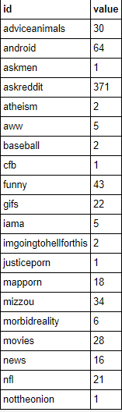
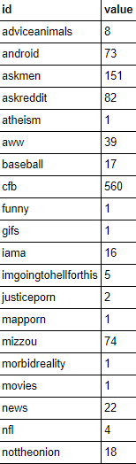
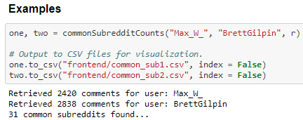
Validations: Common Subreddits
Max_W_
BrettGilpin
View code @ https://github.com/iamjz/matcher/

Slide 12
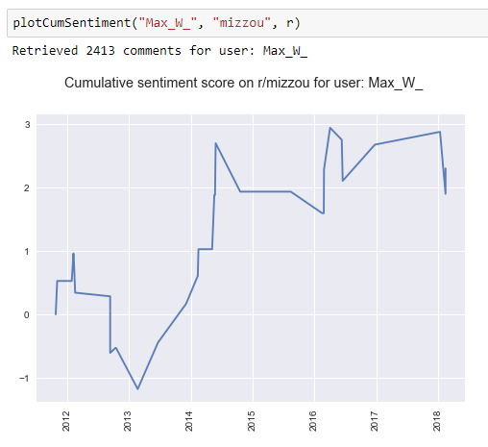
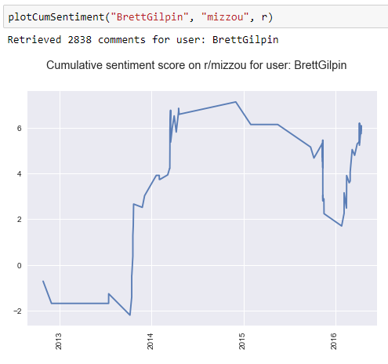
Validations: Subreddit Sentiments
View code @ https://github.com/iamjz/matcher/

Slide 13
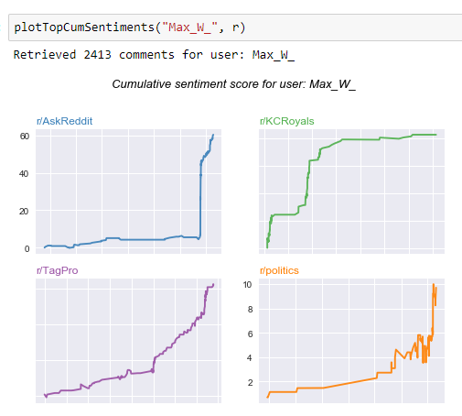
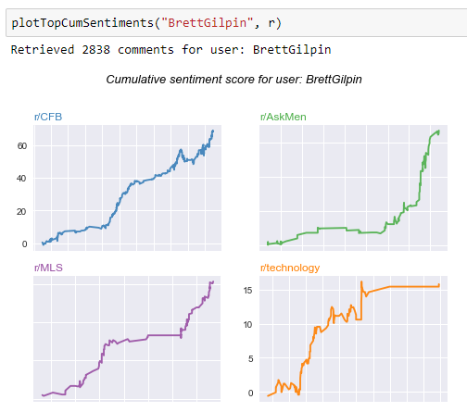
Validations: Top Subreddit Sentiments
View code @ https://github.com/iamjz/matcher/

Slide 14
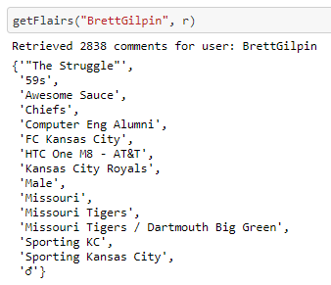
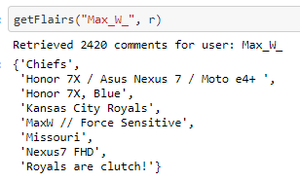
Validations: User Flairs
View code @ https://github.com/iamjz/matcher/

Slide 15
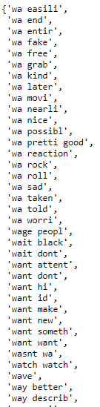
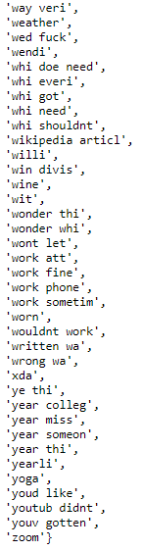

Validations: Common Features
View code @ https://github.com/iamjz/matcher/

Slide 16
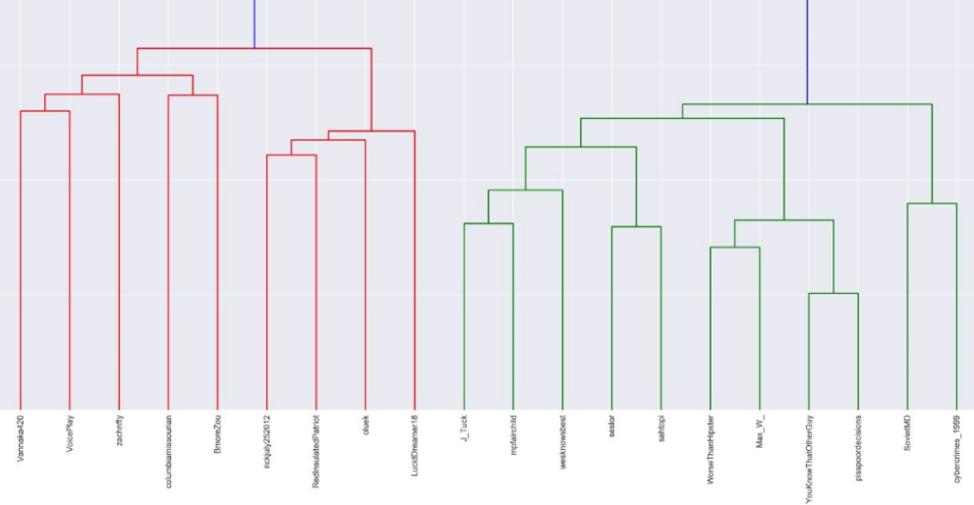
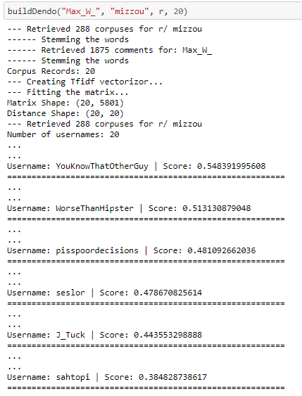
Validations: Hierarchical Clustering
View code @ https://github.com/iamjz/matcher/

Slide 17
Lessons
The Bad
Volume of data
Unable to do this in real-time
Had to store the data somewhere
Spent a lot of time hitting the API
Quantitative validation
Explore common subreddits
Measure sentiment
Ensure same clusters
The Good
Reddit API and PRAW
Great documentation
RESTful
No rate limits
API wrapper easy to use
Cosine similarity on the TFIDF matrix is fast = < 5 seconds
Recommendations made sense
Personal Finance ~ Financial Independence and Early Retirement

Slide 18
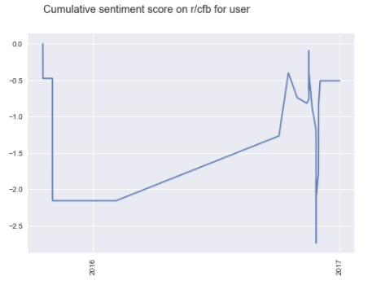
Just for fun…
Sentiment of a University of Michigan fan on a college football subreddit.
* username has been hidden

