Slide 1
Network Recommendation Engine
Jacky Zhao, April 2018

Slide 2
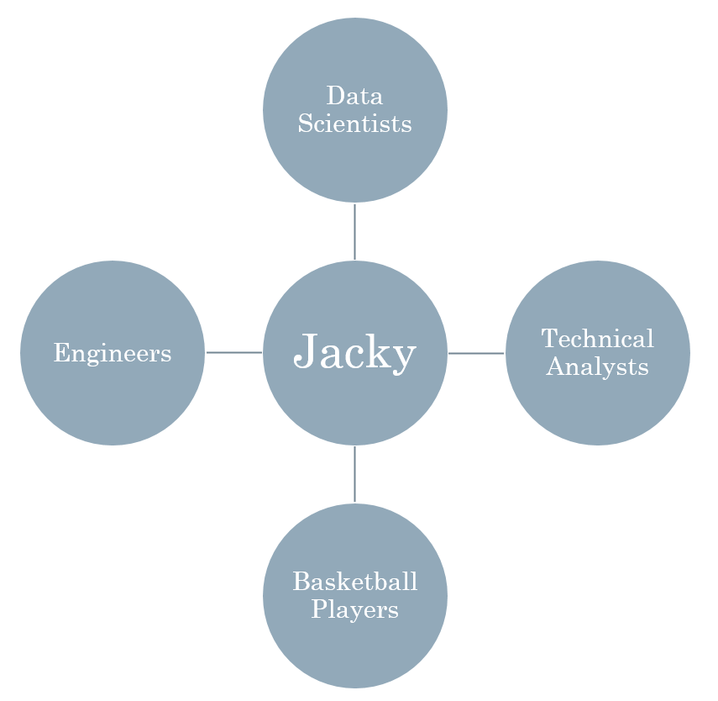
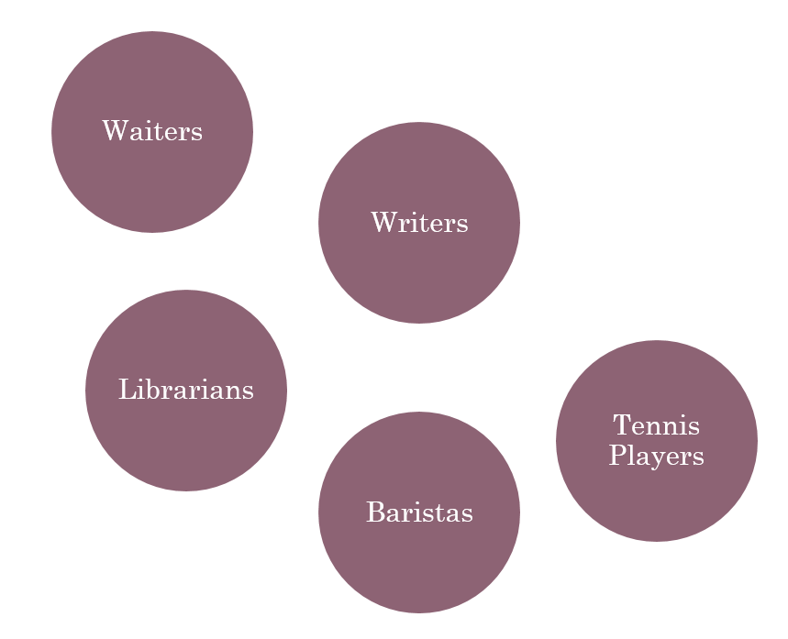
Problem
People tend to self-identify and stay within their own social circle of friends and colleagues.
They are unwittingly excluding others with different labels from their network.
Outside my network
My network

Slide 3
Proposed solution
Recommendation engine API that refers you to 5 likeminded people based on your reddit comments and subreddit of choice. (https://github.com/iamjz/matcher)
Username (BobbyData129)
Subreddit (r/Mizzou)
5 likeminded users
Inputs
Output

Slide 4


What makes this unique?
Matches individuals based on talking points instead of personality questionnaires.
Traditional: OkCupid, eHarmony, Elite Singles, Match.com
Under traditional networking methods, these 2 would have a low chance of meeting.
Likes college basketball
Low-carb diet
Likes modern art
Watches football
Tries out different restaurants
Does graffiti
Bob
Sally

Slide 5
Likes college basketball
Low-carb diet
Likes modern paintings
Watches football
Tries out different restaurants
Does graffiti
Sports
Coaches
Food
Smoothie
Art
Colors
Recruits
Wins
Preseason
Drafts
Kale
Bacon
Delicious
Vibrant
Masterpiece
Paint
Bob
Sally

Slide 6
Implementation
Gather
Reddit API
Recommend
TF-IDF
Validate
Common subreddits
Python library (PRAW)
Data cleansing
Storage
Stop-word removal
Cosine similarity
Outputs top 5 based on similarity score
Similar flairs
Hierarchical document clustering
Porter Stemmer

Slide 7
Implementation: Gather
Reddit RESTful API (https://www.reddit.com/wiki/api):
Requires a Reddit developer account for an API Client ID and Client Secret Key
Free usage – up to 60 requests per minute
Great documentation
PRAW Python Reddit API wrapper (https://praw.readthedocs.io/en/latest):
Only requires basic understanding of Reddit.com
Also great documentation
Data cleansing:
Storage:

Slide 8
Implementation: Recommend
TFIDF
Porter Stemmer
Remove stop-words
Cosine similarity

Slide 9
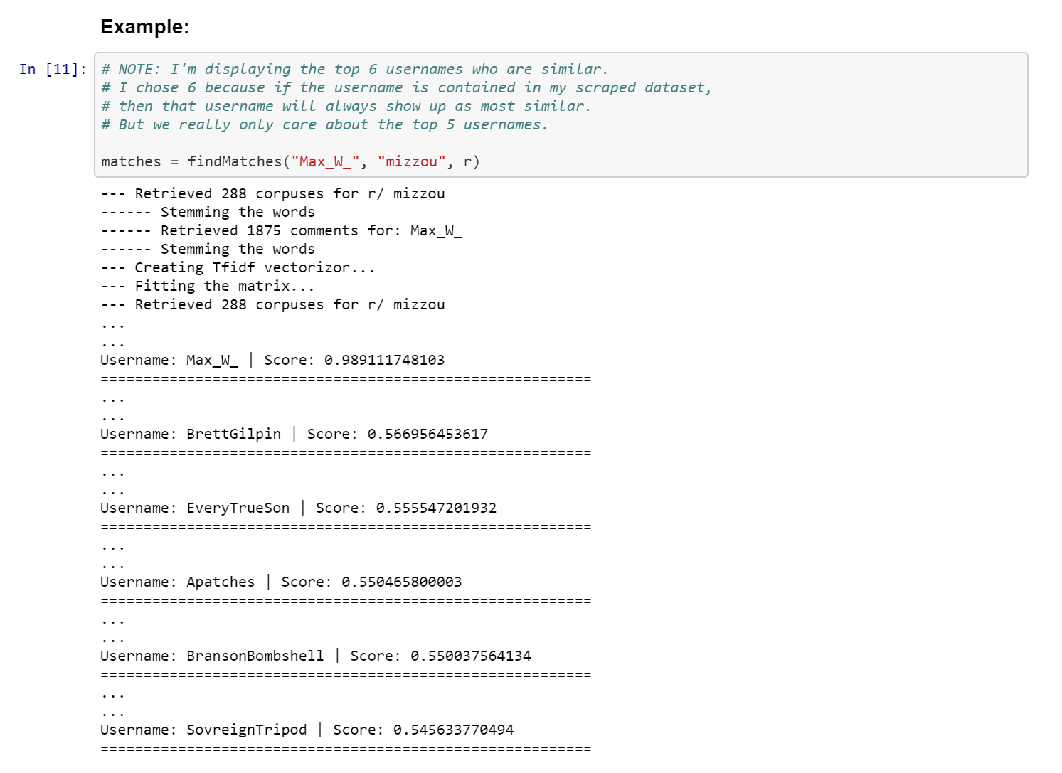
View code @ https://github.com/iamjz/matcher/

Slide 10

Recommendation systems aren’t perfect

Slide 11
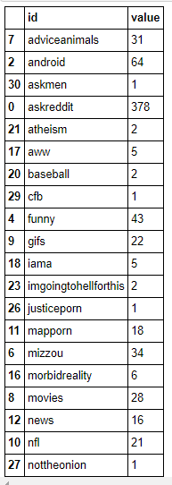
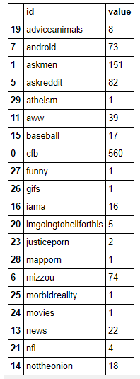
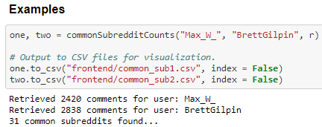
Validations: Common Subreddits
View code @ https://github.com/iamjz/matcher/

Slide 12
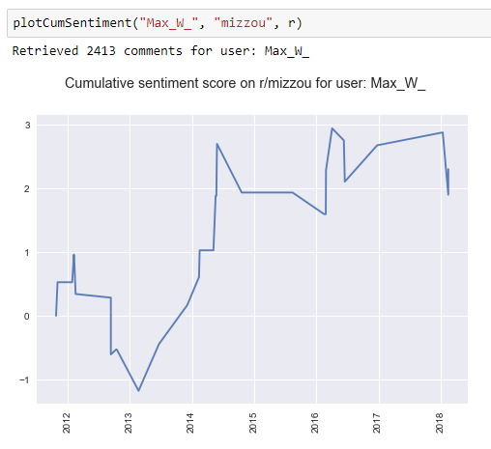
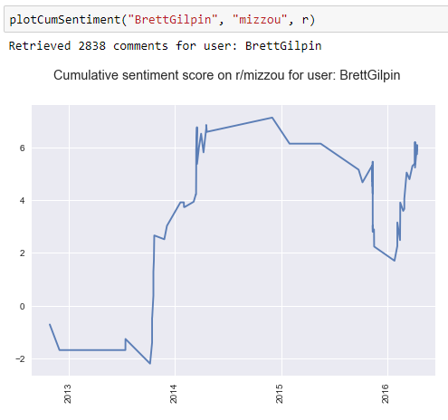
Validations: Subreddit Sentiments

Slide 13
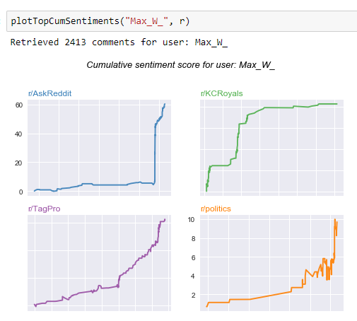
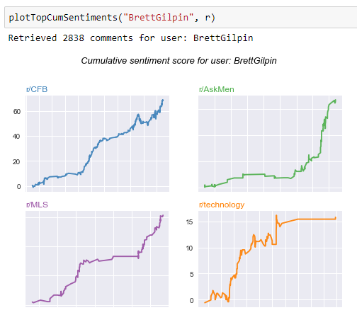
Validations: Top Subreddit Sentiments

Slide 14
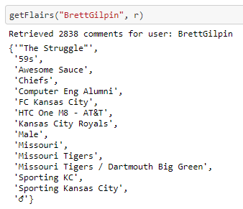
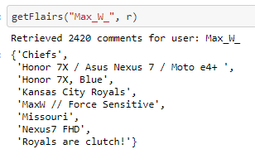
Validations: User Flairs
View code @ https://github.com/iamjz/matcher/

Slide 15
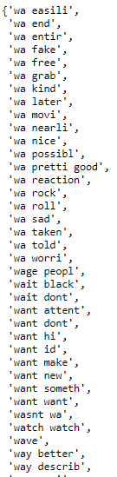
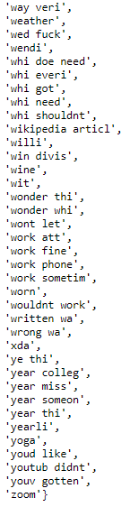

Validations: Common Features
View code @ https://github.com/iamjz/matcher/

Slide 16
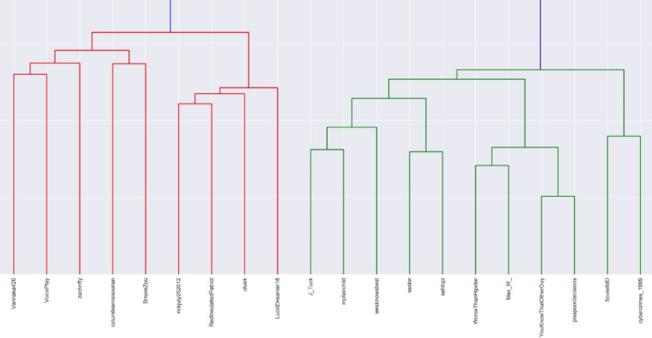
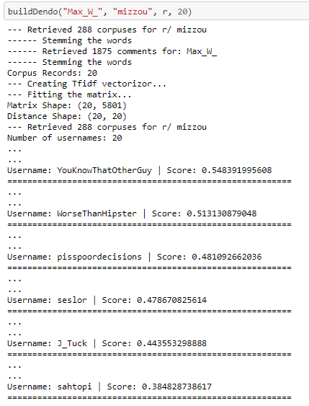
Validations: Hierarchical Clustering
View code @ https://github.com/iamjz/matcher/

Slide 17
Implementation details
TF-IDF (Term frequency – Inverse document frequency):
Reflects the importance of a word to a document in a corpus.
Adjusts for frequently used words:
Increases by number of times a word appears in the document.
Decreases by the frequency of the word in the corpus.
Distance calculation: Measures vector similarity
Cosine similarity: Measures the similarity of vectors with respect to the origin
Catches the direction of the vectors (semantic meaning) better
Euclidean distance: Measures distance between points of interest along the vector
Not quite as powerful for high dimensional data
Next steps:
Flask API for others to consume it
Word2Vec – Semantic Vectors:
Text classification: Liberal or Conservative
Word equation: King + (Woman – Man) = Queen

Slide 18
Lessons
The Bad
Volume of data
Unable to do this in real-time
Had to store the data somewhere
Spent a lot of time hitting the API
Quantitative validation
Explore common subreddits
Measure sentiment
Ensure same clusters
The Good
Reddit API and PRAW
Great documentation
RESTful
No rate limits
API wrapper easy to use
Cosine similarity on the TFIDF matrix is fast = < 5 seconds
Recommendations made sense
Personal Finance ~ Financial Independence and Early Retirement

