Slide 1
Run With It App Demo
By Gary Zhuo and Jerry Mieles CS499s1 July 2016

Slide 2
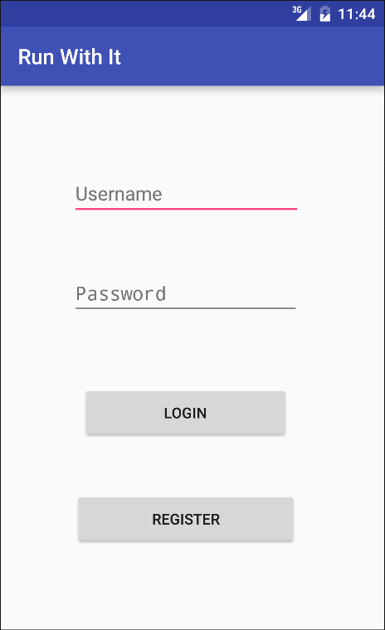
Login Page
Very simple (as it should be)
Once users login they’ll go straight to the map/route finding page

Slide 3
Depth-First Search
We use DFS as a basic concept for our app algorithm
Depth-first search (DFS) is a general technique for traversing a graph
When choosing which vertex to explore next, we favour children over siblings

Slide 4
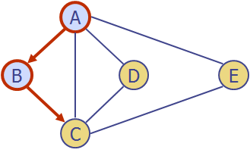

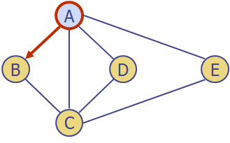

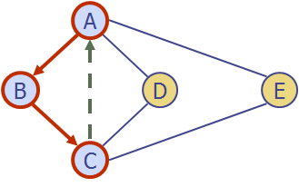
Example

Slide 5
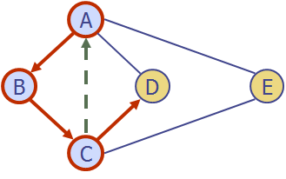
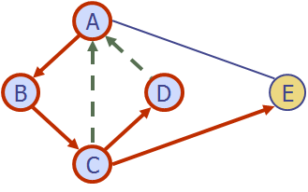
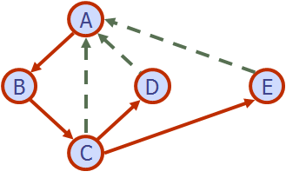
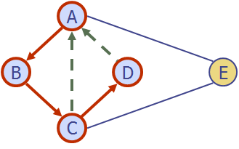
Example (cont.)

Slide 6
Path Finding
the DFS algorithm can be specialized to find all paths between two given vertices.
It always choose a adjacent vertex as the next one
Everytime it goes back, it find a possible route

Slide 7
Our algorithm
DFS(depth,v,path):
path.push(v); //add the current vertex to the path
visited.push(v);
if (depth == 0 && v is target):
print path
Return //stop clause for successful branch
if (depth == 0):
return //stop clause for non successful branch return
for each vertex u such that (v,u) is an edge:
DFS(depth-distance(v,u),u,path) //recursively check all paths for of shorter depth
path.removeLast(); // clean up environment
visited.removeLast();

Slide 8
Our algorithm(cont)
How to find cycles?
We find all routes ending in the vertices which are adjacent to the start vertex.
Then add the start vertex in the end to be a cycle.
Gain all cycles with specific length after DFS
Difficulty of routes: sum of all absolute values of difference of elevations
Selected routes match users’ preference!

Slide 9
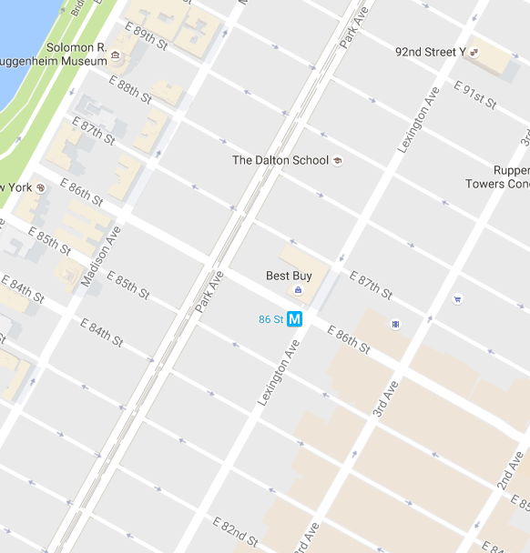
Database grid
11
21
12
31
22
13
41
32
23
14
51
42
33
24
15
52
43
34
25
53
44
35
54
45
55

Slide 10
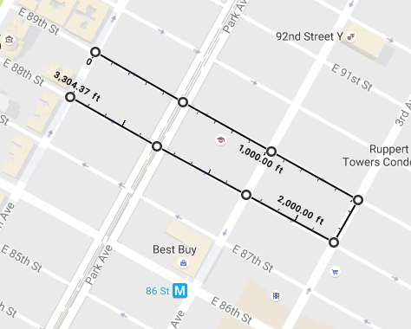

Route 5
2.82172
2.59501
Goes through points 12, 13, 14, 15, 25, 24, 23, 22
4.037
2.22854
2.7180
.049
2.24163

Slide 11
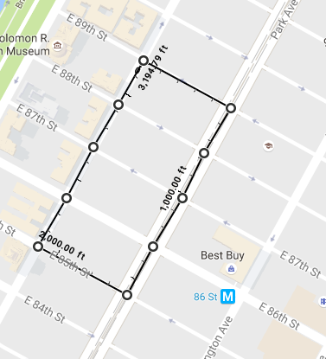
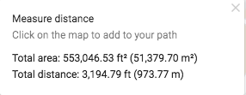
Route 7
Goes through points 12, 13, 23, 33, 43, 53, 52, 42, 32, 22, 21 Also makes a circuit

Slide 12
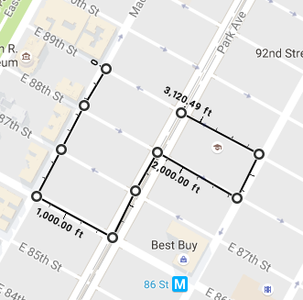

Route 11
Goes through points 12, 22, 32, 42, 43, 33, 23, 24, 14, 13

