Slide 1


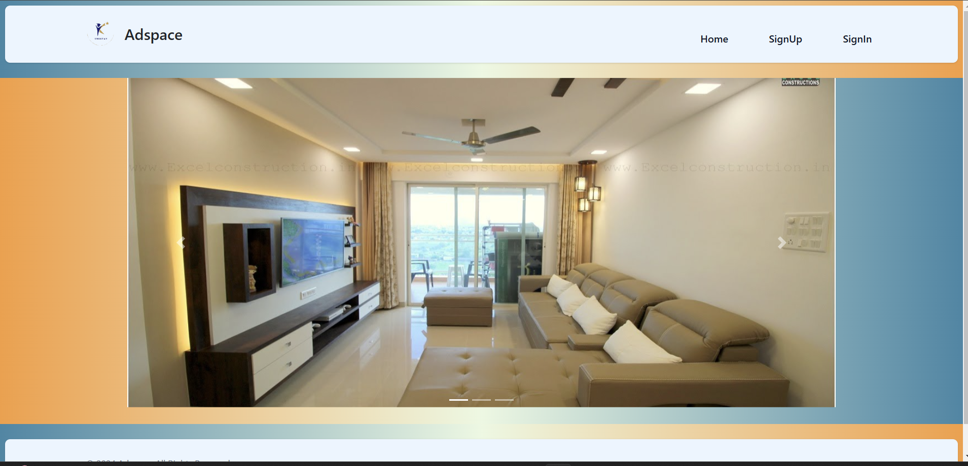
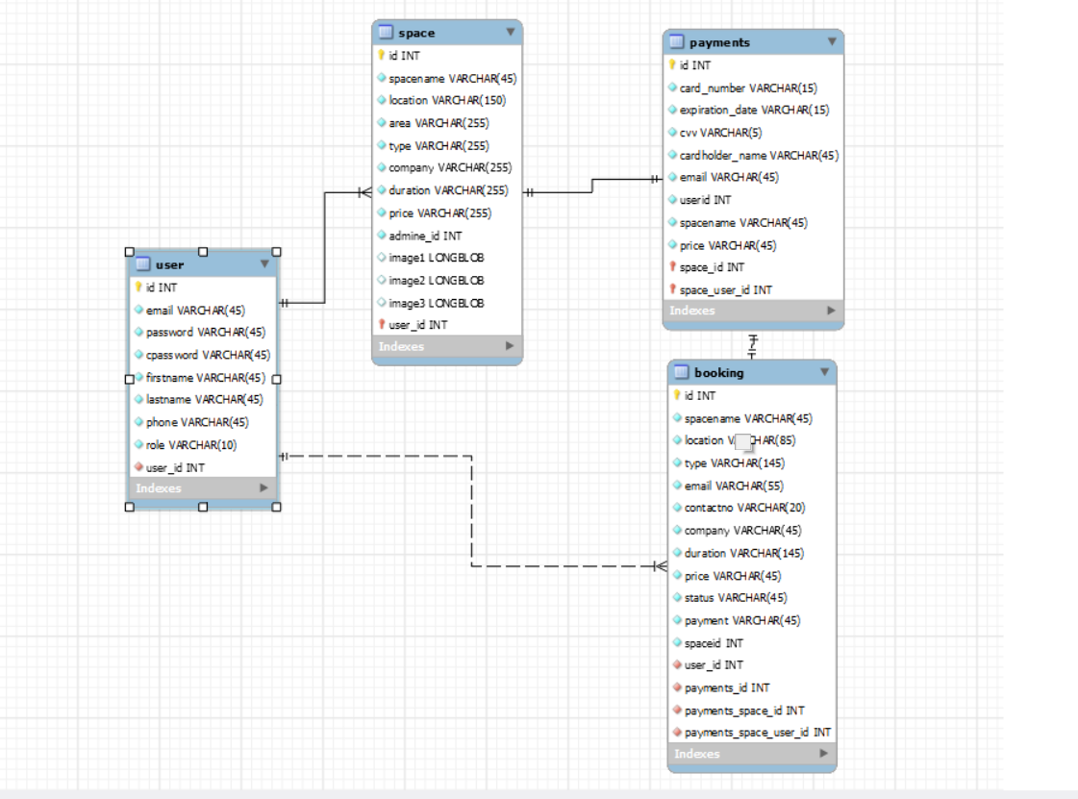
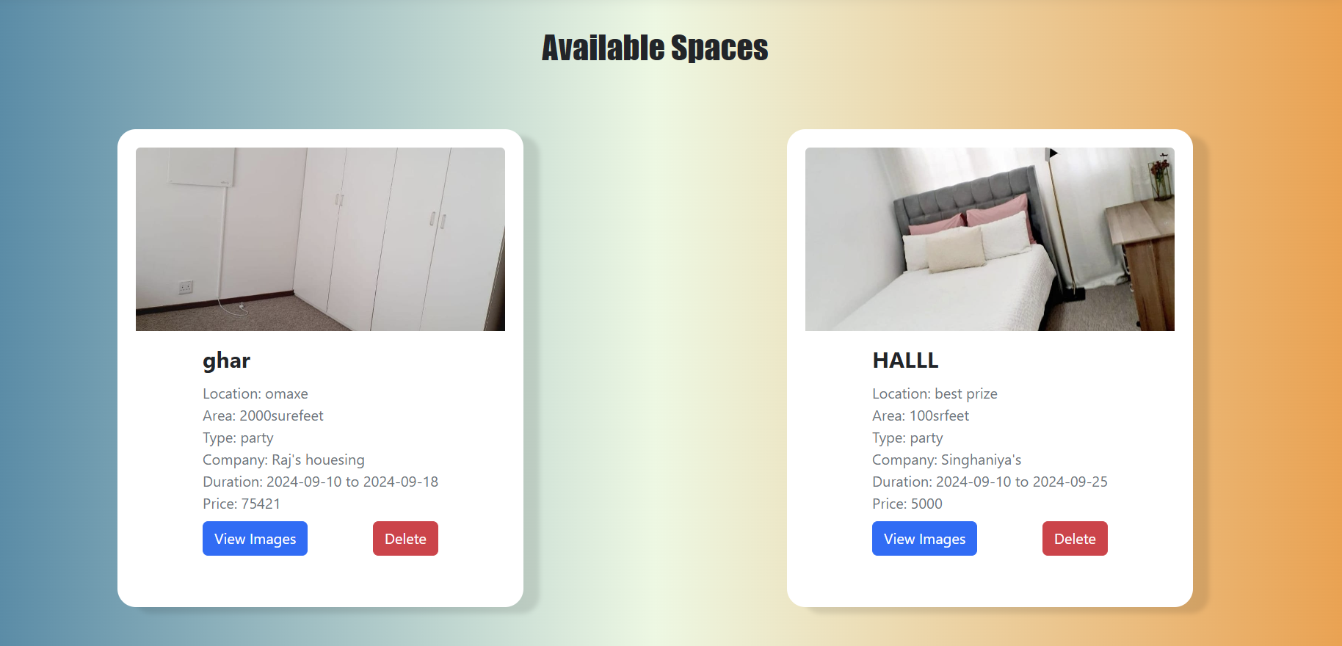
Add Space - Comprehensive Space Rental and Management Platform
Missy Dodia (0827IT211070) Mohammed Kazim shaikh (0827IT211071)
Mohit khatore (0827IT211073) Raj Patidar(0827IT211094)
Department Name, Acropolis Institute of Technology & Research, Indore
Session: Jul. – Dec. 2024
Abstract
Methodology
Results
The "Add Space" project focuses on building a comprehensive web-based application that enables users, brokers, and administrators to efficiently manage, book, and oversee spaces for short-term rental purposes such as events, gatherings, and other needs.
Unlike traditional space rental systems limited to monthly rentals, this project introduces a flexible booking solution allowing spaces to be reserved on an hourly or daily basis. project presents an innovative, web-based solution for managing short-term rentals, catering specifically to events, business meetings, and social gatherings.
"Add Space" introduces a dynamic platform for users, brokers, and administrators, enabling hourly or daily rentals and streamlining booking processes through a role-based system. This system not only increases space utilization but also optimizes operational efficiency by centralizing bookings and reducing overhead. The modular design allows for scalability, integrating additional features such as data analytics, reporting, and search filters. "Add Space" contributes significantly to the market by addressing the gap for flexible short-term rentals and offering a reliable, user-friendly platform that can adapt to evolving business needs.
1) Requirements Gathering –
Collected project requirements from stakeholders and identified key features for the application.
2) System Design -
Created diagrams like ER diagrams and flowcharts to plan the application's structure, database, and workflows.
3) Technology Stack Selection -
Selected JSP, Servlets, JDBC, and MySQL for backend development, ensuring compatibility and efficiency.
4) Development and Implementation -
Built and integrated core modules (e.g., booking, payment, space management) and tested each feature iteratively.
5) Testing and Optimization -
Conducted functionality and usability testing, optimized queries, and improved performance for a seamless user experience.
6) Deployment -
Finalized the project, preparing it for real-world use with complete documentation and user guides.
Proposed Algorithm -
The core algorithm for the 'Add Space' project involves the following steps:
User Registration & Authentication: New users are registered with roles (admin, broker, or user) with input validation and password security mechanisms.
Space Management Operations: Admins/brokers can perform CRUD operations on spaces, including adding, viewing, editing, and deleting space data, using validation checks.
Booking Management: User-initiated bookings trigger status management by brokers (confirm, cancel, or pending).
Notification & Payment Integration: Automated messaging based on booking status changes.
Database Operations: Data storage and retrieval with respect to users, spaces, and bookings using efficient query mechanisms.
The system offers an intuitive interface for managing space bookings and an efficient backend to handle payments and booking statuses. Users benefit from a streamlined experience when searching for and booking spaces. Brokers and admins gain a centralized platform for managing multiple bookings, reducing operational overhead, and providing superior customer service. Payment processing and booking management are automated, enhancing user confidence in transactions.
Introduction
.
The demand for short-term rental spaces has risen substantially as individuals and organizations seek flexible options for events, meetings, and gatherings. Traditional rental solutions are generally geared toward long-term leases, making it challenging for users who need spaces for shorter durations. The "Add Space" project aims to address this need by providing a comprehensive platform for managing short-term rentals with a focus on flexibility, ease of use, and operational efficiency. The platform enables users to search, book, and pay for spaces on an hourly or daily basis, enhancing accessibility for various types of users while allowing brokers and administrators to optimize space utilization.
A core feature of "Add Space" is its automated booking and payment system. When users book a space, the system processes payments, confirms bookings, and provides notifications to both users and brokers, minimizing delays and manual intervention. This automation supports an intuitive user experience by enabling real-time responses and simplifying booking workflows. Furthermore, the modular design allows the platform to scale, supporting additional functionalities such as reporting, data analytics, and advanced search options. This design also ensures that the system can evolve to meet future demands, integrating new technologies and features with minimal structural changes.
Conclusion
The 'Add Space' project aimed to develop a comprehensive platform to Manage short-term space rentals through a user-friendly system that includes brokers,admins, and users. By providing functionalities like user registration, role-based access control, space management, booking operations, and notifications, the project addresses the challenges faced by users and brokers in efficiently managing rental spaces for events and short durations.
Features include flexible booking options, secure login mechanisms, automated status updates, and notifications for transactions. Testing phases confirmed that all modules perform reliably,adhering tothe intended requirements and user expectations .
The project's success lies in creating a seamless and secure environment thatfacilitates effective management of spaces and bookings while minimizing the administrativeburden on brokers and providing convenience to users. This approach helps to bridge the gap between space availability and short-term rental needs.
Objectives
● To develop a user-friendly web application for short term space rentals.
● To enable brokers and admins to efficiently manage space listings and bookings.
● To provide seamless booking and payment processing for users.
● To introduce flexibility in booking durations for users.
● To ensure role-based access control and secure data management.
Acknowledgement
Deeply grateful to my Project Guide, for their invaluable guidance and support throughout this project. We extend my thanks to our Project Co-ordinator, for their assistance and feedback, and to our Head of Department, for providing a motivating environment to complete this work successfully.

