Slide 1
Building AI Agents with Multimodal Models
Part 1: Multimodal Data
Notes:
Hi there, and welcome to Building AI Agents with Multimodal Models.

Slide 2
Agenda
• | Part 1: Multimodal Data
• | Part 2: Intermediate Fusion and CLIP
• | Part 3: Cross-modal Projection and OCR Pipelines
• | Part 4: VSS and GraphRAG
• | Part 5: Wrap-up & Assessment

Slide 3

Prerequisites
Basic familiarity with convolutional neural networks (CNNs)
Basic familiarity with a deep learning framework such as:
PyTorch
TensorFlow
Notes:
If you are familiar with how convolutional neural networks are built, then you have what it takes to complete this course. We will be using PyTorch. If you come from a TensorFlow background, we have provided links to the relevant PyTorch documentation to help you get up to speed quickly.

Slide 4
Multimodality
Notes:
To begin, let’s define what modality is.

Slide 5






The Five Senses
How Humans Perceive
Sight
Smell
Taste
Hearing
Touch
Brain
Notes:
A multimodal model is a statistical model that analyzes multiple modes of data at once. To understand what that means better, we can think of the human brain as a multimodal model. Each of our senses such as sight, smell, taste, hearing, and touch are analyzed and influences our actions. For instance, if we walk into the kitchen, smell something sweet, and it feels warmer than usual, we might predict that a tasty treat is cooking in the oven.

Slide 6
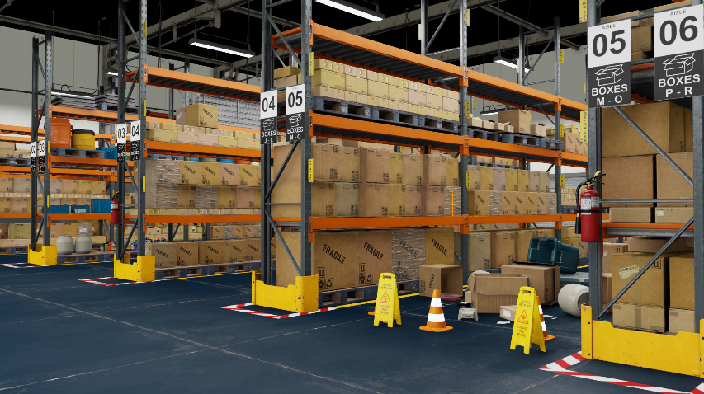
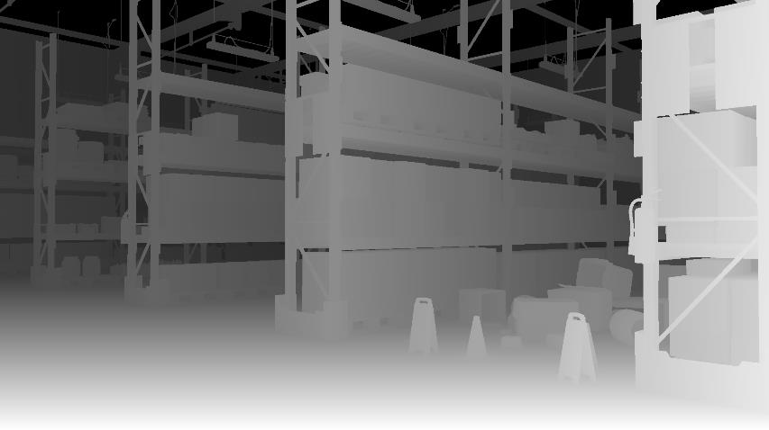
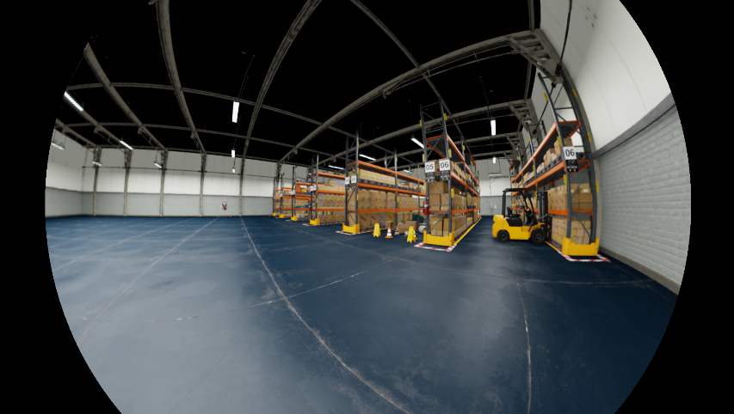
Sight
How A Computer Might See
RGB
Depth
Fisheye
Notes:
When it comes to vision, there are many ways to perceive the world. Just like how some animals see different colors and some have night vision, there are many different kinds of cameras that computers can use to see. Nightvision cameras are designed to see in low light environments, and thermal cameras can see heat. Each individual camera can have a large number of variables that influences what it can see such as field of view, shutter speed, pitch, roll and yaw.

Slide 7
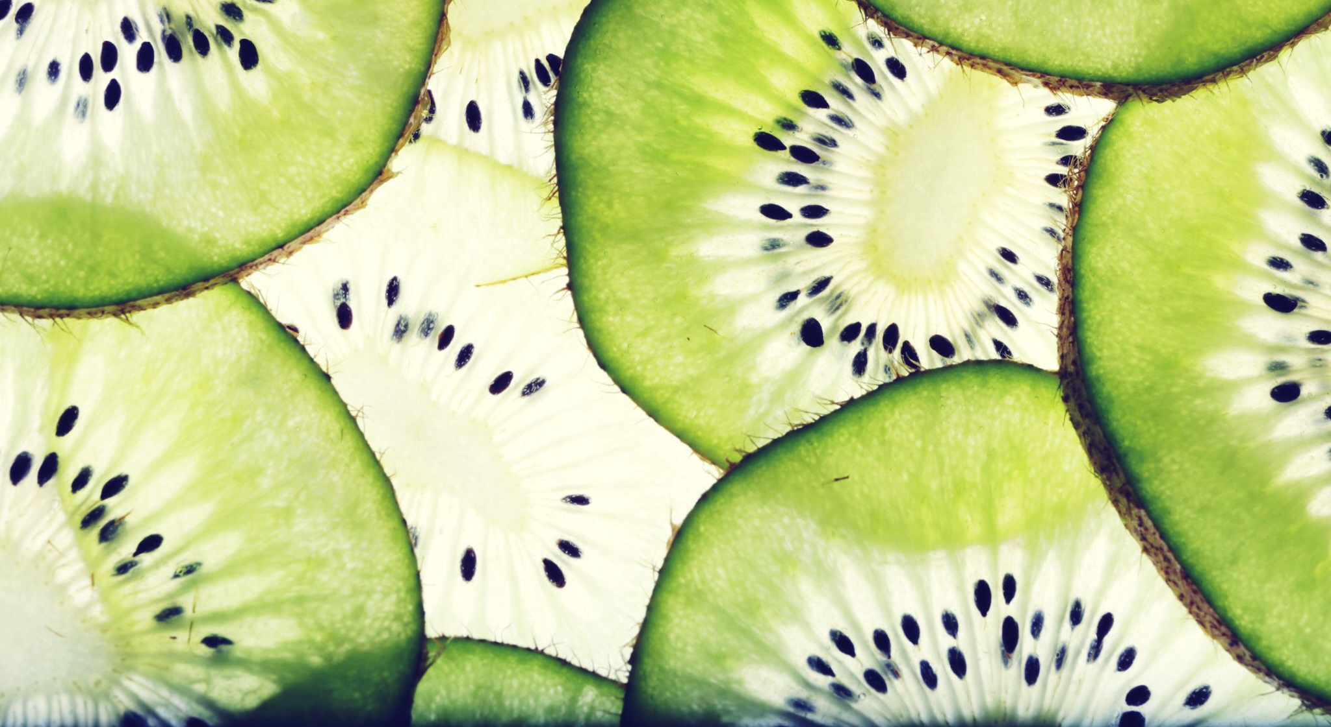
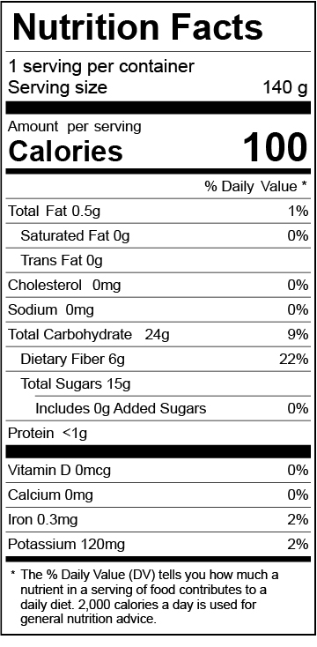
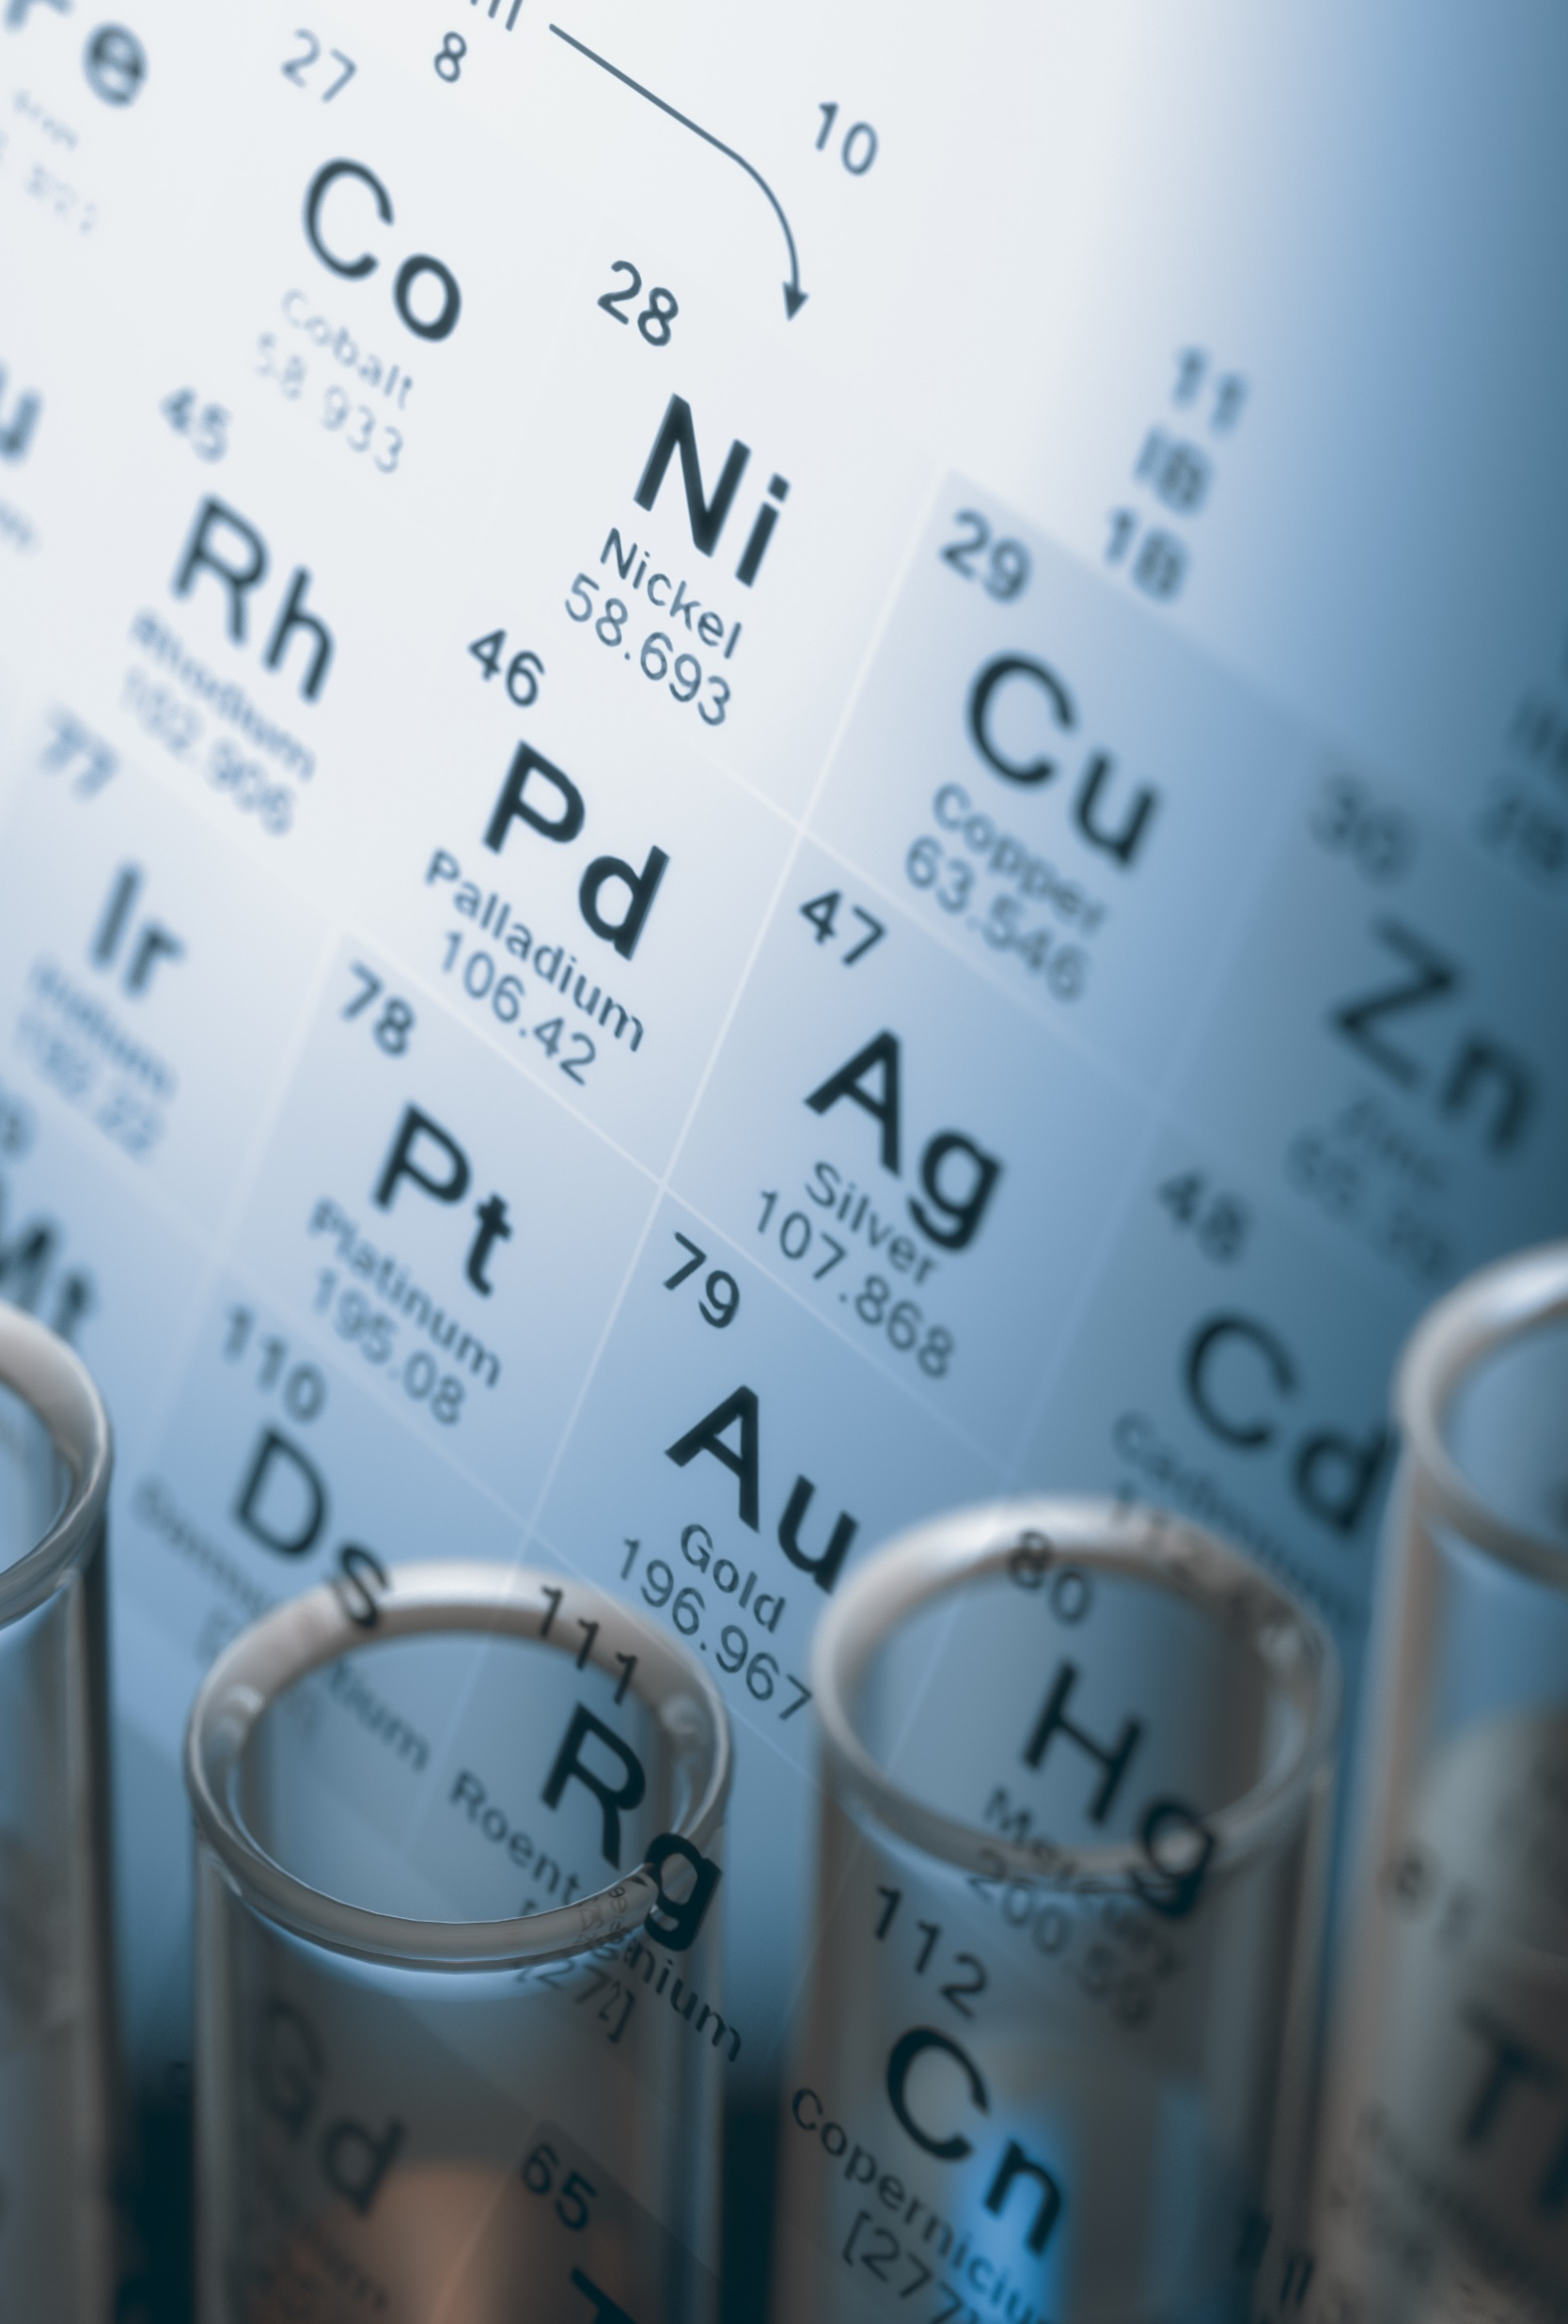
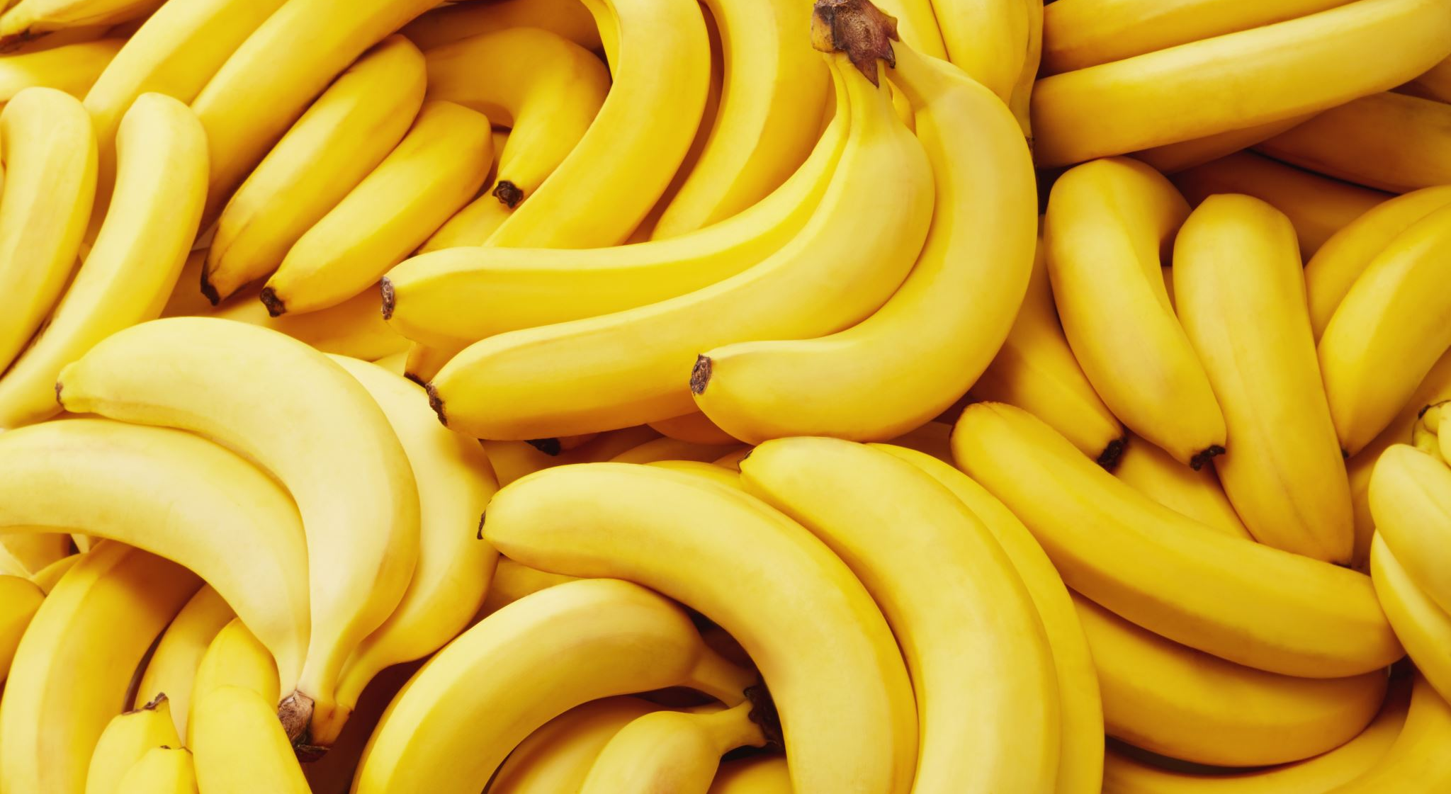
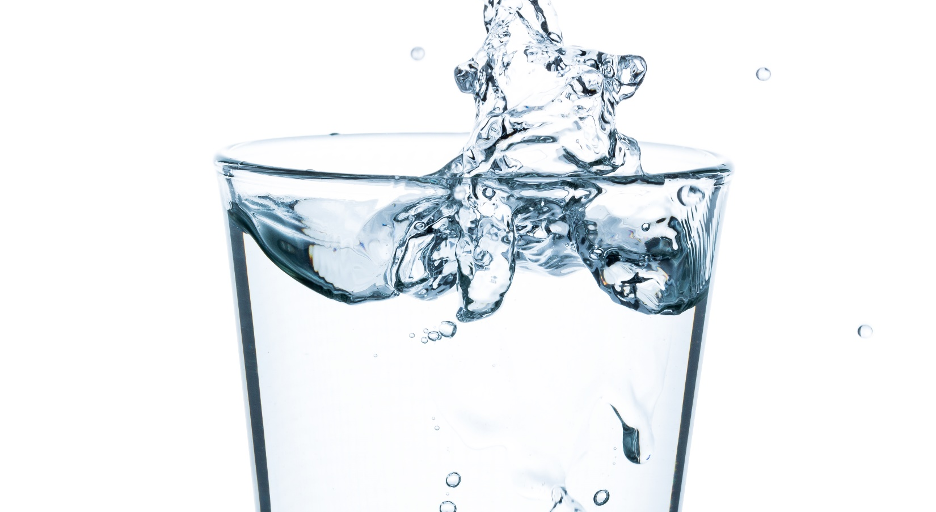
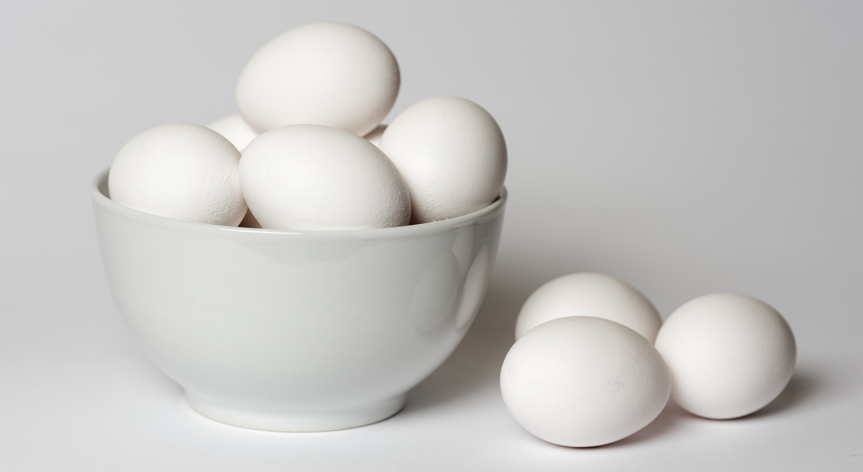
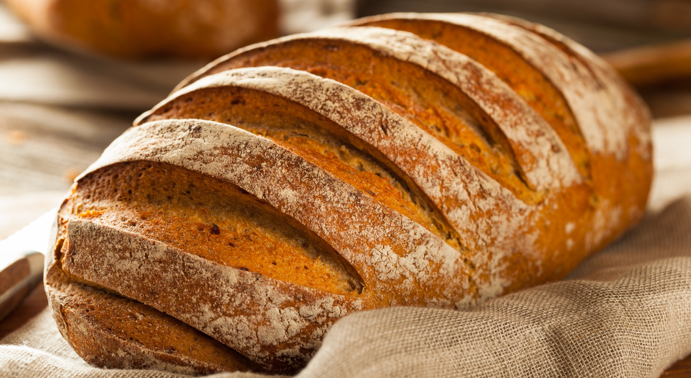
Smell and Taste
How A Computer Might Smell and Taste
pH
Nutrition Facts
Molecular Weight
9
8
7
6
5
Notes:
It may be a while before computers have tongues and noses like humans do, but there are things about food which can be used to infer taste.
For instance, we can use a pH sensor. For a lot of people, simply thinking about lemons makes them imagine a sour acidic taste in their mouth. On the other side, many anti-acid medications have a chalky flavor.
A food’s nutrition facts can be used to infer flavor. If a food has a relatively high sugar content, we may guess that it is sweet. If it has a large amount of vitamin c, we might guess it tastes like oranges.
One theory suggests smell is based on molecular weight, and that smell is perceived through both of our nostrils. It may explain why one nostril tends to be more open than the other. So, we may be ablet to use weight or density to infer taste.
https://www.ncbi.nlm.nih.gov/pmc/articles/PMC6627536/

Slide 8
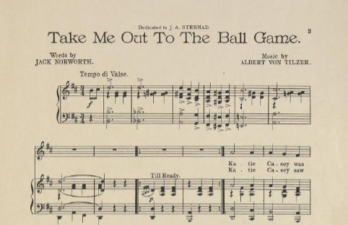
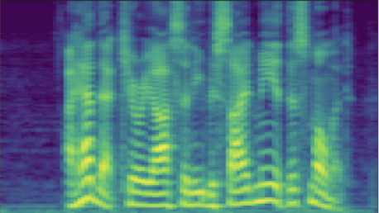
Hearing
How A Computer Might Hear
Sheet Music
Spectrogram
Notes:
Similarly, there are a few different ways a computer might hear something. Sheet music provides a more discreet representation of music. On the other hand, we can take frequencies of sound waves and visually represent them as something called a spectrogram. Amazingly, we can use many of the same data science techniques for images to extract useful information from audio because of these spectrograms.
There are also ultrasonic sensors that allows computers to sense depth much like echolocation used by bats and whales.

Slide 9
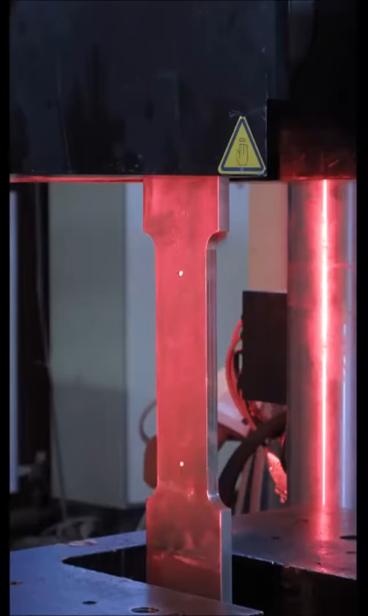
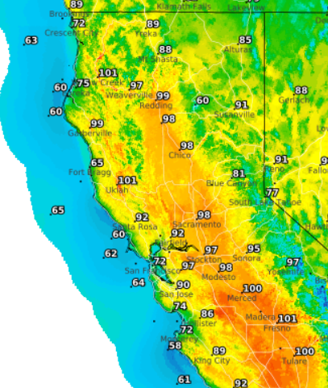
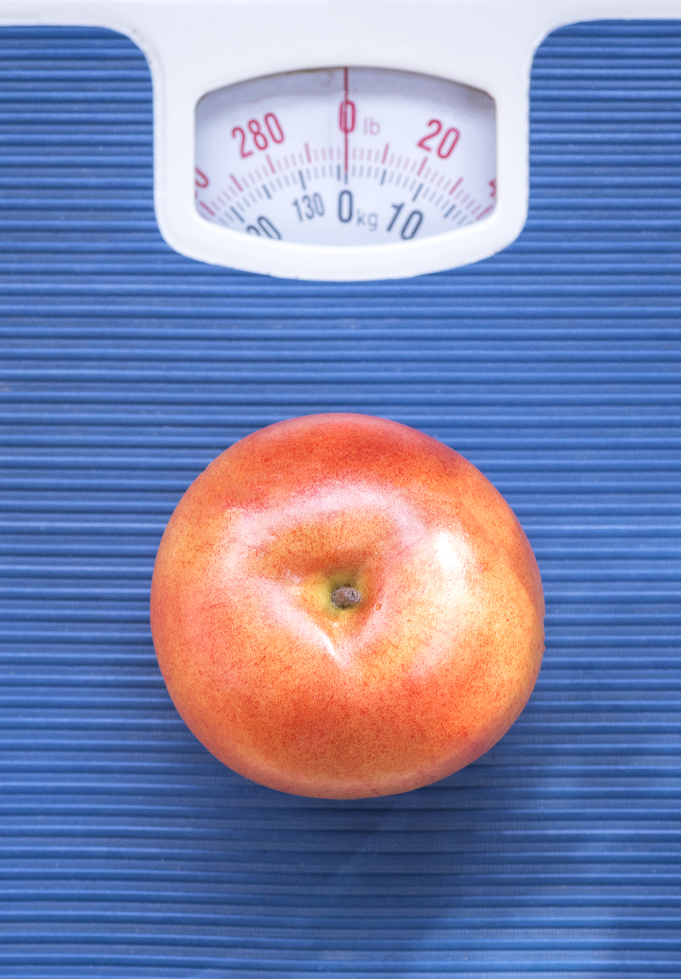
Touch
How A Computer Might Feel
Tensile Strength
Weather Maps
Weight
By Christian V.
Notes:
Industrial Engineers have many interesting tools to measure the physical attributes of an object. On the left is a tensile strength testing machine, which records the stress strain graph of a material.
There are lots of things about weather that is associated with feeling, such as feeling hot or cold, wet or dry, or windy.

Slide 10
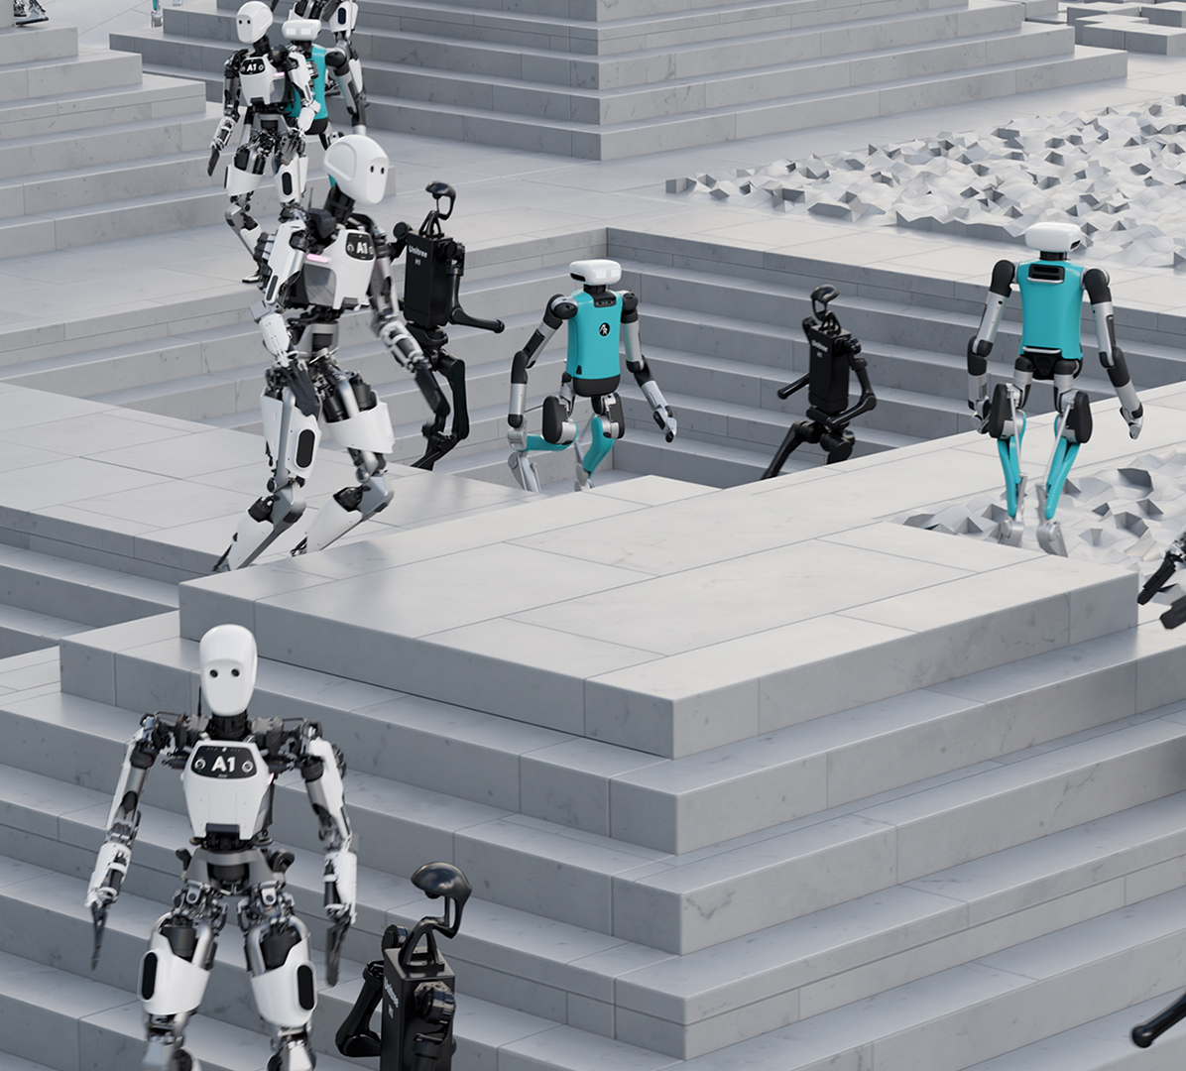
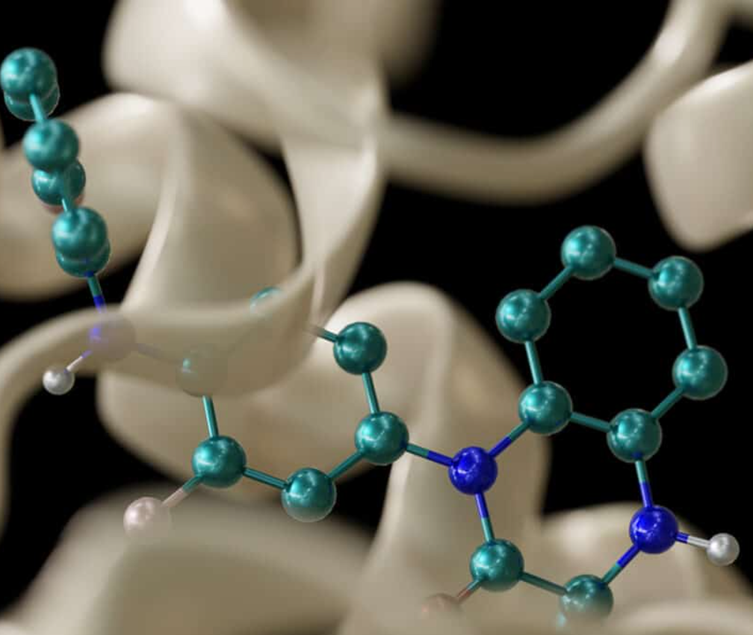
Multimodal Applications
Common Multimodal Use Cases
Robotics
Biology
Notes:
Multimodal models can be used in almost any industry, but two major applications are robotics and biology. Helping robots navigate like humans do requires them to perceive like humans do, with a wide variety of sensors.
As for biology, have you ever gone to the doctor because you weren’t feeling well, but didn’t know why? Healthcare professionals use many kinds of data to diagnose potential problems. This is a challenging and rewarding field where researchers are working hard to help save lives.

Slide 11







Multimodal vs Orchestration
Common Multimodal Use Cases
Modality
Orchestration
Notes:
As computing power has increased, and more standardized neural networks have been developed, systems that connect multiple neural networks together have been created. The process of creating such a system is called orchestration. For example, when a user asks a large language model to “generate a picture of a cute cat”, the LLM passes the request to a diffusion model to perform the work before serving the result to the user.
Hopefully, by the end of this course, it’ll be easier to tell if an application is using a system of neural networks as opposed to one multimodal network.

Slide 12
Lab 1a – Early and Late Fusion
Notes:
I wish I could say multimodal models follow this one simple formula, but the reality is, with the potentially huge variety of data available, it takes a lot of experimentation to find the right neural network architecture for a given. So instead, we will be going over different multi-modal techniques and the theories on when these techniques are effective.

Slide 13
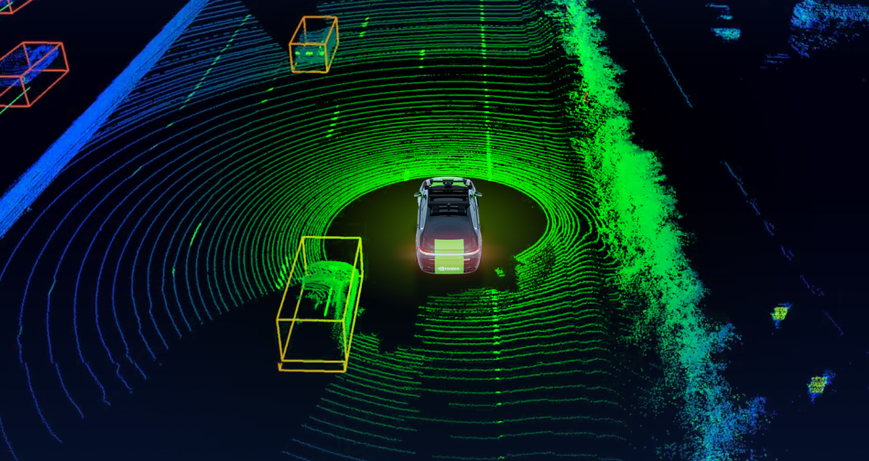
Using LiDAR Data
Notes:
In our first lab, we’re going to be using emulated LiDAR data, so let’s learn a little more about it. If you’ve ever seen a self-driving car before, chances are, there was a LiDAR on it. LiDAR stands for Light Detection and Ranging. A LiDAR device has an array of lasers that emit a beam of light undetectable to the human eye. The light then bounces back, and a sensor interprets the estimated distance that the light traveled.
Because of its ability to measure distances, LiDARs are a valuable tool in helping self-driving cars navigate the road safely.

Slide 14
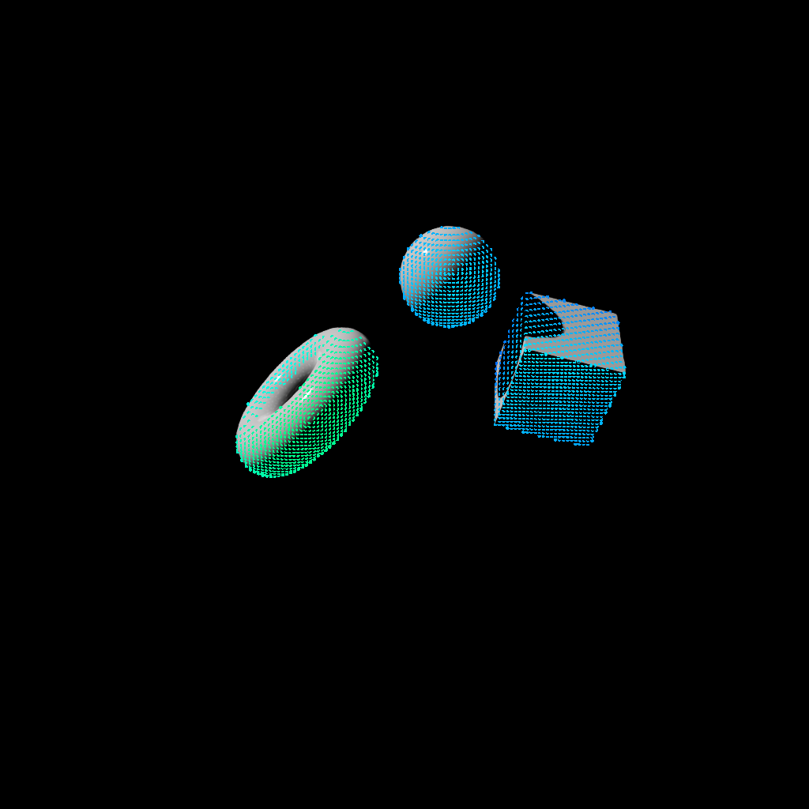
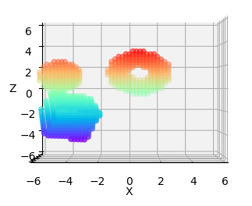
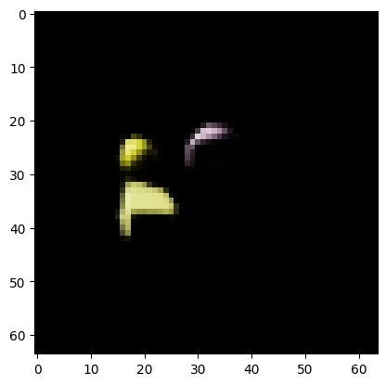
LiDAR vs Camera
Common Multimodal Use Cases
Notes:
Let’s use LiDAR data and camera data to make a simple “hello world” style multimodal model. To do this, we used the Isaac Sim Replicator from NVIDIA Omniverse to create a custom dataset. We created three objects and randomly placed them and rotated them. We then emulated a lidar and a camera.
On the left, we have a high-resolution photo of the objects. Each dot is where a laser from the lidar collided with an object. With both of our LiDAR data and our camera data, can we estimate where the center of each object is? It turns out, we don’t need high resolution data to do this, so to speed things up, we will be using 64 by 64 pixel images.
We’ll start by creating a model for each data type: one for camera and one for LiDAR. Which data type do you think performs better and why? Unfortunately, it would be mathematically difficult to prove why one data type is better than the other, but I’ll share some theories in the next slide deck.

Slide 15
Azimuth and Zenith
Finding Stars
Zenith
Target
Point of Reference
Zenith Angle
Azimuth Angle
Notes:
In order to make this competition between camera and LiDAR data as fair as possible, we will be using the same number of lasers as there are pixels in the camera. Different LiDAR systems have different data configurations, but in our case, we be using 4,096 lasers arranged in a grid. The grid is 64 lasers across and 64 lasers tall.
Each laser is shot out at a different angle. If our LiDAR system is pointed forward, then the Azimuth Angle is the horizontal deviation from forward, and the Zenith angle is the vertical deviation.

Slide 16
Fusion Techniques
Notes:
Once we’re done creating one model each for the camera and LiDAR data, there’s something surprisingly simple we can do to create a multimodal model.

Slide 17
Fusion Techniques
Late
Notes:
We can take the outputs of the two models and connect them to another layer of neurons. Tada! We’ve made a multimodal model. This is called “Late Fusion” because we’re combining the neural networks at their ends. In a way, it’s similar to ensemble learning.

Slide 18
Fusion Techniques
Late
Early
Notes:
On the other hand, early fusion concatenates the input data before it enters the neural network. We’ll get into which technique is better in the next section, but for now, what do you think? Can you think of when one strategy would be better than the other?

Slide 19
Lab 1b – Exploring Modalities
Notes:
It’s going to take a few minutes to run our experiments in the first lab, so while those experiments are going, let’s dive into multimodal data.

Slide 20
Hypothesis:
Any data that can be turned into a matrix can be used for neural network reasoning
Notes:
There are many different kinds of data in the world, but as long as we can represent the data as some form of matrix of numbers, we can analyze it.

Slide 21
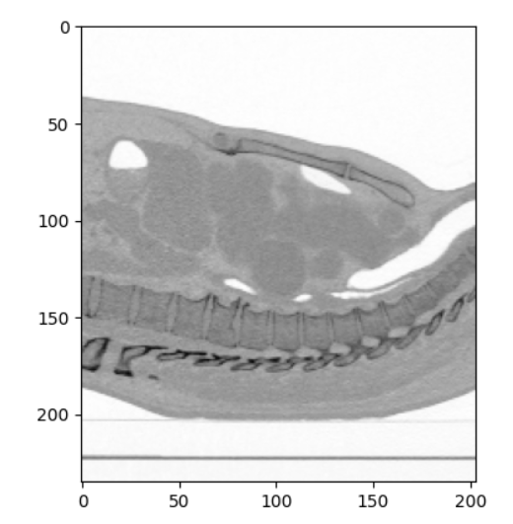
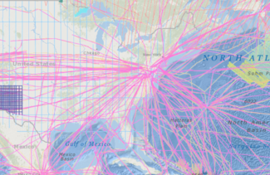
Atypical Data
CT Scan
Spectrogram
Magnetic Data
Notes:
So to get some practice, we’ll take a look at a few atypical data types and how to convert them from their raw format into a matrix. The better we can understand the data, the easier it will be to create a model that can do something useful with it.

Slide 22
Let’s Get Started!
Notes:
Itching to get coding? Let’s get started!

