Slide 1
Building AI Agents with Multimodal Models
Part 2: Intermediate Fusion and Contrastive Pretraining
Notes:
Hi there, and welcome to Building AI Agents with Multimodal Models.

Slide 2
Agenda
• | Part 1: Multimodal Data
• | Part 2: Intermediate Fusion
• | Part 3: Cross-modal Projection and OCR Pipelines
• | Part 4: VSS and GraphRAG
• | Part 5: Wrap-up & Assessment

Slide 3
Experiment Results
Notes:
Before we move on to the theory, let’s take a look at our experimental results.

Slide 4
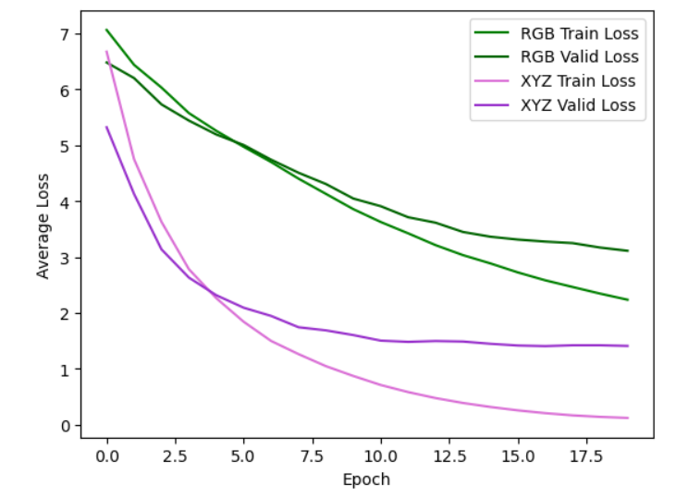





Single Modal Data - Results
Brain
Notes:
First, let’s look at how the single modal models faired. In this case, the LiDAR data was more effective.
Since neural networks are a bit of a black box, it’s hard to say exactly why. However, we can throw out some theories. Whenever I’m trying to design a statistical model, I first think, how would I do this if I had to do this myself? For instance, with the RGB data, I would need to find someway to convert it into position data. I could make an estimate based on where the objects are in the picture. Since the positions are in a 3-dimensional space, that estimate could be tricky.
On the other hand, the LiDAR data very directly gives us position information. We wouldn’t need to convert from one mode to another. The more direct the calculation, the easier it will be for the neural network to recognize it.

Slide 5
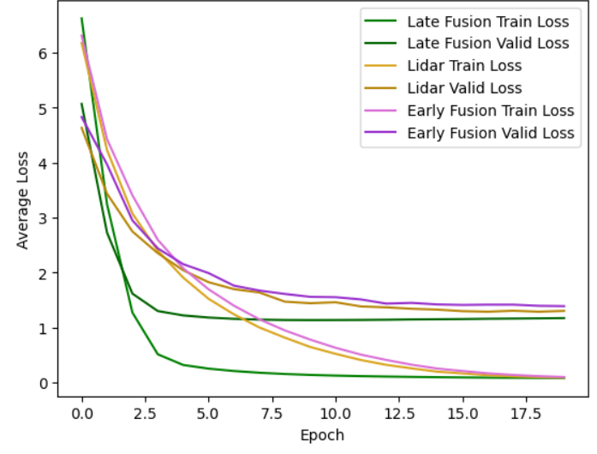

Multimodal Data - Results
Brain
Notes:
Next, let’s look at the multimodal results. Hooray! We successfully made a multimodal model! But why does this victory feel so empty?
Because the late fusion model was trained with pre-trained models, it had a head start compared to the early fusion model and the single modal model. Eventually, they all converged to relatively the same result. It turns out, more data isn’t always better. In this case, because the LiDAR data was so effective at helping to predict the RGB data was effectively ignored. So, our multimodal models performed the same as the single modal model.

Slide 6
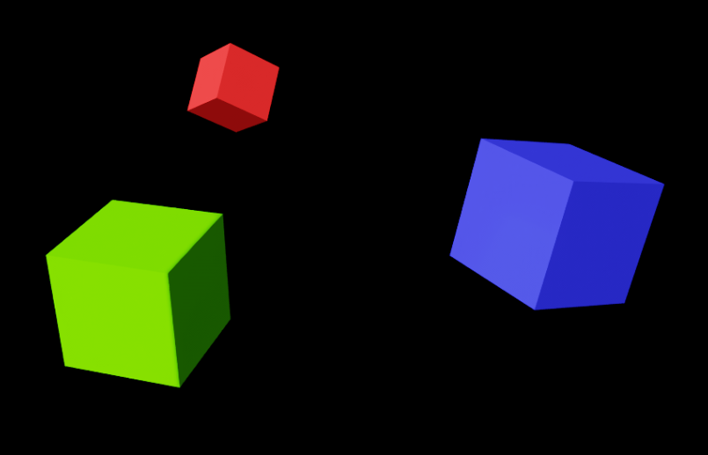
Next Experiment
Brain
Notes:
So next time, we’re going to use a dataset that forces our models to consider both modes of data. We will have two cubes of different colors. The LiDAR sensor cannot see color, so the RGB image data will help our neural networks identify which cube is which.
As we learned in the previous lab, the LiDAR data is more effective at calculating a position than RGB data. Can we find the best of both worlds and make a truly multimodal model?

Slide 7
Lab 2a - Intermediate Fusion
Notes:
In the previous lab, we experimented with early and late fusion. But what if we fused our model somewhere in the middle?

Slide 8
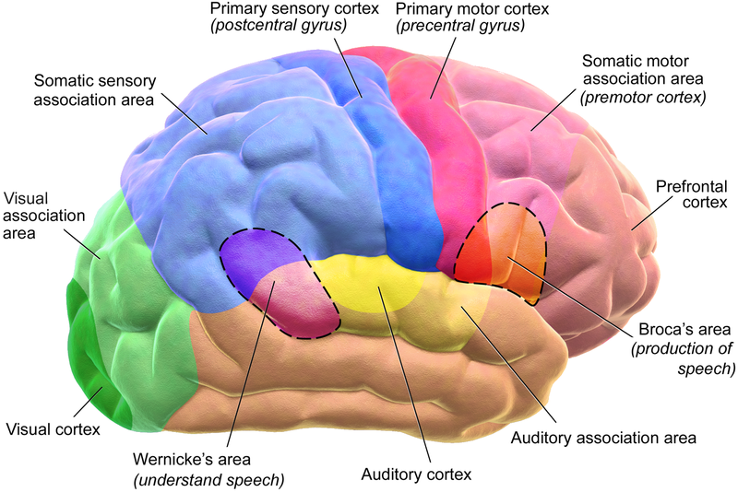
Human Inputs and Outputs
The Human Brain as a Multimodal Model
Blausen.com staff (2014). "Medical gallery of Blausen Medical 2014". WikiJournal of Medicine 1 (2). DOI:10.15347/wjm/2014.010. ISSN 2002-4436
Notes:
To get some inspiration, let’s look at one of the most complicated multimodal models: the human brain. There is still much to learn about the brain and how it works, but scientists have generally figured out which part of the brain analyzes which mode of data.
Humans have many forms of data inputs and data outputs. If there was not any structure to how the brain handled information, it would constantly have information overload. So different parts of the brain are dedicated to different datatypes. Much of that analysis feeds into our prefrontal cortex, which is the brain’s center for reasoning.

Slide 9
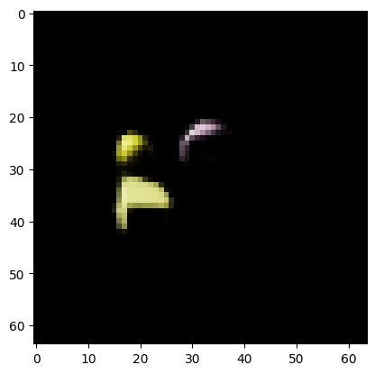
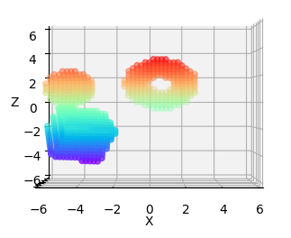
Intermediate Fusion
Convolution
Convolution
Flatten
Flatten
Dense
Notes:
Here’s one approach we can do. We can convolve each of our data types separately. Then, we can concatenate the results of each convolution into one giant vector. Finally, we feed the combined data into a dense neural network.
Because we’re mixing our modalities in the middle of our model, and not the beginning or the end, this is called intermediate fusion. Just like the human brain, this gives the advantage of analyzing each mode separately before carefully considering the bigger picture.

Slide 10
Intermediate Fusion
Convolution
Convolution
Flatten
Flatten
Dense
Dense
Notes:
By the way, intermediate fusion is a vague term, and represents any form of fusion in the middle of the model. We could also do something like this with recurrent connections.

Slide 11
Intermediate Fusion
Finding the Center
Brain
Notes:
By the way, if you were to calculate the positions of the centers of these cubes by hand, how would you go about it?

Slide 12
Intermediate Fusion
Finding the Center
Brain
Brain
Notes:
If it was me, I would try to recognize a corner. If we take the average of the three lines along the edges connected to the corner, that would give us the cube’s diagonal. Halfway along the diagonal would give us the center.

Slide 13
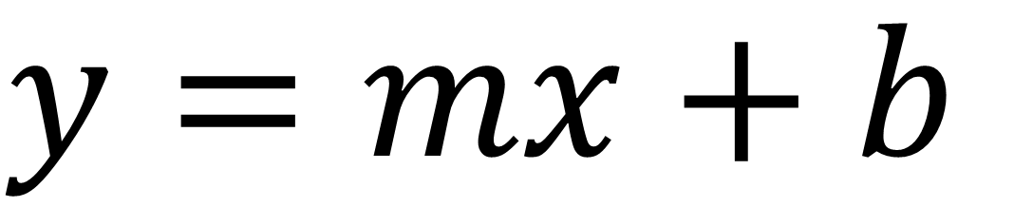
Intermediate Fusion
Finding the Center
Static after training
$$y=mx+b$$
Variable after training is complete
Brain
Brain
Notes:
Dense neural networks would have a difficult time with this approach. In order to calculate a line, we would need its slope. Even though neurons are regression lines under the hood, their slope is set after training. Our cubes have random rotation, meaning, they have variable slope. It would be great if our model was flexible enough to handle that.

Slide 14
Intermediate Fusion
Convolution
Convolution
Convolution
Convolution
Flatten
Flatten
Concatenate
Dense
Dense
Notes:
If this is the structure of our model, let’s see if we can add a multiplication term. Where would be the best place to do it?
The honest answer is to experiment with a lot of different approaches to see what’s best, but let’s see if we can build some intuition.

Slide 15
Intermediate Fusion
Convolution
Convolution
Convolution
Convolution
Flatten
Flatten
Concatenate
Dense
Dense
Notes:
If the result of a convolution is a matrix, we could matrix multiply the results after the first stage of convolution for each modality. That might be too soon though, since the modal first needs to recognize what it’s seeing. At this point, it hasn’t identified where the corners of the cubes are.

Slide 16
Intermediate Fusion
Convolution
Convolution
Convolution
Convolution
Flatten
Flatten
Concatenate
Dense
Dense
Output
Notes:
We could split the dense layer, and then add a multiplication step at the end, but would that give out model enough time to find the center of the cube? If we were doing this calculation by hand, there would still be a few steps after finding the lines that define the edges. We would still need to calculate the diagonal.and find the middle of it.

Slide 17
Intermediate Fusion
Convolution
Convolution
Convolution
Convolution
Flatten
Dense
Dense
Notes:
So how about here? If we do our multiplication in the middle of our model, that gives our model the ability to identify the inputs to the multiplication, as well as enough time to analyze the results.
In this case, we will do a matrix multiplication instead of a cellwise multiplication. A cellwise multiplication would keep the multiplication term tied to its location in the image. A matrix multiplication allows one part of the image to influence another part.

Slide 18
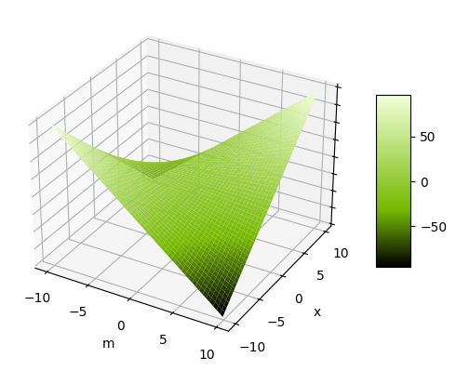
Multiplication Overfitting
y
Notes:
Multiplication is a great way to add flexibility into our models, but with that flexibility comes a tendency to overfit. The tricks to prevent this are the same as the tricks to preventing overfitting in any large model. A wide variety of data can justify this added complexity to the model.

Slide 19
Lab Experiment
Early Fusion
Late Fusion
Intermediate Fusion Concatenate
Intermediate Fusion Multiplication
Notes:
In the next lab, we’ll compare four models: early fusion, late fusion, intermediate fusion with concatenation and intermediate fusion with multiplication.

Slide 20
The Curse of Dimensionality
Notes:
Speaking of overfitting, this would be a good time to bring up the curse of dimensionality.

Slide 21
The Curse of Dimensionality
 | 6 | 7 | 8 | 9 | 10 | 11 | 12 | 13 | 14 | 15 | 16
Shoe Size
Notes:
The curse of dimensionality is a concept proposed by Prichard E. Bellman. The more dimensions our data has, to more difficult it becomes to analyze it. Overfitting is an example of this curse. Another example is data collection. Let’s say we’re fashion designers, and we’re looking to design shoes that look great on everyone. US shoe sizes go from 6 to 16. If we ignore half sizes, we would need 11 people in each of the different categories to get a good representation.

Slide 22
The Curse of Dimensionality
 | 6 | 7 | 8 | 9 | 10 | 11 | 12 | 13 | 14 | 15 | 16
Shoe Size
Notes:
If we start by sampling 5 people, and they all have different shoe sizes, we’re 45% done to getting a full representation of our categories.

Slide 23
The Curse of Dimensionality
XS
S
M
L
XL
 | 6 | 7 | 8 | 9 | 10 | 11 | 12 | 13 | 14 | 15 | 16
Shirt Size
Shoe Size
Notes:
But if we add another dimension, like shirt size, we’d only be 9% to getting full representation.

Slide 24
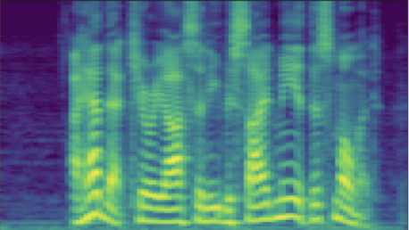
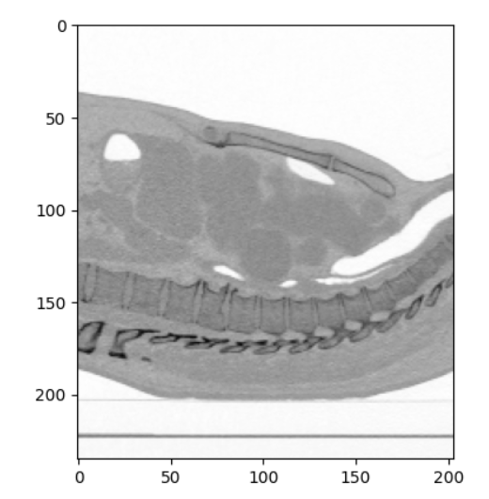
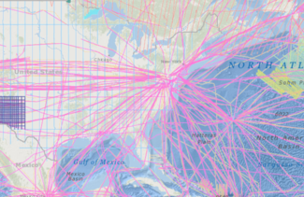
Choosing Data
Analysis Paralysis
CT Scan
Spectrogram
Magnetic Data
Notes:
When it comes to multimodal models, sometimes there will be a wide variety of data available to use when modelling neural networks, and it can be tempting to throw everything at the model and hope for the best. But just like how humans get analysis paralysis, giving the model too much information may hinder the network from learning.

Slide 25
Choosing Data
Highly Correlated Data
Notes:
In fact, if two kinds of data are perfectly correlated with each other, there’s no benefit of using both in the model. In this case, one type of data could be used to represent the other, so rather than trying to analyze two things, it’s better the choose the simpler option and only analyze one of them.

Slide 26
Lab 2b – Contrastive Pretraining
Notes:
Just like in the first set of labs, it’s going to take a little while to run the experiments. While that’s cooking, let’s explore contrastive pre-training. This is a powerful multimodal technique that allows us to swap one datatype for another.

Slide 27
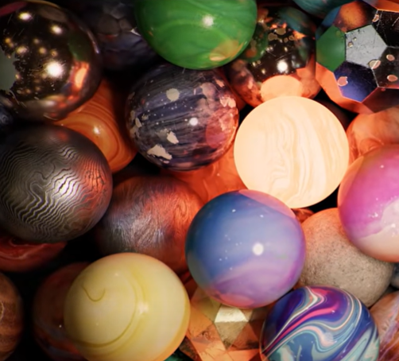
Matching Text to Image
Is it Possible?
“A bunch of different marbles”
Notes:
Here is the goal of contrastive pretraining. Let’s use the famous model, CLIP, as an example.
Let’s say we have an image and a corresponding description of that image.

Slide 28
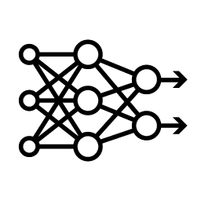
Matching Text to Image
Is it Possible?
[0.8, -0.6, 0.7]
“A bunch of different marbles”
Notes:
Can we create a model such that it produces the same vector embedding for both the text and the image?

Slide 29
Cosine Similarity
[0.0, 1.0]
“A bunch of different marbles”
[1.0, 1.0]
Notes:
To see why this would be useful, let’s say this model gives our image an embedding of 0, 1. And, it gives the text an embedding of 1, 1.

Slide 30
Cosine Similarity
[0.0, 1.0]
[1.0, 1.0]
“A bunch of different marbles”
Notes:
We can check if the image is aligned with the text by using the cosine similarity. We can plot the vectors…

Slide 31
Cosine Similarity
[0.0, 1.0]
[1.0, 1.0]
“A bunch of different marbles”
$${45}^{°}$$
$$cos\left({45}^{°}\right)=\frac{\sqrt{2}}{2}$$
Notes:
Find the angle between them, and use the cosine of the angle to see how well these vectors align.

Slide 32
Cosine Similarity
[0.0, 1.0]
[1.0, 1.0]
“A bunch of different marbles”
$$cos\left({90}^{°}\right)=0$$
$$cos\left({270}^{°}\right)=0$$
$${45}^{°}$$
$$cos\left(0^{°}\right)=1$$
$$cos\left({180}^{°}\right)=−1$$
$$cos\left({45}^{°}\right)=\frac{\sqrt{2}}{2}$$
Notes:
Cosine of 0 is 1. That’s perfect! When the vectors are completely aligned, we get a value of 1. On the other hand, Cosign of 180 degrees is -1. This is also fine, we have an easy way to tell if vectors are opposites. Relatedly, cosine of 90 and 270 degrees is 0. The 0 here can be deceptive. It means there is no relationship, which is not the same as an opposite relationship.
This is great and all, but how are we going to calculate the angle between the vectors? Without a trusty protractor, we’d have to draw some extra lines and use SOHCAHTOA… that’s kind of a mess. There’s an easier way with the computer.

Slide 33
Dot Product
[0.0, 1.0]
[1.0, 1.0]
[0.0, 1.0]
[1.0, 1.0]
“A bunch of different marbles”
Notes:
First, we’re going to snap each vector to the unit circle. The vertical vector already has a length of 1, so we don’t have to do anything. For the other vector, we divide each component (in this case x and y), by the length or magnitude of the vector. We can use the good ole Pythagorean theorem to get the length. Thankfully, most matrix libraries like NumPy and PyTorch have this function built-in.

Slide 34
Dot Product
[0.0, 1.0]
[0.0, 1.0]
[1.0, 1.0]
$$\frac{\sqrt{2}}{2},\frac{\sqrt{2}}{2}$$
“A bunch of different marbles”
Notes:
Nice, everything is aligned.

Slide 35
Dot Product
A
[0.0, 1.0]
B
[0.0, 1.0]
[1.0, 1.0]
$$\frac{\sqrt{2}}{2},\frac{\sqrt{2}}{2}$$
“A bunch of different marbles”
Notes:
Let’s call the vertical line A and the other B.

Slide 36
Dot Product
A
[0.0, 1.0]
B
[0.0, 1.0]
[1.0, 1.0]
$$\frac{\sqrt{2}}{2},\frac{\sqrt{2}}{2}$$
“A bunch of different marbles”
 | A | B | A x B
x | 0 | $$\frac{\sqrt{2}}{2}$$ | 0
y | 1 | $$\frac{\sqrt{2}}{2}$$ | $$\frac{\sqrt{2}}{2}$$
Notes:
We can multiply both of the x values together and both of the y values together…

Slide 37
Dot Product
A
[0.0, 1.0]
B
[0.0, 1.0]
[1.0, 1.0]
$$\frac{\sqrt{2}}{2},\frac{\sqrt{2}}{2}$$
“A bunch of different marbles”
 | A | B | A x B
x | 0 | $$\frac{\sqrt{2}}{2}$$ | 0
y | 1 | $$\frac{\sqrt{2}}{2}$$ | $$\frac{\sqrt{2}}{2}$$
Notes:
Add them up, and what do we get?

Slide 38
Dot Product
A
[0.0, 1.0]
B
[0.0, 1.0]
[1.0, 1.0]
$$\frac{\sqrt{2}}{2},\frac{\sqrt{2}}{2}$$
“A bunch of different marbles”
 | A | B | A x B
x | 0 | $$\frac{\sqrt{2}}{2}$$ | 0
y | 1 | $$\frac{\sqrt{2}}{2}$$ | $$\frac{\sqrt{2}}{2}$$
$$\frac{\sqrt{2}}{2}$$
Notes:
Square root of two over two.

Slide 39
Dot Product
A
[0.0, 1.0]
B
[0.0, 1.0]
[1.0, 1.0]
$$\frac{\sqrt{2}}{2},\frac{\sqrt{2}}{2}$$
“A bunch of different marbles”
 | A | B | A x B
x | 0 | $$\frac{\sqrt{2}}{2}$$ | 0
y | 1 | $$\frac{\sqrt{2}}{2}$$ | $$\frac{\sqrt{2}}{2}$$
$$cos\left({45}^{°}\right)=$$
$$\frac{\sqrt{2}}{2}$$
Notes:
The same as cosine of 45 degrees. Mathemagical!

Slide 40
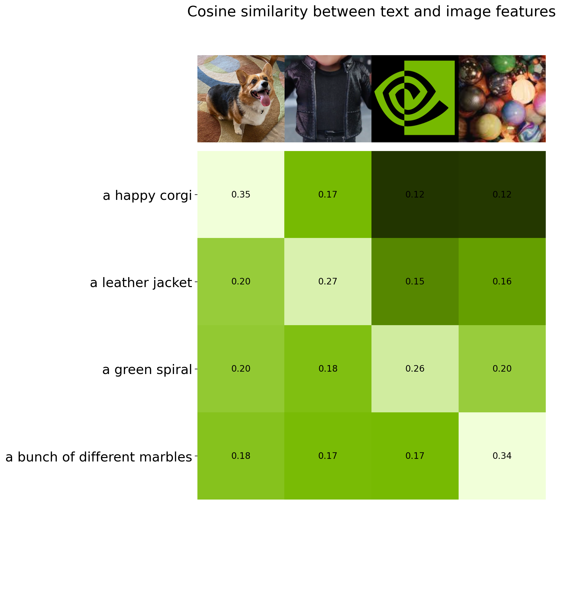
CLIP Training
Cosine similarity between encoding for “A happy corgi” and encoding for each image
A happy corgi
A leather jacket
Cosine similarity between encoding for the NVIDIA logo and encoding for each text
A green spiral
A bunch of different marbles
Notes:
CLIP uses the cosine similarity to train its neural network. Let’s say we have a batch of images with descriptions. During CLIP’s training, it will calculate the cosine similarity for each combination of image and text in the batch.

Slide 41
CLIP Training
A happy corgi
Minimize
A leather jacket
A green spiral
Minimize
A bunch of different marbles
Maximize
Notes:
The diagonal is the “correct” answer, so the loss function uses cross entropy to maximize the values along the diagonal. Everything else is the “wrong” answer, so the loss function will minimize those.

Slide 42
RAG and Vector Databases
Notes:
Not only can we use a contrastive-pretraining model to swap one data type with another, it also allows us to quickly query information. Let’s see how.

Slide 43
Vector Databases
[0.7, 0.2, -0.1]
CLIP
[-0.1, 0.1, -0.8]
[-0.2, -0.1, 0.4]
[0.8, -0.6, 0.7]
Notes:
Let’s say we have a database of images. We can use CLIP or any other contrastive pretraining model to get a vector embedding of these images. If we store all those vectors in a database, we got ourselves a vector database.

Slide 44


Retrieval Augmented Generation (RAG)
Please give me a picture of a cute corgi.
a cute corgi
CLIP
[0.6, 0.1, -0.1]
Notes:
This way, when a user interacts with a chatbot such as an LLM system, the LLM system can retrieve information for the user based on a user’s query. The system can extract the relevant text from the query, and feed it through CLIP, resulting in another vector.

Slide 45
Retrieval Augmented Generation (RAG)
a cute corgi
[0.6, 0.1, -0.1]
[0.7, 0.2, -0.1]
0.9933
[-0.1, 0.1, -0.8]
0.0599
Cosine Similarity
[-0.2, -0.1, 0.4]
-0.6017
[0.8, -0.6, 0.7]
0.4651
Notes:
Then, we can take the cosine similarity between the user’s query and the images in our database.

Slide 46
Retrieval Augmented Generation (RAG)
a cute corgi
[0.6, 0.1, -0.1]
[0.7, 0.2, -0.1]
0.9933
Best Match
[-0.1, 0.1, -0.8]
0.0599
[-0.2, -0.1, 0.4]
-0.6017
[0.8, -0.6, 0.7]
0.4651
Notes:
The image with the highest corresponding cosine similarity is considered the best match.

Slide 47
Contrastive Outline-Image Pretraining
Image
Outline
Notes:
Contrastive pretraining is not limited to between text and images. As long as there is a high enough correlation between the data, any two data types can be used for this kind of technique. So for the lab, let’s make a contrastive outline-image pretraining model. COIP isn’t as catchy sounding as CLIP, but such a model can still be useful. We’ll use it to make a database of clothing where users can search for the matching article by sketching an outline.

Slide 48
Let’s Get Started!
Notes:
Itching to get coding? Let’s get started!

