Slide 1
Building AI Agents with Multimodal Models
Part 3: Cross-modal Projection
Notes:
Hi there, and welcome to Building AI Agents with Multimodal Models.

Slide 2
Agenda
• | Part 1: Multimodal Data
• | Part 2: Intermediate Fusion
• | Part 3: Cross-modal Projection and OCR Pipelines
• | Part 4: VSS and GraphRAG
• | Part 5: Wrap-up & Assessment

Slide 3
Experiment Results
Notes:
Before we move on to the theory, let’s take a look at our experimental results.

Slide 4
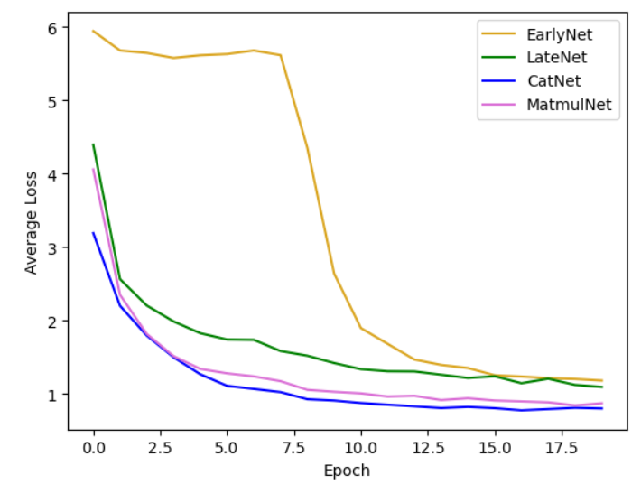





Experiment Results
Brain
Notes:
First, let’s look at how the single modal models faired. In this case, the LiDAR data was more effective.
Since neural networks are a bit of a black box, it’s hard to say exactly why. However, we can throw out some theories. Whenever I’m trying to design a statistical model, I first think, how would I do this if I had to do this myself? For instance, with the RGB data, I would need to find someway to convert it into position data. I could make an estimate based on where the objects are in the picture. Since the positions are in a 3-dimensional space, that estimate could be tricky.
On the other hand, the LiDAR data very directly gives us position information. We wouldn’t need to convert from one mode to another. The more direct the calculation, the easier it will be for the neural network to recognize it.

Slide 5
Cross-modal Projection
Notes:
So far, we’ve learned a few interesting fusion techniques that we can do with matrix math. To finish this series on fusion, we’ll deep dive Vision Language models, and the fusion technique that powers them: model projection.

Slide 6
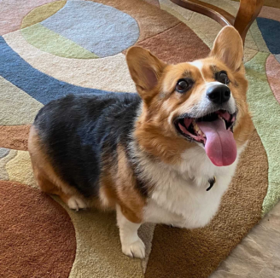

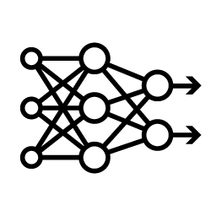
Vision Language Models
What breed of dog is in this picture?
A corgi. The markings on its back are called a “saddle”.
Notes:
Let’s say we want to make a model that can reason about images as well as a Large Language Model can reason about text.

Slide 7
LLM Architecture
A simplified overview
Embeddings
Attention
Linear
Text Input
Output
Notes:
Large Language Models took a lot of hard work and research in order to be created. It would be extremely convenient if we could take advantage of that hard work.

Slide 8
LLM Architecture
A simplified overview
Embeddings
Attention
Linear
Text Input
Output
Notes:
What if we could convert image embeddings into text embeddings?

Slide 9
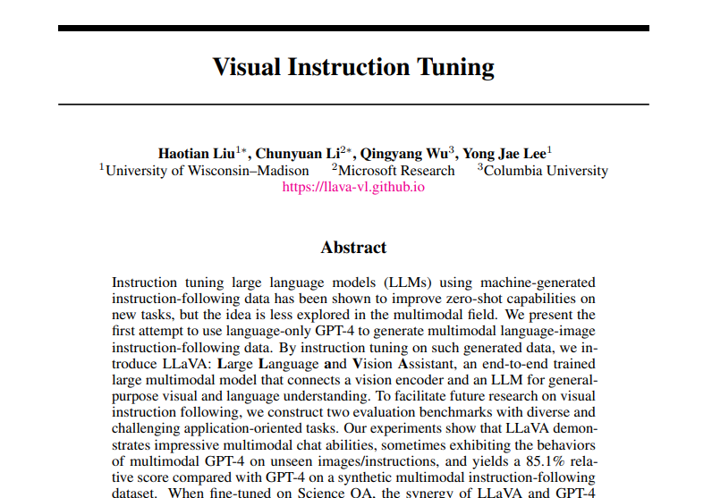
Notes:
In the landmark paper “Visual Instruction Tuning”, researching propose a method to do this. It sounds simple on paper, but can be surprisingly challenging in practice. Let’s see how.
https://arxiv.org/abs/2304.08485

Slide 10
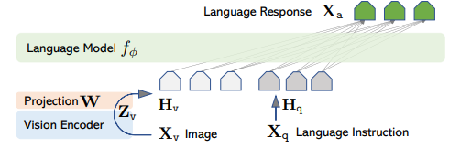
The Projection Matrix
Notes:
Here’s the theory. Ideally, we’d like some way to image encodings into language encodings.

Slide 11
The Projection Matrix
$$H_{v}=W∙Z_{v}, with Z_{v}=g\left(X_{v}\right)$$
Notes:
Here’s the formula the paper gives. Let’s say we have an image, called X_v, and we can get an encoding for that image, called Z_v. The paper proposes creating a trainable matrix, W, that we can multiply the image encodings with to make corresponding text encodings: H_v. We can then concatenate H_v with any text encoding for any text we’d like to analyze with our image.

Slide 12
Projection in Physics
Notes:
The paper does not go into much detail on how this trainable matrix is created, so let’s see if we can deduce what it is. First, let’s take a look at the physics definition of Projection.

Slide 13
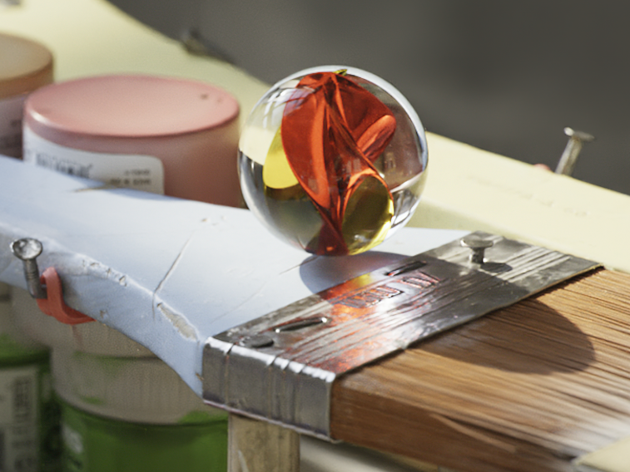
The Projection Matrix
Marble Physics
Notes:
So what exactly does projection mean? Almost any matrix operation has a physics or video game-based example of it, so let’s use one of those to deepen our understanding. Let’s say we want to recreate the physics in the NVIDIA Marbles demo. If you haven’t played this game, I recommend installing Omniverse and checking it out!

Slide 14
The Projection Matrix
Marble Physics
Notes:
Here’s a two dimensional simplification. Let’s say we have a marble on a slope, and we’d like to calculate where the marble should go next.

Slide 15
The Projection Matrix
Marble Physics
Gravity
0, -1
x₀, y₀
Notes:
If gravity is pushing down on the marble, it should cause the marble to roll down the hill.

Slide 16
The Projection Matrix
Marble Physics
Gravity (u)
Slope (v)
x₀, y₀
Notes:
Let’s call gravity u and the slope v

Slide 17
The Projection Matrix
Marble Physics
Gravity (u)
0, -1
Slope (v)
-2, -1
x₀, y₀
Notes:
We’re going to need the angle between our slope and gravity. To start, we’ll pick a direction for our slope. It doesn’t matter which direction. The math will come to the same result.
To get the angle between our two vectors, we should align their origins so that they’re both extending from the same spot

Slide 18
The Projection Matrix
Marble Physics
Gravity (u)
0, -1
θ
Slope (v)
-2, -1
x₀, y₀
Notes:
We’re going to need the angle between our slope and gravity, so let’s extend it down a bit.

Slide 19
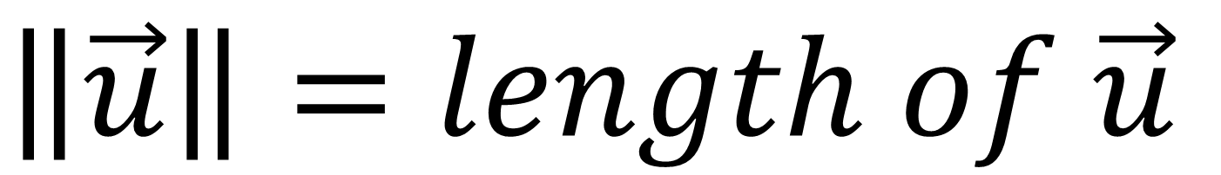
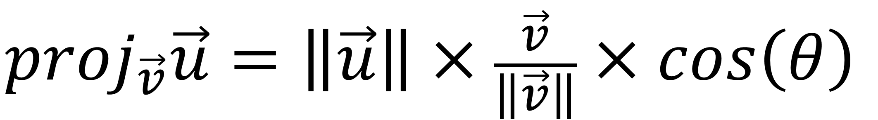

The Projection Matrix
Marble Physics
Gravity (u)
0, -1
θ
$${proj}_{\vec{v}}\vec{u}=\left\|\vec{u}\right\|×\frac{\vec{v}}{\left\|\vec{v}\right\|}×cos\left(θ\right)$$
$$\left\|\vec{u}\right\|=length of \vec{u}$$
Slope (v)
-2, -1
x₀, y₀
$${proj}_{\vec{v}}\vec{u}$$
Notes:
The projection of u onto v is equal to the length of u, times v normalized by its length, times the cosine of the angle between them.

Slide 20
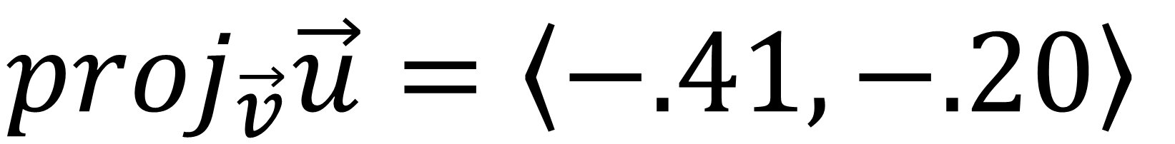
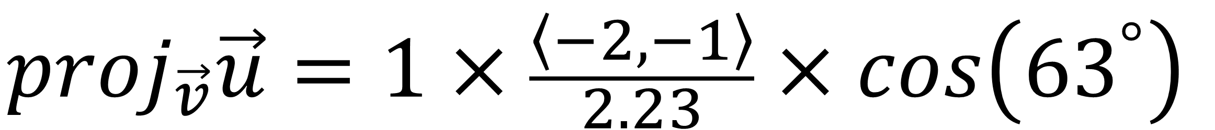
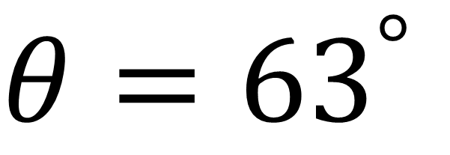
The Projection Matrix
Marble Physics
Gravity (u)
0, -1
θ
$${proj}_{\vec{v}}\vec{u}=\left\|\vec{u}\right\|×\frac{\vec{v}}{\left\|\vec{v}\right\|}×cos\left(θ\right)$$
$$θ={63}^{°}$$
Slope (v)
-2, -1
x₀, y₀
$${proj}_{\vec{v}}\vec{u}=1×\frac{\left\langle −2, −1\right\rangle }{2.23}×cos\left({63}^{°}\right)$$
$${proj}_{\vec{v}}\vec{u}$$
$${proj}_{\vec{v}}\vec{u}=\left\langle −.41, −.20\right\rangle$$
Notes:
If we plug in our values, we can get that a marble sitting on a slope such as this one would accelerate left .79 units and down .39 units.

Slide 21
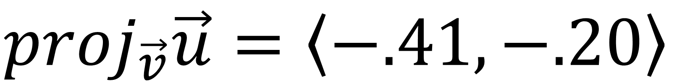
The Projection Matrix
Marble Physics
Gravity (u)
0, -1
θ
$${proj}_{\vec{v}}\vec{u}=\left\|\vec{u}\right\|×\frac{\vec{v}}{\left\|\vec{v}\right\|}×cos\left(θ\right)$$
$$θ={63}^{°}$$
Slope (v)
-2, -1
x₀, y₀
$${proj}_{\vec{v}}\vec{u}=1×\frac{\left\langle −2, −1\right\rangle }{2.23}×cos\left({63}^{°}\right)$$
$${proj}_{\vec{v}}\vec{u}$$
$${proj}_{\vec{v}}\vec{u}=\left\langle −.41, −.20\right\rangle$$
Notes:
By the way, the exact length of v doesn’t matter as long as we have the correct ratio of horizontal to vertical change.

Slide 22
The Projection Matrix
Marble Physics
Gravity (u)
0, -1
θ
$${proj}_{\vec{v}}\vec{u}=\left\|\vec{u}\right\|×\frac{\vec{v}}{\left\|\vec{v}\right\|}×cos\left(θ\right)$$
$$θ={63}^{°}$$
Slope (v)
-2, -1
x₀, y₀
$${proj}_{\vec{v}}\vec{u}=1×\frac{\left\langle −2, −1\right\rangle }{2.23}×cos\left({63}^{°}\right)$$
$${proj}_{\vec{v}}\vec{u}$$
$${proj}_{\vec{v}}\vec{u}=\left\langle −.41, −.20\right\rangle$$
Notes:
Also, remember how earlier in the course, we mentioned how the cosine similarity can be calculated using the dot product?

Slide 23
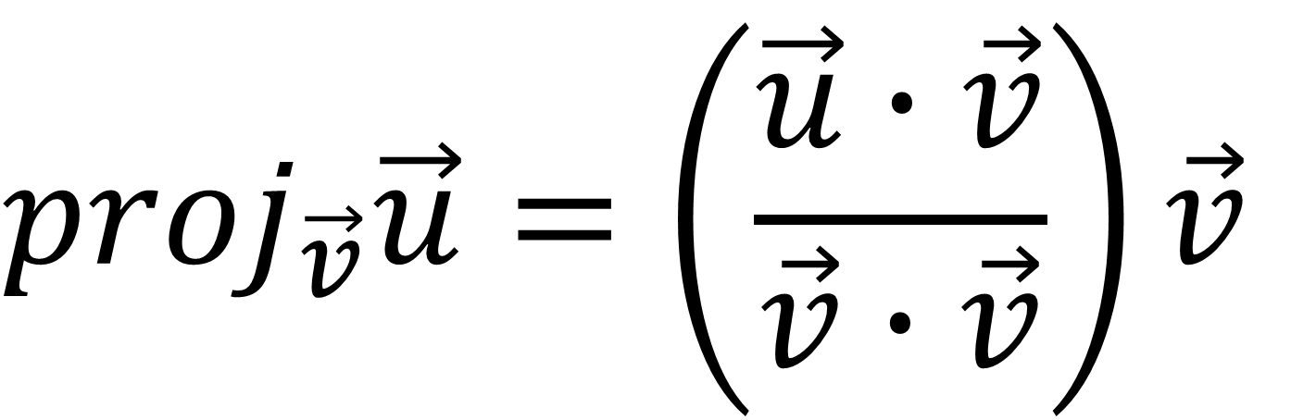
The Projection Matrix
Marble Physics
Gravity (u)
0, -1
θ
$${proj}_{\vec{v}}\vec{u}=\left\|\vec{u}\right\|×\frac{\vec{v}}{\left\|\vec{v}\right\|}×cos\left(θ\right)$$
$${proj}_{\vec{v}}\vec{u}=\left(\frac{\vec{u}∙\vec{v}}{\vec{v}∙\vec{v}}\right)\vec{v}$$
Slope (v)
-2, -1
x₀, y₀
$${proj}_{\vec{v}}\vec{u}$$
Notes:
We can use dot products instead of a cosine here. Isn’t the symmetry in the numerator and denominator interesting? I believe this is what mathematicians call an “elegant solution”.

Slide 24
Projection in
Visual Instruction Tuning
Notes:
Now that we know the physics inspiration, let’s see how Llama uses projection.

Slide 25
The Projection Matrix
Marble Physics
Gravity (u)
Slope (v)
x₀, y₀
$${proj}_{\vec{v}}\vec{u}$$
Notes:
Now that we’ve gone over the physical definition of projection, let’s get a little more abstract.

Slide 26
The Projection Matrix
Marble Physics
Gravity (u)
Image Emb
Slope (v)
Text Emb
x₀, y₀
$${proj}_{\vec{v}}\vec{u}$$
Notes:
Instead of projecting one physical vector onto another, perhaps we can project an image vector onto a text vector.

Slide 27
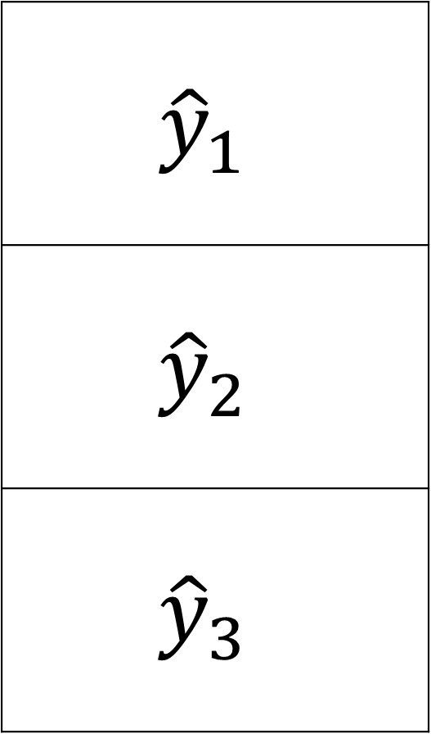
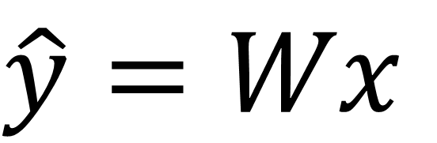
The Projection Matrix
Matrix Multiplication
x₁ | x₂ | x₃ | x₄
$$\hat{y}=Wx$$
w₁₁ | w₁₂ | w₁₃ | w₁₄
w₂₁ | w₂₂ | w₂₃ | w₂₄
w₃₁ | w₃₂ | w₃₃ | w₃₄
$${\hat{y}}_{1}$$
$${\hat{y}}_{2}$$
$${\hat{y}}_{3}$$
Notes:
This time, we’ll try to find some sequence of matrix operations that we will call W. We’re still trying to map one vector onto another, but instead, our goal is to make a multivariate prediction y_hat based on our input x. It doesn’t matter what method we use to do it as long as our prediction y_hat is close to what we’re trying to predict: y.
Because of how flexible this approach is, we can convert vectors from some number of dimensions into a vector of a different number of dimensions. So if we want to project a 4 dimensional vector onto a 3 dimensional space, we could try to find a 4 by 3 matrix to matrix multiply with.

Slide 28
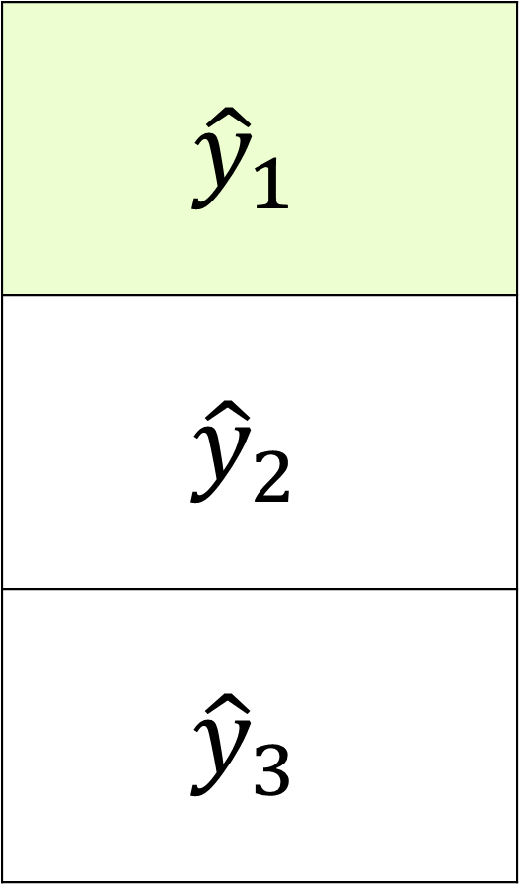
The Projection Matrix
Matrix Multiplication
x₁ | x₂ | x₃ | x₄
$$\hat{y}=Wx$$
w₁₁ | w₁₂ | w₁₃ | w₁₄
w₂₁ | w₂₂ | w₂₃ | w₂₄
w₃₁ | w₃₂ | w₃₃ | w₃₄
$${\hat{y}}_{1}$$
$${\hat{y}}_{2}$$
$${\hat{y}}_{3}$$
$$={ x}_{1}w_{11}+x_{2}w_{12}+x_{3}w_{13}+x_{4}w_{14}$$
Notes:
If we multiply a vector by a matrix, we can calculate the result one row at a time. For each input in x, we would multiply by the corresponding weight in w. Then, we add the results of all of the multiplications to get one value in our resulting prediction vector.

Slide 29
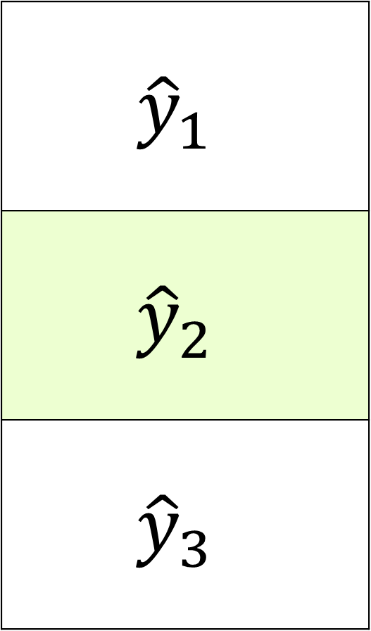
The Projection Matrix
Matrix Multiplication
x₁ | x₂ | x₃ | x₄
$$\hat{y}=Wx$$
w₁₁ | w₁₂ | w₁₃ | w₁₄
w₂₁ | w₂₂ | w₂₃ | w₂₄
w₃₁ | w₃₂ | w₃₃ | w₃₄
$${\hat{y}}_{1}$$
$${\hat{y}}_{2}$$
$${\hat{y}}_{3}$$
$$={ x}_{1}w_{11}+x_{2}w_{12}+x_{3}w_{13}+x_{4}w_{14}$$
$$=x_{1}w_{21}+x_{2}w_{22}+x_{3}w_{23}+x_{4}w_{24}$$

Slide 30
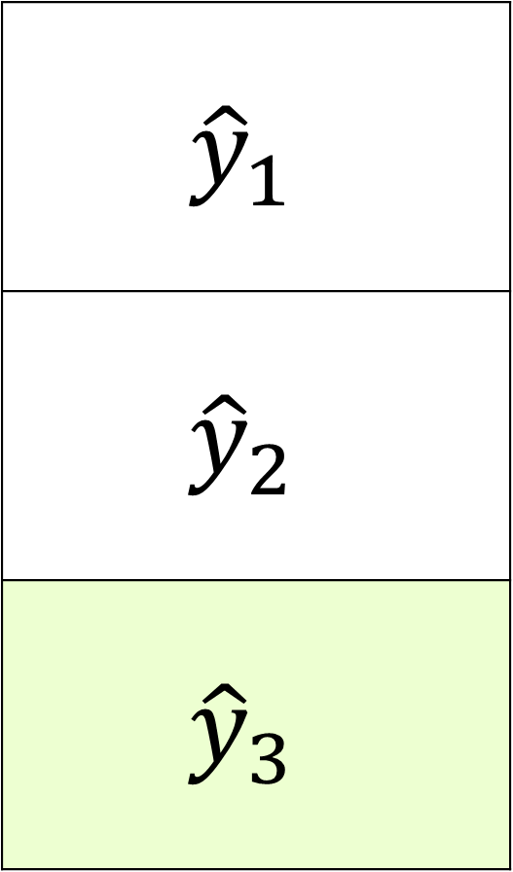
The Projection Matrix
Matrix Multiplication
x₁ | x₂ | x₃ | x₄
$$\hat{y}=Wx$$
w₁₁ | w₁₂ | w₁₃ | w₁₄
w₂₁ | w₂₂ | w₂₃ | w₂₄
w₃₁ | w₃₂ | w₃₃ | w₃₄
$${\hat{y}}_{1}$$
$${\hat{y}}_{2}$$
$${\hat{y}}_{3}$$
$$={ x}_{1}w_{11}+x_{2}w_{12}+x_{3}w_{13}+x_{4}w_{14}$$
$$=x_{1}w_{21}+x_{2}w_{22}+x_{3}w_{23}+x_{4}w_{24}$$
$$=x_{1}w_{31}+x_{2}w_{32}+x_{3}w_{33}+x_{4}w_{34}$$

Slide 31

The Projection Matrix
Matrix Multiplication
x₁ | x₂ | x₃ | x₄
$$\hat{y}=Wx$$
$${\hat{y}}_{1}$$
$${\hat{y}}_{2}$$
$${\hat{y}}_{3}$$
$$={ x}_{1}w_{11}+x_{2}w_{12}+x_{3}w_{13}+x_{4}w_{14}$$
$$=x_{1}w_{21}+x_{2}w_{22}+x_{3}w_{23}+x_{4}w_{24}$$
$$=x_{1}w_{31}+x_{2}w_{32}+x_{3}w_{33}+x_{4}w_{34}$$
$${\hat{y}}_{1}$$ | $${\hat{y}}_{2}$$ | $${\hat{y}}_{3}$$
Notes:
This is the exact same thing a layer of neurons does in a neural network! So rather than reinvent the tooling for this projection matrix ourselves, we can replicate this projection matrix with neural network linear layers.

Slide 32
Visual Instruction Tuning
in Practice
Notes:
Now that we know the theory behind how these models were created, let’s dive into a practical example: how the LLM LLama was converted to the Visual Lanugage model, LlaVa.

Slide 33
LlaVA Architecture
CLIP Vision Tower
CLIP Embeddings
Notes:
To get our image embeddings, we’re going to use CLIP. LlaVa refers to this as “the Vision Tower”. We’ll use CLIP image processing tools. We’re not going to use the final 512 length vector that’s outputted by CLIP. Instead, we’ll use the output of a hidden state.

Slide 34
LlaVA Architecture
CLIP Vision Tower
Projector
CLIP Embeddings
Projection Model
Notes:
We’ll take the hidden state output and feed it into our projector…

Slide 35
LlaVA Architecture
CLIP Vision Tower
Projector
Llama
CLIP Embeddings
Projection Model
Llama Embeddings
Notes:
And connect it to the Llama model. User prompts will also be processed by Llama so we can get their text embeddings.

Slide 36
LlaVA Architecture
CLIP Vision Tower
Projector
Llama
CLIP Embeddings
Projection Model
Llama Embeddings
Notes:
We’ll then concatenate the projected image embeddings with the text embeddings….

Slide 37
LlaVA Architecture
CLIP Vision Tower
Projector
Llama
CLIP Embeddings
Projection Model
Llama Embeddings
Attention
Linear
Output
Notes:
And pass everything through the rest of the llama architecture as though it was one giant text embedding. This is possible because the attention mechanism is flexible to different input sizes.

Slide 38
LlaVA Architecture
CLIP Vision Tower
Projector
Llama
CLIP Embeddings
Projection Model
Llama Embeddings
Attention
Embedding Sizes
50
Linear
768
Output
Notes:
To clarify, the output of the CLIP Vision tower is going to be 50 by 768 values.

Slide 39
LlaVA Architecture
CLIP Vision Tower
Projector
Llama
CLIP Embeddings
Projection Model
Llama Embeddings
Embedding Sizes
Attention
Embedding Sizes
50
32000
50
Linear
768
4096
Output
Notes:
When we pass that through the projector, we’ll get 50 by 4096 values. Even though this data is two dimensional we’re going to treat it like it’s a batch of 50 vectors. So if we have a batch of training data, we’ll have a batch of a batch of 50 vectors. Each vector passed through the projector model has no influence on the other vectors.
So in a sense, for each image being passed through, we’re trying to find the best fitting 50 hypothetical text tokens to describe it. It’s like a form of poetry where haiku meets Alice and Wonderland’s Jabberwocky nonsense vocabulary.

Slide 40

LlaVA Architecture
Patches
Projector
50
Projection Model
4096
Projector
3 x 50
Projection Model
4096
Notes:
Still, it can be quite challenging to find the perfect haiku to describe an image. To compensate, we can break an image up into smaller images, or “Patches”. This way, we can get as many encodings as we have patches.

Slide 41
Lab 3a – Model Projection
Notes:
Now that we’ve talked about how it works, let’s get some hands-on practice.

Slide 42
Hypothesis:
If we can project image embeddings into text embeddings, we can project text embedding into image embeddings
Notes:
Here’s a thought. If we can project image embeddings into text space, can we project text embeddings into image space?

Slide 43

Model Projection
Lab 3a
Convolutional Neural Network
Flatten
Linear
Kniphofia Uvaria
Salvia Splendens
Tagetes Patula
Notes:
Let’s find out. We’re going to take a standard convolutional neural network used for image classification. In this case, it will be identifying different flower breeds.

Slide 44

Model Projection
Lab 3a
A red and yellow flower in the shape of a pinecone with spikey petals.
CLIP Text Encoding
Convolutional Neural Network
Projection Model
Flatten
Linear
Kniphofia Uvaria
Salvia Splendens
Tagetes Patula
Notes:
We’ll take this trained model and try to inject CLIP text encodings into it. Because the output of our flatten layer is a single vector, we’ll try to project CLIP’s output vector into an image vector. This will be a one vector to one vector conversion.

Slide 45
Lab 3b – OCR Pipelines
Notes:
Like the previous labs, this set of labs comes in pairs.

Slide 46
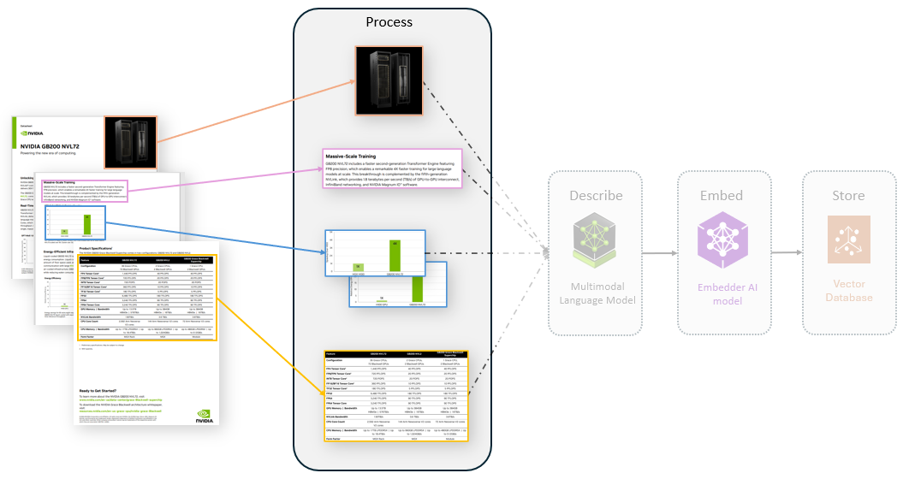
OCR Pipelines
Lab 3b
Notes:
This time, we’ll review some data operation tools used to analyze PDFs, including the unstructured library.

Slide 47
Let’s Get Started!
Notes:
Itching to get coding? Let’s get started!

