Slide 1
Hepatitis C Transmission and Progression Among People Who Have Injected Drugs in Singapore: Modelling Treatment for Elimination

Slide 2
Background
Hepatitis C Virus (HCV) burden is highly concentrated among people who inject drugs (PWID)
  Local studies report about 42.5% (36-47%) anti-HCV seroprevalence among PWIDs.*
Effective treatment exists, but linkage to care remains a major barrier.
  Among HCV-positive halfway-house residents, only 48.6% reached confirmatory RNA testing and 12.6% initiated treatment.*
Incarceration provides a high-yield treatment opportunity.
  Unrestricted DAA access increased treatment uptake by 460%, with 99% completion and 99.1% sustained virological response (SVR) among incarcerated HCV patients.*
Repeated prison-community transitions make intervention timing important.
  Singapore recorded 1,152 Drug Rehabilitation Centre (DRC) admissions and 1,241 releases in 2017. And the 2017 DRC release cohort had 45.2% five-year recidivism.*
DAA: Direct acting antivirals; *Winslow et al. 2007; Hsiang et al. 2022; Wong et al. 2021; Singapore Prison Service.

Slide 3
Research gap
International HCV models may not capture Singapore-specific incarceration and reinjection dynamics.
Existing Singapore modelling has not explicitly represented age-specific prison–community transitions when designing treatment strategies.
Despite highly effective DAAs, it remains unclear who should be treated, where, and at what coverage to achieve sustained HCV elimination.
DAA: Direct acting antivirals; *Pawltosky et al. 2020; Hernandez-Con et al. 2023; Goodyear et al. 2021; Chaillon et al. 2020;

Slide 4
Aims
To develop a dynamic compartmental model capturing incarceration cycles, HCV transmission, and liver disease progression among PWIDs in Singapore.
To simulate treatment coverage and disease progression under alternative DAA scale–up strategies.
Prioritizing individuals by incarceration status, disease eligibility, and age group.
To estimate relative reductions in HCV incidence and advanced liver disease burden (especially HCC) attributable to prioritized DAA treatment strategies, relative to status quo.
PWIDs: people who inject drugs; DAA: direct acting antiviral; HCC: hepatocellular carcinoma;

Slide 5
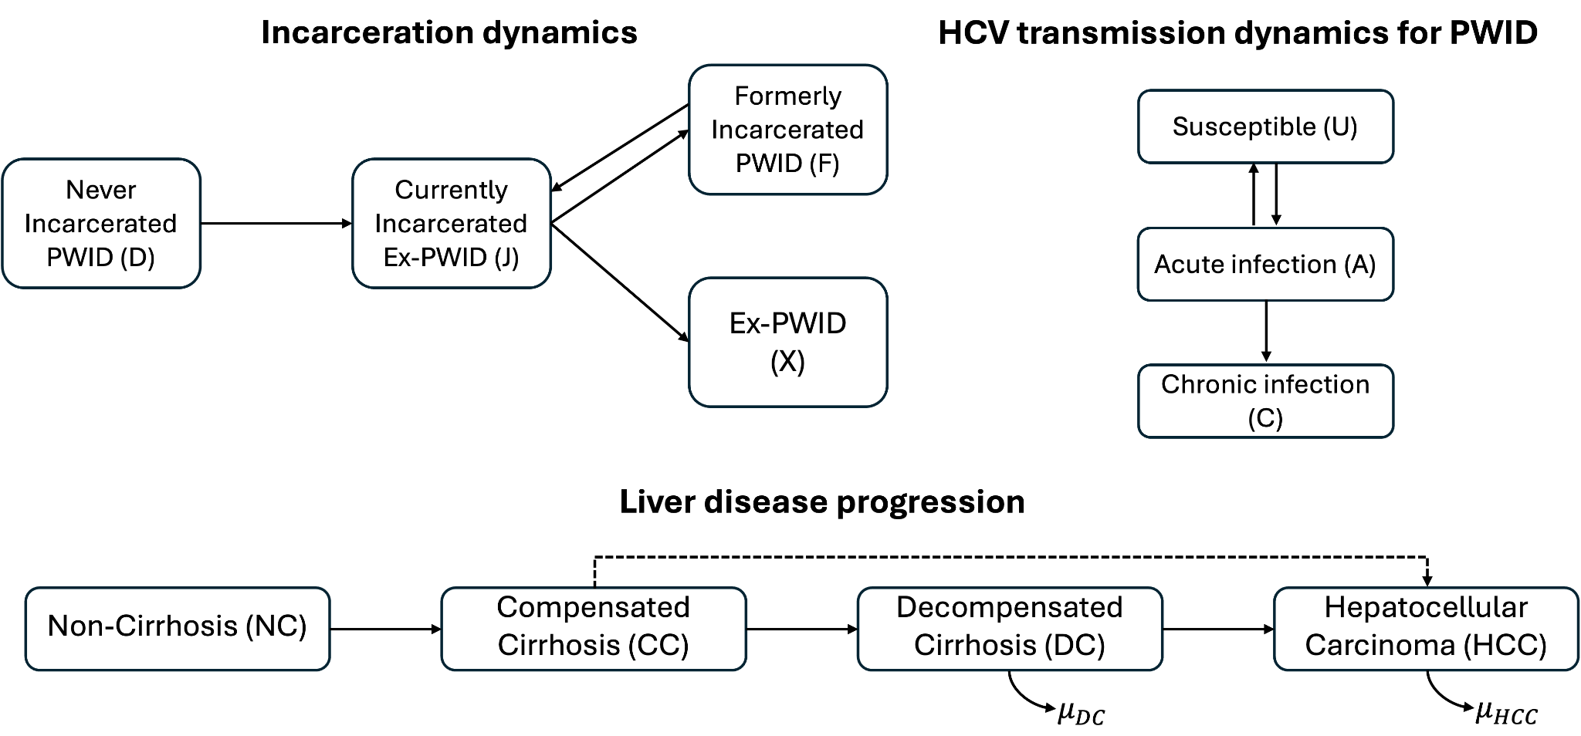
Compartmental model schematic
Deterministic, discrete–time transmission model with a daily time step.
Six age groups (<20 to 60+), with age progression explicitly modelled.
Age–specific mortality adjusted by risk ratios for PWIDs relative to the general population.
Temporal parameters omit for simplicity.
PWID: people who inject drugs; Mathers et al. 2013;

Slide 6
Incarceration dynamics
All individuals enter the model as uninfected, non–cirrhotic, and never–incarcerated PWIDs.
Only individuals in D and F are assumed susceptible to HCV infection through needle sharing.
After release, individuals either resume injection (F), or permanently cease (X), determined by an age–invariant recidivism probability estimated from Singapore Changi prison HCV screening data.
PWID: people who inject drugs;

Slide 7
HCV transmission dynamics
For newly infected individuals in acute stage (A), they will
  Either clear infection spontaneously within six months (back to U), or
  Progress to chronic infection (C), followed by sequential progression through later stages of liver disease.

Slide 8
Liver disease progression
Direct progression from compensated cirrhosis to HCC is allowed.*
Progression rates are literature–based and adjusted for Singapore’ high genotype 3 prevalence (~78%).*
HCV–related liver transplantation is excluded due to its rarity in Singapore.*
*Zhao et al. 2019; Chaillon et al. 2020;

Slide 9
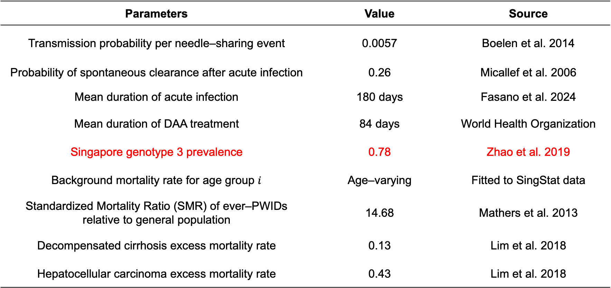
Some fixed parameters
Parameters | Value | Source
Transmission probability per needle–sharing event | 0.0057 | Boelen et al. 2014
Probability of spontaneous clearance after acute infection | 0.26 | Micallef et al. 2006
Mean duration of acute infection | 180 days | Fasano et al. 2024
Mean duration of DAA treatment | 84 days | World Health Organization
Singapore genotype 3 prevalence | 0.78 | Zhao et al. 2019
Background mortality rate for age group $i$ | Age–varying | Fitted to SingStat data
Standardized Mortality Ratio (SMR) of ever–PWIDs relative to general population | 14.68 | Mathers et al. 2013
Decompensated cirrhosis excess mortality rate | 0.13 | Lim et al. 2018
Hepatocellular carcinoma excess mortality rate | 0.43 | Lim et al. 2018
DAA: Direct–acting antiviral;

Slide 10
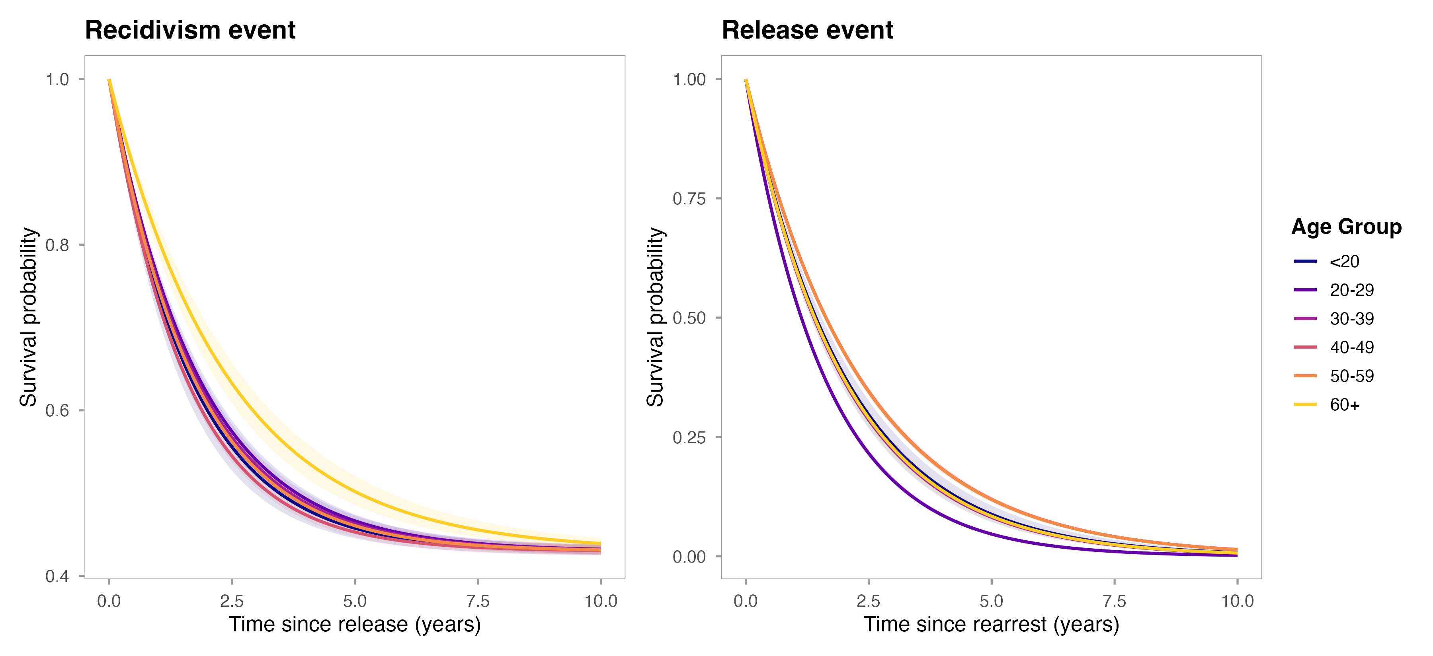
Recidivism and release survival curve
Estimated from arrest and release records spanning Jan 2007 – Dec 2017 Singapore prison data.
Recidivism risk after release peaks at ages 40–49, while PWIDs under 20 had the longest community intervals before re–arrest.

Slide 11
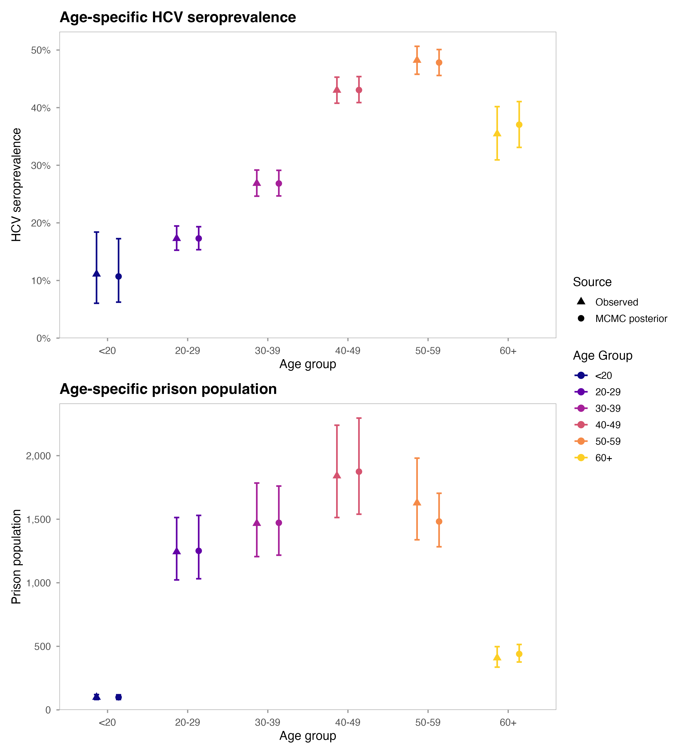
Model calibration
Transmission parameters are currently being calibrated so that model–predicted HCV prevalence among PWIDs in prison aligns with observed values.
PWID: people who inject drugs;

Slide 12
Model predictions at 2017
Stratum | Total population (95% BCI) | Active HCV cases (95% BCI)
Never–incarcerated PWID (D) | 3,734 (3,436–4,069) | 975 (869–1,090)
Incarcerated ex–PWID (J) | 6,618 (6,101–7,290) | 2,341 (2,118–2,617)
Formerly–incarcerated PWID (F) | 2,954 (2,715–3,264) | 1,366 (1,247–1,506)
Formerly–incarcerated ex–PWID (X) | 26,243 (23,717–29,624) | 6,342 (5,741–7,100)
Current PWID (D + F) | 6,688 (6,151–7,333) | 2,341 (2,116–2,596)
Ever-PWID (D + J + F + X) | 39,561 (36,140–44,078) | 11,065 (10,006––12,285)
About 39,600 ever-PWIDs were estimated in 2017, including around 6,700 current PWIDs.
About 11,100 active HCV infections were estimated among ever-PWIDs (28% prevalence), while the prevalence is higher among current PWIDs (35.0%).
Formerly incarcerated ex-PWIDs accounted for roughly 57% of all HCV infections.
PWID: People who inject drugs;
Notes:
1. Change ever-PWID -> not/currently incarcerated

Slide 13
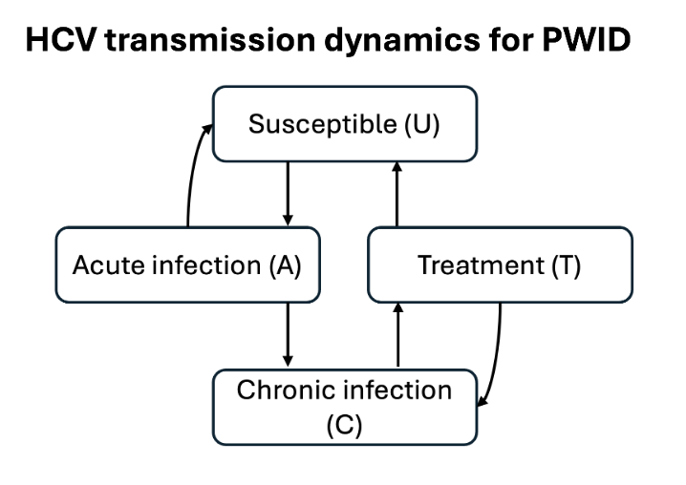
Treatment
Treatment lasts 12 weeks, with no immunity assumed following recovery.
Successful treatment leads to sustained virological response after 12 weeks (SVR12).
After achieving SVR12:
  Progression is assumed to stop in non–cirrhotic PWIDs and slows in cirrhotic PWIDs until reinfection.
  Survival improves for DC and HCC stages.
SVR12 rates vary by disease stage and treatment regimen based on clinical evidence.
PWID: people who inject drugs; DC: decompensated cirrhosis; HCC: hepatocellular carcinoma; An et al. 2022; Pawlotsky et al. 2020; Morgan et al. 2013;

Slide 14
Future treatment scenarios design
Parameters | Value (e.g.)
Disease–stage–specific recruitment rates | 1%-15% (D/F/X); 10-100% (J)
Delivery setting | prison–, community–, mixed–based
Treatment regimen choice for DC/HCC | SOF/VEL+RBV, SOF/VEL*
Treatment minimum age | 40, 50, 60
Note: SOF/VEL is considered as pan-genotypic DAA treatment regimen according to European Association for the Study of the Liver (EASL) 2020 HCV treatment guideline.
Outcomes include HCV incidence, cumulative infections, DC/HCC incidence, and HCC mortality, compared with no treatment.
*SOF: sofosbuvir; VEL: velpatasvir; RBV: ribavirin; DC: decompensated cirrhosis; HCC: hepatocellular carcinoma; Xiao et al. 2025

Slide 15
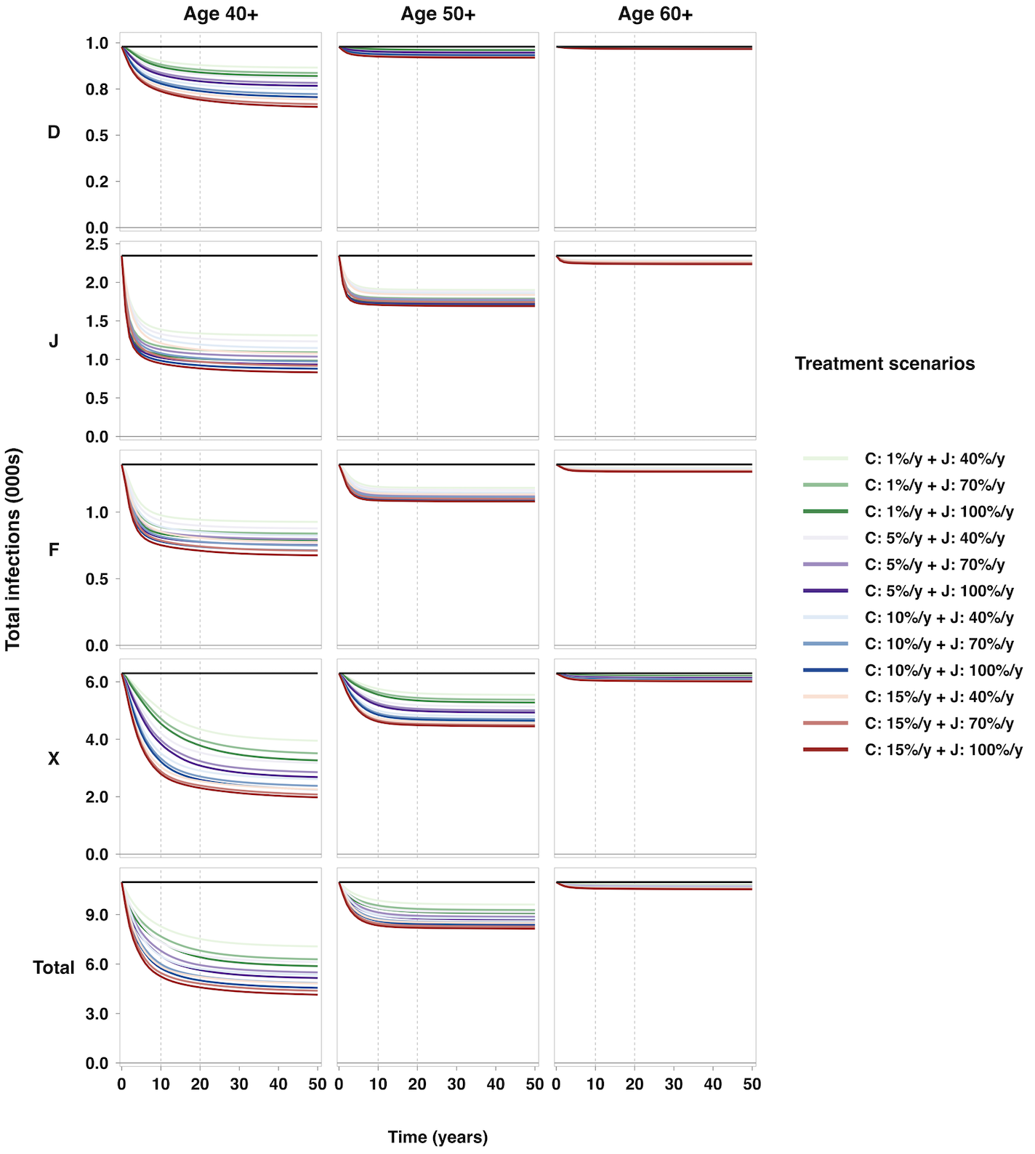
Treatment scenarios: Age group targeting
Explanation:
Age 40+: Only PWID aged 40+ are treatment-eligible
Age 50+: Only PWID aged 50+ are treatment-eligible
Age 60+: Only PWID aged 60+ are treatment-eligible
C: Community treatment (D+F+X)
J: Prison treatment (J)
Findings:
Age ≥40 targeting substantially reduced HCV burden, but did not achieve elimination.
Benefits decreased rapidly with higher age thresholds; age ≥60 targeting had minimal impact.
Higher community treatment coverage produced substantially larger gains than increasing prison coverage alone.
Age restriction is a major barrier to elimination.
Notes:
Community: screening is a problem

Slide 16
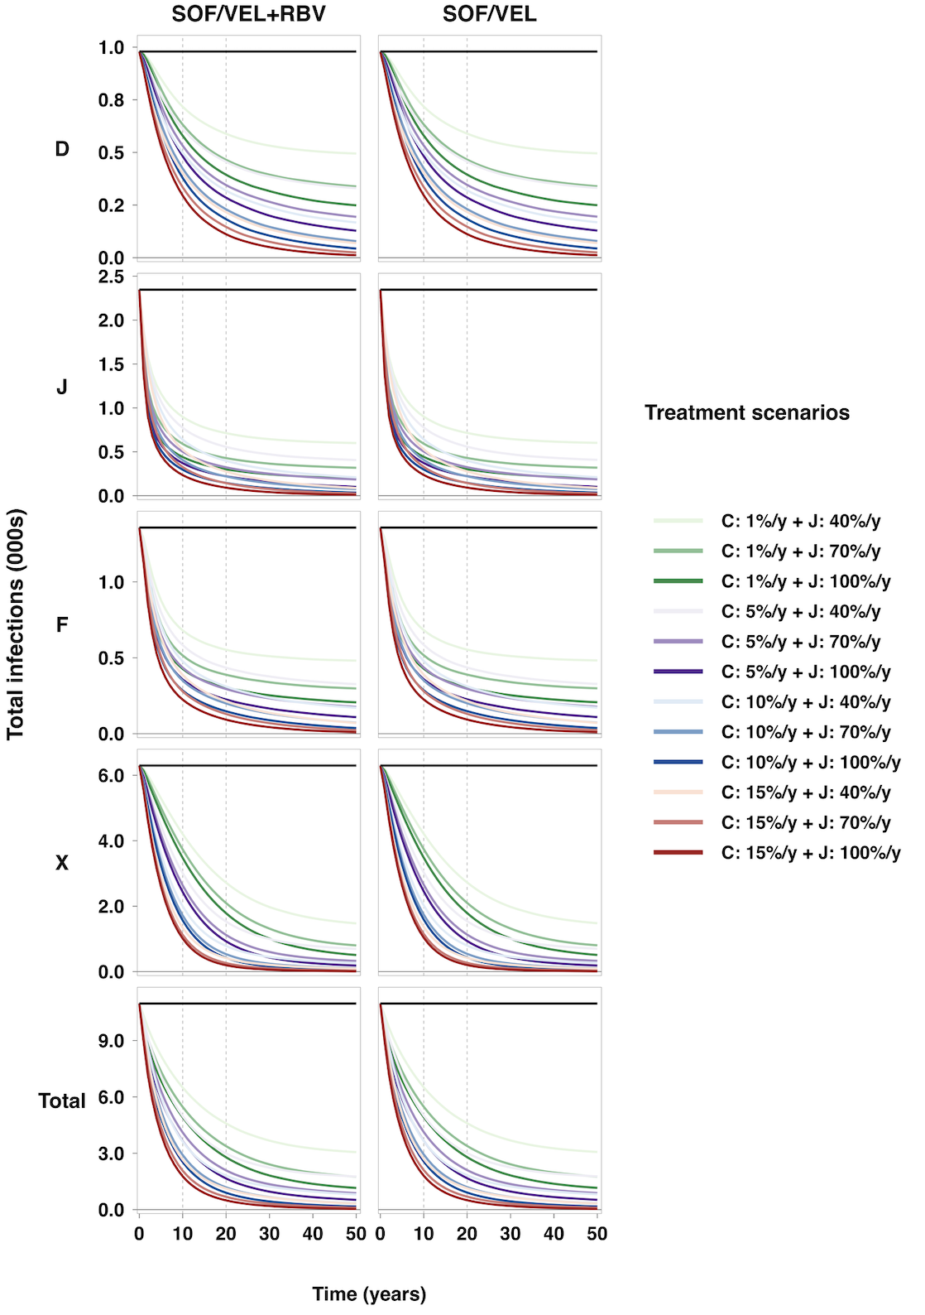
Treatment scenarios: Treatment regimen
Explanation:
SOF/VEL + RBV: Add ribavirin (RBV) for advanced liver disease stages (DC/HCC)
SOF/VEL: standard pan-genotypic treatment
C: Community treatment (D+F+X)
J: Prison treatment (J)
Findings:
Adding RBV provided only a marginal additional reduction in HCV infections compared with SOF/VEL alone.
Population-level impact was driven primarily by treatment coverage rather than regimen choice.
Intensifying the regimen alone could not compensate for low treatment coverage.
HCV elimination is an access problem more than an efficacy problem.

Slide 17
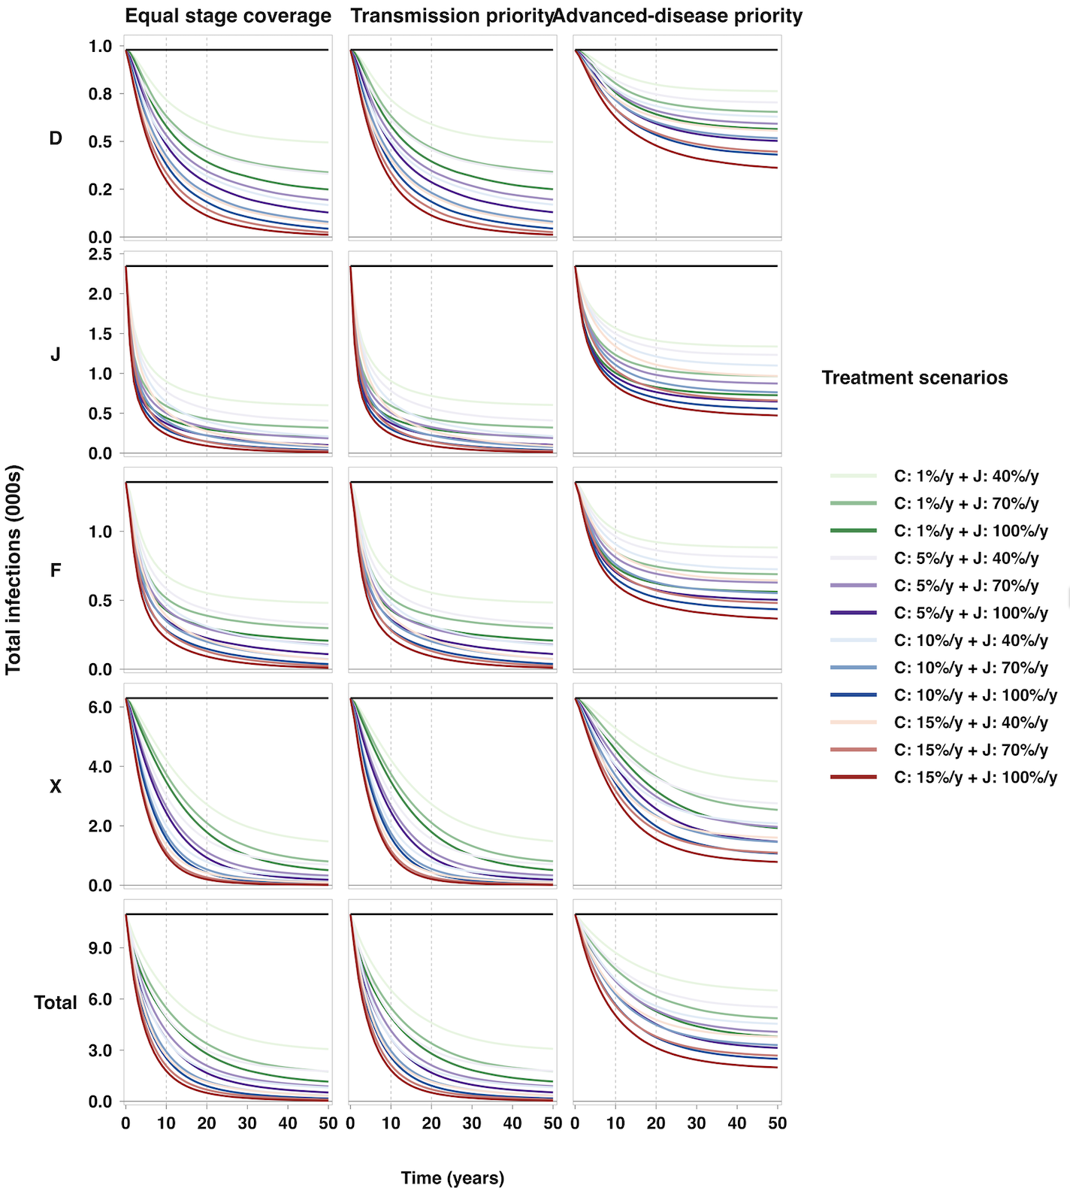
Treatment scenarios: Liver disease stage
Explanation:
C: Community treatment (D+F+X)
J: Prison treatment (J）
Scenario | (NC, CC, DC, HCC)
Equal stage coverage | (1.0, 1.0, 1.0, 1.0)
Transmission priority | (1.0, 1.0, 0.4, 0.3)
Advanced-disease priority | (0.3, 0.5, 0.8, 1.0)
Findings:
Equal-stage coverage and transmission-priority strategies produced very similar reductions in HCV infections.
Advanced-disease prioritisation was substantially less effective for HCV elimination.
HCV elimination requires high treatment coverage in NC/CC, where most infections occur.
Broad access to treatment in early-disease stage (NC/CC) is essential.
Notes:
symptomatic (3rd row)

Slide 18
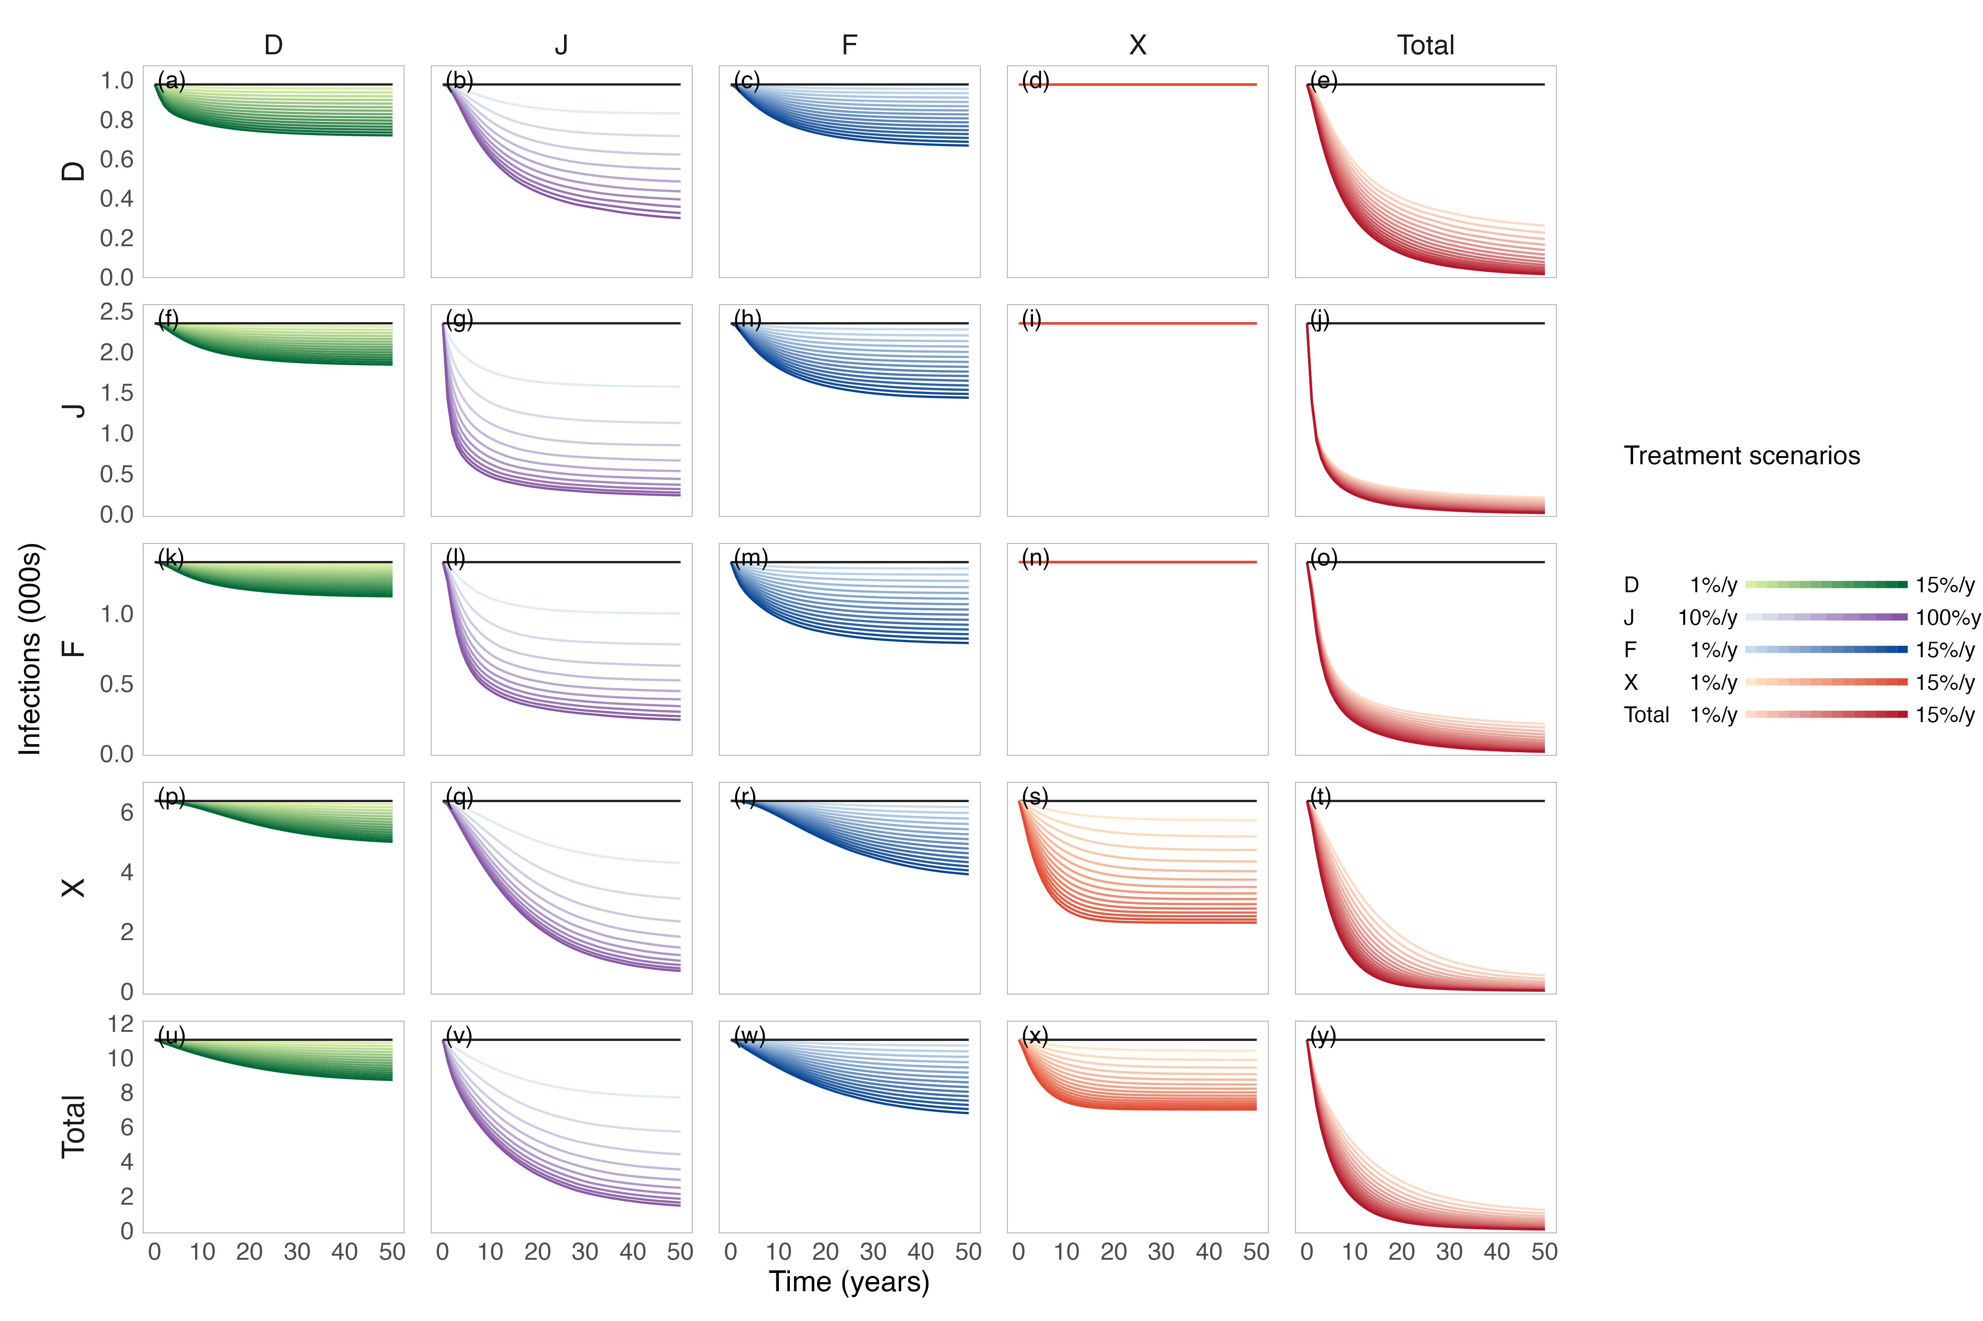
Treatment scenarios: Delivery settings
Explanation:
D/J/F/X: Only treat PWIDs within the stratum
Total: Coverage applied to D/F/X with 100% treatment coverage for J
Findings:
Prison-based treatment was highly effective in rapidly reducing HCV infections across strata.
However, residual infections remained after prison treatment alone, particularly in the community.
Adding community treatment provided further reductions and helped move the population closer to elimination.
Prison-based treatment should be the core intervention, with community treatment used to address residual HCV burden.

Slide 19
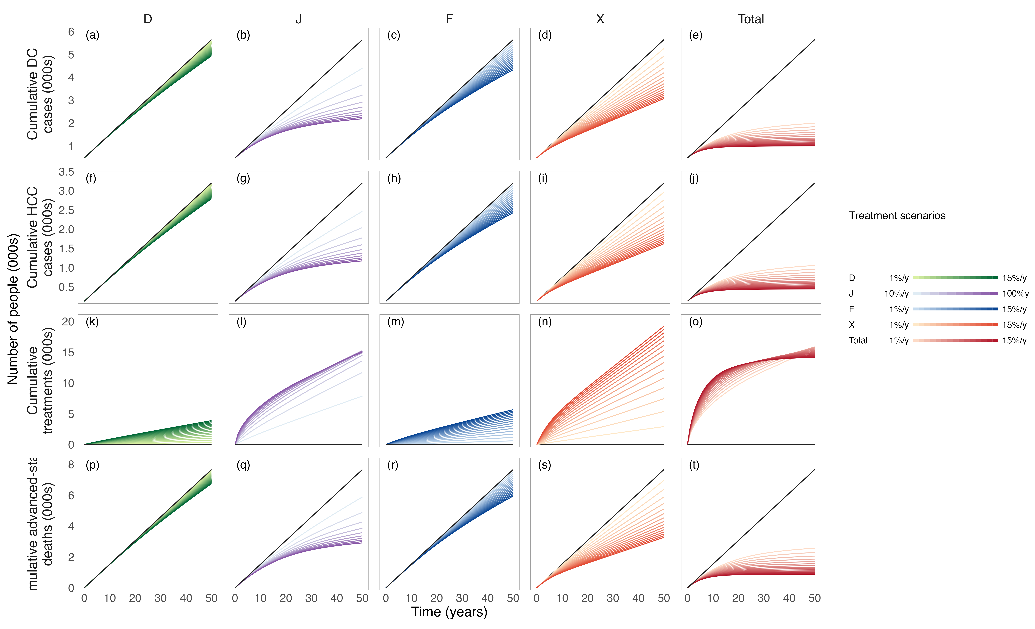
DC/HCC cases & deaths under different delivery settings & coverage
Explanation:
D/J/F/X: Only treat PWIDs within the stratum
Total: Coverage applied to D/F/X with 100% treatment coverage for J
Findings:
Prison-based treatment substantially reduced DC, HCC, and advanced-stage deaths.
Higher treatment coverage produced larger health gains and faster reductions in severe liver outcomes.
More intensive treatment did not necessarily require more treatment initiations long term
Early treatment scale-up can both improve health outcomes and reduce long-term treatment burden.

Slide 20
References
Chaillon A, Thurairajah PH, Hsiang JC, Martin N. What is required for achieving HCV elimination in Singapore? A modeling study. J Hepatol 2020; 73: S818.
Zhao Y, Thurairajah PH, Kumar R, Tan J, Teo EK, Hsiang JC. Novel non-invasive score to predict cirrhosis in the era of hepatitis C elimination: A population study of ex-substance users in Singapore. Hepatobiliary Pancreat Dis Int 2019; 18: 143–8.
Zhu RX, Seto W-K, Lai C-L, Yuen M-F. Epidemiology of hepatocellular carcinoma in the Asia-Pacific region. Gut Liver 2016; 10. DOI:10.5009/gnl15257.
Ashtari S. Hepatocellular carcinoma in Asia: prevention strategy and planning. World J Hepatol 2015; 7: 1708.
Wu Y-J, Xu M-Y, Lu L-G. Clinical advances in fibrosis progression of chronic hepatitis B and C. J Clin Transl Hepatol 2014; 2: 222–7.
Pawlotsky J-M, Negro F, Aghemo A, et al. EASL recommendations on treatment of hepatitis C: final update of the series. J Hepatol 2020; 73: 1170–218.
Hernandez-Con P, Wilson DL, Tang H, et al. Hepatitis C cascade of care in the direct-acting antivirals era: a meta-analysis. Am J Prev Med 2023; 65: 1153–62.
Goodyear T, Brown H, Browne AJ, Hoong P, Ti L, Knight R. “I want to get better, but…”: identifying the perceptions and experiences of people who inject drugs with respect to evolving hepatitis C virus treatments. Int J Equity Health 2021; 20: 81.
Mathers BM, Degenhardt L, Bucello C, Lemon J, Wiessing L, Hickman M. Mortality among people who inject drugs: a systematic review and meta-analysis. Bull World Health Organ 2013; 91: 102–23.
Boelen L, Teutsch S, Wilson DP, et al. Per-event probability of hepatitis C infection during sharing of injecting equipment. PLoS One 2014; 9: e100749.

Slide 21
References
Micallef JM, Kaldor JM, Dore G. Spontaneous viral clearance following acute hepatitis C infection: a systematic review of longitudinal studies. J Viral Hepat 2006; 13: 34–41.
Fasano M, Ieva F, Ciarallo M, Caccianotti B, Santantonio TA. Acute hepatitis C: current status and future perspectives. Viruses 2024; 16: 1739.
Lim AG, Qureshi H, Mahmood H, et al. Curbing the hepatitis C virus epidemic in Pakistan: the impact of scaling up treatment and prevention for achieving elimination. Int J Epidemiol 2018; 47: 550–60.
Fattovich G, Stroffolini T, Zagni I, Donato F. Hepatocellular carcinoma in cirrhosis: incidence and risk factors. Gastroenterology 2004; 127: S35–50.
An J, Park DA, Ko MJ, et al. Direct-acting antivirals for HCV treatment in decompensated liver cirrhosis patients: a systematic review and meta-analysis. J Pers Med 2022; 12: 1517.
Morgan RL, Baack B, Smith BD, Yartel A, Pitasi M, Falck-Ytter Y. Eradication of hepatitis C virus infection and the development of hepatocellular carcinoma: a meta-analysis of observational studies. Ann Intern Med 2013; 158: 329–37.
Xiao J, Zhang X, Mao X, Lai S, Li S, Sheng Y. Efficacy and safety of velpatasvir plus sofosbuvir with or without ribavirin in hepatitis C patients with decompensated cirrhosis: a systematic review and meta-analysis. J Viral Hepat 2025; 32: e70078.

