Slide 1
Hepatitis C Transmission and Progression Among People Who Have Injected Drugs in Singapore: Modelling Treatment for Elimination
He Yichen
02 Oct 2026
Supervisor: Dr. Borame Dickens

Slide 2
Background
Hepatitis C Virus (HCV) infection is a highly prevalent among people who inject drugs (PWIDs) in Singapore.
  Local studies report about 42.5% (36-47%) anti-HCV seroprevalence among PWIDs.*
Effective treatment exists, but linkage to care remains challenging in the community.
  Among HCV-positive halfway-house residents, only 48.6% reached confirmatory RNA testing and 12.6% initiated treatment.*
Incarceration provides a high-yield opportunity for treatment delivery.
  Unrestricted DAA access increased treatment uptake by 460%, with 99% completion and 99.1% sustained virological response (SVR) among incarcerated HCV patients.*
Repeated prison-community transitions make treatment setting and timing important.
  Singapore recorded 1,152 Drug Rehabilitation Centre (DRC) admissions and 1,241 releases in 2017. And the 2017 DRC release cohort had 45.2% five-year recidivism.*
DAA: Direct acting antivirals; *Winslow et al. 2007; Hsiang et al. 2022; Wong et al. 2021; Singapore Prison Service.

Slide 3
Research gap
International HCV models may not capture Singapore-specific incarceration and reinjection dynamics.
Existing Singapore modelling has not explicitly represented age-specific prison–community transitions when designing treatment strategies.
Despite highly effective DAAs, it remains unclear who should be treated, where, and at what coverage to achieve sustained HCV elimination.
DAA: Direct acting antivirals; *Pawltosky et al. 2020; Hernandez-Con et al. 2023; Goodyear et al. 2021; Chaillon et al. 2020;

Slide 4
Aims
To develop a dynamic compartmental model capturing incarceration cycles, HCV transmission, and liver disease progression among PWIDs in Singapore.
To simulate treatment coverage and disease progression under alternative DAA scale–up strategies.
To estimate relative reductions in HCV incidence and advanced liver disease burden (especially HCC) attributable to prioritized DAA treatment strategies, relative to status quo.
PWIDs: people who inject drugs; DAA: direct acting antiviral; HCC: hepatocellular carcinoma;

Slide 5
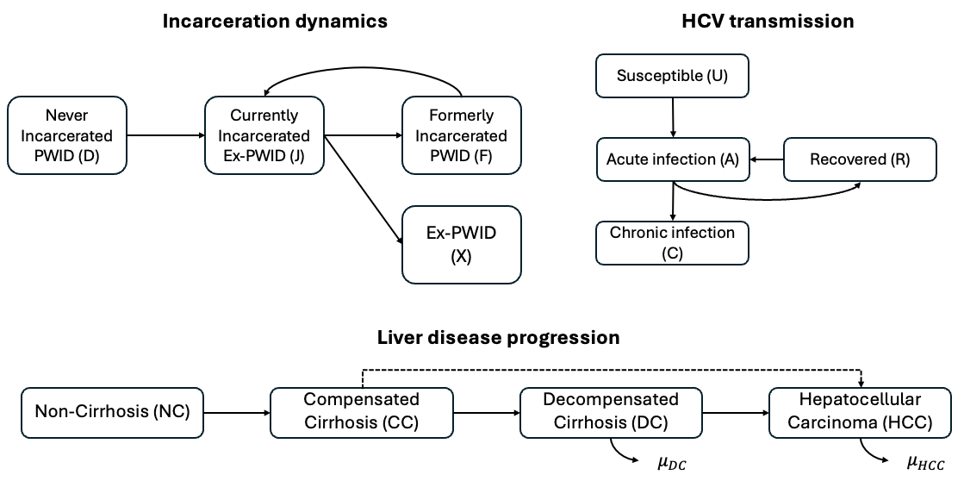
Compartmental model schematic
Deterministic, discrete–time transmission model with a daily time step.
Six age groups (<20 to 60+), with age progression explicitly modelled.
Age–specific mortality adjusted by risk ratios for PWIDs relative to the general population.
Temporal parameters omit for simplicity.
PWID: people who inject drugs; Mathers et al. 2013;

Slide 6
Incarceration dynamics
All individuals enter the model as uninfected, non–cirrhotic, and never–incarcerated PWIDs.
Only individuals in D and F are assumed susceptible to HCV infection through needle sharing.
After release, individuals either resume injection (F), or permanently cease (X), determined by an age–invariant recidivism probability estimated from Singapore Changi prison HCV screening data.
PWID: people who inject drugs;

Slide 7
HCV transmission dynamics
For newly infected individuals in acute stage (A), they will
  Either clear infection spontaneously within six months (enter R), or
  Progress to chronic infection (C), followed by sequential progression through later stages of liver disease.

Slide 8
Liver disease progression
Direct progression from compensated cirrhosis to HCC is allowed.*
Progression rates are literature–based and adjusted for Singapore’ high genotype 3 prevalence (~78%).*
HCV–related liver transplantation is excluded due to its rarity in Singapore.*
*Zhao et al. 2019; Chaillon et al. 2020;

Slide 9
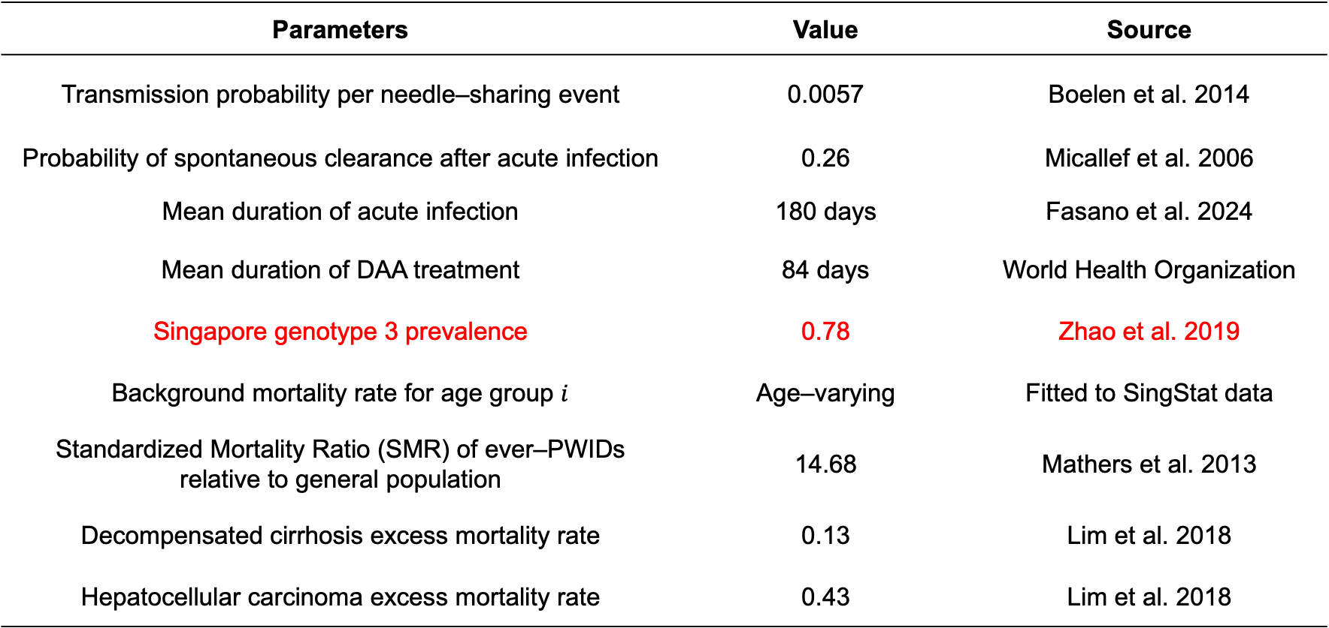
Some fixed parameters
Parameters | Value | Source
Transmission probability per needle–sharing event | 0.0057 | Boelen et al. 2014
Probability of spontaneous clearance after acute infection | 0.26 | Micallef et al. 2006
Mean duration of acute infection | 180 days | Fasano et al. 2024
Mean duration of DAA treatment | 84 days | World Health Organization
Singapore genotype 3 prevalence | 0.78 | Zhao et al. 2019
Background mortality rate for age group $i$ | Age–varying | Fitted to SingStat data
Standardized Mortality Ratio (SMR) of ever–PWIDs relative to general population | 14.68 | Mathers et al. 2013
Decompensated cirrhosis excess mortality rate | 0.13 | Lim et al. 2018
Hepatocellular carcinoma excess mortality rate | 0.43 | Lim et al. 2018
DAA: Direct–acting antiviral;

Slide 10
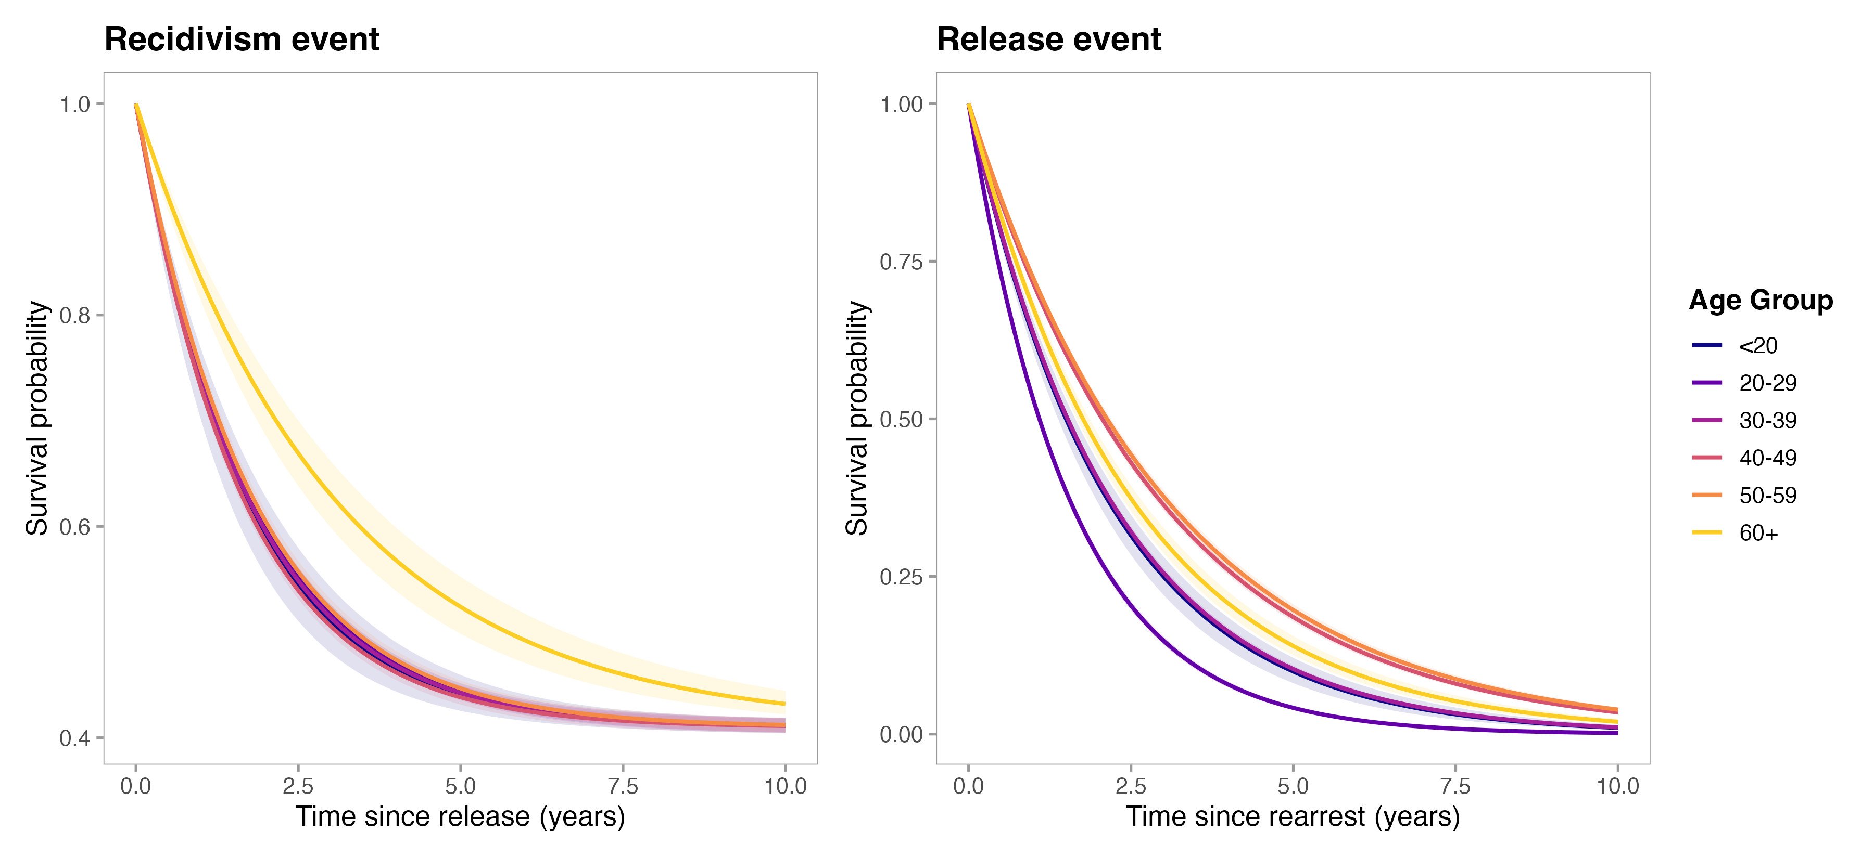
Recidivism and release survival curve
Estimated from arrest and release records spanning Jan 2007 – Dec 2017 Singapore prison data.
Recidivism risk after release peaks at ages 40–49, while PWIDs under 20 had the longest community intervals before re–arrest.

Slide 11
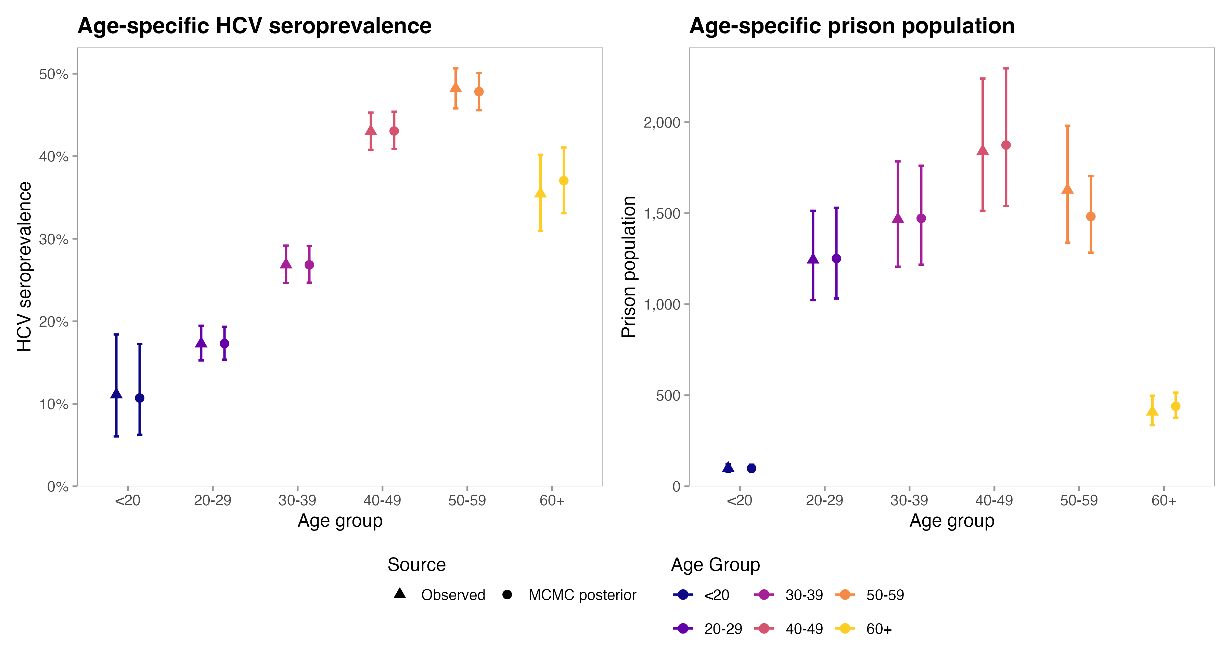
Model calibration
Age-specific HCV seroprevalence and prison population were calibrated against Feb 2014-Dec 2016 Singapore Changi prison HCV screening data.
PWID: people who inject drugs;

Slide 12
Model predictions at 2015
Stratum | Total population (95% BCI) | Active HCV cases (95% BCI)
Never–incarcerated PWID (D) | 1,336 (1,201–1,504) | 221 (103–212)
Incarcerated PWID (J) | 3,174 (2,834–3,611) | 1,014 (510–1,331)
Formerly–incarcerated PWID (F) | 1,452 (1,302–1,641) | 612 (317–783)
Formerly–incarcerated ex–PWID (X) | 14,094 (12,610–15,974) | 3,001 (1,464–4,000)
Current PWID (D + F) | 2,790 (2,506–3,148) | 833 (417–1,093)
Ever-PWID (D + J + F + X) | 20,054 (17,988–22,603) | 4,840 (2,395––6,398)
Around 2,800 current PWIDs were estimated in 2015, with active HCV prevalence of approximately 30%.
Formerly-incarcerated current PWIDs (F) had the highest HCV prevalence (~43%), indicating a high-burden group around the prison-community transition.
Former PWIDs (X) accounted for the largest absolute HCV burden due to much larger population size, leaving a substantial residual community reservoir.
PWID: People who inject drugs;

Slide 13
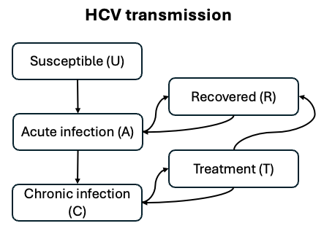
Treatment
Treatment lasts 12 weeks, with no immunity assumed following recovery.
Successful treatment leads to sustained virological response after 12 weeks (SVR12).
After achieving SVR12:
  Progression is assumed to stop in non–cirrhotic PWIDs and slows in cirrhotic PWIDs until reinfection.
  Survival improves for DC and HCC stages.
SVR12 rates vary by disease stage and treatment regimen based on clinical evidence.
PWID: people who inject drugs; DC: decompensated cirrhosis; HCC: hepatocellular carcinoma; An et al. 2022; Pawlotsky et al. 2020; Morgan et al. 2013;

Slide 14
Current prison and community initiatives in Singapore
WHO 2030 targets*: Reduce HCV incidence by 80% and HCV-related mortality by 65%, relative to 2015 levels.
Prison-based care: Opt-in HCV screening at prison entry, with unrestricted access to direct-acting antivirals (DAAs) for chronic HCV infection since 2019.
Community screening: HCSA–ETT aims to screen up to 600 at-risk individuals, primarily former drug offenders reached through halfway houses, between August 2025 and December 2026.
Treatment support: MOH’s Drug Advisory Committee recommends sofosbuvir 400 mg/velpatasvir 100 mg (SOF/VEL) for chronic hepatitis C in accordance with its registered indications.
*HCSA: Healthcare Service Act; ETT: Educate, Test, Treat; WHO targets: https://www.who.int/publications/i/item/9789240028395; Prison: Wong et al. 2021; Community: https://www.moh.gov.sg/newsroom/speech-by-mdm-rahayu-mahzam--minister-of-state--mddi--and-moh--at-the--educate--test--treat-----mou-signing-ceremony-between-hcsa-highpoint-and-ttsh; MOH: https://www.ace-hta.gov.sg/healthcare-professionals/ace-technology-guidance/drug-guidance/direct-acting-antiviral-agents-for-treating-chronic-hepatitis-c/;

Slide 15
From screening capacity to treatment capacity
Halfway houses are not explicitly modelled. Their target population is approximated by previously incarcerated individuals in F (active injecting) and X (former injecting).
As the relative contribution of F and X is unknown, we vary the allocation of annual screening capacity between them.
For each stratum, the annual treatment-start cap equals its allocated screening capacity multiplied by its chronic HCV prevalence among individuals not currently receiving treatment.
For example, set screening capacity as 600 in 2026, assuming PWIDs from F and X are equally distributed (50% vs. 50%), and current HCV viremic prevalence in F and X are 40% and 20%, then treatment capacity for F and X in 2026 will be:
New treatment starts are allowed until the stratum-specific cap is reached. Further starts are then suspended for the remainder of the year, while ongoing treatment continues.
Treatment-start counts reset each year, and caps are updated using the corresponding prevalence.
Active injecting (F)
600 * 50% = 300
Active injecting (F) treatment capacity
300 * 40% = 120
Screening
Capacity
600
Former injecting (X)
600 * 50% = 300
Former injecting (X) treatment capacity
300 * 20% = 60

Slide 16
Current treatment scenarios design
Parameters | Value (e.g.)
Treatment age period | All ages
Treatment regimen | SOF/VEL* (12 weeks)
Delivery setting | Formerly-Incarcerated (ex-)PWIDs
Budget | DAA treatment + delivery cost & HCV anti-body/RNA test cost & consultation fee
Screening capacity per year | 600, 1000, 2000, 5000, 8000, No cap
Screening capacity distribution for F and X per year | (50%,50%), (75%, 25%), (25%, 75%)
Outcomes include HCV incidence, liver-cirrhosis mortality, total cost, and total number of treatment starts relative to status quo.
*SOF: sofosbuvir; VEL: velpatasvir; DAA: Direct-acting antiviral;
Notes:
SOF/VEL (12 weeks) is considered as pan-genotypic DAA treatment regimen according to EASL 2020 and AASLD/IDSA 2024 HCV treatment guideline.*

Slide 17
Cost table
Parameters | Value (SGD) | Source
SOF/VEL (12 weeks) | 40405.2984 | Wong et al. 2019
Anti-body HCV test | 25.31 | NHG Health Clinic Charges
HCV RNA PCR | 313 | Parkway 2026 test catalogue
Docter consultation | 25 | NHG Health Clinic Charges
Costs are discounted at 3% annually, using 2026 as the base year.
HCV antibody and HCV RNA PCR testing costs are included for all PWIDs with a history of HCV infection.
Consultation and treatment Costs are included for all PWIDs with confirmed chronic HCV infection.
Total budget includes all costs incurred in J (incarcerated), F (active injecting), and X (former injecting) during 2026–2030.
NHG: National Healthcare Group;

Slide 18
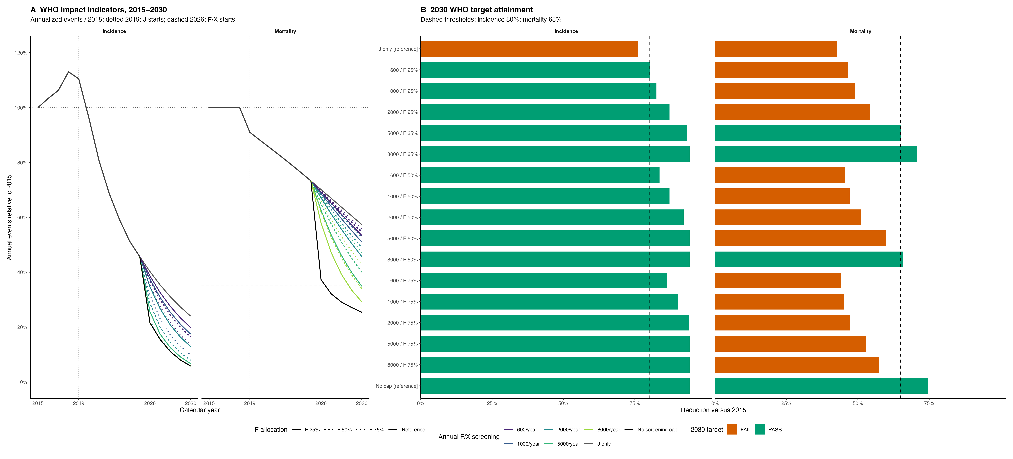
HCV incidence and mortality trajectory (2015-2030)

Slide 19
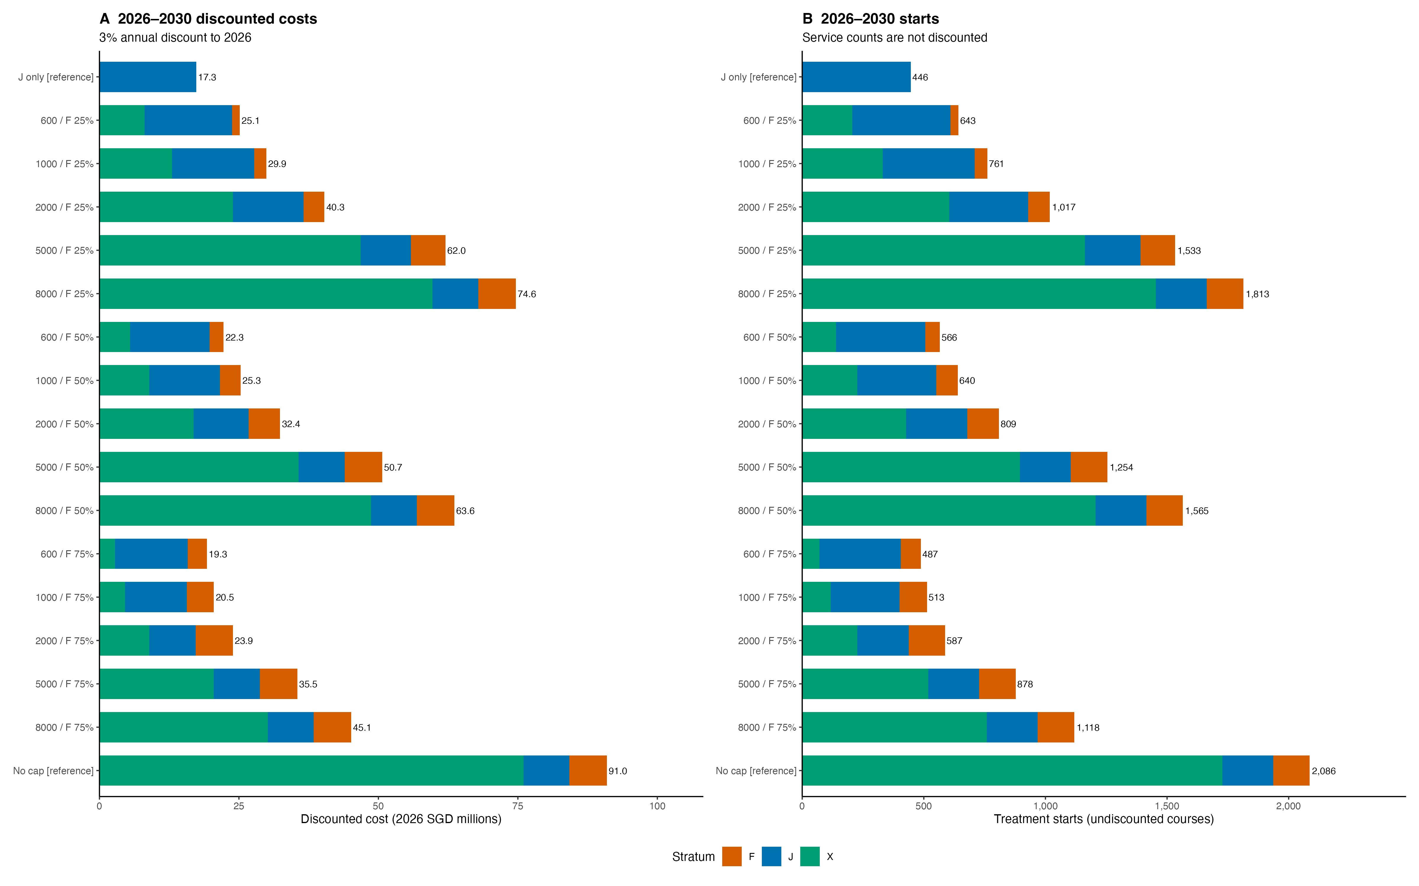
Cumulative cost & treatment starts (2026-2030)

Slide 20
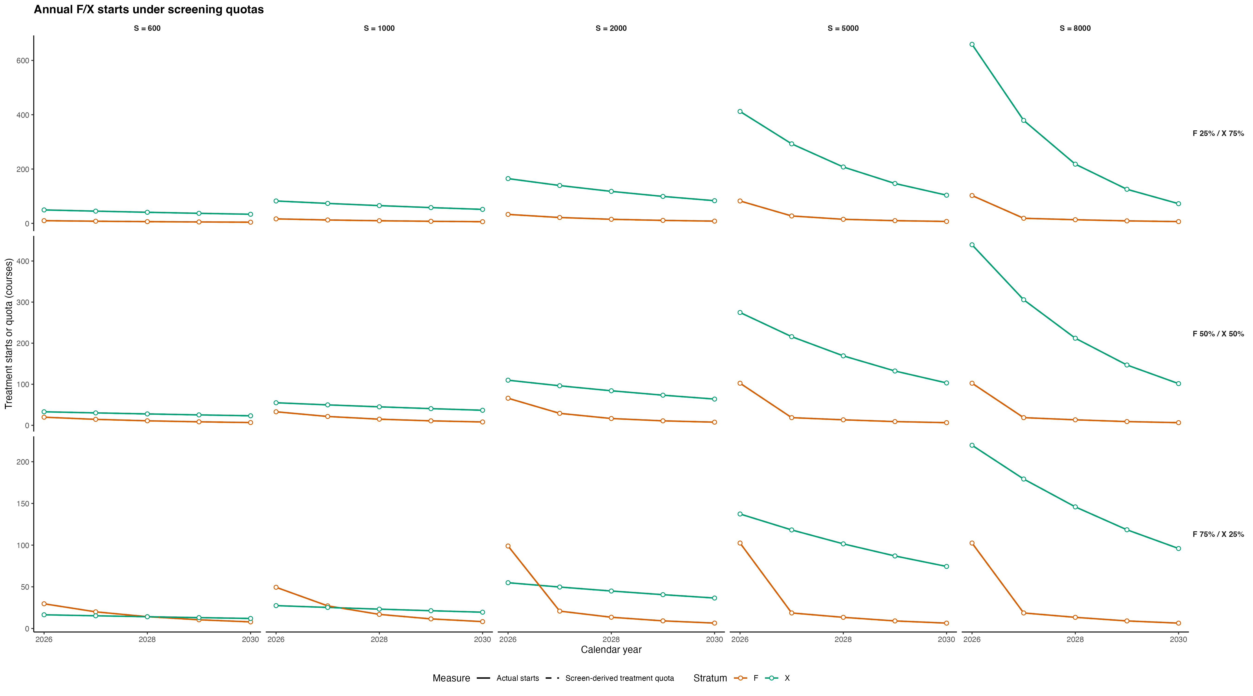
Annual F/X treatment starts under screening quotas (2026-2030)

Slide 21
Summary of analysis results (2026-2030)
Scenario | Incidence decrease (%) | Mortality decrease (%) | Targets | Budget (discounted in S$) | F/X treatment starts | J treatment starts
J-only | 76.0 | 42.6 | FAIL | 17.33m | 0 | 446
600/y, F 50% | 83.6 | 45.4 | FAIL | 22.26m | 200 | 366
5000/y, F 25% | 93.3 | 65.1 | PASS | 62.03m | 1304 | 228
8000/y, F 25% | 94.2 | 70.8 | PASS | 74.65m | 1604 | 209
8000/y, F 50% | 94.2 | 66.0 | PASS | 63.63m | 1355 | 209
No cap | 94.2 | 74.6 | PASS | 90.96m | 1877 | 209

Slide 22
Conclusion (so far)
Mortality is the main barrier. All 15 screening scenarios met the incidence target, but only three met both 2030 targets.
F and X require complementary strategies. Screening F supports transmission control, while reaching X’s larger chronic infection burden is essential for reducing deaths.
Should prioritise treatment in X. Prioritising F excessively leaves screening slots unused and limits mortality benefits in X.
Lowest-capacity scenario meeting both targets. 5,000 screens/year, allocated 25% to F and 75% to X, narrowly achieved both targets, at S$62.0 million over 2026–2030.
High treatment demand in the first year. Lowest-capacity scenario required approximately 38% of its five-year F/X treatment starts in the first year.

Slide 23
Next steps
Incorporate uncertainty of input parameters and costs.
Additional combinations of screening capacity and F/X distribution still need to be explored to identify the minimum community component required.

Slide 24
Limitations
Costs are based on publicly available proxy prices rather than verified healthcare-payer costs.
The model excludes the general population and cannot directly establish whether Singapore achieves national HCV elimination.
Costs are not adjusted for inflation, which may underestimate future budget requirements.
Screening is assumed to be representative within each stratum, with complete linkage of detected chronic infections to treatment.

Slide 25
References
Chaillon A, Thurairajah PH, Hsiang JC, Martin N. What is required for achieving HCV elimination in Singapore? A modeling study. J Hepatol 2020; 73: S818.
Zhao Y, Thurairajah PH, Kumar R, Tan J, Teo EK, Hsiang JC. Novel non-invasive score to predict cirrhosis in the era of hepatitis C elimination: A population study of ex-substance users in Singapore. Hepatobiliary Pancreat Dis Int 2019; 18: 143–8.
Zhu RX, Seto W-K, Lai C-L, Yuen M-F. Epidemiology of hepatocellular carcinoma in the Asia-Pacific region. Gut Liver 2016; 10. DOI:10.5009/gnl15257.
Ashtari S. Hepatocellular carcinoma in Asia: prevention strategy and planning. World J Hepatol 2015; 7: 1708.
Wu Y-J, Xu M-Y, Lu L-G. Clinical advances in fibrosis progression of chronic hepatitis B and C. J Clin Transl Hepatol 2014; 2: 222–7.
Pawlotsky J-M, Negro F, Aghemo A, et al. EASL recommendations on treatment of hepatitis C: final update of the series. J Hepatol 2020; 73: 1170–218.
Hernandez-Con P, Wilson DL, Tang H, et al. Hepatitis C cascade of care in the direct-acting antivirals era: a meta-analysis. Am J Prev Med 2023; 65: 1153–62.
Goodyear T, Brown H, Browne AJ, Hoong P, Ti L, Knight R. “I want to get better, but…”: identifying the perceptions and experiences of people who inject drugs with respect to evolving hepatitis C virus treatments. Int J Equity Health 2021; 20: 81.
Mathers BM, Degenhardt L, Bucello C, Lemon J, Wiessing L, Hickman M. Mortality among people who inject drugs: a systematic review and meta-analysis. Bull World Health Organ 2013; 91: 102–23.
Boelen L, Teutsch S, Wilson DP, et al. Per-event probability of hepatitis C infection during sharing of injecting equipment. PLoS One 2014; 9: e100749.

Slide 26
References
Micallef JM, Kaldor JM, Dore G. Spontaneous viral clearance following acute hepatitis C infection: a systematic review of longitudinal studies. J Viral Hepat 2006; 13: 34–41.
Fasano M, Ieva F, Ciarallo M, Caccianotti B, Santantonio TA. Acute hepatitis C: current status and future perspectives. Viruses 2024; 16: 1739.
Lim AG, Qureshi H, Mahmood H, et al. Curbing the hepatitis C virus epidemic in Pakistan: the impact of scaling up treatment and prevention for achieving elimination. Int J Epidemiol 2018; 47: 550–60.
Fattovich G, Stroffolini T, Zagni I, Donato F. Hepatocellular carcinoma in cirrhosis: incidence and risk factors. Gastroenterology 2004; 127: S35–50.
An J, Park DA, Ko MJ, et al. Direct-acting antivirals for HCV treatment in decompensated liver cirrhosis patients: a systematic review and meta-analysis. J Pers Med 2022; 12: 1517.
Morgan RL, Baack B, Smith BD, Yartel A, Pitasi M, Falck-Ytter Y. Eradication of hepatitis C virus infection and the development of hepatocellular carcinoma: a meta-analysis of observational studies. Ann Intern Med 2013; 158: 329–37.
Xiao J, Zhang X, Mao X, Lai S, Li S, Sheng Y. Efficacy and safety of velpatasvir plus sofosbuvir with or without ribavirin in hepatitis C patients with decompensated cirrhosis: a systematic review and meta-analysis. J Viral Hepat 2025; 32: e70078.

Slide 27
Extra slides

Slide 28
Why annual treatment starts so low?
Low treatment starts reflect limited screening coverage, rather than few remaining HCV infections.
In 2030, X still contains approximately 1,123 chronically infected individuals among 14,516 eligible for screening. Screening 300 people yields an annual treatment cap of only 300 × 1,123 / 14,516 ≈ 23 starts.
F contributes approximately 7 additional starts, bringing the combined F/X total to around 30 starts that year.
Although the HCSA–ETT study reported 37.3% HCV antibody positivity, this includes past infections and does not represent the proportion with current chronic infection eligible for treatment.
Yew et al. 2024; https://hcsa.org.sg/mou-signing-between-hcsa-highpoint-halfway-house-pertapis-halfway-house-selarang-halfway-house-teen-challenge-singapore-and-the-helping-hand-to-strengthen-collaboration-in-the-first-hepatitis-c-el/

Slide 29
Stage-, genotype-, and regimen- specific SVR12 rates
Genotype | Liver disease stage | Regimen | SVR12 rates | Source
3 | NC/HCC | SOF/VEL | 0.98 | Pawlotsky et al. 2020
Other GT | NC/CC | SOF/VEL | 0.99 | Pawlotsky et al. 2020
3 | DC/HCC | SOF/VEL | 0.45 | Pawlotsky et al. 2020 Xiao et al. 2025
Other GT | DC/HCC | SOF/VEL | 0.90 | Pawlotsky et al. 2020 Xiao et al. 2025
3 | DC/HCC | SOF/VEL + RBV | 0.87 | Pawlotsky et al. 2020 Xiao et al. 2025
Other GT | DC/HCC | SOF/VEL + RBV | 0.92 | Pawlotsky et al. 2020 Xiao et al. 2025
NC: Non-cirrhosis; CC: Compensated Cirrhosis; DC: Decompensated Cirrhosis; HCC: Hepatocellular Carcinoma; SVR12: Sustained virological response after 12 weeks;

Slide 30
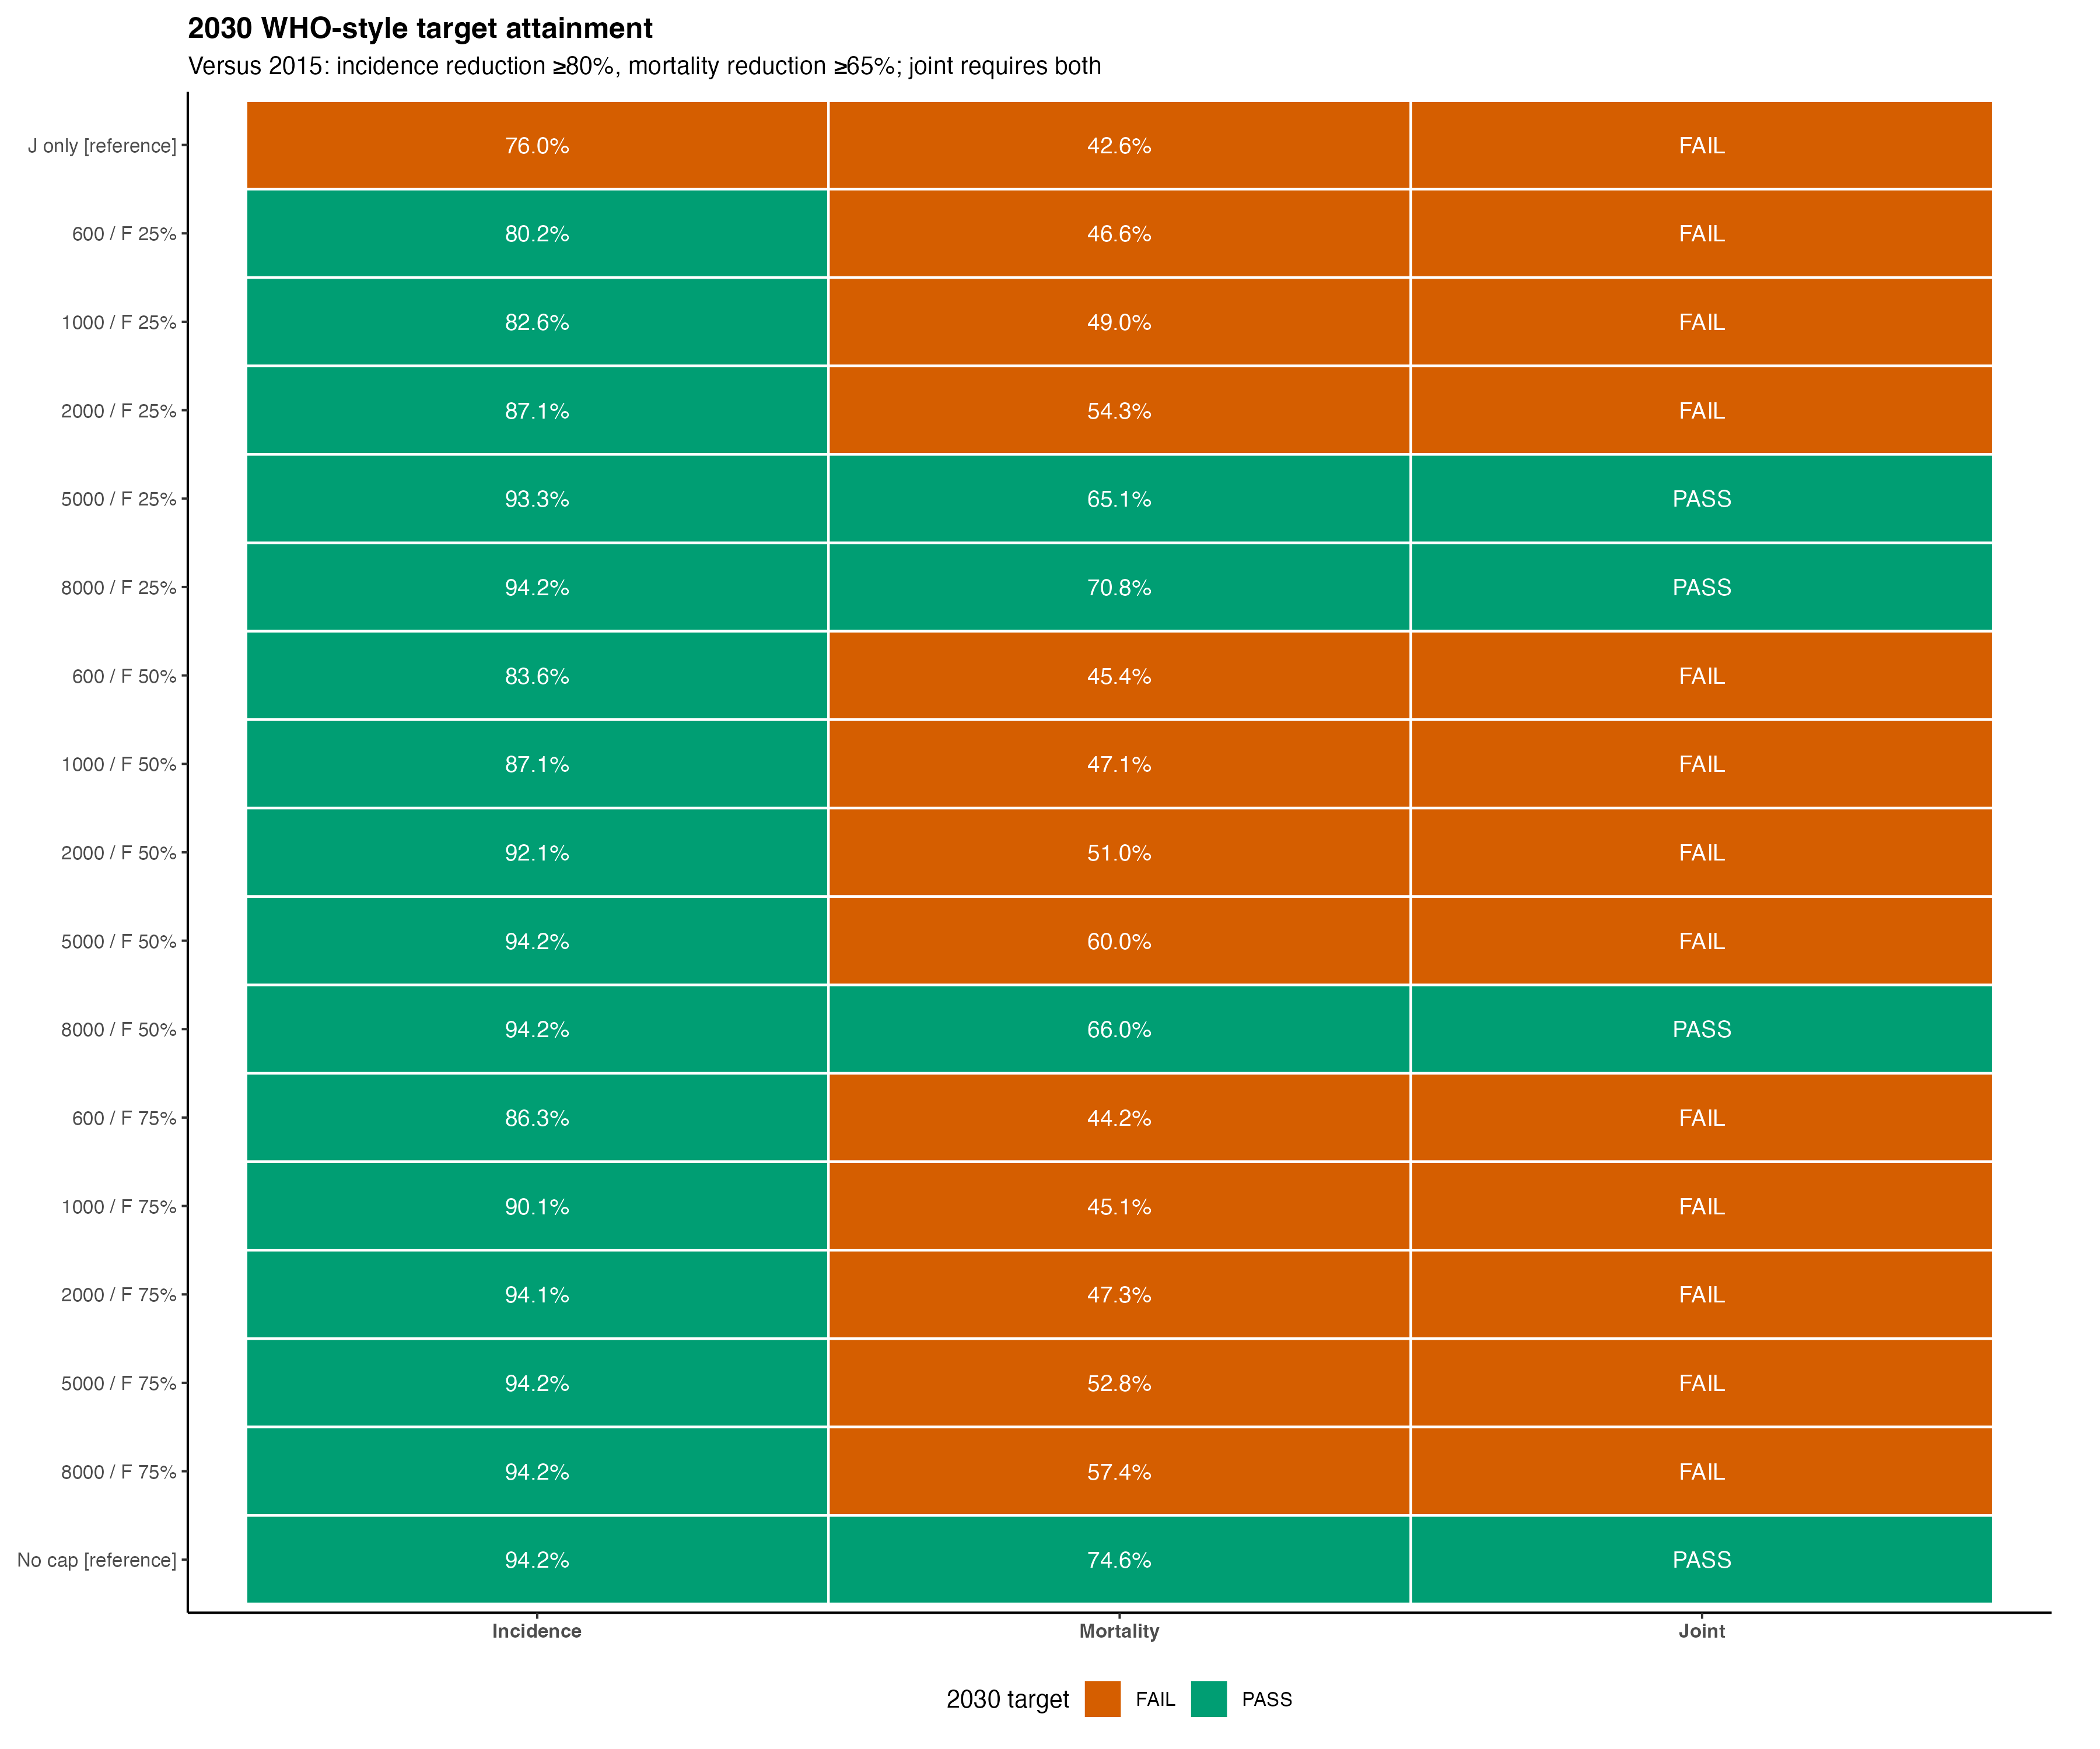
2030 WHO HCV elimination target attainment

Slide 31
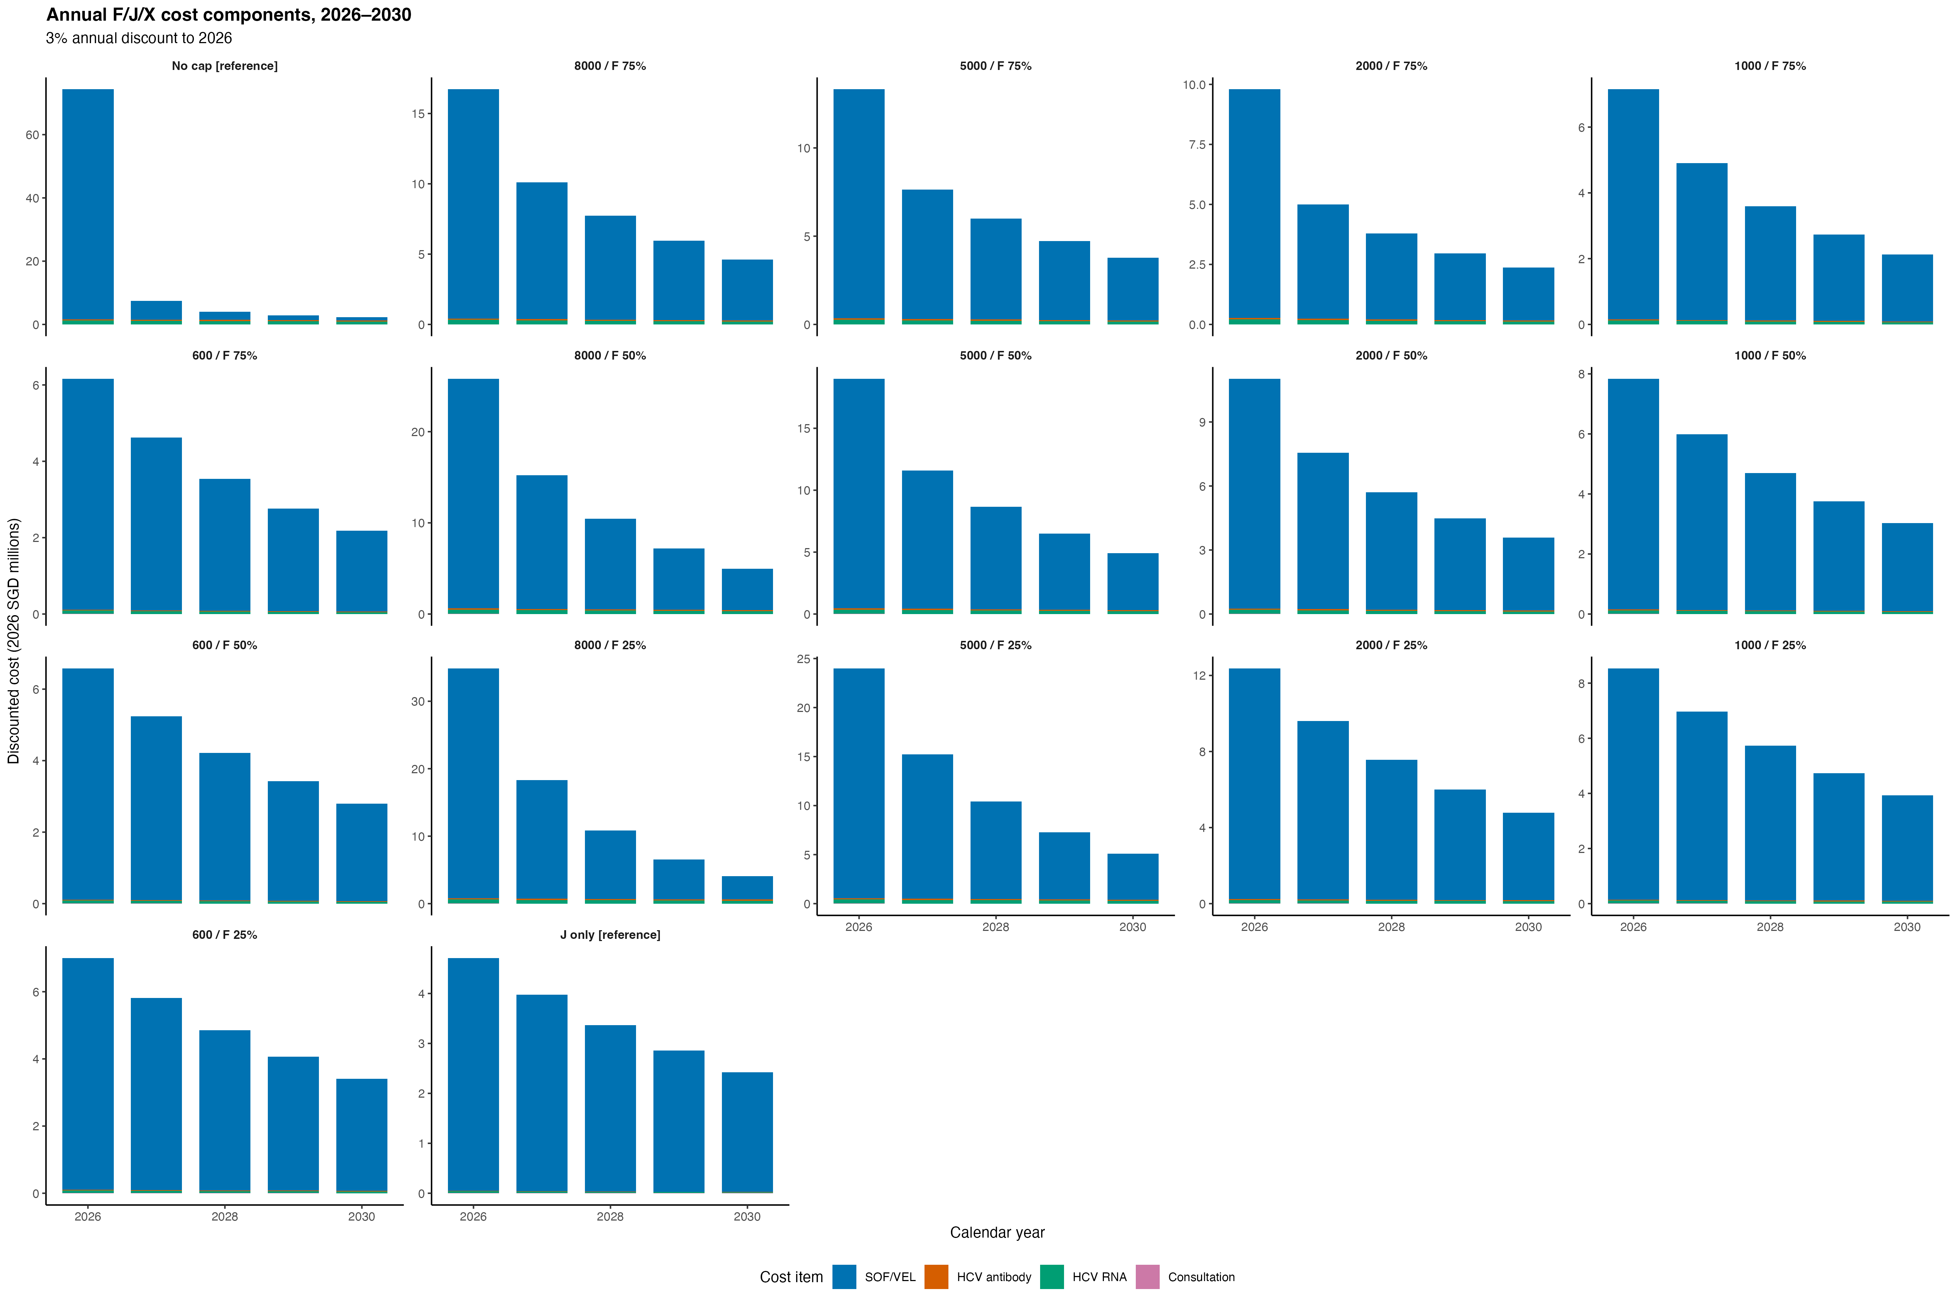
2026-2030 J/F/X cost components

Slide 32
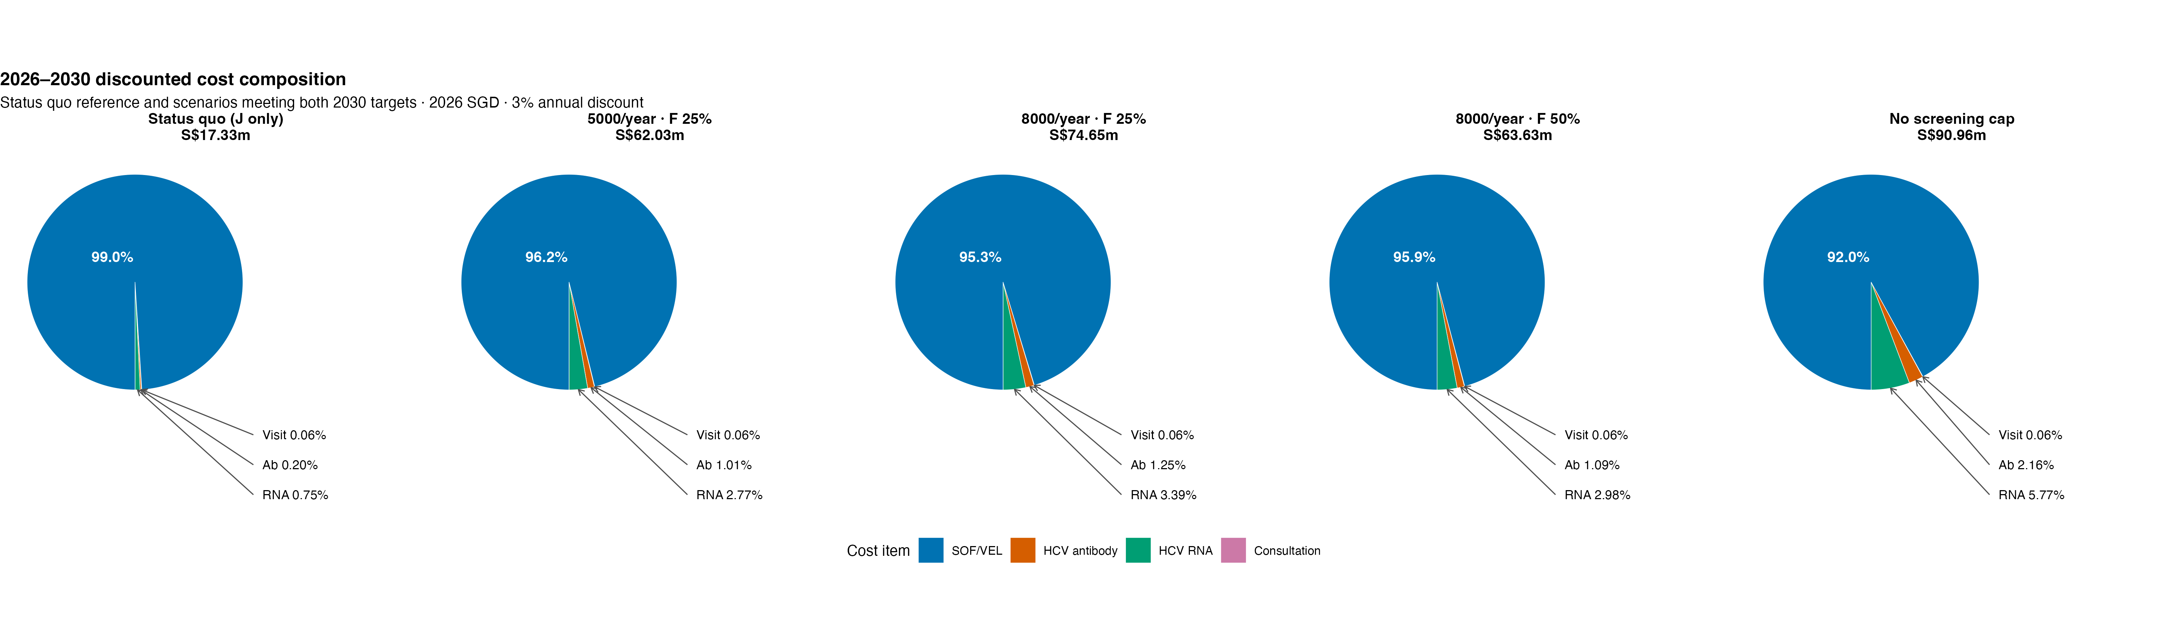
2026-2030 discounted cost composition

Slide 33
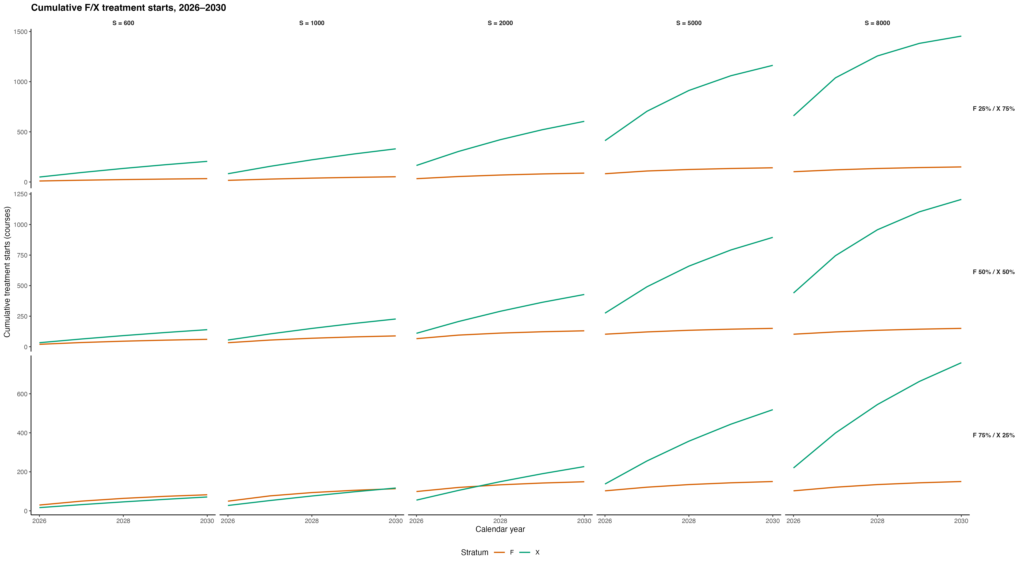
2026-2030 cumulative F/X treatment starts

