Slide 1
Liver Cancer Prevention Through HCV Treatment Among PWIDs in Singapore

Slide 2
HCV-related liver cancer background & research gap
Background*
Hepatitis C Virus (HCV) is a major preventable upstream cause of liver cancer.
  HCV is curable using direct-acting antivirals (DAA) therapy.
People who injected drugs (PWIDs) face high infection risks, but treatment uptake remains low.
Incarceration provides repeated opportunities for testing and curative treatment.
Existing modelling studies have evaluated HCV transmission, disease progression, treatment scale-up, and prison- and community-based interventions among PWIDs.
Research gap
International prison models may not transfer directly to Singapore-specific incarceration and HCV dynamics.
Previous Singapore models did not explicitly capture age-specific incarceration and prison–community transitions among PWIDs.
The optimal combination of treatment target, setting, intensity, and clinical pathway for long-term HCC prevention remains unclear.
PWIDs: people who inject drugs; HCC: hepatocellular carcinoma; *Pawltosky et al. 2020; Hernandez-Con et al. 2023; Goodyear et al. 2021; Chaillon et al. 2020;

Slide 3
Aims
To develop a dynamic compartmental model capturing incarceration cycles, HCV transmission, and liver disease progression among PWIDs in Singapore.
To simulate treatment coverage and disease progression under alternative DAA scale-up strategies.
Prioritizing individuals by incarceration status, disease eligibility, and age group.
To estimate relative reductions in HCV incidence and advanced liver disease burden (especially HCC) attributable to prioritized DAA treatment strategies, relative to status quo.
PWIDs: people who inject drugs; DAA: direct acting antiviral; HCC: hepatocellular carcinoma;

Slide 4
Assumptions
Transmission and immunity
Acute infection and spontaneous clearance
Genotype distribution
Treatment regimen
  Ribavirin eligibility and co-administration
Disease progression
Mortality
  Adjustment from ever-PWID standardized mortality ratio (SMR)
PWIDs: people who inject drugs; DAA: direct acting antiviral; HCC: hepatocellular carcinoma;

Slide 5
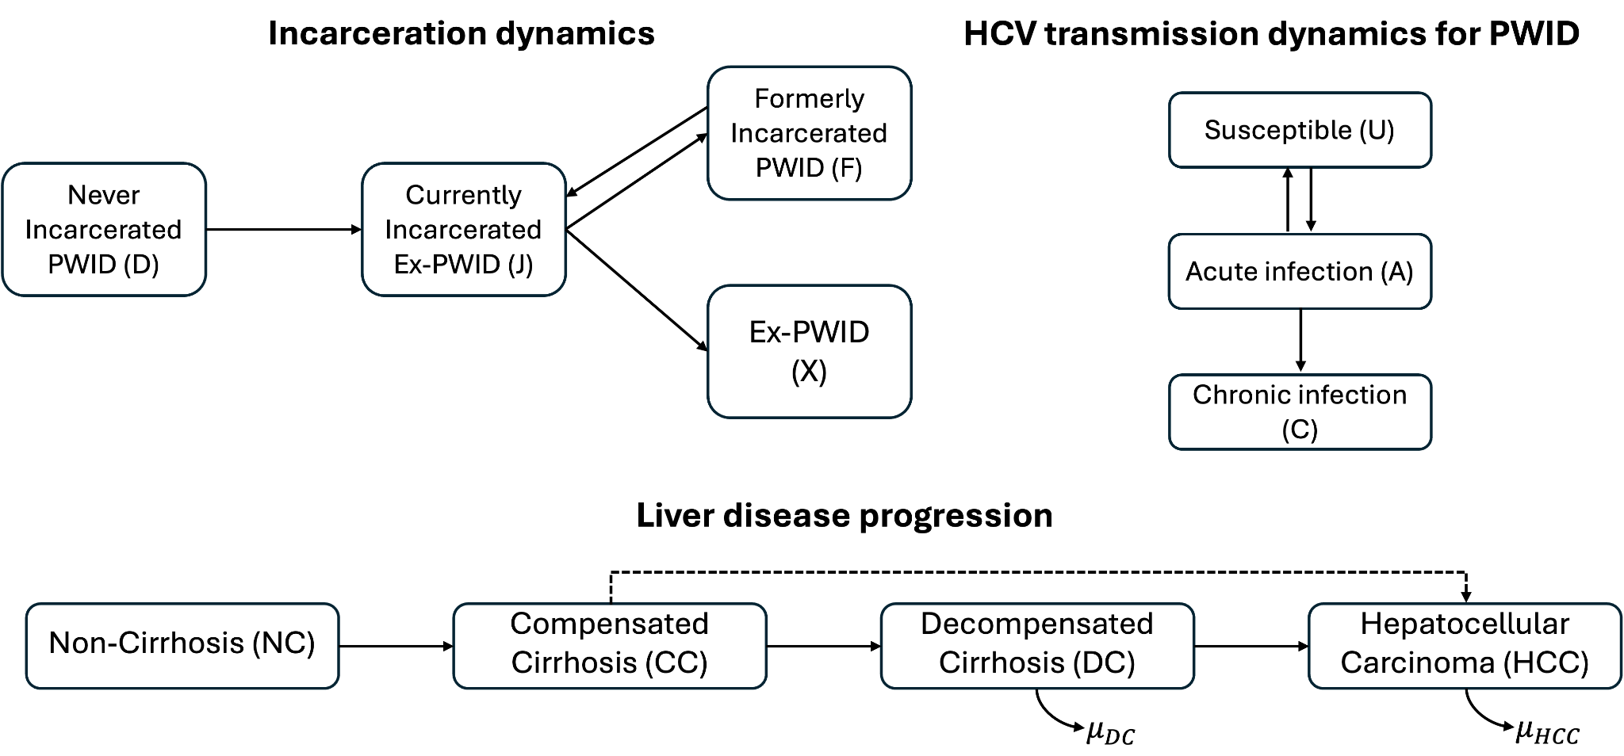
Compartmental model schematic
Deterministic, discrete-time transmission model with a daily time step.
Six age groups (<20 to 60+), with age progression explicitly modelled.
Age-specific mortality adjusted by risk ratios for PWIDs relative to the general population.
Temporal parameters omit for simplicity.
PWID: people who inject drugs; Mathers et al. 2013;

Slide 6
Incarceration dynamics
All individuals enter the model as uninfected, non-cirrhotic, and never-incarcerated PWIDs.
Only individuals in D and F are assumed susceptible to HCV infection through needle sharing.
After release, individuals either resume injection (F), or permanently cease (X), determined by an age-invariant recidivism probability estimated from Singapore Changi prison HCV screening data.
PWID: people who inject drugs;

Slide 7
HCV transmission dynamics
For newly infected individuals in acute stage (A), they will
  Either clear infection spontaneously within six months (back to U), or
  Progress to chronic infection (C), followed by sequential progression through later stages of liver disease.

Slide 8
Liver disease progression
Direct progression from compensated cirrhosis to HCC is allowed.*
Progression rates are literature-based and adjusted for Singapore’ high genotype 3 prevalence (~78%).*
HCV-related liver transplantation is excluded due to its rarity in Singapore.*
*Zhao et al. 2019; Chaillon et al. 2020;

Slide 9
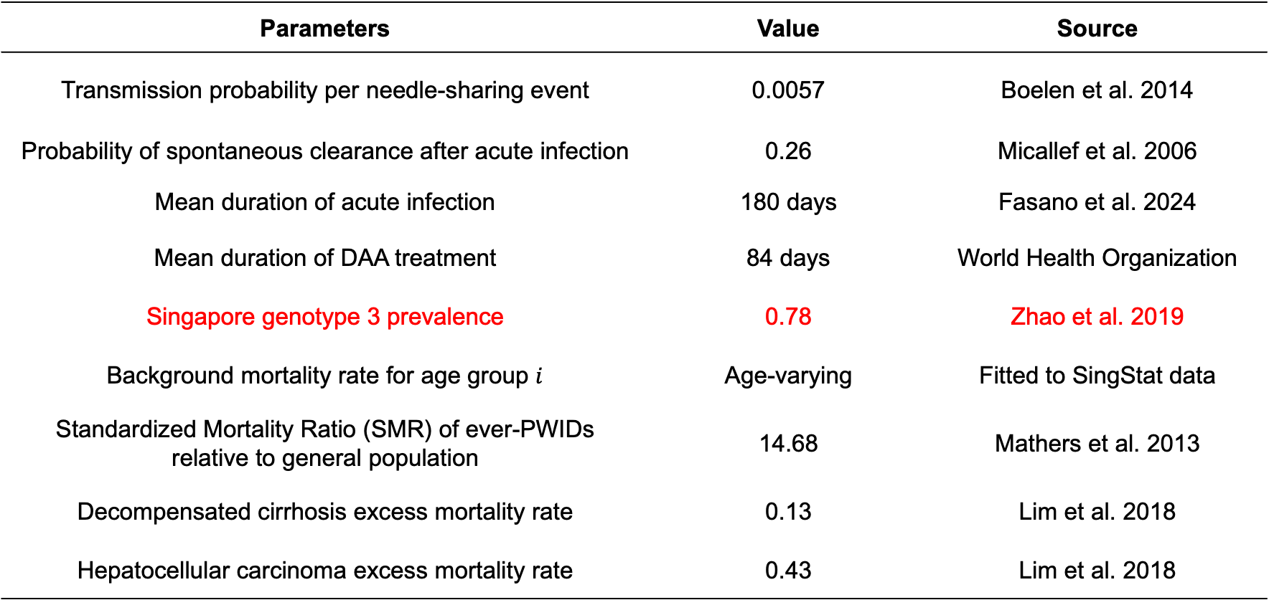
Some fixed parameters
Parameters | Value | Source
Transmission probability per needle-sharing event | 0.0057 | Boelen et al. 2014
Probability of spontaneous clearance after acute infection | 0.26 | Micallef et al. 2006
Mean duration of acute infection | 180 days | Fasano et al. 2024
Mean duration of DAA treatment | 84 days | World Health Organization
Singapore genotype 3 prevalence | 0.78 | Zhao et al. 2019
Background mortality rate for age group $i$ | Age-varying | Fitted to SingStat data
Standardized Mortality Ratio (SMR) of ever-PWIDs relative to general population | 14.68 | Mathers et al. 2013
Decompensated cirrhosis excess mortality rate | 0.13 | Lim et al. 2018
Hepatocellular carcinoma excess mortality rate | 0.43 | Lim et al. 2018
DAA: Direct-acting antiviral;

Slide 10
Preliminary results: Model estimate at 2017
Stratum | Total population (95% BCI) | HCV cases (95% BCI)
Never-incarcerated PWID (D) | 3,734 (3,436-4,069) | 975 (869-1,090)
Incarcerated ex-PWID (J) | 6,618 (6,101-7,290) | 2,341 (2,118-2,617)
Formerly-incarcerated PWID (F) | 2,954 (2,715-3,264) | 1,366 (1,247-1,506)
Formerly-incarcerated ex-PWID (X) | 26,243 (23,717-29,624) | 6,342 (5,741-7,100)
Current PWID (D + F) | 6,688 (6,151-7,333) | 2,341 (2,116-2,596)
Ever-PWID (D + J + F + X) | 39,561 (36,140-44,078) | 11,065 (10,006-12,285)
Literature | Time | Population | Results
Teo et al. | 2017 | NSUM estimated IVDU population | 11,000 (6,500–17,000)
Quaye et al. | 2019 | NSUM PWID population | 3,470 (1,540–7,830)
Chaillon et al. | calibrated to 2017 | Ever-PWID = Current + Former PWID | ~11,000
DAA: Direct-acting antiviral;

Slide 11
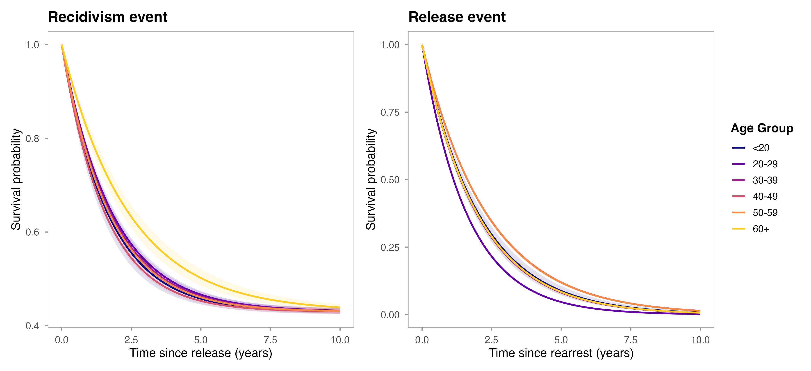
Preliminary results: Recidivism and release survival curve
Estimated from arrest and release records spanning Jan 2007 – Dec 2017 Singapore prison data.
Recidivism risk after release peaks at ages 40-49, while PWIDs under 20 had the longest community intervals before re-arrest.

Slide 12
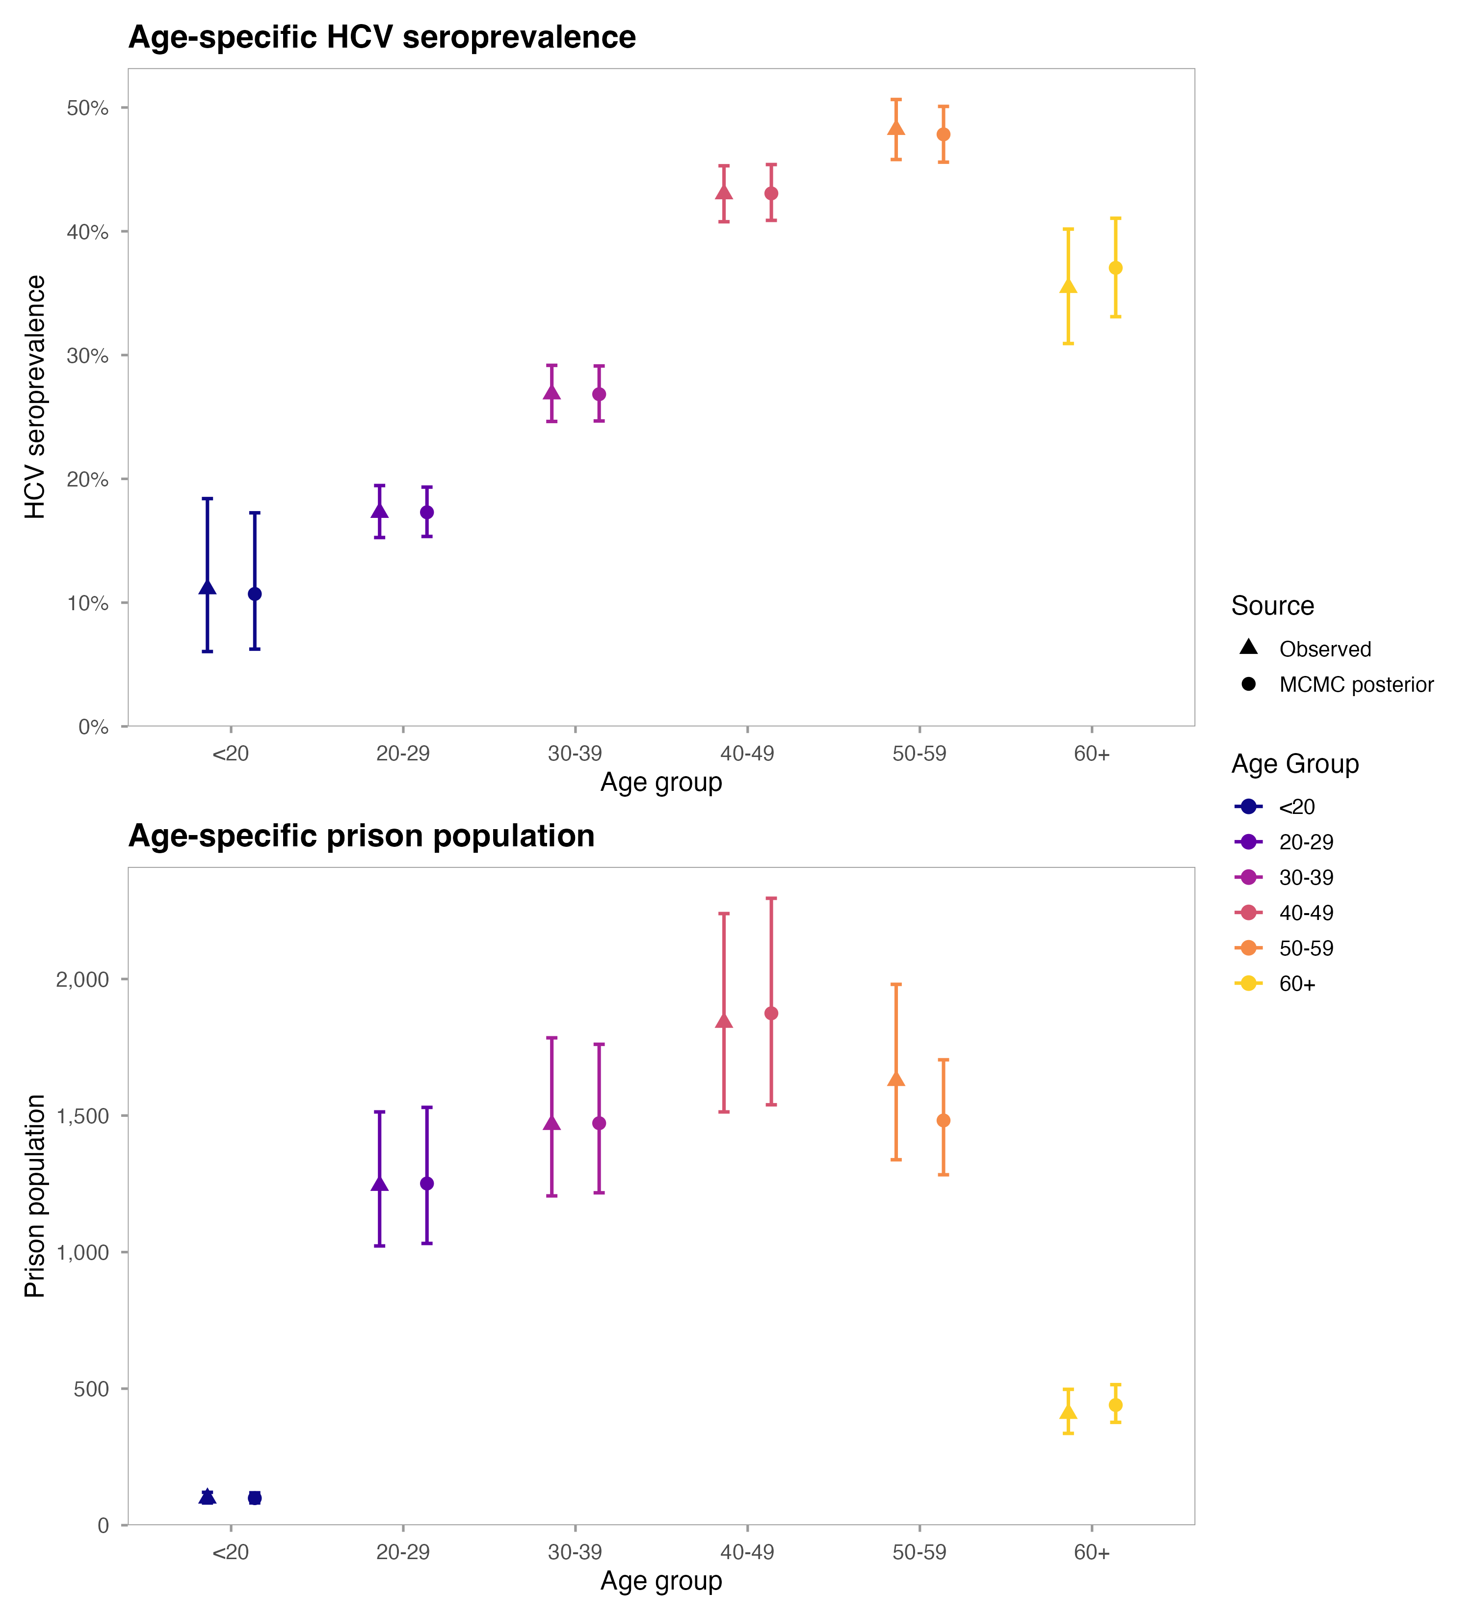
Preliminary results: Model calibration
Transmission parameters are currently being calibrated so that model-predicted HCV prevalence among PWIDs in prison aligns with observed values.
PWID: people who inject drugs;

Slide 13
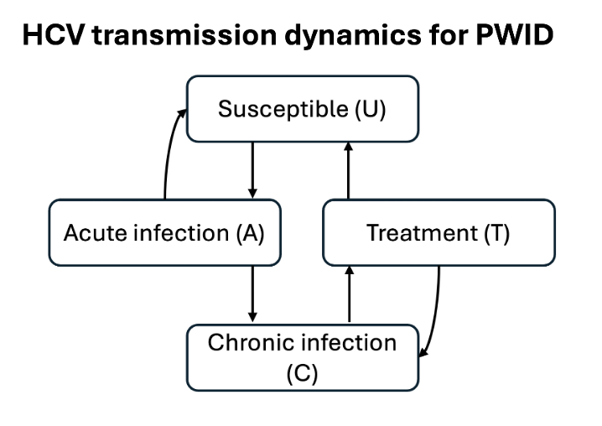
Treatment
Treatment lasts 12 weeks, with no immunity assumed following recovery.
Successful treatment leads to sustained virological response after 12 weeks (SVR12).
After achieving SVR12:
  progression is assumed to stop in non-cirrhotic PWIDs and slows in cirrhotic PWIDs until reinfection.
  Survival improves for DC and HCC stages.
SVR12 rates vary by disease stage and treatment regimen based on clinical evidence.
PWID: people who inject drugs; DC: decompensated cirrhosis; HCC: hepatocellular carcinoma; An et al. 2022; Pawlotsky et al. 2020; Morgan et al. 2013;

Slide 14
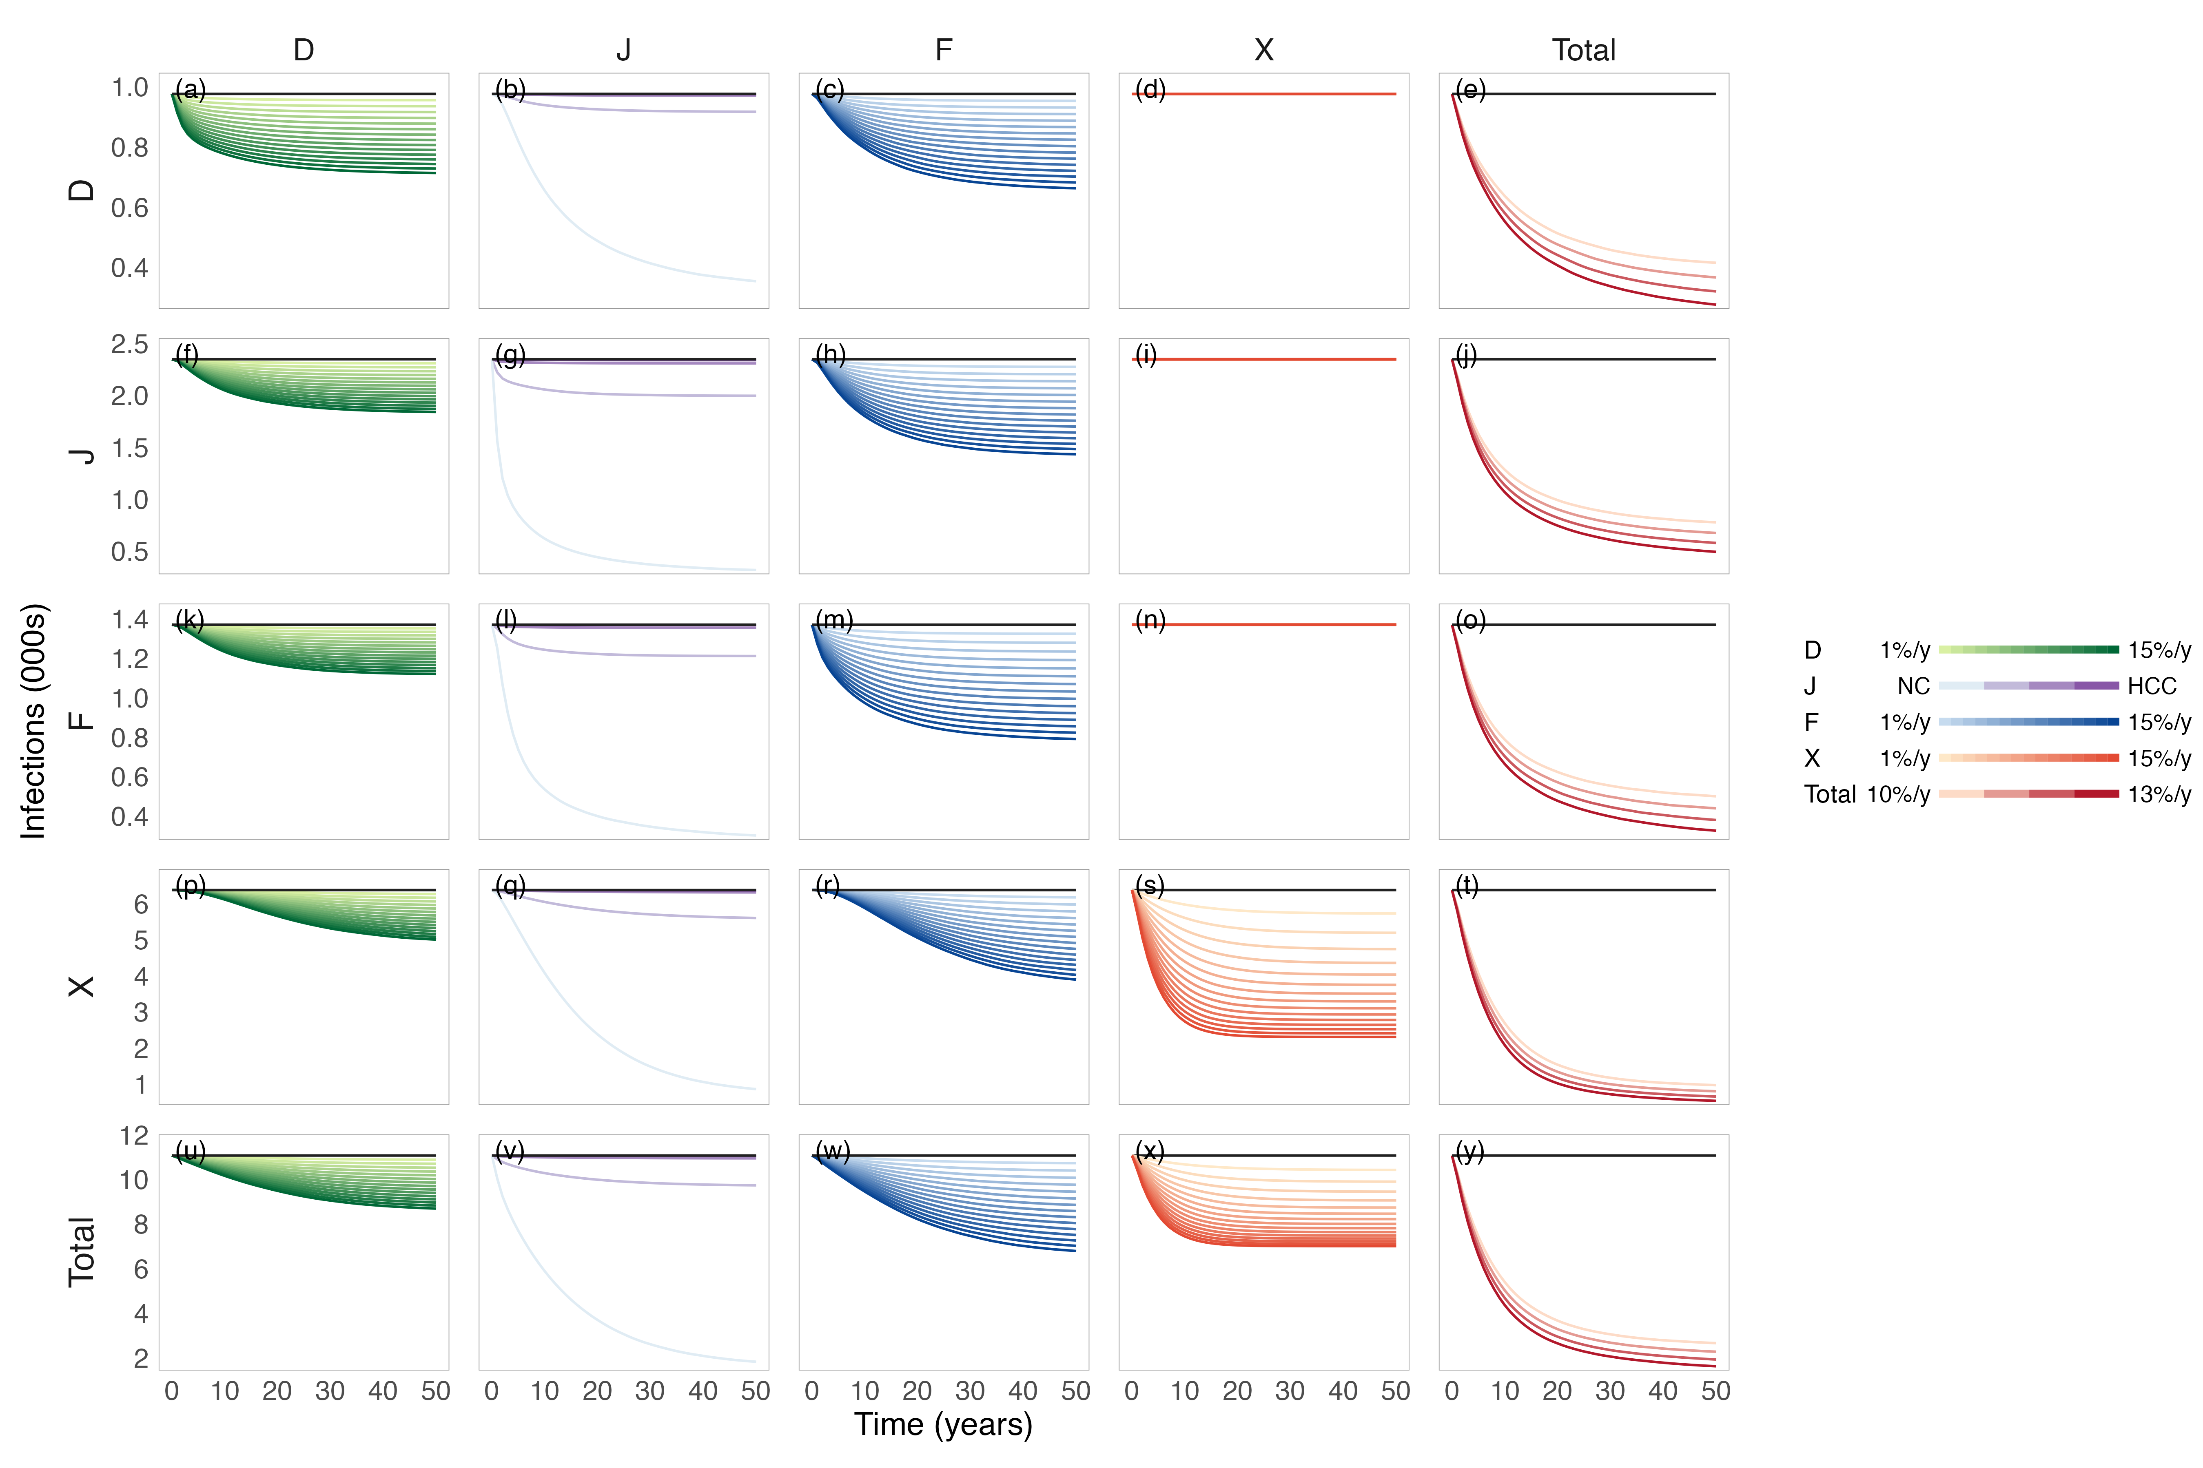
Preliminary results: Infections under different scenarios
PWID: people who inject drugs;

Slide 15
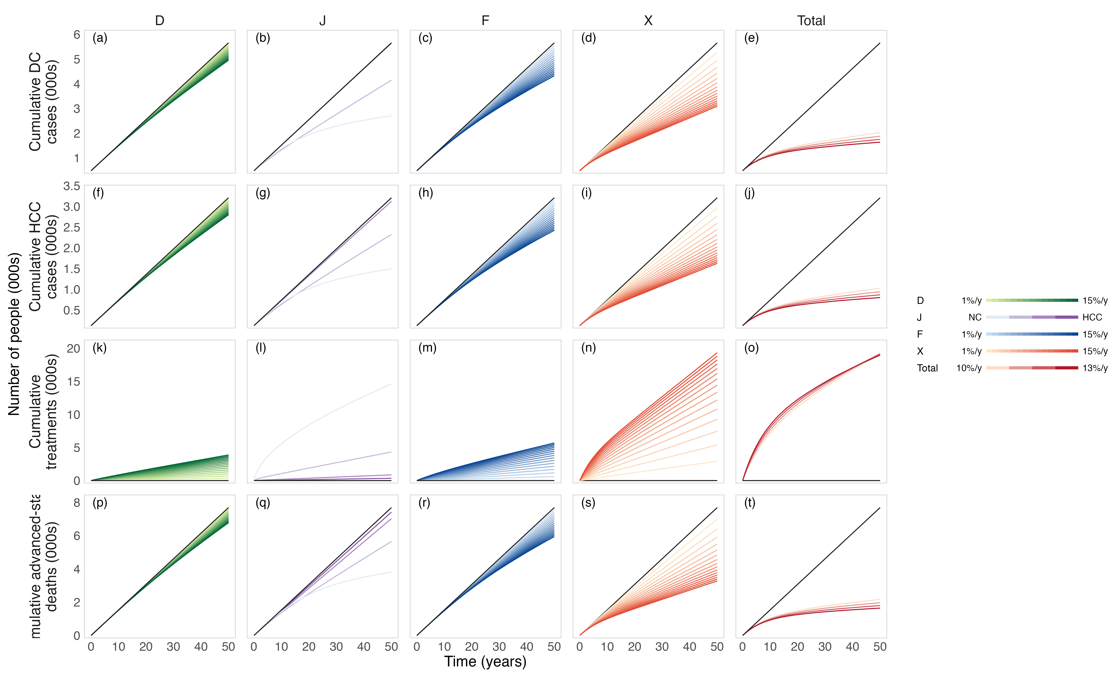
Preliminary results: DC & HCC cases under different scenarios
PWID: people who inject drugs;

Slide 16
Treatment scenarios design
Parameters | Value
Disease-stage-specific recruitment rates | 40%, 70%, 100% (for each disease stage)
Delivery setting | prison-, community-, mixed-based
Treatment regimen choice for DC/HCC | SOF/VEL+RBV, SOF/VEL*
Treatment minimum age | 15, 20, 25
Treatment maximum age | 40, 45, 50
4,374 scenarios will be evaluated in total.
Outcomes include HCV prevalence, cumulative infections, DC/HCC incidence, and HCC mortality, compared with no treatment.
*SOF: sofosbuvir; VEL: velpatasvir; RBV: ribavirin; DC: decompensated cirrhosis; HCC: hepatocellular carcinoma; Xiao et al. 2025

Slide 17
Decision criteria for treatment scenarios recommendation
Decision criteria | Description
Maximum health benefit | Avert most HCC cases
Maximum treatment efficiency | Avert most HCC cases per PWID treated
All scenarios are simulated over 50 years to capture delayed effects on DC and HCC.
PWID: people who inject drugs; DC: decompensated cirrhosis; HCC: hepatocellular carcinoma;

Slide 18
Next step plan
Finish model calibration and validation using Singapore Changi Prison data (2007–2017).
Complete treatment strategies settings and conduct large-scale scenario simulations.
Identify optimal treatment designs under alternative decision criteria and derive policy recommendations.

