Slide 1
Hepatitis C Transmission and Progression Among People Who Have Injected Drugs in Singapore: Modelling Treatment for Elimination
He Yichen
18 Sep 2026
Supervisor: Dr. Borame Dickens

Slide 2
Background
Hepatitis C Virus (HCV) infection is a highly prevalent among people who inject drugs (PWIDs) in Singapore.
  Local studies report about 42.5% (36-47%) anti-HCV seroprevalence among PWIDs.*
Effective treatment exists, but linkage to care remains challenging in the community.
  Among HCV-positive halfway-house residents, only 48.6% reached confirmatory RNA testing and 12.6% initiated treatment.*
Incarceration provides a high-yield opportunity for treatment delivery.
  Unrestricted DAA access increased treatment uptake by 460%, with 99% completion and 99.1% sustained virological response (SVR) among incarcerated HCV patients.*
Repeated prison-community transitions make treatment setting and timing important.
  Singapore recorded 1,152 Drug Rehabilitation Centre (DRC) admissions and 1,241 releases in 2017. And the 2017 DRC release cohort had 45.2% five-year recidivism.*
DAA: Direct acting antivirals; *Winslow et al. 2007; Hsiang et al. 2022; Wong et al. 2021; Singapore Prison Service.

Slide 3
Research gap
International HCV models may not capture Singapore-specific incarceration and reinjection dynamics.
Existing Singapore modelling has not explicitly represented age-specific prison–community transitions when designing treatment strategies.
Despite highly effective DAAs, it remains unclear who should be treated, where, and at what coverage to achieve sustained HCV elimination.
DAA: Direct acting antivirals; *Pawltosky et al. 2020; Hernandez-Con et al. 2023; Goodyear et al. 2021; Chaillon et al. 2020;

Slide 4
Aims
To develop a dynamic compartmental model capturing incarceration cycles, HCV transmission, and liver disease progression among PWIDs in Singapore.
To simulate treatment coverage and disease progression under alternative DAA scale–up strategies.
To estimate relative reductions in HCV incidence and advanced liver disease burden (especially HCC) attributable to prioritized DAA treatment strategies, relative to status quo.
PWIDs: people who inject drugs; DAA: direct acting antiviral; HCC: hepatocellular carcinoma;

Slide 5
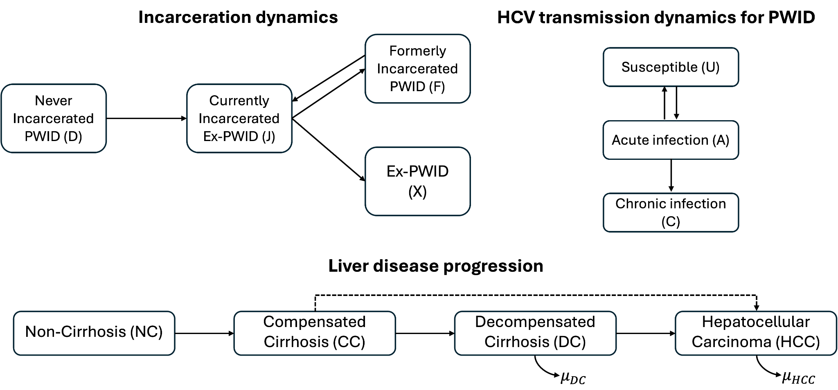
Compartmental model schematic
Deterministic, discrete–time transmission model with a daily time step.
Six age groups (<20 to 60+), with age progression explicitly modelled.
Age–specific mortality adjusted by risk ratios for PWIDs relative to the general population.
Temporal parameters omit for simplicity.
PWID: people who inject drugs; Mathers et al. 2013;

Slide 6
Incarceration dynamics
All individuals enter the model as uninfected, non–cirrhotic, and never–incarcerated PWIDs.
Only individuals in D and F are assumed susceptible to HCV infection through needle sharing.
After release, individuals either resume injection (F), or permanently cease (X), determined by an age–invariant recidivism probability estimated from Singapore Changi prison HCV screening data.
PWID: people who inject drugs;

Slide 7
HCV transmission dynamics
For newly infected individuals in acute stage (A), they will
  Either clear infection spontaneously within six months (back to U), or
  Progress to chronic infection (C), followed by sequential progression through later stages of liver disease.

Slide 8
Liver disease progression
Direct progression from compensated cirrhosis to HCC is allowed.*
Progression rates are literature–based and adjusted for Singapore’ high genotype 3 prevalence (~78%).*
HCV–related liver transplantation is excluded due to its rarity in Singapore.*
*Zhao et al. 2019; Chaillon et al. 2020;

Slide 9
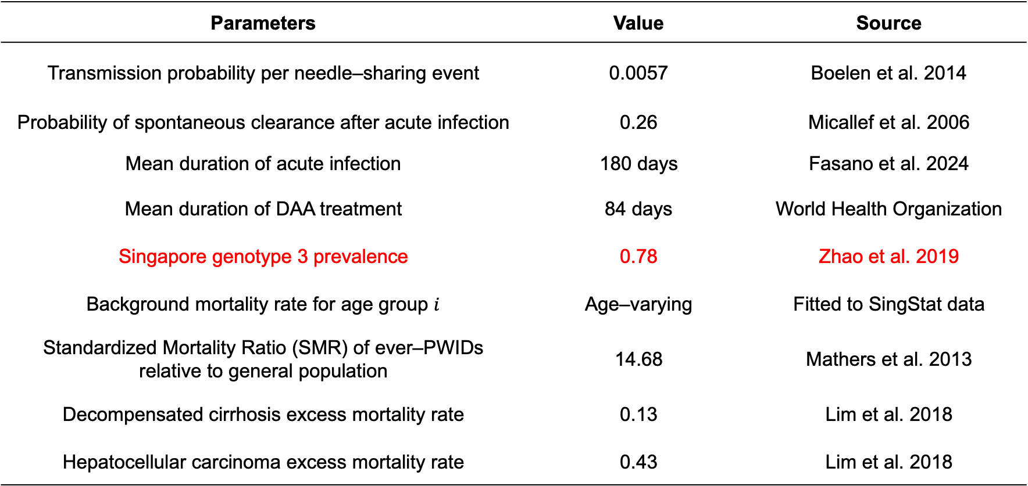
Some fixed parameters
Parameters | Value | Source
Transmission probability per needle–sharing event | 0.0057 | Boelen et al. 2014
Probability of spontaneous clearance after acute infection | 0.26 | Micallef et al. 2006
Mean duration of acute infection | 180 days | Fasano et al. 2024
Mean duration of DAA treatment | 84 days | World Health Organization
Singapore genotype 3 prevalence | 0.78 | Zhao et al. 2019
Background mortality rate for age group $i$ | Age–varying | Fitted to SingStat data
Standardized Mortality Ratio (SMR) of ever–PWIDs relative to general population | 14.68 | Mathers et al. 2013
Decompensated cirrhosis excess mortality rate | 0.13 | Lim et al. 2018
Hepatocellular carcinoma excess mortality rate | 0.43 | Lim et al. 2018
DAA: Direct–acting antiviral;

Slide 10
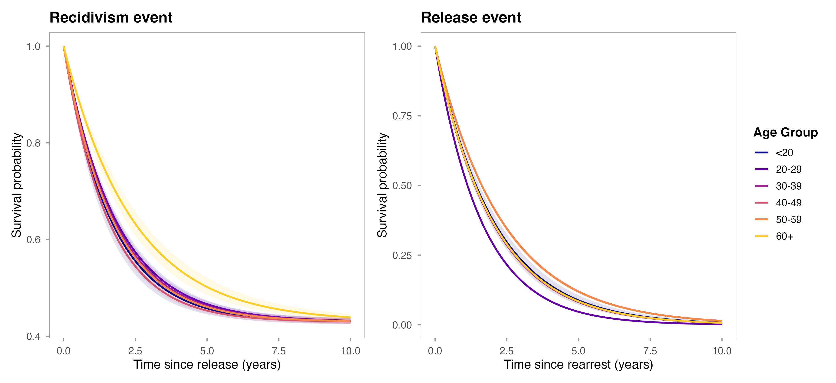
Recidivism and release survival curve
Estimated from arrest and release records spanning Jan 2007 – Dec 2017 Singapore prison data.
Recidivism risk after release peaks at ages 40–49, while PWIDs under 20 had the longest community intervals before re–arrest.

Slide 11
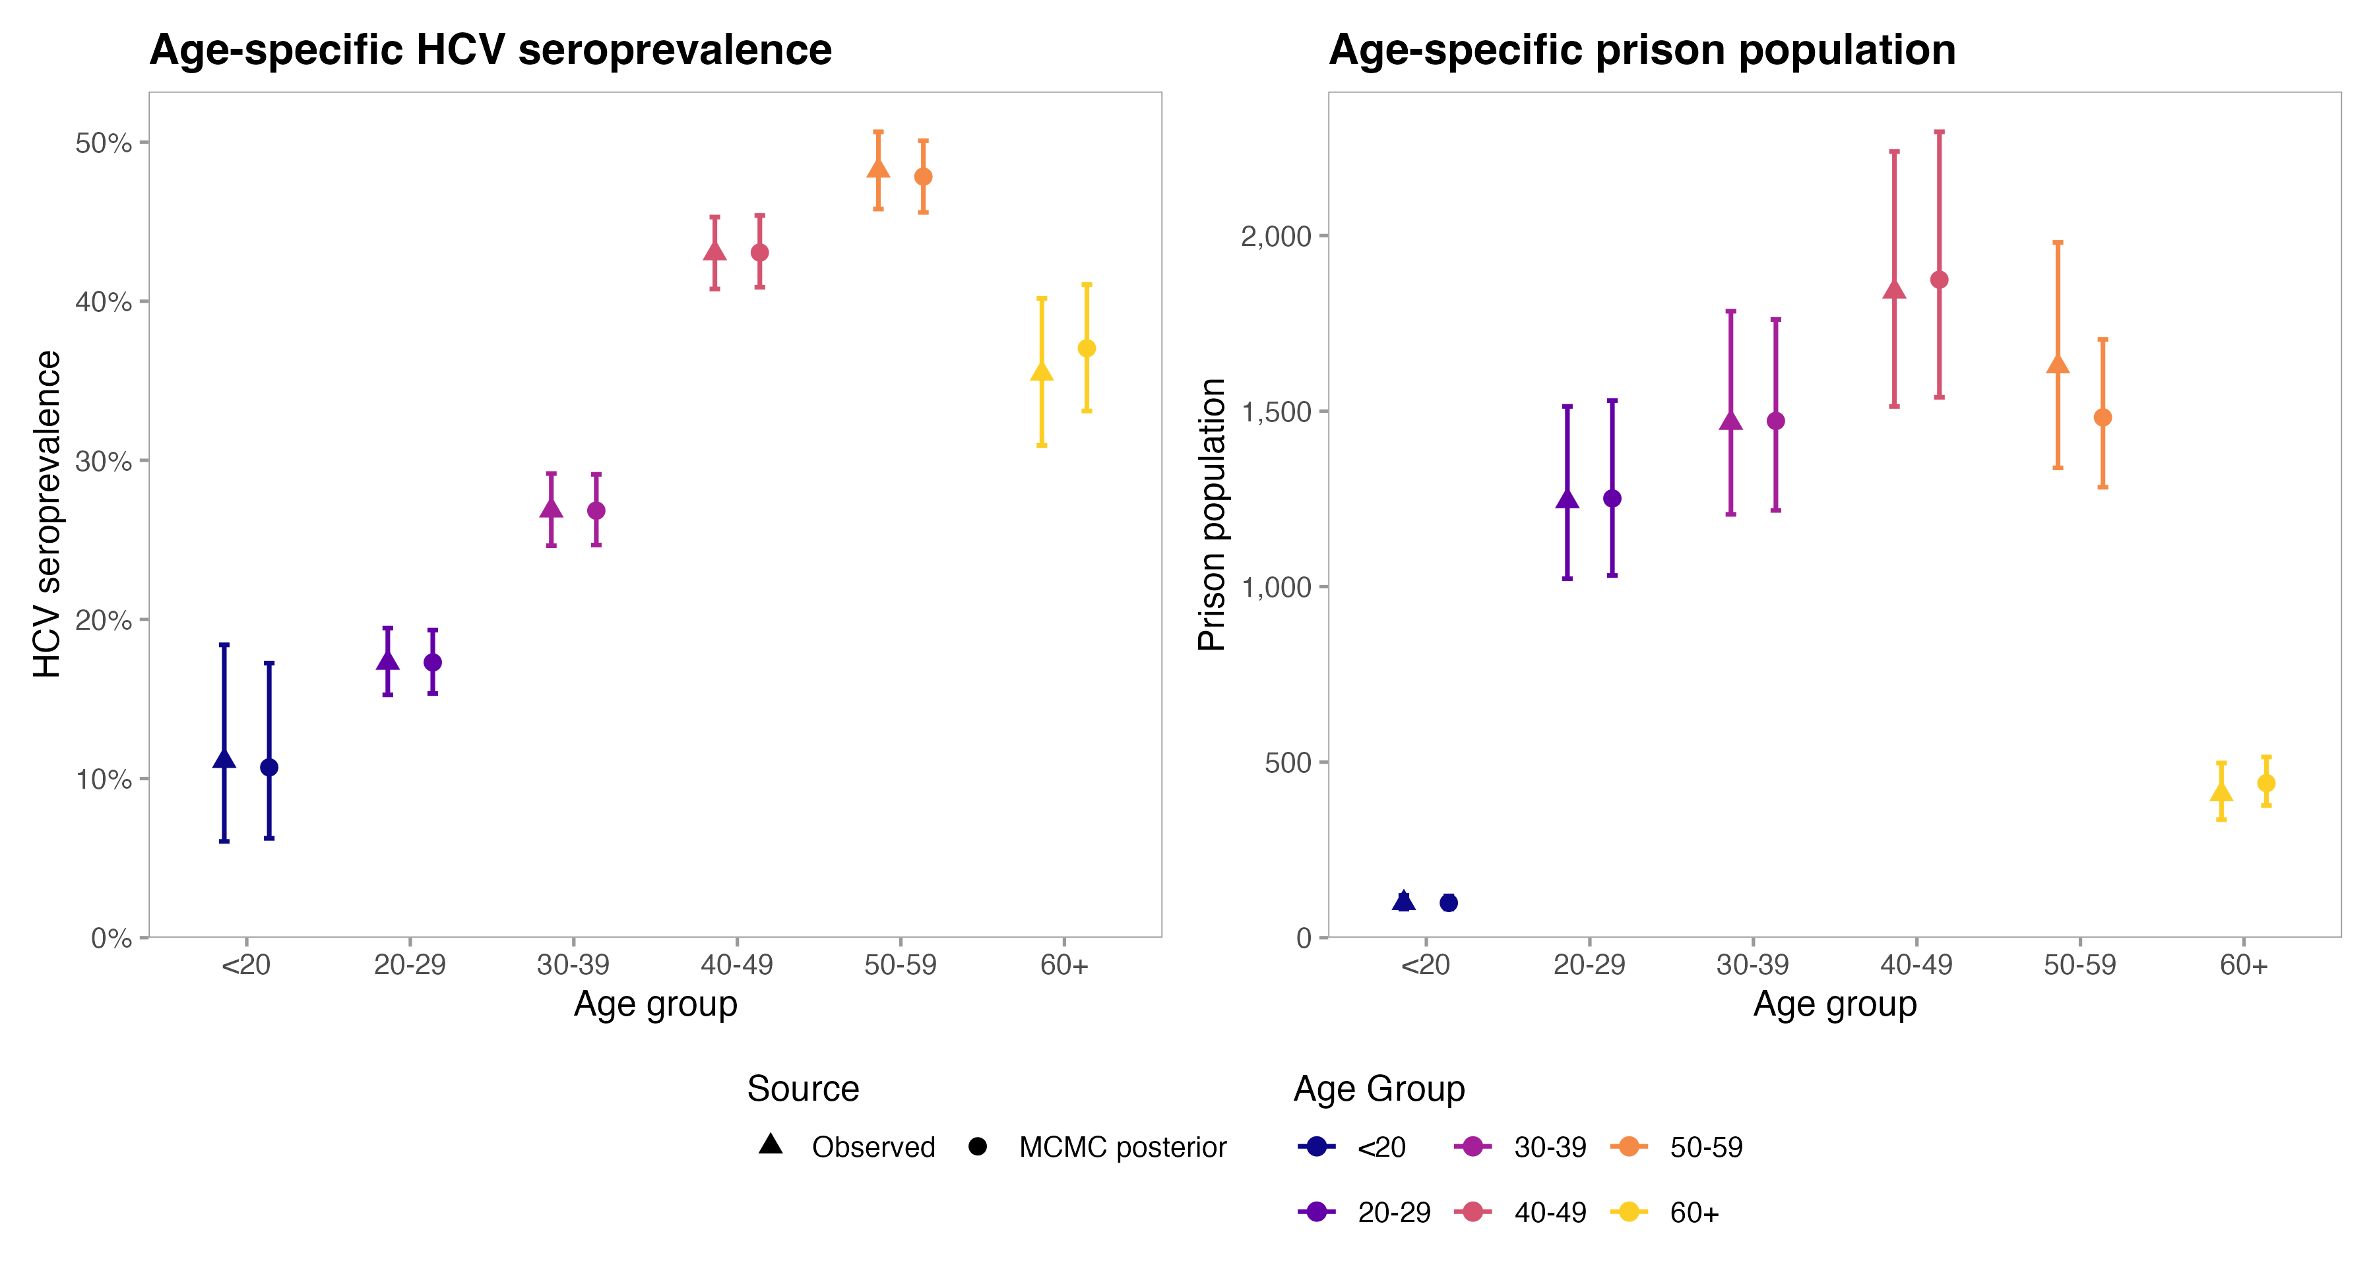
Model calibration
Age-specific HCV seroprevalence and prison population were calibrated against Feb 2014-Dec 2016 Singapore Changi prison HCV screening data.
PWID: people who inject drugs;

Slide 12
Model predictions at 2017
Stratum | Total population (95% BCI) | Active HCV cases (95% BCI)
Never–incarcerated PWID (D) | 3,734 (3,436–4,069) | 975 (869–1,090)
Incarcerated PWID (J) | 6,618 (6,101–7,290) | 2,341 (2,118–2,617)
Formerly–incarcerated PWID (F) | 2,954 (2,715–3,264) | 1,366 (1,247–1,506)
Formerly–incarcerated ex–PWID (X) | 26,243 (23,717–29,624) | 6,342 (5,741–7,100)
Current PWID (D + F) | 6,688 (6,151–7,333) | 2,341 (2,116–2,596)
Ever-PWID (D + J + F + X) | 39,561 (36,140–44,078) | 11,065 (10,006––12,285)
Around 6,700 current PWIDs were estimated in 2017, with active HCV prevalence of approximately 35%.
Formerly-incarcerated current PWIDs (F) had the highest HCV prevalence (~46%), indicating a high-burden group around the prison-community transition.
Former PWIDs (X) accounted for the largest absolute HCV burden due to much larger population size, leaving a substantial residual community reservoir.
PWID: People who inject drugs;
Notes:
Formerly-incarcerated current PWIDs (F) have the highest HCV prevalence, whereas the much larger ex-PWID population (X) contains the largest absolute number of infections.

Slide 13
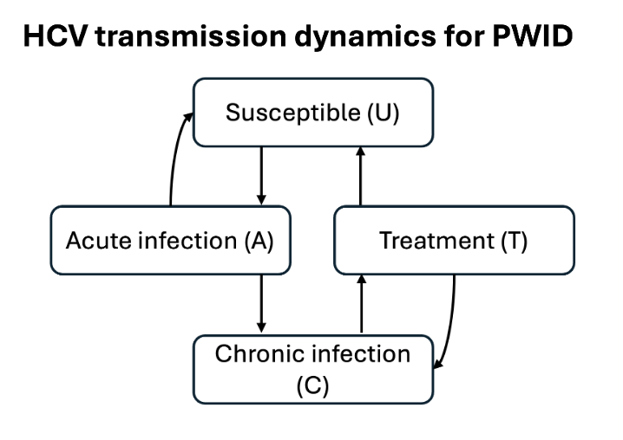
Treatment
Treatment lasts 12 weeks, with no immunity assumed following recovery.
Successful treatment leads to sustained virological response after 12 weeks (SVR12).
After achieving SVR12:
  Progression is assumed to stop in non–cirrhotic PWIDs and slows in cirrhotic PWIDs until reinfection.
  Survival improves for DC and HCC stages.
SVR12 rates vary by disease stage and treatment regimen based on clinical evidence.
PWID: people who inject drugs; DC: decompensated cirrhosis; HCC: hepatocellular carcinoma; An et al. 2022; Pawlotsky et al. 2020; Morgan et al. 2013;

Slide 14
Current treatment scenarios design
Parameters | Value (e.g.)
Treatment minimum age | 40, 50, 60
Treatment regimen choice for DC/HCC | SOF/VEL+RBV, SOF/VEL* (12 weeks)
Disease–stage–specific recruitment rates | Equal, Early-/Late- stage priortirised
Delivery setting | prison–, community–, mixed–based
Note:
SOF/VEL (12 weeks) is considered as pan-genotypic DAA treatment regimen according to EASL 2020 and AASLD/IDSA 2024 HCV treatment guideline.*
RBV is evaluated as regimen-intensification scenario for advanced liver disease due to its higher SVR in genotype 3 infections.
Outcomes include HCV incidence, cumulative infections, DC/HCC incidence, and HCC mortality, compared with no treatment.
*SOF: sofosbuvir; VEL: velpatasvir; RBV: ribavirin; DC: decompensated cirrhosis; HCC: hepatocellular carcinoma; EASL: European Association for the Study of the Liver; AASLD: American Association for the Study of Liver Diseases; IDSA: Infectious Diseases Society of America; Xiao et al. 2025; Pawlotsky et al 2020; Xiao et al 2024;
Notes:
We examined four different parameters that could affect elimination: who is eligible for treatment, which disease stages are prioritised, which regimen is used, and most importantly, where treatment is delivered.
The purpose is to identify which of these factors actually drives population-level elimination.

Slide 15
Treatment scenarios: Age group targeting
Explanation:
Age 40+: Only PWIDs aged 40+ are treatment-eligible
Age 50+: Only PWIDs aged 50+ are treatment-eligible
Age 60+: Only PWIDs aged 60+ are treatment-eligible
C: Community treatment (F+X)
J: Prison treatment (J)
Findings:
Age ≥40 targeting substantially reduced HCV burden, but did not achieve elimination.
Benefits decreased rapidly with higher age thresholds with age ≥60 targeting had minimal impact.
Higher community treatment coverage produced substantially larger gains than increasing prison coverage alone.
Age restriction is a major barrier to elimination.
C: 1%/y = each year, 1% of treatment-eligible HCV-infected individuals in F+X initiate DAA treatment.
Notes:
Community: screening is a problem
为什么D还是会下降？
D still declines indirectly because both D and F are active PWID. Treating F and J reduces the infectious pool and therefore the force of infection entering D. For example, under C=15%/y and J=100%/y:
快速介绍图：
“Moving from left to right, the minimum treatment age increases from 40 to 60. Across all strata, the curves become progressively flatter, meaning less reduction in infections.”
重点 pattern：
“Even increasing treatment coverage cannot fully compensate for excluding younger PWIDs.”
Take-home：
Broad eligibility is important for elimination; age-based restriction creates a residual transmission pool.

Slide 16
Treatment scenarios: Treatment regimen
Explanation:
SOF/VEL + RBV (12 weeks): Add ribavirin (RBV) for advanced liver disease stages (DC/HCC)
SOF/VEL (12 weeks): standard pan-genotypic treatment
C: Community treatment (F+X)
J: Prison treatment (J)
Findings:
Adding RBV provided only a marginal additional population-level reduction in HCV infections compared with SOF/VEL alone.
Differences between treatment-coverage scenarios were substantially larger than differences between regimens.
Higher regimen efficacy could not compensate for low treatment coverage.
Within the model, achieving elimination was more sensitive to treatement coverage than to regimen choice.
Notes:
Changes:
Showing the difference instead of showing all subfigures

Slide 17
Treatment scenarios: Liver disease stage
Explanation:
C: Community treatment (F+X)
J: Prison treatment (J）
Context | (NC, CC, DC, HCC)
Equal stage coverage | (1.0, 1.0, 1.0, 1.0)
Transmission priority | (1.0, 0.8, 0.4, 0.3)
Advanced-disease priority | (0.3, 0.5, 0.8, 1.0)
Findings:
Equal-stage coverage and transmission-priority strategies produced very similar reductions in HCV infections.
Advanced-disease prioritisation was substantially less effective for HCV elimination.
HCV elimination requires high treatment coverage in NC/CC, where most infections occur.
Broad access to treatment in early-disease stage (NC/CC) is essential.
Notes:
symptomatic (3rd row)
“The first column treats all disease stages relatively equally. The second prioritises earlier stages that contain most of the transmission reservoir. The third prioritises advanced liver disease.”
然后直接指出：
“The first two columns behave similarly, whereas advanced-disease prioritisation consistently leaves substantially more infections.”
解释：
DC/HCC treatment is clinically important, but these patients are not the main reservoir driving ongoing transmission.
所以：
To achieve elimination, treatment needs to reach NC/CC patients before they progress to advanced disease.

Slide 18
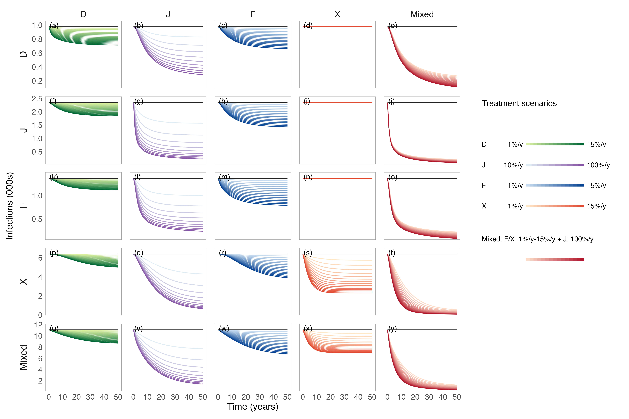
Treatment scenarios: Delivery settings
Explanation:
D/J/F/X: Only treat PWIDs within the stratum
Mixed: Coverage applied to F/X with 100% treatment coverage for J
Findings:
Prison-based treatment was highly effective in rapidly reducing HCV infections across strata.
However, residual infections remained after prison treatment alone, particularly in the community.
Adding community treatment provided further reductions and helped move the population closer to elimination.
Prison-based treatment could provide the core elimination platform, with community treatment addressing residual HCV burden.
Notes:
先告诉他们横向是什么：
“Each column represents treatment concentrated in a different setting or the combined population.”
然后只讲三个 pattern。
Pattern 1：Prison treatment 很强
“Prison treatment produces a rapid and substantial reduction in infections across the population, despite treatment being concentrated in the incarcerated population.”
这是你的 strongest result。
Pattern 2：但有 residual infections
“However, prison treatment alone does not completely remove infections among PWIDs remaining in the community.”
Pattern 3：community 是补充
“Adding community treatment further reduces this residual burden and moves the system closer to elimination.”
然后给政策 interpretation：
“This suggests a hub-and-spoke strategy: prison-based screening and treatment as the core platform, with targeted community treatment used to close the remaining elimination gap.”
我建议把你 slide 上：
Prison-based treatment should be the core intervention...
稍微改成更稳妥的：
Prison-based treatment could provide the core elimination platform, with community treatment addressing residual HCV burden.
“could provide” 比 “should be” 更适合目前尚未完成经济和实施分析的阶段。

Slide 19
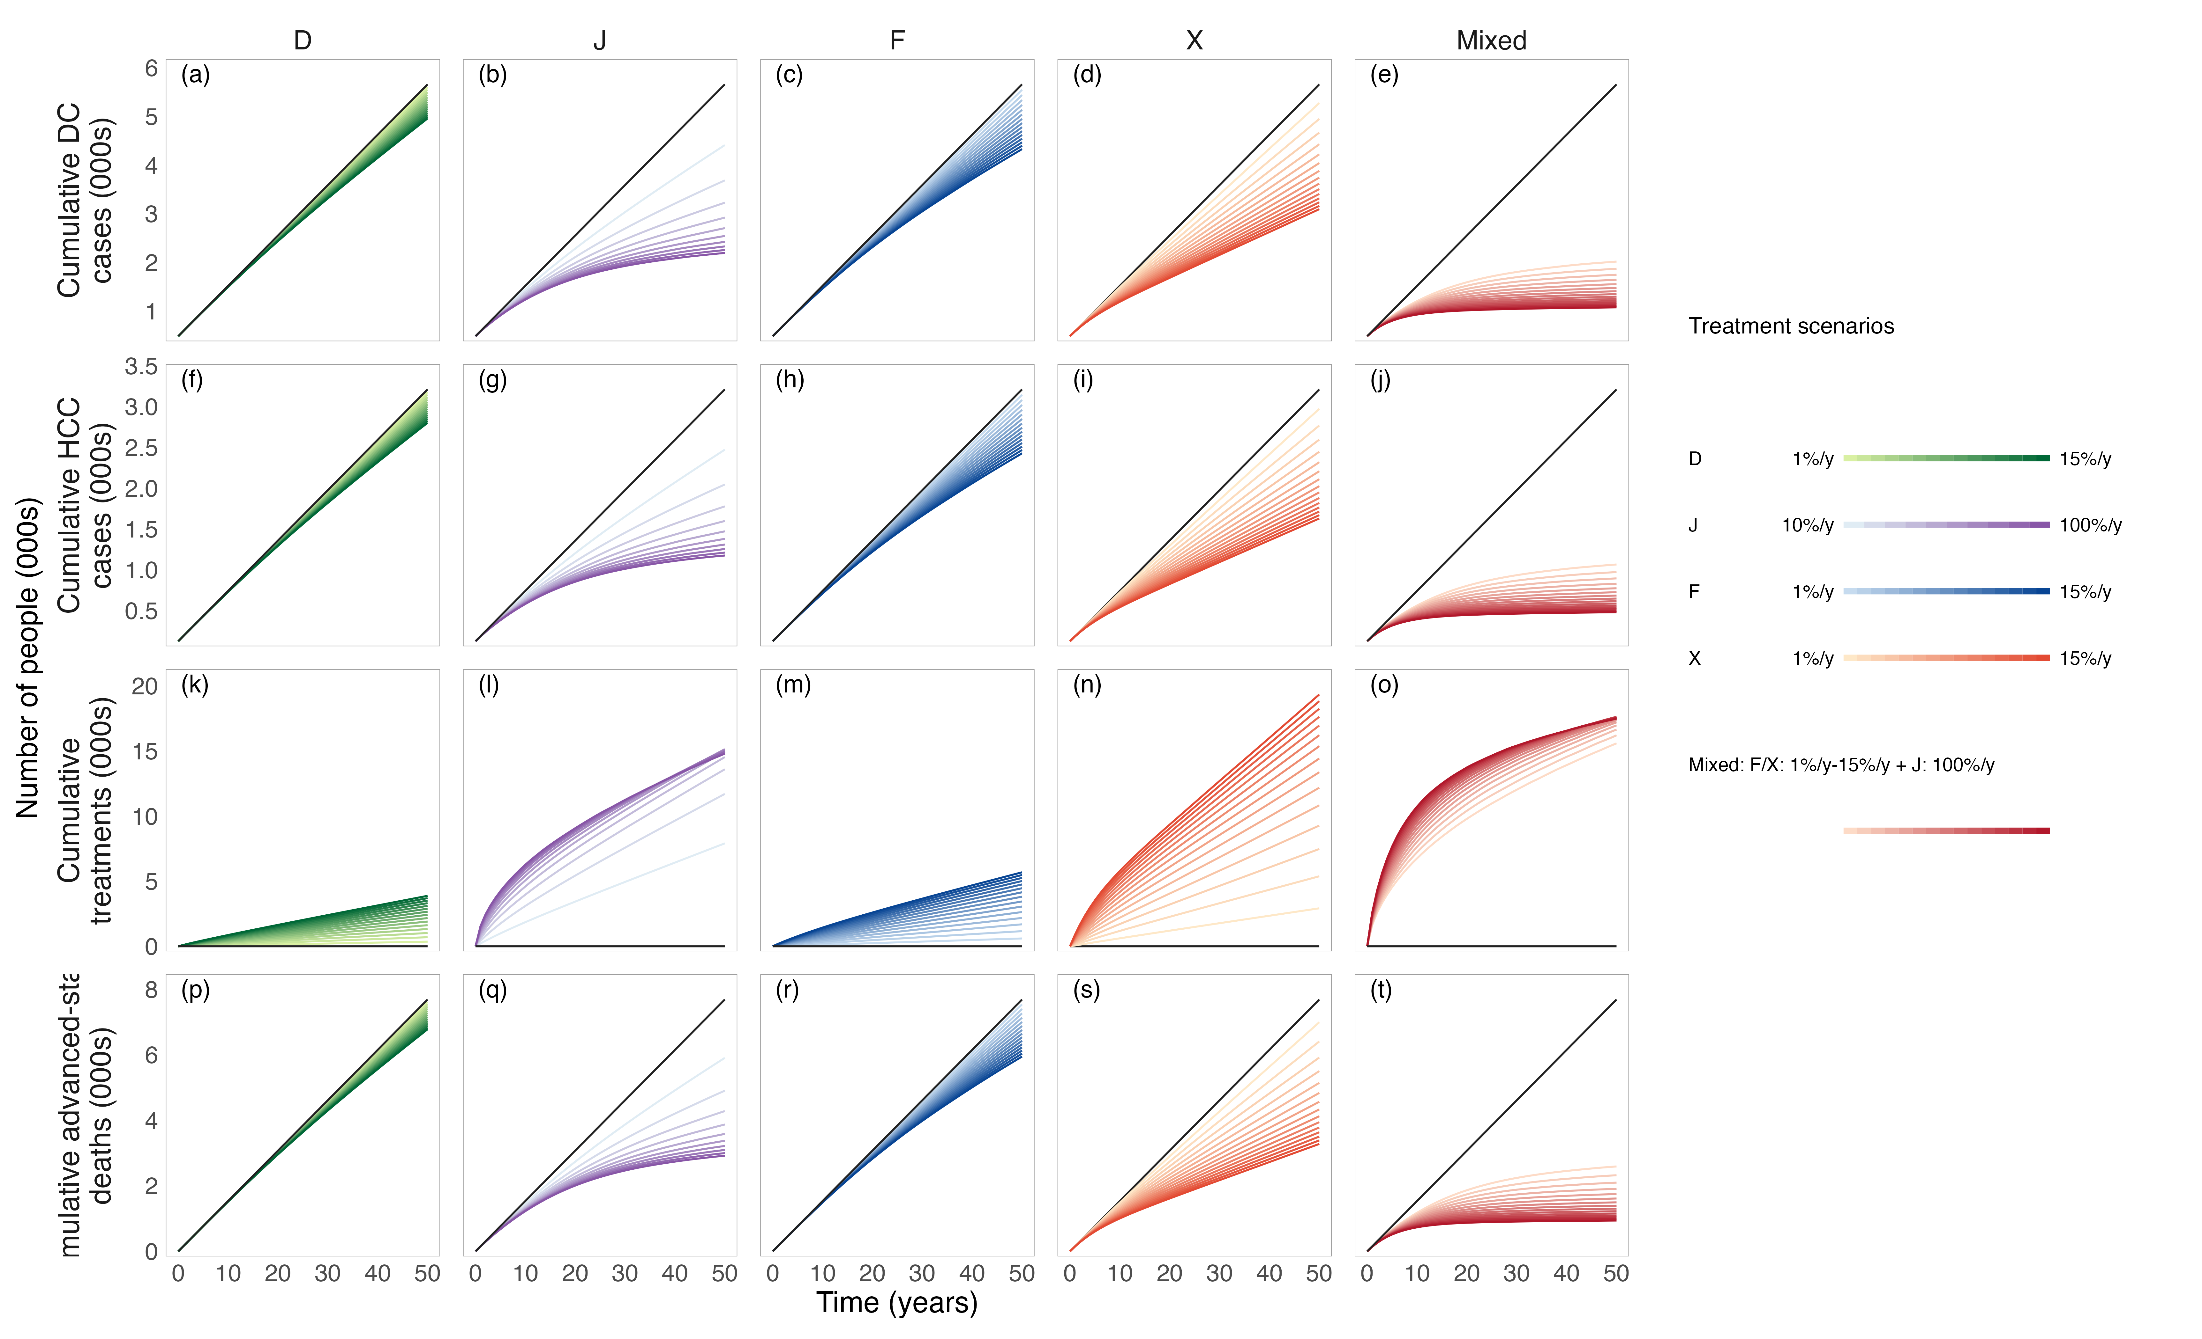
DC/HCC cases & deaths under different delivery settings & coverage
Explanation:
D/J/F/X: Only treat PWIDs within the stratum
Mixed: Coverage applied to F/X with 100% treatment coverage for J
Findings:
Prison-based treatment substantially reduced DC/HCC cases, and advanced-stage deaths.
Higher treatment coverage produced larger health gains and faster reductions in severe liver outcomes.
More intensive treatment did not necessarily require more treatment initiations in the long term.
Early treatment scale-up can both improve health outcomes and reduce long-term treatment burden.
Notes:
Prison-based treatment not only controls transmission, but also brings downstream clinical benefits
The same pattern is seen for severe liver outcomes: increasing treatment coverage substantially reduces cumulative DC cases, HCC cases and advanced-stage deaths.
然后指出一个非常适合的结果：
Early intensive treatment does not necessarily mean permanently higher treatment burden.
There may be a larger upfront programme effort, but suppressing transmission early can reduce the long-term treatment requirement.
This may reduce long-term treatment demand; whether it is cost-saving still needs economic evaluation.

Slide 20
Conclusion (so far)
Prison-based screening and treatment can achieve a substantial reduction in HCV burden among PWIDs and could form the core of an elimination strategy.
Residual infections remain in the community, indicating that targeted treatment of F/X populations is needed to further close the elimination gap.
A mixed prison–community approach is expected to produce the greatest epidemiological benefit.
Overall, the current results support a prison-centered, community-complementary pathway toward HCV elimination among PWIDs in Singapore.

Slide 21
Next steps
RBV-related adverse effects are not yet explicitly modelled, and detailed HCC treatment pathways are not included.
Additional combinations of prison and community coverage still need to be explored to identify the minimum community component required after maximizing prison treatment.
Screening, treatment delivery costs, productivity losses and downstream HCC treatment costs have not yet been incorporated.
Notes:
Changes:
1. Community outreach removed

Slide 22
Limitations
Notes:
Changes:
1. Community outreach removed

Slide 23
References
Chaillon A, Thurairajah PH, Hsiang JC, Martin N. What is required for achieving HCV elimination in Singapore? A modeling study. J Hepatol 2020; 73: S818.
Zhao Y, Thurairajah PH, Kumar R, Tan J, Teo EK, Hsiang JC. Novel non-invasive score to predict cirrhosis in the era of hepatitis C elimination: A population study of ex-substance users in Singapore. Hepatobiliary Pancreat Dis Int 2019; 18: 143–8.
Zhu RX, Seto W-K, Lai C-L, Yuen M-F. Epidemiology of hepatocellular carcinoma in the Asia-Pacific region. Gut Liver 2016; 10. DOI:10.5009/gnl15257.
Ashtari S. Hepatocellular carcinoma in Asia: prevention strategy and planning. World J Hepatol 2015; 7: 1708.
Wu Y-J, Xu M-Y, Lu L-G. Clinical advances in fibrosis progression of chronic hepatitis B and C. J Clin Transl Hepatol 2014; 2: 222–7.
Pawlotsky J-M, Negro F, Aghemo A, et al. EASL recommendations on treatment of hepatitis C: final update of the series. J Hepatol 2020; 73: 1170–218.
Hernandez-Con P, Wilson DL, Tang H, et al. Hepatitis C cascade of care in the direct-acting antivirals era: a meta-analysis. Am J Prev Med 2023; 65: 1153–62.
Goodyear T, Brown H, Browne AJ, Hoong P, Ti L, Knight R. “I want to get better, but…”: identifying the perceptions and experiences of people who inject drugs with respect to evolving hepatitis C virus treatments. Int J Equity Health 2021; 20: 81.
Mathers BM, Degenhardt L, Bucello C, Lemon J, Wiessing L, Hickman M. Mortality among people who inject drugs: a systematic review and meta-analysis. Bull World Health Organ 2013; 91: 102–23.
Boelen L, Teutsch S, Wilson DP, et al. Per-event probability of hepatitis C infection during sharing of injecting equipment. PLoS One 2014; 9: e100749.

Slide 24
References
Micallef JM, Kaldor JM, Dore G. Spontaneous viral clearance following acute hepatitis C infection: a systematic review of longitudinal studies. J Viral Hepat 2006; 13: 34–41.
Fasano M, Ieva F, Ciarallo M, Caccianotti B, Santantonio TA. Acute hepatitis C: current status and future perspectives. Viruses 2024; 16: 1739.
Lim AG, Qureshi H, Mahmood H, et al. Curbing the hepatitis C virus epidemic in Pakistan: the impact of scaling up treatment and prevention for achieving elimination. Int J Epidemiol 2018; 47: 550–60.
Fattovich G, Stroffolini T, Zagni I, Donato F. Hepatocellular carcinoma in cirrhosis: incidence and risk factors. Gastroenterology 2004; 127: S35–50.
An J, Park DA, Ko MJ, et al. Direct-acting antivirals for HCV treatment in decompensated liver cirrhosis patients: a systematic review and meta-analysis. J Pers Med 2022; 12: 1517.
Morgan RL, Baack B, Smith BD, Yartel A, Pitasi M, Falck-Ytter Y. Eradication of hepatitis C virus infection and the development of hepatocellular carcinoma: a meta-analysis of observational studies. Ann Intern Med 2013; 158: 329–37.
Xiao J, Zhang X, Mao X, Lai S, Li S, Sheng Y. Efficacy and safety of velpatasvir plus sofosbuvir with or without ribavirin in hepatitis C patients with decompensated cirrhosis: a systematic review and meta-analysis. J Viral Hepat 2025; 32: e70078.

Slide 25
Extra slides

Slide 26
Model estimate at 2017
Stratum | Total population (95% BCI) | HCV cases (95% BCI)
Never–incarcerated PWID (D) | 3,734 (3,436–4,069) | 975 (869–1,090)
Incarcerated ex–PWID (J) | 6,618 (6,101–7,290) | 2,341 (2,118–2,617)
Formerly–incarcerated PWID (F) | 2,954 (2,715–3,264) | 1,366 (1,247–1,506)
Formerly–incarcerated ex–PWID (X) | 26,243 (23,717–29,624) | 6,342 (5,741–7,100)
Current PWID (D + F) | 6,688 (6,151–7,333) | 2,341 (2,116–2,596)
Ever-PWID (D + J + F + X) | 39,561 (36,140–44,078) | 11,065 (10,006––2,285)
Literature | Time | Population | Results
Teo et al. | 2017 | NSUM estimated IVDU population | 11,000 (6,500–17,000)
Quaye et al. | 2019 | NSUM PWID population | 3,470 (1,540–7,830)
Chaillon et al. | calibrated to 2017 | Ever–PWID = Current + Former PWID | ~11,000
NSUM: Network scale–up method; IVDU: Intravenous drug users; PWID: People who inject drugs;

Slide 27
Stage-, genotype-, and regimen- specific SVR12 rates
Genotype | Liver disease stage | Regimen | SVR12 rates | Source
3 | NC/HCC | SOF/VEL | 0.98 | Pawlotsky et al. 2020
Other GT | NC/CC | SOF/VEL | 0.99 | Pawlotsky et al. 2020
3 | DC/HCC | SOF/VEL | 0.45 | Pawlotsky et al. 2020 Xiao et al. 2025
Other GT | DC/HCC | SOF/VEL | 0.90 | Pawlotsky et al. 2020 Xiao et al. 2025
3 | DC/HCC | SOF/VEL + RBV | 0.87 | Pawlotsky et al. 2020 Xiao et al. 2025
Other GT | DC/HCC | SOF/VEL + RBV | 0.92 | Pawlotsky et al. 2020 Xiao et al. 2025
NC: Non-cirrhosis; CC: Compensated Cirrhosis; DC: Decompensated Cirrhosis; HCC: Hepatocellular Carcinoma; SVR12: Sustained virological response after 12 weeks;

