Slide 1
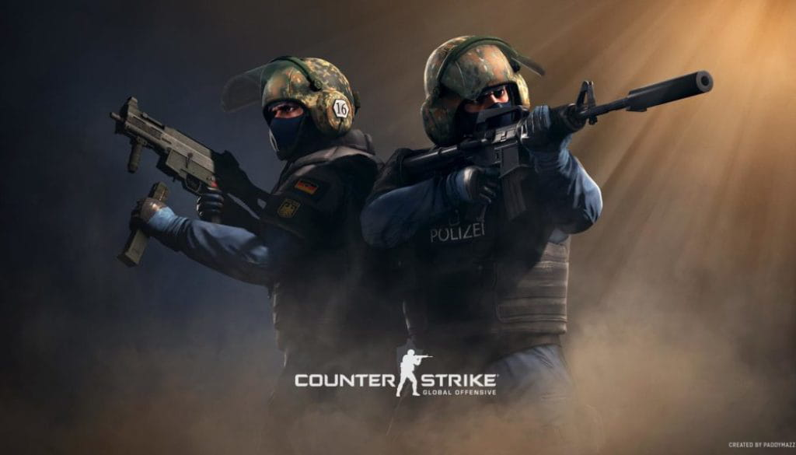
Who will win the game- Machine learning based on a player’s performance
By: Lev Kravtsov

Slide 2
Abstract
Counter-Strike (CS) is a series of multiplayer first-person shooter video games in which teams of terrorists battle to perpetrate an act of terror (bombing, hostage-taking, assassination) while counter-terrorists try to prevent it.
The game has first released In 1999 on Windows Operating system, as a “Mod” to the popular game at the time – Half-Life.
In this version of the game: Counter Strike-Global Offensive, the popularity of online competitions and tournaments have been at an all time high, due to that my interest to find , if there is a correlation between –How well a player performs in a game, and the outcome of the specific game.
The results were interesting and the work I’ve done on this project was very fun and taught me a lot of interesting things regarding the python libraries and the python language as an whole.
Keywords: Data-Science, Decision Tree, LogisticRegression ,KNN

Slide 3
Issues During Project
During the project I’ve encountered various issues that endangered the continuation of the project, specifically the Data acquisition.
The Site that I’ve used in order to find my Data for the project : www.hltv.org , has appeared to be very possessive of their data,
Even though it is open to view to the public.
Additional issue I had, was finding the correct statistical algorithm in order to find the best percentage of correct , or incorrect ,
Result as the data I’ve used isn’t numerical enough to give it simple way to apply the algorithms too.

Slide 4
External Resources
Course Site-campusIl
StackOverflow
GitHub
Kaggle (only for inspiration, no data have been used from this site)
Discord servers (Python servers for Data Science)
YouTube (for teaching me everything )
hltv.org (the site I used for getting the data for the project)

Slide 5
Crawling-Scraping
Because the site that I’ve used in order to crawl through, has been very possessive towards their data, I had to find
A way to crawl and scrape through in creative ways and not just brute force (which I did at the start and got blocked several times).
Because of the repeating blocking, I decided to crawl and scrape a part of the site and not all of it , specifically from 2015-2021.
I’ve used the rankings of teams as part of my features when teaching the machine how to predict the results.
Based on the rankings I was able to uniquely find each of the players of the teams and scrape their data into a dataframe that was then used in order to build a dataset that I could work on and handle the data and visualize it.

Slide 6
Data Handling
As part of the data handling , one of the thing that I found necessary to do was fix the dates to be acceptable in Python, so the language will understand it and be able to process it correctly when is used.
In addition, I’ve made sure that any column that is holding a numeric data will be in a numeric format of int64 instead of strings , for example “team_round”, “kills”, “deaths”, “rating”.

Slide 7
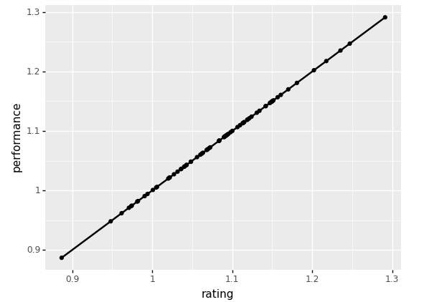
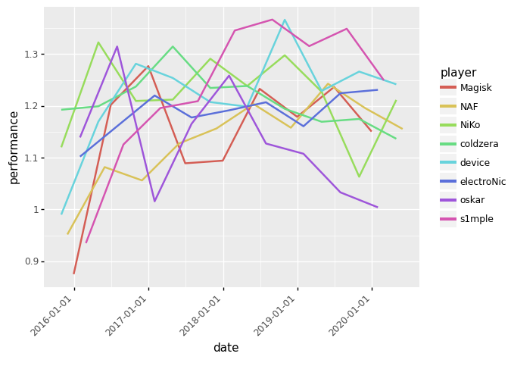
Visualizations

Slide 8
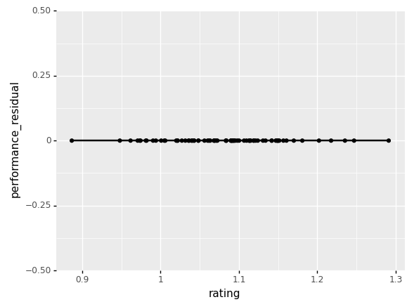
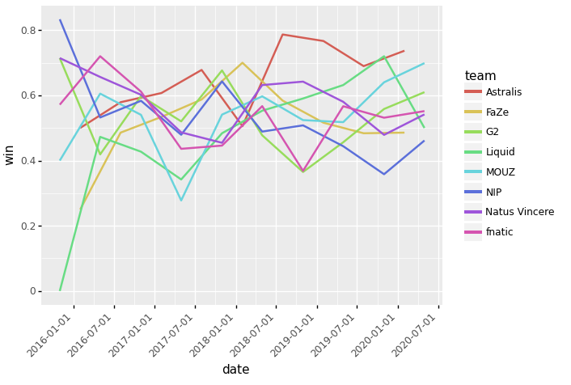

Slide 9
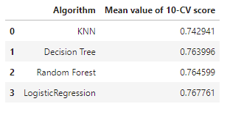
Statistical Algorithms
- KNN : 74%
Decision Tree: 76%
Random Forest: 77%
LogisticRegression: 77%

Slide 10
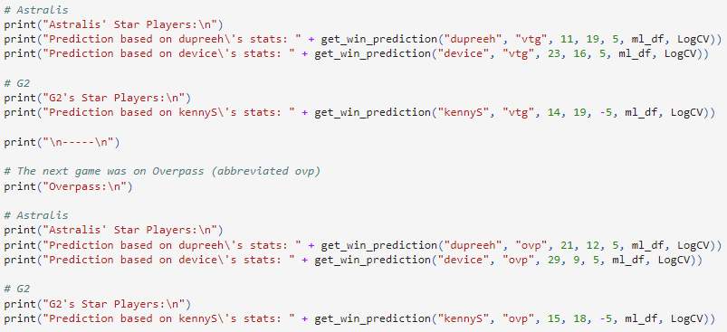
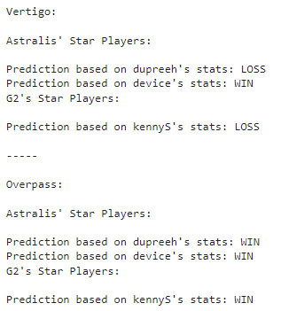
Win predictions
The set I used in order to predict a win was : kills, deaths, and rank difference between the players.
Using the Statistical algorithms, we searched for the closest value to 1(100%) and used them in order to predict most accurately the result.
Using LogisticRegression and the data about each player in each match, we were able to predict each team would they win or lose.

Slide 11
Conclusion
In conclusion, After testing different Statistical algorithms , I’ve deducted that, the best algorithm to predict the output of a match between two teams losing machine learning would be:
LogisticRegression: 77%

