Slide 1
Avatari
Making Fitness FUN!!!
Notes:
Hello everybody!
Before I start off, show of hands, who here loves going to the gym? … Well you guys are weird and this app isn’t for you.
We’re here today to talk about AVATARI, which we hope will help make fitness easier and more fun.

Slide 2
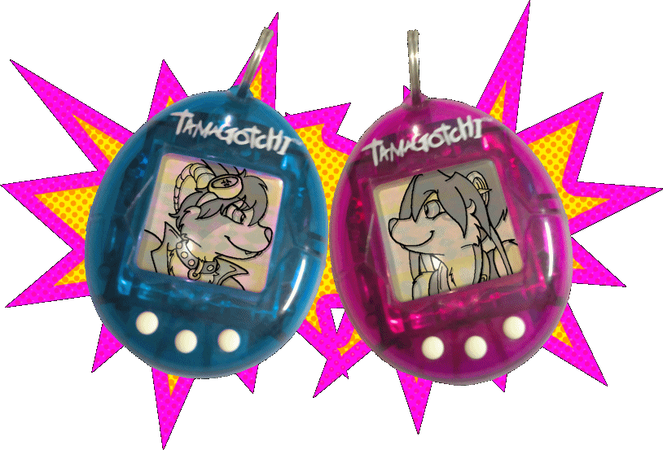
What is it?
Web Application Integrating with FitBit.
A game that encourages Fitness.
Visual Representation of Personal Fitness Achievements.
Interactive and based on Fitness Performance.
Individual Goals or Head-to-head Challenges.
  Friends or strangers
  Find out who else is on your level
Notes:
DENHOLM
AVATARI is a concept inspired from the Tamagotchi, but utilizes the hardware of a Fit Bit.
It will be a web application based game that monitors the development of a user avatar.
You are responsible for taking care of your avatar, who grows stronger with your activity, and weaker without it.
The game will include real life challenges based on your fitness level, and continue to become more interesting and difficult
as you and your TARI improve.
When competing against yourself isn’t enough, you can challenge other TARIs to duel in events like GPS-tracked sprints, or other group tasks.

Slide 3
Why do we need it?
Reward system that is not self-deprecating.
Incremental + Achievable Mini-goals.
Reinforces a consistent fitness schedule.
Encourages goal achievement by having fun.
Notes:
Often we feel that working out justifies some kind of reward, like 12 hours of Netflix or a 9th slice of cake.
AVATARI hopes to provide a reward system that doesn’t take away from the benefit of fitness.
Fitness goals will also feel more achievable with incremental mini-goals that help maintain motivation.
Aspects of the game will rely on real-world time, and rewards or penalties will encourage a consistent workout schedule.
Most importantly, it makes fitness easier by making it fun!

Slide 4
Summary
A game that makes fitness fun
Can use it as both independent & peer based fitness encouragement
Questions?
Notes:
Overall, it’s a game that hopes to improve your relationship with your body, and acts as a booster to fitness encouragement.

