Slide 1
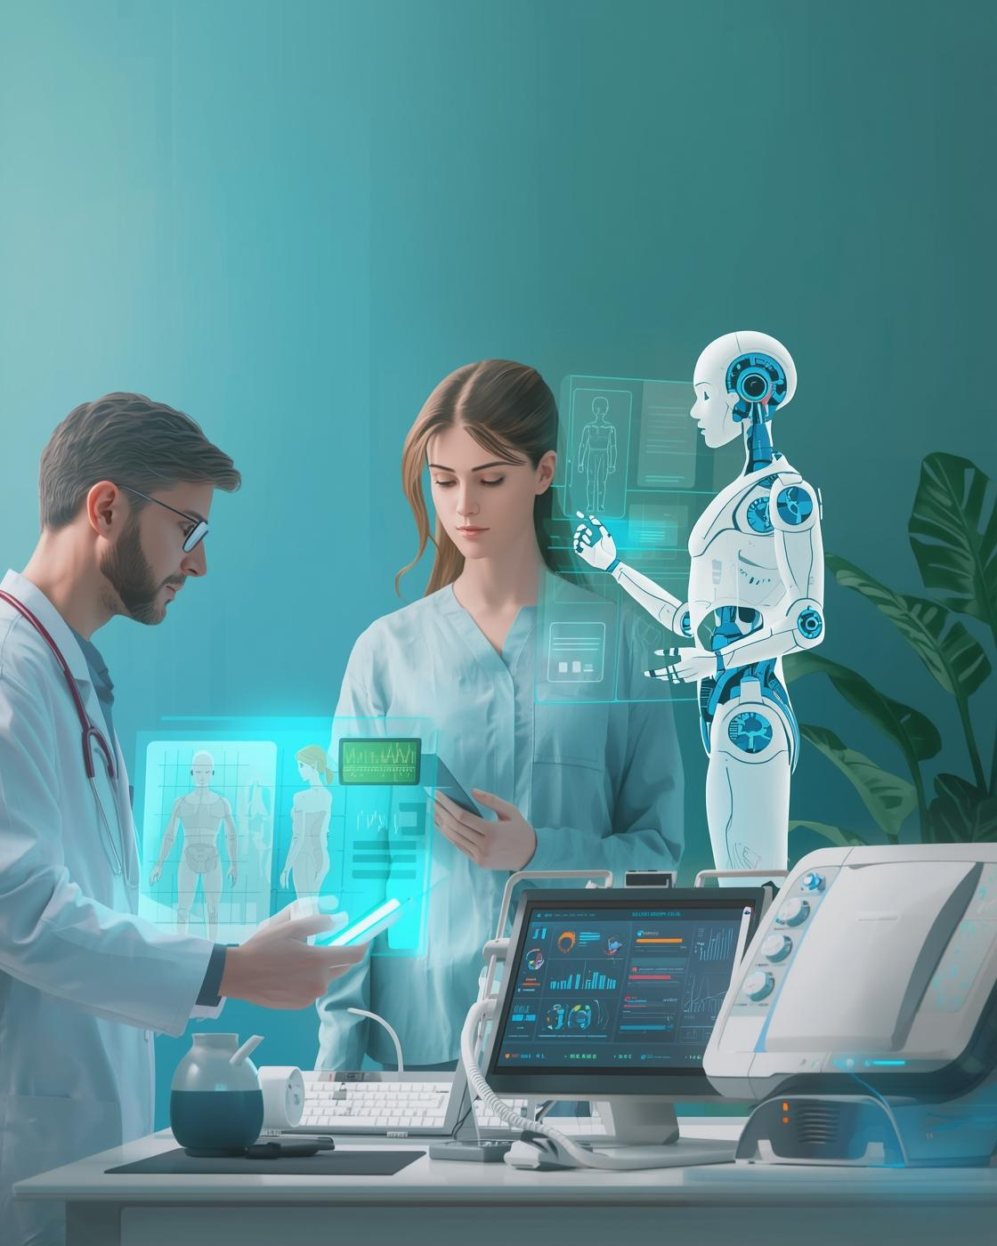
The Future of Medicine
If AI is performing better than human doctors, should it be allowed to make medical descisions?
Md. Shahria Sarker Shuvo
2131653642

Slide 2
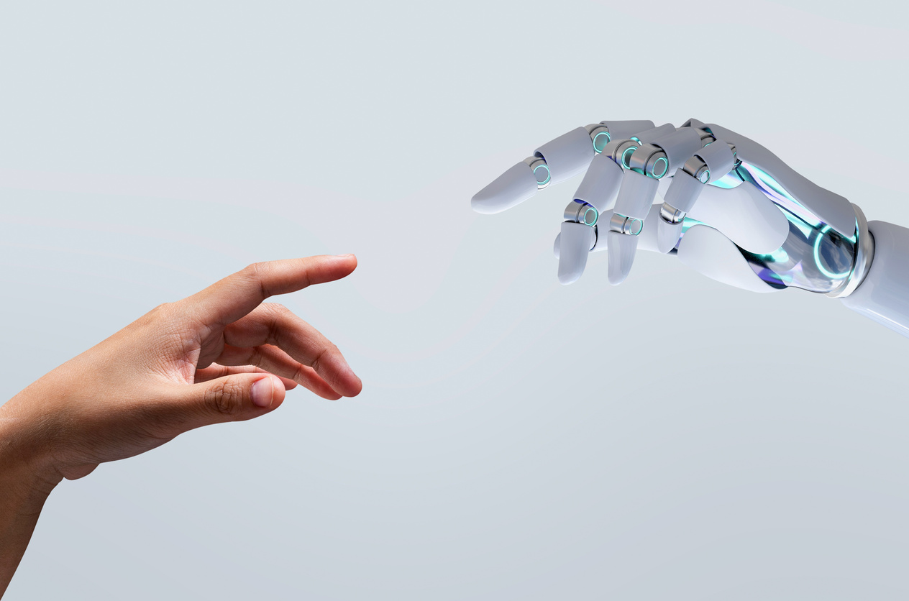
YES, But not alone
Three reasons why humans and doctors should work together
Superhuman Accuracy
The Power of Data
Fair Healthcare

Slide 3
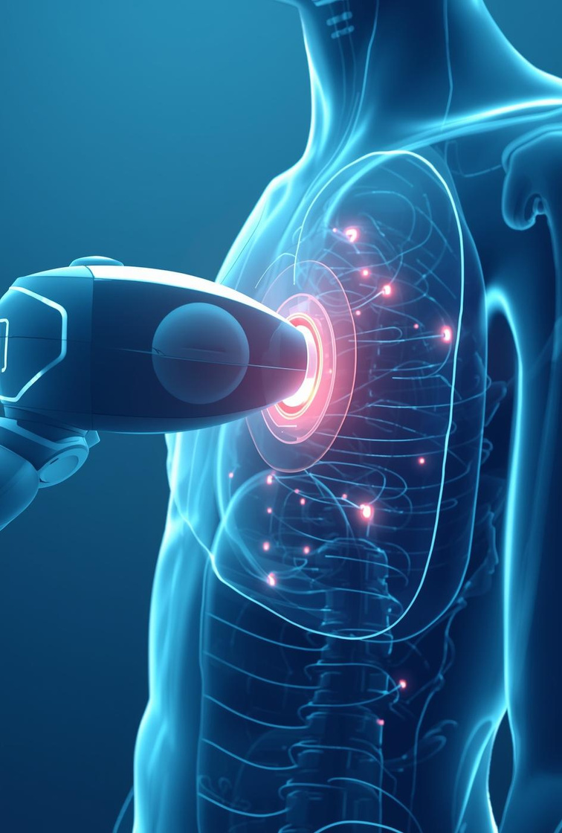
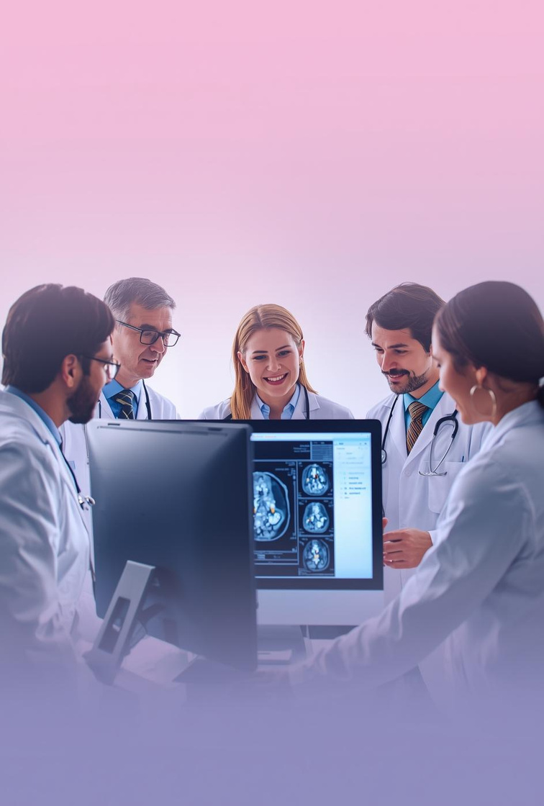
Superhuman Accuracy
AI spots tiny, invisible patterns
Never gets tired
More accurate medical image detection
AI as a powerful medical tool

Slide 4
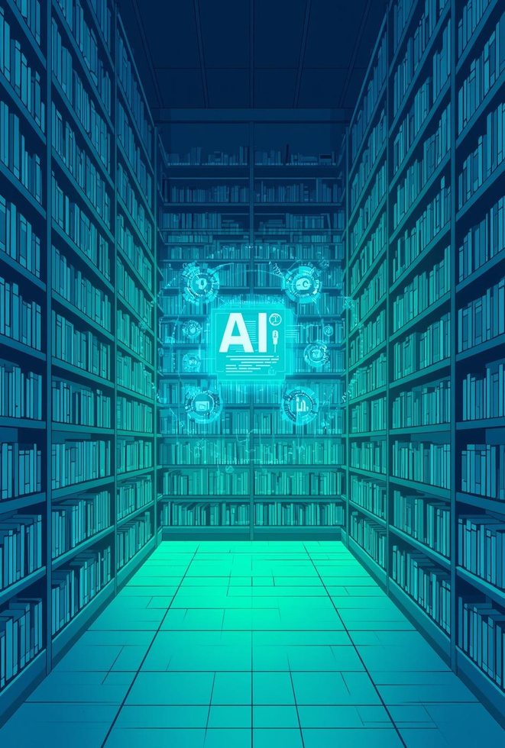
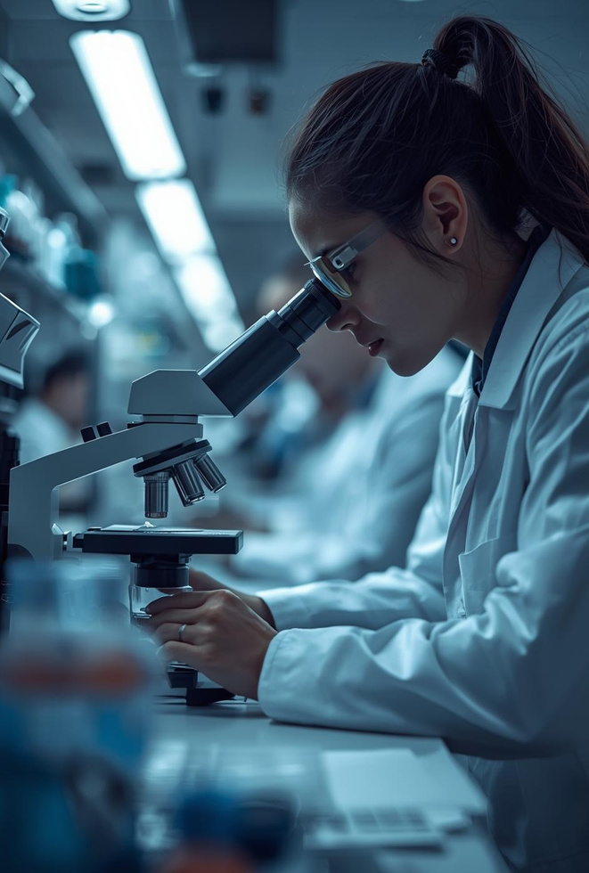
Power of Data
AI reads millions of medical records
Faster rare-disease detection
Data-driven treatment suggestions
Human touch still essential
“Can we trust a machine?”
Who will hold your hand when you get bad news?
Who will understand your fear and explain things with emotion? A doctor.

Slide 5
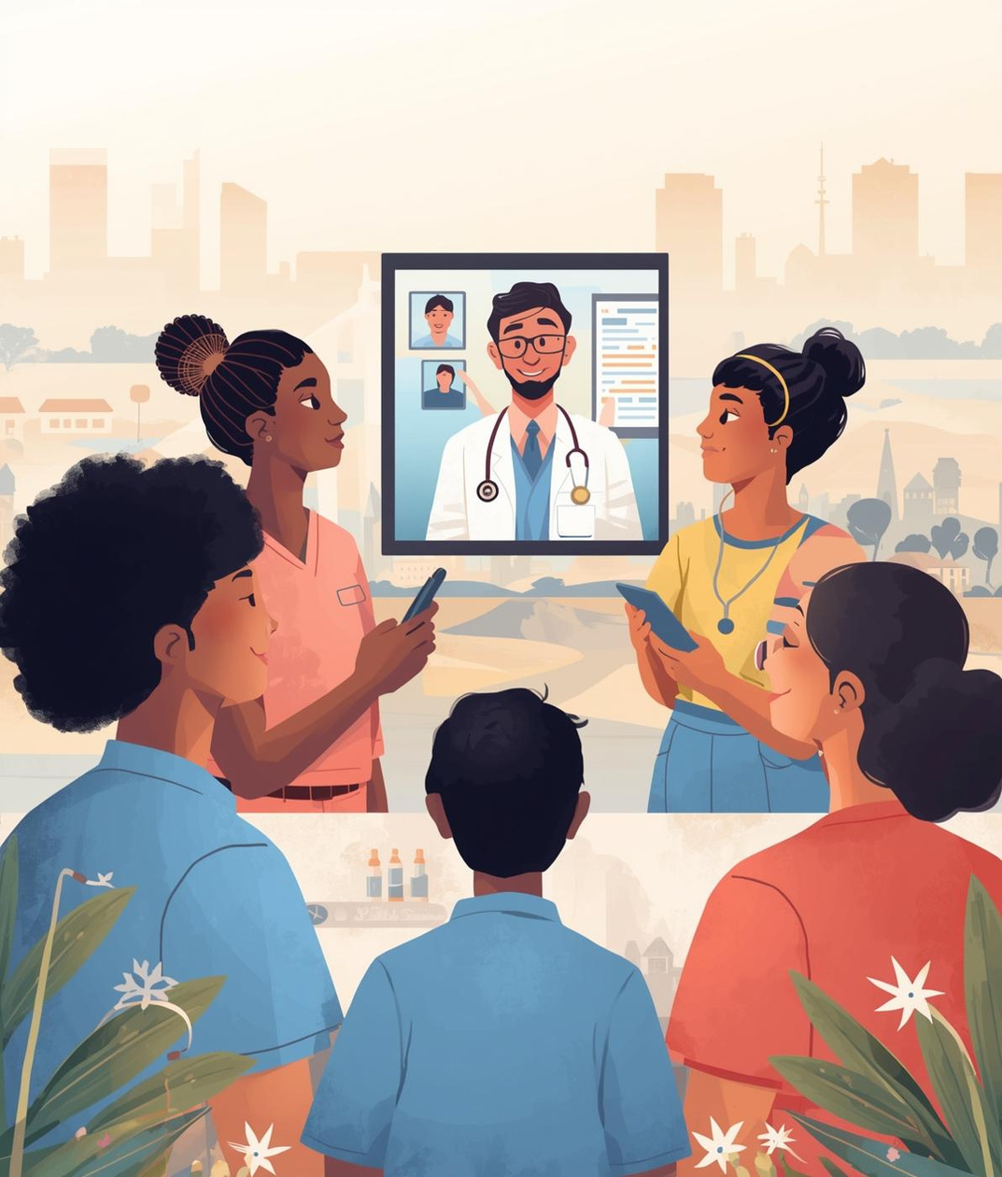
Access for All
Bridging Healthcare Inequalities
Advanced technologies can provide expert medical assistance to both urban and rural communities, ensuring everyone has access to quality healthcare, regardless of their location or circumstances.

Slide 6
Thank You

