Slide 1
Classifying human written text from GPT-2 generated text
Group 3: Millie, Komal and Zoe

Slide 2
Introduction
Primary task
Binary classification to differentiate fake text from human-generated text.
Models - Logistic Regression, Convolutional Neural Network and BERT.
Background
GPT-2 models (117M, 345M, 762M and 1542M) released in stages because weaponizing language models is a serious concern.
Project motivation
Contribute to the field of fake text detection by building classification models designed for the primary task.

Slide 3
Previous Works
Understanding Convolutional Neural Networks for Text Classification (2018)
Talks about the challenges involved with using CNN for text classification since unlike images text is discrete data.
Authors demonstrated binary classification task for sentiment analysis
Factuality Classification Using the Pre-trained Language Representation Model BERT (2019)
Factuality detection : task of assigning factual tag to verbal events present in a dataset
Used multi-layer bidirectional BERT model to showcase multilingual fact classification.

Slide 4
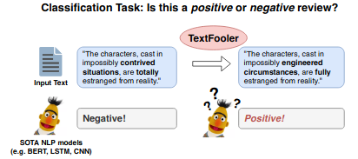
Previous Works
DocBERT: BERT for Document Classification (2019)
Used logistic regression and SVM (both inherently discriminative) for baselines to highlight the effectiveness of BERT.
showcased that even though BERT is generative it can give high performance in classification tasks.
Is BERT Really Robust? A Strong Baseline for Natural Language Attack on Text Classification and Entailment (2020)

Slide 5
Data
Human generated text consists of 250K documents from the WebText dataset, which is a collection of text from blogs and papers.
The GPT-2 generated text includes two 250K documents, labeled Temperature-1 and Top-k40 (hyperparameters of the GPT-2 model that affect the randomness in output).
Top-K 40: Conditionally generated samples from the paper use top-k random sampling with k = 40.
Sampled the first 50K human generated texts and the first 50K GPT-2 generated text of Top-K 40 configuration.

Slide 6
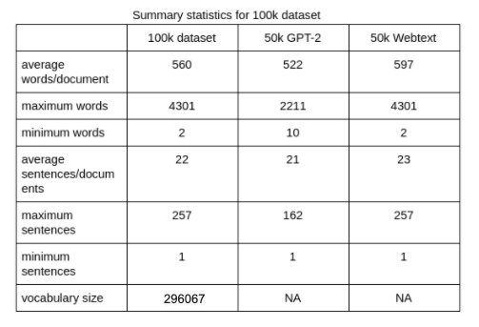
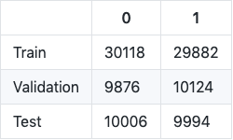
Summary Statistics on Dataset

Slide 7
Model, Results and Analysis
Computing infrastructure: GPU from Google Colab
Logistic Regression
Convolutional Neural Network
BERT

Slide 8
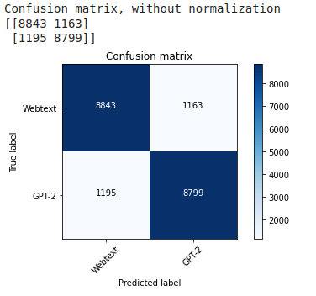
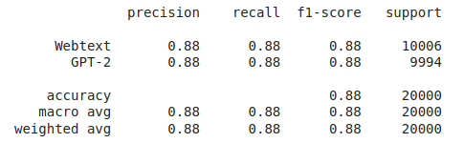
Logistic Regression
F1 score : 88 %
Marginally better at predicting GPT2 as compared to WebText

Slide 9


Logistic Regression Analysis
Test string 1 (GPT2) : “James Harden is shooting 29 percent down the floor when guarded by Kawhi Leonard in this series, including just 10 percent from three. When not guarded by Leonard, Harden is shooting nearly 50 percent.”
Test String 2 (WebText) : “COPYRIGHT NOTICE
This project is licensed under the Creative Commons Attribution-ShareAlike 3.0 Unported License.
Feel free to use, copy, modify, publish and distribute, including commercial products or services.”

Slide 10
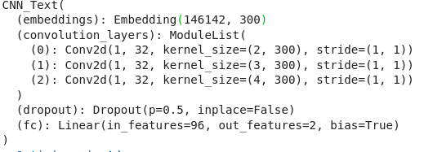
CNN - engineering
Code source - adapted from the CNN tutorial
Tokenizer - spacy for english
Model -
Optimizer is Adam with a learning rate of 0.0001
Loss function is CrossEntropyLoss

Slide 11
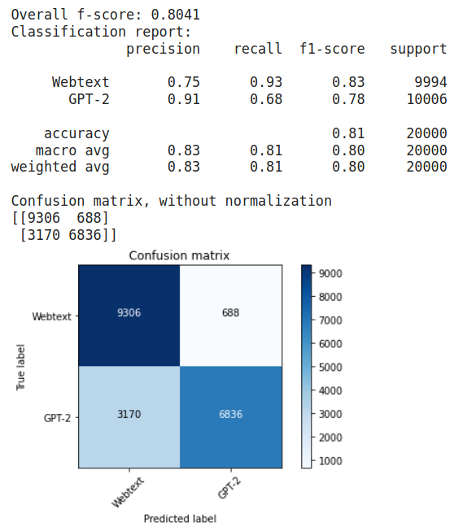
CNN - results
F-score: 80.41%
Model had difficulty correctly identifying GPT-2 text

Slide 12
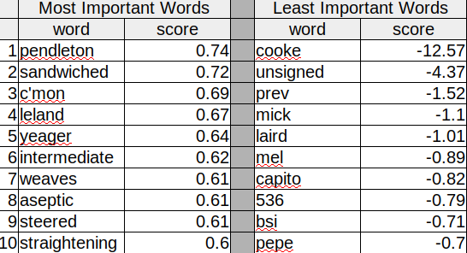
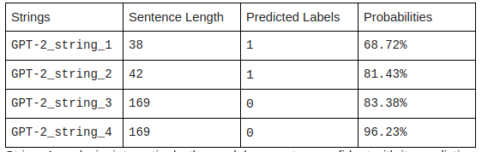
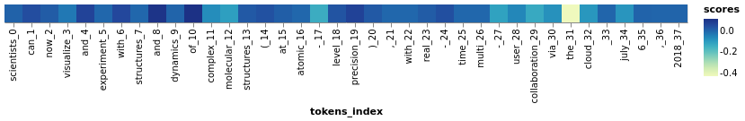
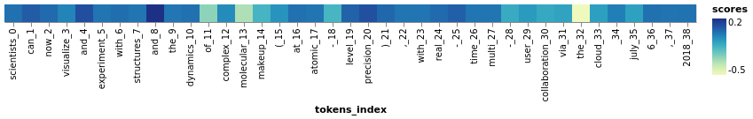
CNN - analysis
Findings: sequence length and repetition are important features.
GPT-2_string_1: "Scientists can now visualize and experiment with structures and dynamics of complex molecular structures (at atomic-level precision), with real-time multi-user collaboration via the cloud \n\n July 6, 2018"
GPT-2_string_5: "Scientists can now visualize and experiment with structures and the dynamics of complex molecular makeup (at atomic-level precision), with real-time multi-user collaboration via the cloud \n\n July 6, 2018"
The model was 74.22% confident string_5 is GPT-2 generated.

Slide 13
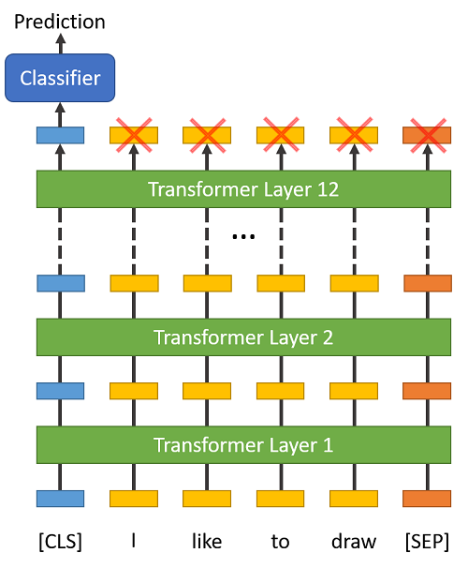
BERT - engineering
Code source - BertForSequenceClassification from the huggingface pytorch implementation
Tokenizer - BertTokenizer included with BERT (bert-based-uncased version)
On the output of the final (12th) transformer, only the first embedding (the [CLS] token) is used by the classifier.

Slide 14
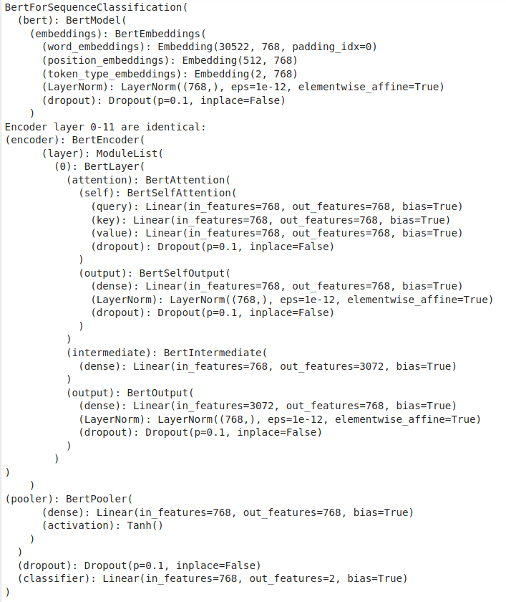
BERT - engineering
Model -
Optimizer is AdamW with learning rate = 2e-5 and epsilon = 1e-8

Slide 15
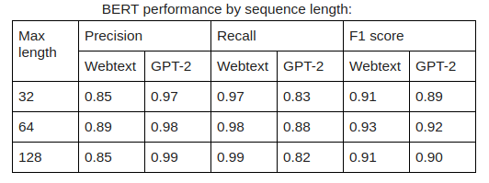
BERT - experiment on MAX_LEN
To examine how the truncating affect BERT’s performance, we tried to set the MAX_LEN = 32, 64, 128.
Our model performed consistently well across all sequence lengths.
Training BERT on longer sentences made the model more prone to overfitting.

Slide 16
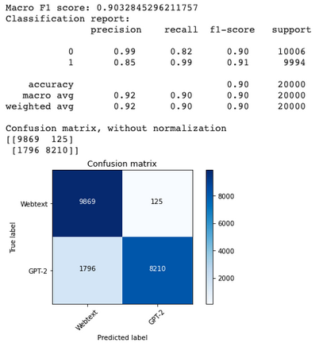
BERT - results
F-score: 90.33%
Model had difficulty correctly identifying GPT-2 text
Error rate = 9.6%
GPT-2
Webtext

Slide 17
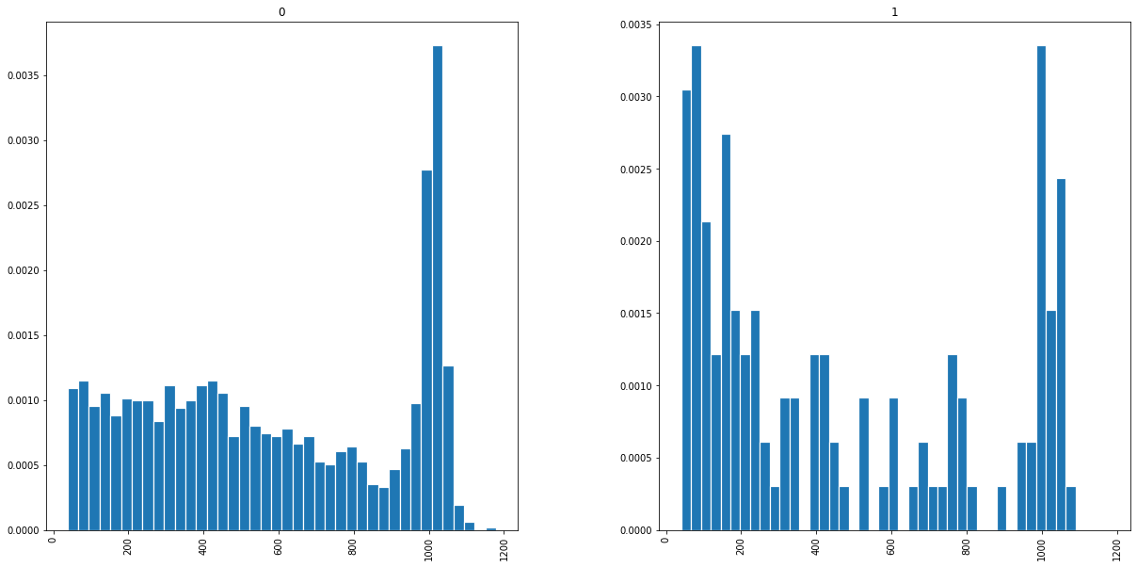
BERT - analysis
GPT-2
Webtext
The shorter Webtext documents were more prone to wrong predictions than GPT-2 data.
At around 1000 tokens, there is a spike in wrong predictions for both sources, showing that truncating documents adversely affect BERT’s performance.

Slide 18

Conclusion
BERT is better but at a high training cost.
Model | Epochs | Training Time | F-score on Test Set
LR | 1 | < 1 minute | 88.23%
CNN | 20 | 11 minutes | 80.41%
BERT | 4 | 1.5 hour | 90.34%

Slide 19

Future Direction
More models to try!
fastText
GLTR
GPT-2
RoBERTa
etc!

Slide 20
References
Understanding Convolutional Neural Networks for Text Classification | https://www.aclweb.org/anthology/W18-5408/
Factuality Classification Using the Pre-trained Language Representation Model BERT (2019) | http://ceur-ws.org/Vol-2421/FACT_paper_3.pdf
DocBERT: BERT for Document Classification (2019) | https://arxiv.org/abs/1904.08398
Is BERT Really Robust? A Strong Baseline for Natural Language Attack on Text Classification and Entailment (2020) Image on slide 3 | https://arxiv.org/abs/1907.11932
BERT: Pre-training of Deep Bidirectional Transformers for Language Understanding (2019) Image on slide 13 | https://arxiv.org/pdf/1810.04805.pdf

