Slide 1


Object detection using AWS Rekognition ( Serverless and Queue)
IT456-Software Group Project - iv
Mit Yogeshkumar Pandya
20IT076 - IT-1-D1

Slide 2

What is AWs rekognition?
AWS Rekognition is Amazon’s cloud-based software as a service (SaaS) computer vision platform. AWS Rekognition provides you with pre-trained models but you can also train your custom models without any prior knowledge of Machine Learning or Computer Vision.
AWS Rekognition can analyse millions of images and videos within seconds. It is very fast, flexible and scalable. Once you have trained your model, you can again retrain it by adding more and more training images.
Notes:
Ask the students if they are familiar with web scraping. Show the definition.
The basic idea is to create a program that:
Visits a website
Gets the content of the website
Extracts information from the content
Uses the information in some automated way

Slide 3
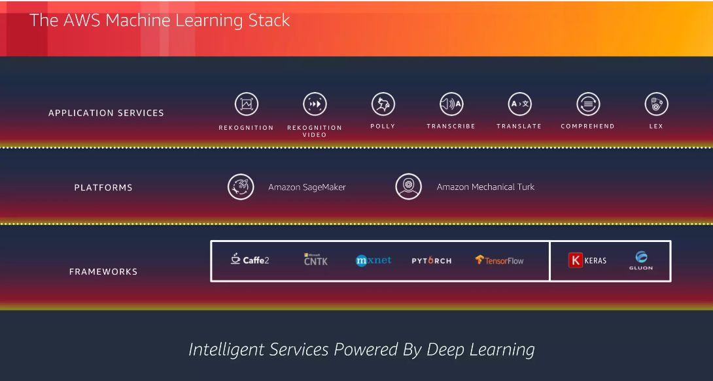
Stack For Services

Slide 4





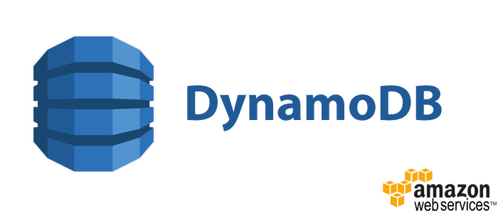
What services we are going to use?

Slide 5
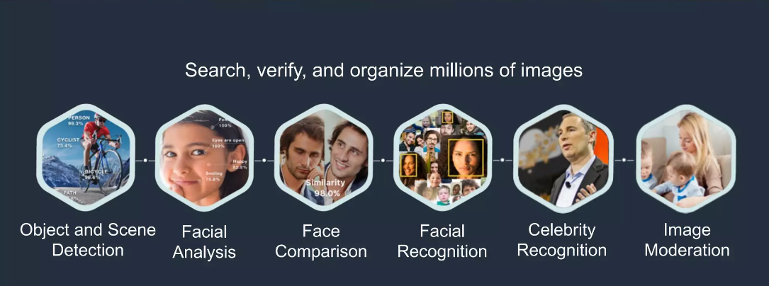
Applications

Slide 6
Why to use Rekognition?
1-Object & Scene Detection
Photo-sharing apps can power smart searches and quickly find cherished memories, such as weddings,
hiking, or sunsets
2-Facial Analysis
Retail businesses can understand the demographics and sentiment of in-store customers
3-Face Comparison
Hotels & hospitality businesses can provide seamless access for guests and VIPs
4-Facial Recognition
Public safety teams can leverage face collections to automate tracking of persons of interest
Notes:
Explain a bit about HTTP. First, ask the students where they have seen HTTP before. They have probably seen it in front of URLs.
Give the definition of HTTP (and what it stands for). The illustration shows the process. For the purposes of this lesson, the server-side does not really matter; it’s all about the client.
Go through the explanation of what happens when a person goes to a website. Explain that for web scraping, there is no rendering – just parsing.
So how can we actually use this to scrape data in Python?

Slide 7
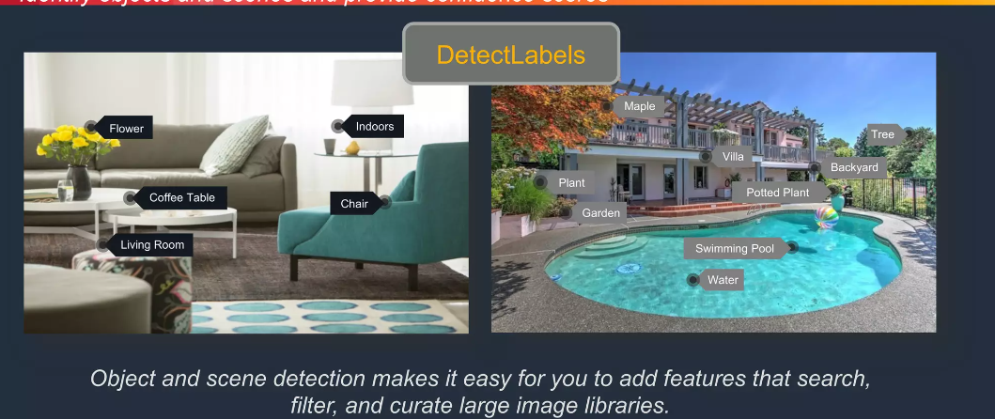
Object and scene detection
Object detection is a computer vision technique that allows to identify and locate objects in images or videos.
Suppose we have trained our own model which detects the Dog, Cat and Fish in an image. Its an image detection model. After training our own custom model we get the Amazon Resource Name (ARN) of that model. ARNs uniquely identify AWS resources. We need this ARN when we create a Lambda Function, then we will mention this ARN of the model.

Slide 8
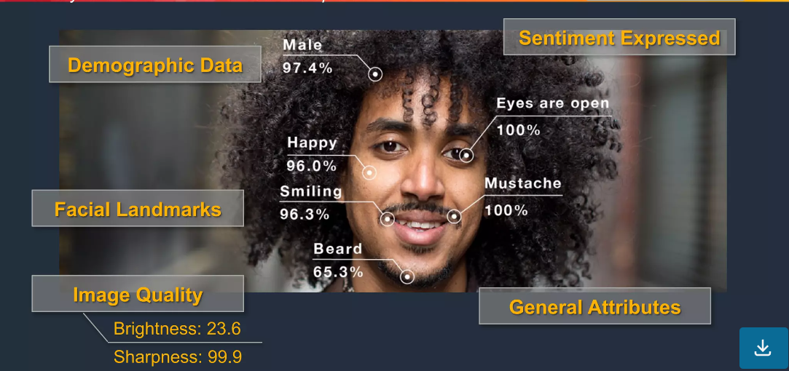
Facial analysis

Slide 9
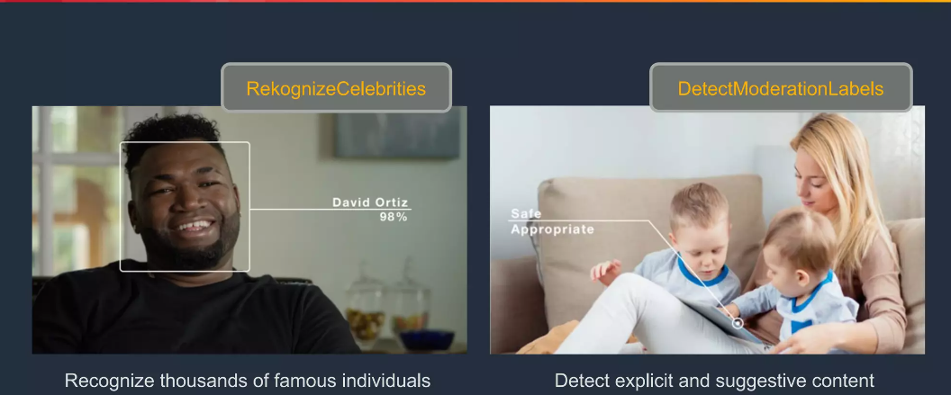
Facial analysis

Slide 10
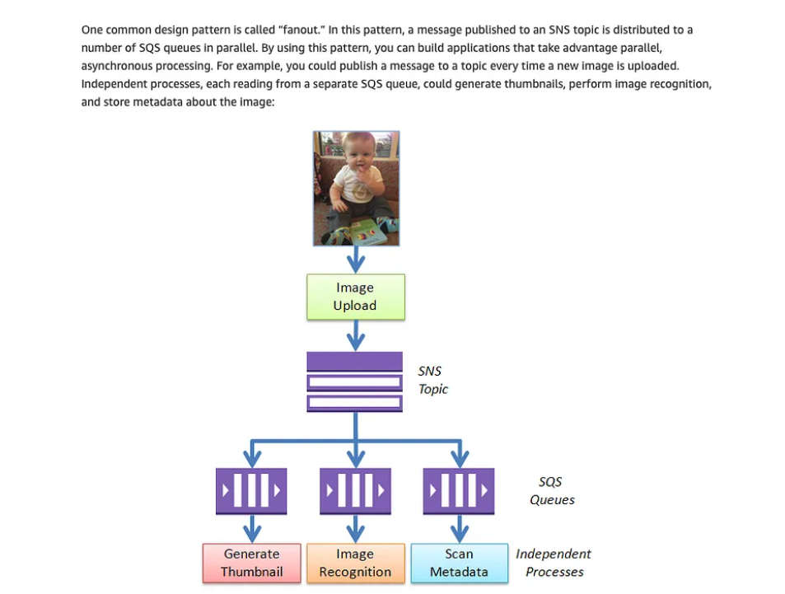
Why utilization of sns and sqs matters?
The Amazon Simple Queue Service (SQS) and the Amazon Simple Notification Service (SNS) are important “glue” components for scalable, cloud-based applications.
The lambda function alone cannot handle so many triggers at the same time and there is a possibility that it gets stuck or the requests get clogged (happened with me in the past) and then it skip the files. To prevent this, we need an SNS topic on the top and then there would be SQS Queues and then a Lambda function.
When an image is uploaded in the S3 bucket, a message is published to an SNS topic that an image has been uploaded and then that image goes into the queue. The lambda function takes the images one by one from the queue and processes it.

Slide 11
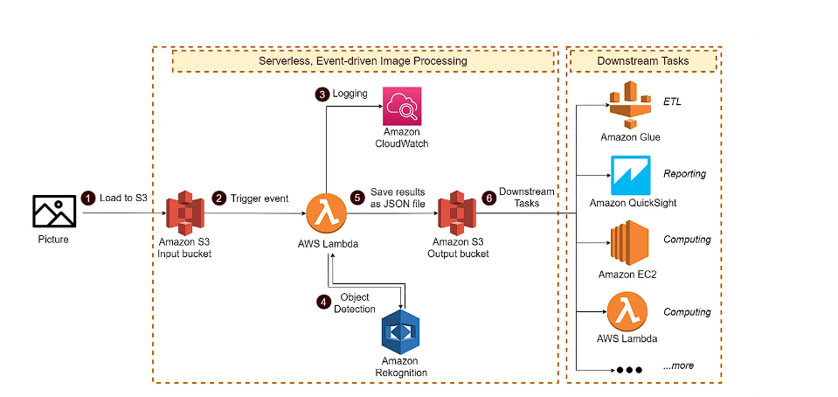
What can be implemeted further
As per this serverless architecture , I could possibly implement log monitoring too , with the help of cloudwatch.
Integrating some of the downstream tasks like ETL , reporting and computing , if the sns and sqs workload fails.
Notes:
Introduce the Beautiful Soup Python library. The purpose of this library is to take HTML text, and turn it into a manageable data object.
Start by importing the library.
Next, get the soup object using the BeautifulSoup function. The result should be stored in a variable (not showed)
After that, there is a lot to be done!

Slide 12
Conclusion
To conclude the topic and start implementing the project i required to estimate the cost of the setup and hence , after that my main implementation of project is going to start by next week.
Thank you :)
Prepared by - Mit Pandya 20it076
Notes:
Go over all of the things learned in this lesson.
The total workflow is like this:
An HTML document exists on a website. Using the Requests library (which wraps around HTTP), the HTML text is pulled into the Python program. Within the Python program, the Beautiful Soup library converts the HTML into usable data objects. From there, the data can be presented nicely!

