Slide 1
TR-069 Protocol
25.Jun.2018
Paul
Quber inc.

Slide 2
Contents
Device Monitoring Protocols
TR-069 Protocol Architecture
RPCs
Message Flow

Slide 3
Device Management Protocols

Slide 4
Device Management Protocols
Device Type | Protocols
Network Device | SNMP
Cable Model, STB | TR-069
IoT | OMA-DM, L2M2M

Slide 5
TR-069 Protocol Architecture

Slide 6
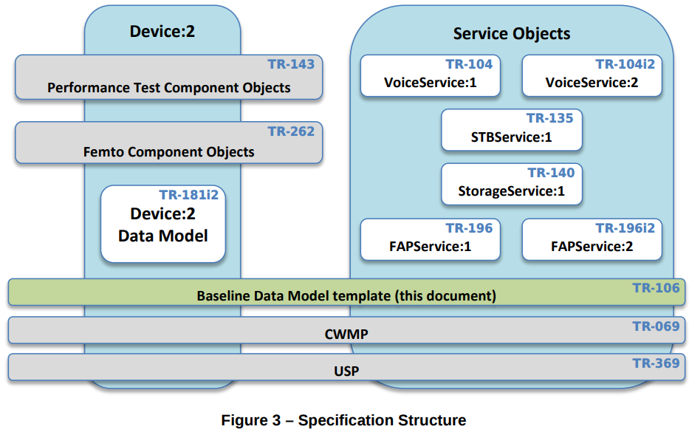
Protocol Architecture

Slide 7
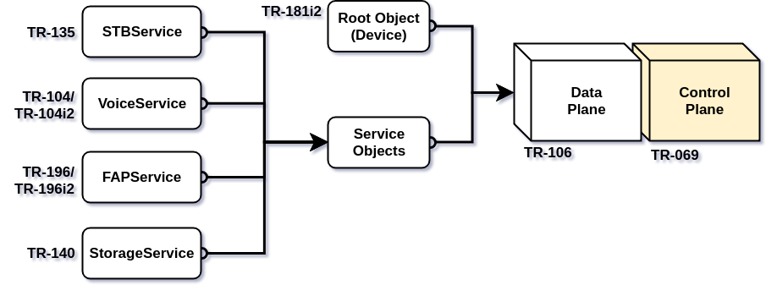
Protocol Architectures

Slide 8
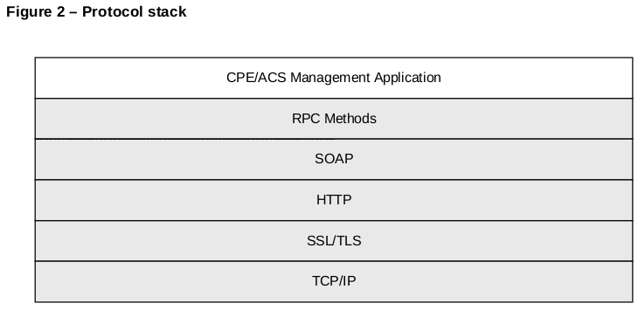
Protocol Stack

Slide 9
RPCs

Slide 10
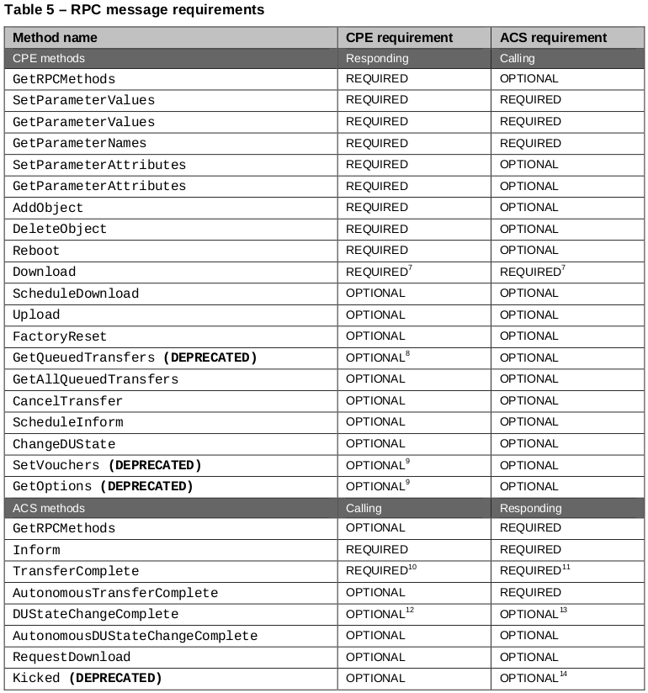
Remote Procedure Call (RPC)s

Slide 11
Message Flow

Slide 12
Ordinary Message Flow
# | Procedure | Related RPCs
1 | Session 생성 | Inform
2 | Parameter 및 Attribute 조회 및 설정 | GetParameterNames GetParameterValues GetParameterAttributes SetParameterValues SetParameterAttributes
3 | 요청 작업 | Download Upload CancelTransfer ChangeDUState FactoryReset Reboot AddObject DeleteObject
4 | Session 종료 | Empty message

Slide 13
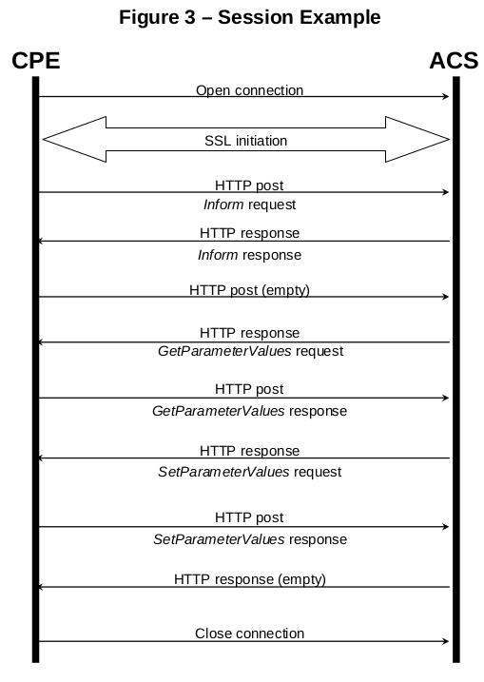
Session Example

Slide 14
References
Docs.
Specs
https://www.broadband-forum.org/standards-and-software/technical-specifications/technical-reports
Data Models
https://cwmp-data-models.broadband-forum.org/
Tutorial
https://www.qacafe.com/tr-069-training/

