Slide 1
RIDE SAFE:Enhancing Motorcycle Safety
PIP104 University Project-II
Review-1
Batch Number:ECM-G04
Roll Number | Student Name
20201ECM0012 | Pratiksha R Murthy
20201ECM0032 | Cherisshma KC
20201ECM0011 | Abhishek D
20201ECM0024 | Reuben B
20201ECM0030 | Mita R
Under the Supervision of,
Dr. Kokila S
School of Computer Science & Engineering
Presidency University

Slide 2
Introduction
Road accidents are a major cause of death and injury worldwide, especially among cyclists. In recent years, motorcycle accidents have been on the rise, posing significant risks to riders' safety. According to the World Health Organization, over 500,000 cyclists are killed each year in road accidents.
Timely response to accidents is crucial for minimizing injuries and saving lives.
To address this issue, we propose the development of an Intelligent Bike Crash Alert System that can send an SOS signal to a centralized command center in the event of a bike crash.
This system aims to improve emergency response times and enhance rider safety. This would allow emergency responders to arrive at the scene of a crash more quickly and provide assistance to injured cyclists.

Slide 3
Literature Review
Numerous studies have highlighted the importance of reducing response times to motorcycle accidents.
Existing solutions such as smartphone-based apps and GPS tracking systems have limitations in accuracy and reliability.
Our proposed system leverages advanced sensors, including accelerometers and gyroscopes, to detect bike crashes accurately.
Additionally, it utilizes IoT connectivity for seamless communication with the centralized command center.

Slide 4
Proposed Method
Our system comprises: crash detection sensors, a microcontroller unit, communication module, crash alarm, and active breaking systems.
The crash alarm system is a basic form, a forward collision warning system which the speed of vehicle and the distance between the vehicles, so that it can provide a warning to the driver.
The crash detection sensors continuously monitor the bike's movements and orientation.
When a crash is detected, the microcontroller processes this information and triggers the communication module to send an SOS signal to the centralized command center.

Slide 5
Objectives
Develop an active brake assist system(ABA).
Develop a robust crash detection algorithm.
Design and build a compact and durable hardware system.
Implement an efficient communication protocol for transmitting SOS signals.
Establish a connection with a centralized command center for emergency response coordination.
low-cost and easy-to-install
Evaluate the performance of the device in real-world conditions.
Make the device available to cyclists at an affordable price.

Slide 6
Methodology
Sensor selection and integration.
Algorithm development for crash detection.
Microcontroller programming and hardware assembly.
Communication module configuration.
Testing and validation of the system in real-world scenarios.
Integration with a centralized command center's infrastructure.

Slide 7
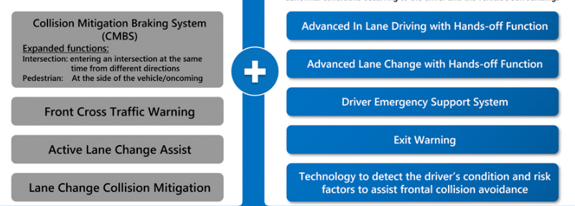
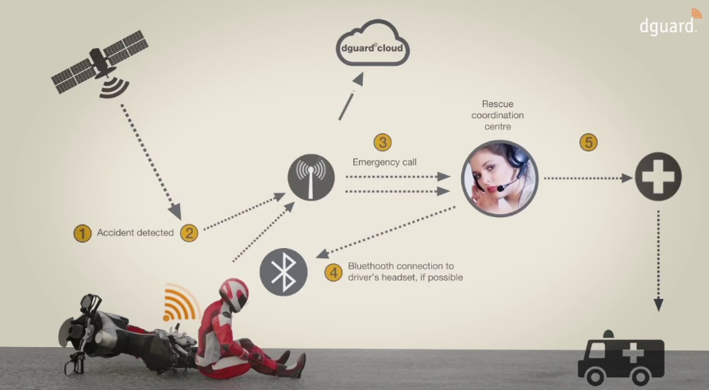
Timeline of Project
Month 1:Design phase
Month 2:Development phase
Month 3:Testing phase
Month 4:Integration phase

Slide 8
Expected Outcomes
A reliable Bike Crash Alert System capable of accurately detecting crashes and slowing down the motorcycle if necessary.
Reduced emergency response times for motorcycle accidents.
Enhanced rider safety and reduced injury severity.
Improved coordination between riders and centralized command centers during emergencies.
A low-cost and easy-to-install
Evaluation data that demonstrates the performance of the device in real-world conditions.
A plan for making the device available to cyclists at an affordable price.

Slide 9
Conclusion
The development of an Intelligent Bike Crash Alert System is essential for improving rider safety and emergency response times.
It can help to reduce the time it takes for emergency responders to arrive at the scene of a crash, which can improve the chances of survival for injured cyclists
By leveraging advanced sensor technology and IoT connectivity, this system has the potential to save lives and minimize injuries in motorcycle accidents.
The device is also relatively inexpensive and easy to build.

Slide 10
References
https://ijariie.com/AdminUploadPdf/BIKE_ACCIDENT_DETECTION_DEVICE_ijariie9756.pdf
https://ieeexplore.ieee.org/document/10060469
Automatic emergency braking in cars will be standard by 2022, but false activations still a concern - CBS News

Slide 11
Thank You

