Slide 1
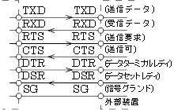
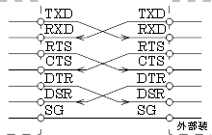
TXD
RXD
RTS
CTS
DTR
DSR
SG
TXD
RXD
RTS
CTS
DTR
DSR
SG
TXD
RXD
RTS
CTS
DTR
DSR
SG
TXD
RXD
RTS
CTS
DTR
DSR
SG

