Slide 1
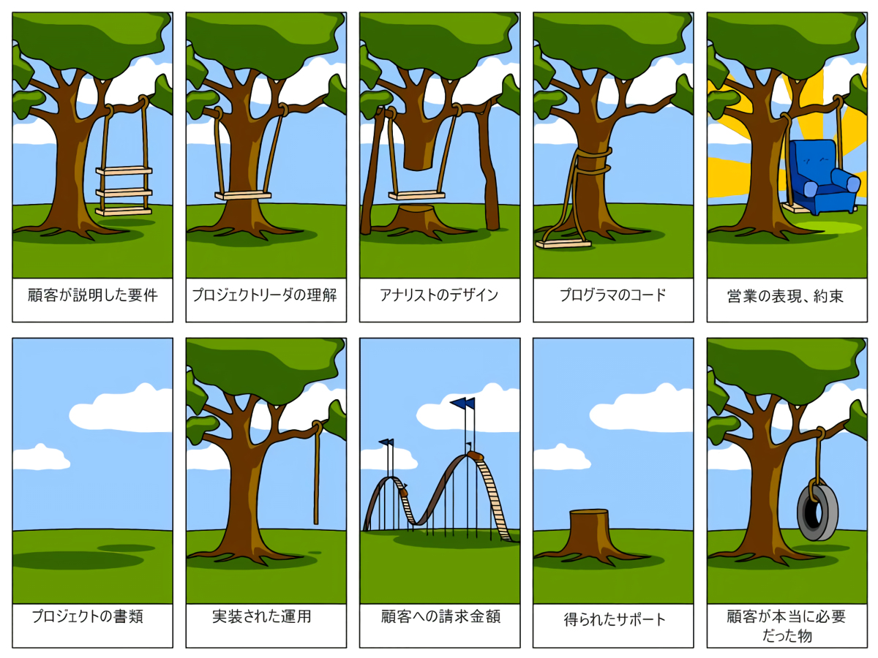
Pixiv
https://www.pixiv.net/artworks/98603591

