Slide 1
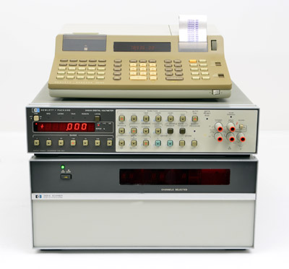
https://www.hpmemoryproject.org/wb_pages/wall_b_page_14c.htm

