Slide 1
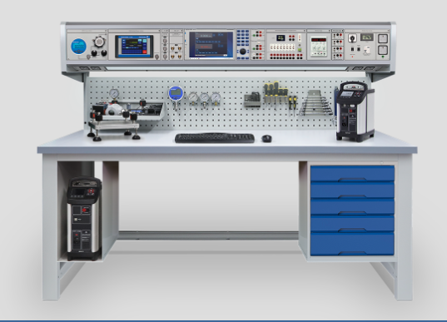
https://www.timeelectronics.com/calibration-benches/

