Slide 1
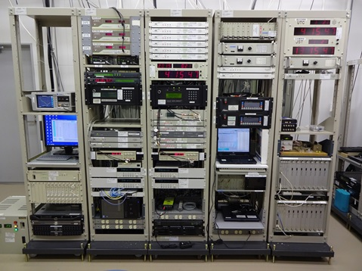
https://unit.aist.go.jp/ripm/time-stdg/calibration.html

